Slide 1
Welcome to my

Slide 2
Introduction
Ramendra Nath Pramanik
Assistant Head Master
Kasba High School
Paba, Rajshahi
Mobile: 01716437772
E-mail: ramenpr81@gmail.com
Sub: English grammar and composition
Class: Eight
Unit: 2
Time: 50 Min
Date: 07/11/2019

Slide 3
Lets watch a video

Slide 4
The video is about …………
Preposition
TO

Slide 5
Today’s topic:
Using the preposition of place

Slide 6
Learning outcome
By the end of this lesson SS will be able to –
tell the name of Preposition.
do the proper use of preposition.
explain about something.
write a paragraph

Slide 7
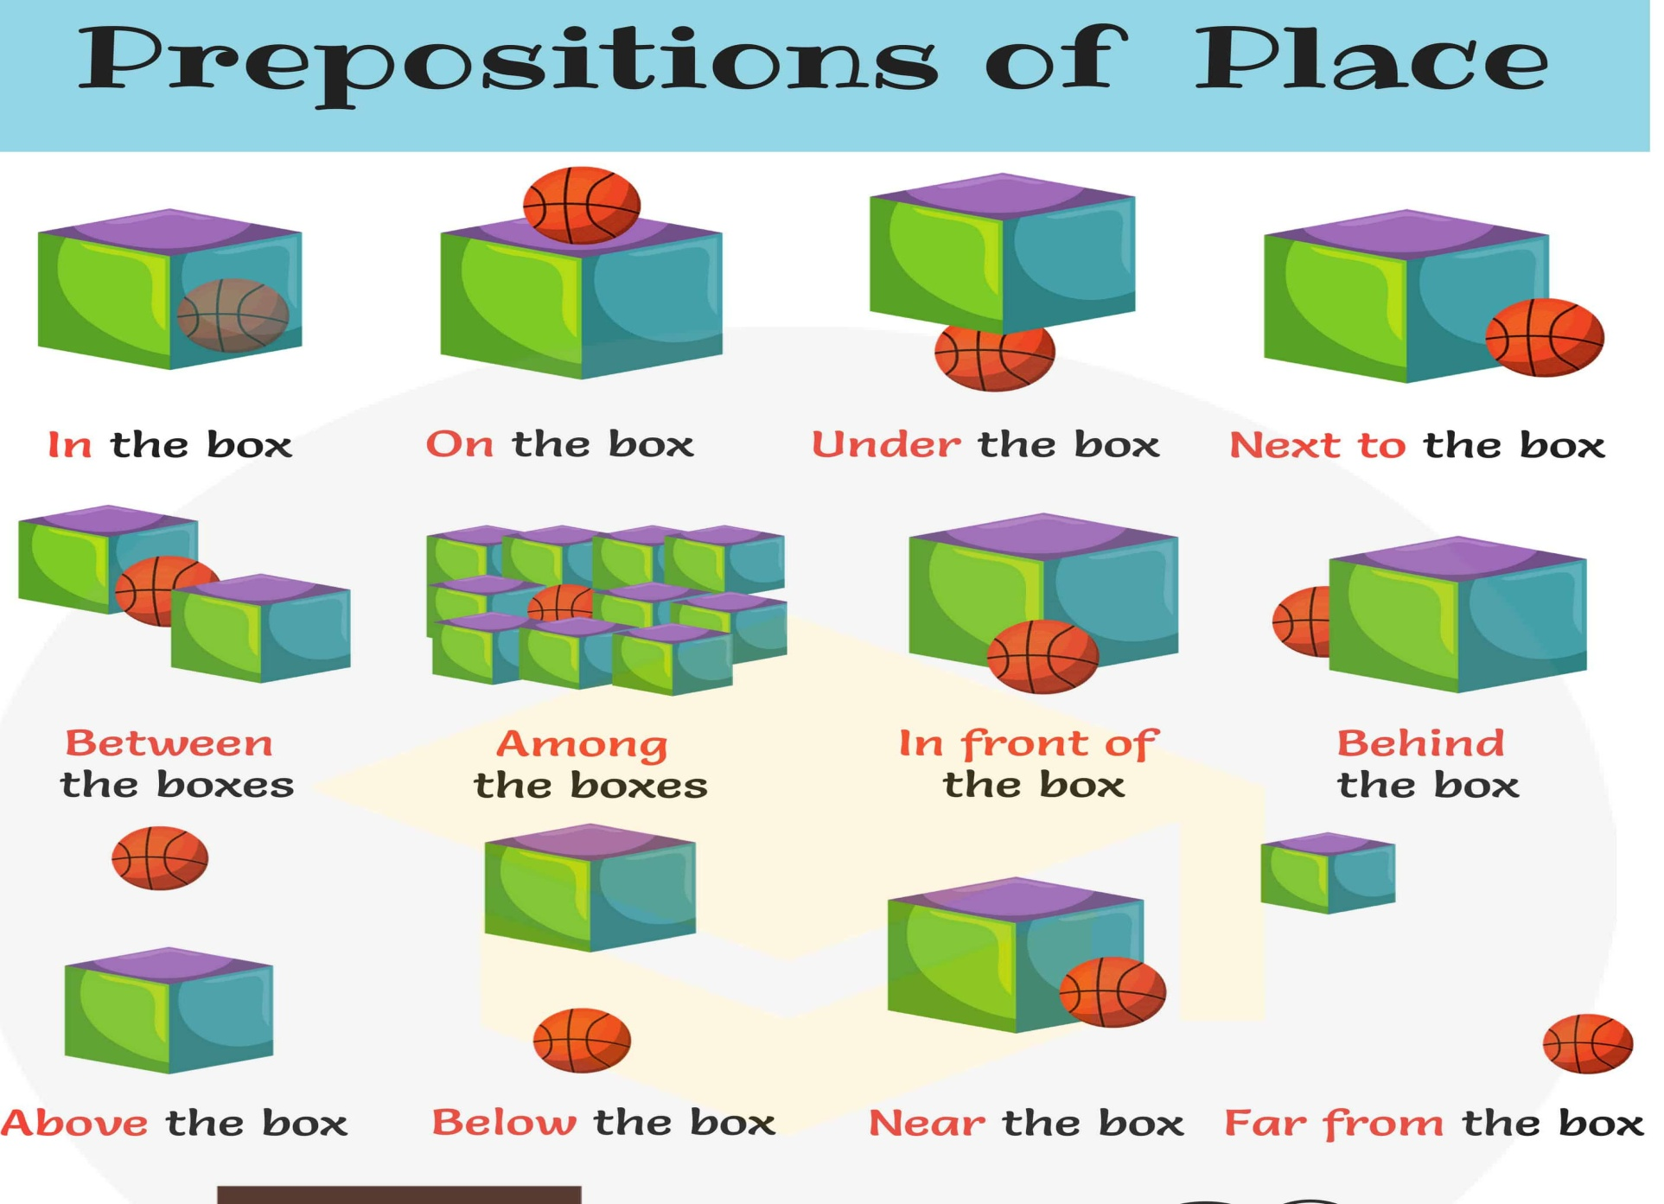
Look at the picture below:

Slide 8
Individual work
5 min
Fill in the gaps below:
Mr. Kamal was born ….. 7 April 1980 ……. a small village …. the district …….. Pabna. He completed his primary and secondary education …….. two local school. Then he came …… Rajshahi …….higher education.

Slide 9
10 min
Group work
Write a short paragraph about your class room using the following prepositions:
in, to, beside, at, on, of, from etc.

Slide 10
5 min
Evaluation
Answer the questions orally-
1. What is preposition?
2. Make a sentence using “to”.
3. Where do we use “in”?
4. Kamal comes …..school……Alimganj.

Slide 11
Home task
Write a paragraph about your school.

Slide 12
Thank you.

