Slide 1
This is a hidden slide
Dear honorable teacher please follow the instructions that has given in the slide notes (under the every slide). It would be helpful to take a successful class. Thanks a lot. I wish you good luck.

Slide 2
WELCOME
HOW ARE YOU ?

Slide 3
IDENTITY
Kamruzzaman Sarker.
Assistant. Teacher
Bakasar High School
Debidwar, Cumilla
Lesson
ENGLISH GRAMMAR.
Class : Nine & Ten
Unit : Four, Lesson - 1.

Slide 4
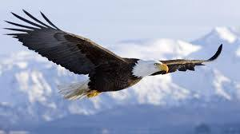
Look at the flying bird.
T : Do you know, here flying what kinds of verb ?
S : Sir, here flying is present participle

Slide 5
Lesson Declaration
So today we shall discuss about
Participle

Slide 6
LESSON OUTCONES
By the end of the lesson students will have
learnt what participle means.
learnt the uses of different participles.
learnt finding out different participles.
learnt filling the gaps using participles.
Join the pairs of sentences by using participles.

Slide 7
Definition of Participle
A participle is a form of verb working as both an adjective and a verb in the sentence.
Kinds of Participle
There are three kinds of Participle.
1. Present Participle
Eating , doing, going etc.
2. Past Participle
Ate, did, went etc.
3. Perfect Participle
Having eaten, having done

Slide 8
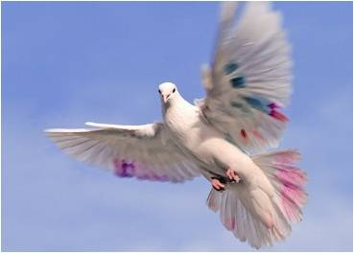
Definition of Present Participle.
A Present Participle expresses an action going on. It is formed by adding ‘ing’ to verb in the sentence. When a participle works as an Adjective, it qualifies the noun.
Examples :
A rolling stone gathers no moss.
( rolling qualifies stone).
The hunter looked at the flying bird
(flying qualifies bird).
Give me some writing paper
(writing qualifies paper)

Slide 9
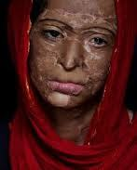
Definition of Past Participle :
It is the past participle form of a verb. It works both as a verb and an adjective.
Examples :
A burnt child dreads the fire.
The Minister came to visit the
eroded riverbanks.
There is a broken chair in the room.
They will not receive the rejected goods.
Anwar has built a house.

Slide 10
Perfect Participle :
Perfect Participle is formed by using having before the past participle. It also works as a verb and an adjective.
Example :
Having reached home, he went straight to his mother.
Having read the, he gave it to me.
Having seen the film, we shed tears.
Having eaten rice, he went to bed.

Slide 11
Individual Work
Open your English Grammar book page no. 22
Read the passage carefully :
And pick out the three kinds of participles.

Slide 12
Pair Works
Fill in the following passage using right participles from the box
reaching | closed | waiting | Coming | ringing
Before reaching the school, Saad heard the final bell (a) …………………………… (b) …………………………. School, he found the gate (c) ………………………. . So he could not enter the class (d) …………………. by the class teacher. He was (e)…………………………. outside.
Ans : a) ringing, b) reaching, c) closed, d) plying, e) standing.

Slide 13
Group Works
Join the following pairs of sentences by using participles
I saw the old man. He was walking.
(I saw the old man was walking).
I put some tea dust in the water. The water was boiling then
( I put some tea dust in the boiling water).
We visited the area. The area was affected by flood.
( we visited the flood affected area).
He closed the door. Then he went out for a walk.
( Having closed the door he went out for a walk ).
Give me some paper. I want to write.
( give me some writing paper ).

Slide 14
HOME WORK
Complete the exercise ‘C’ with participles :
Page – 25 of your Grammar book.

Slide 15
Acknowledgement
We would like to express our cordial gratitude to the Ministry of Education, Directorate of Secondary & Higher Education, NCTB, a2i
and
the panel of honorable editors ( Md. Jahangir Hasan, Associate Professor (English) TTC, Rangpur, Ranjit Poddar, Associate Professor (English) TTC, Dhaka, and Urmila Ahmed, Associate Professor (English) TTC, Dhaka, to enrich the contents.

Slide 16
THE END.

