Slide 1
Wel- come

Slide 2
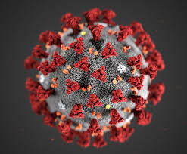
COVID-19 A GREAT EPIDEMIC
There are lot,s of viruses in the world & Corona Virus is one of the most dangerous virus in virus family.

Slide 3
Video of symptoms of Corona Virus

Slide 4
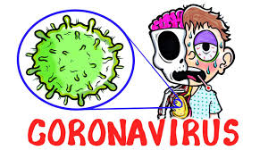
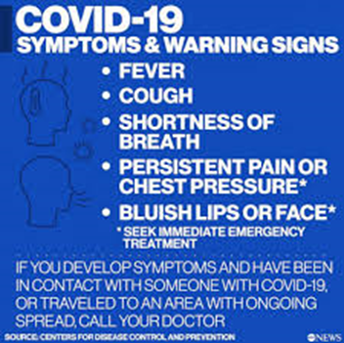
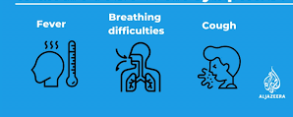
Symptoms of COVID-19

Slide 5
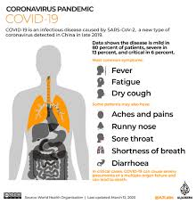
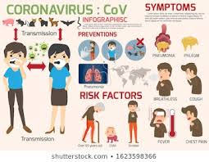
Who are affected?
People of all ages are affected

Slide 6
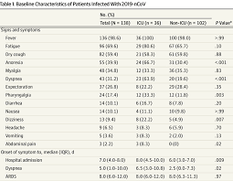
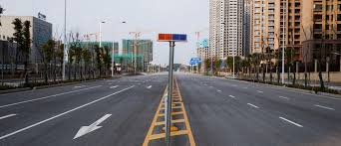
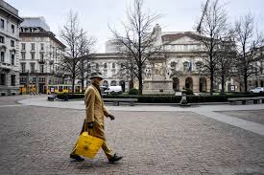
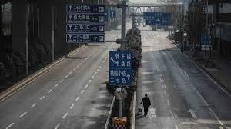
World,s position : Thousand,s of people died .
The world is Lockdown

Slide 7
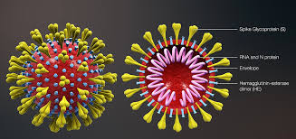
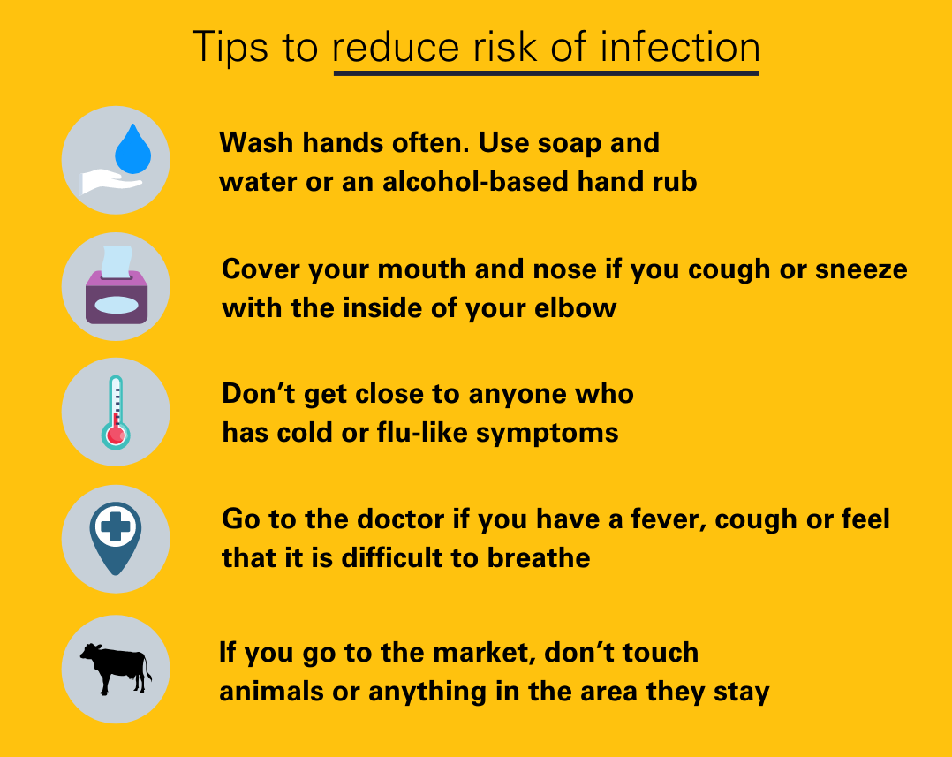
Medicine:There is no specific medicine still invented to prevent it.

Slide 8
Some rules
PLEASE stay at home
Keep away from close contact
Use mask
Cover your mouth with tissue while snezzing
Drink hot water
Wash your hands with soap properly
Follow the rules of cleanliness
Be happy & strong

Slide 9
The World is your so save it,be respnsible
May Allah save us from this epidemic soon.
Amin
Thank you

