Slide 1
Welcome

Slide 2
Introduction
MST. UMME SALWA
SENIOR TEACHER
SANTAHAR B.P. HIGH SCHOOL
SANTAHAR, ADAMDIGHI,BOGRA

Slide 3
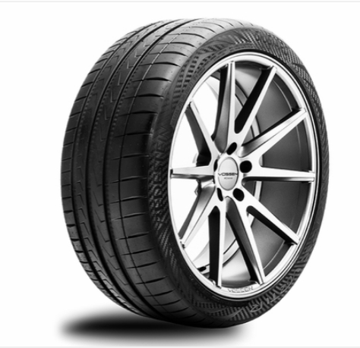
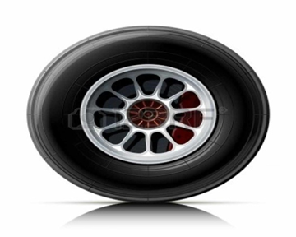
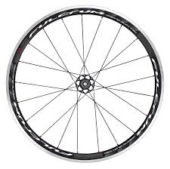
What can you see in these pictures?
Wheels

Slide 4
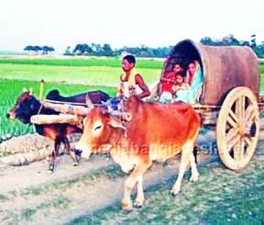
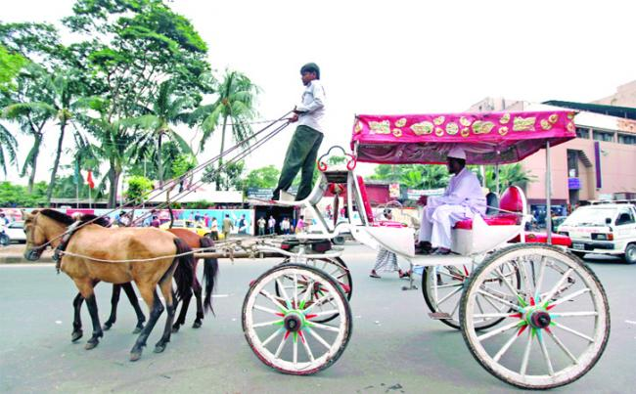
Where can we see wheels?
Every where around us.

Slide 5
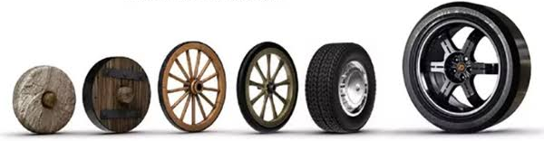
Can you guess how old the wheels are? Look at the evolution of wheels.
8000 B.C.
3500 B.C.
2000 B.C.
1889
1946
2020

Slide 6
Today our lesson is --
“ The History Of The Wheel ”
Class - Eight
Subject - English First Paper
Unit - Nine
Lesson - Two

Slide 7
Learning Outcomes
After we have studied this lesson we will be able to-
read and understand texts.
True or false.
Fill in the blank.
Ask and answer questions
Write down paragraph.

Slide 8
You know that the invention of the wheel has helped to create a new civilization.

Slide 9
But do you know who first used wheels?
?

Slide 10
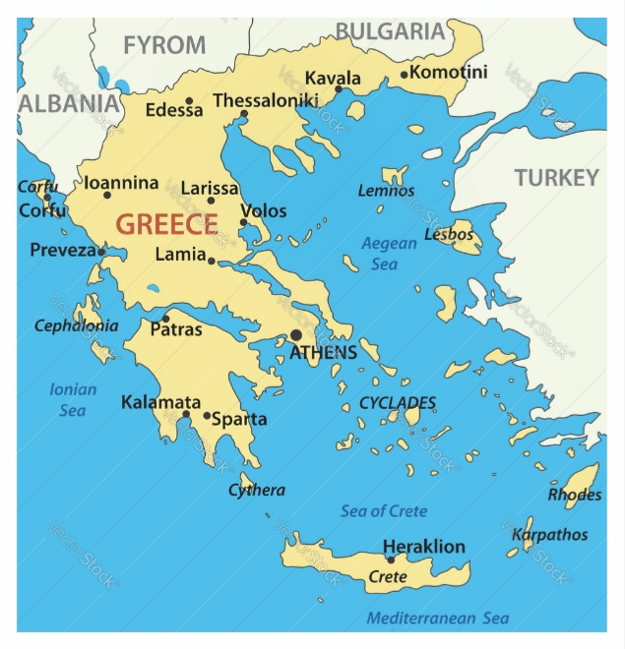
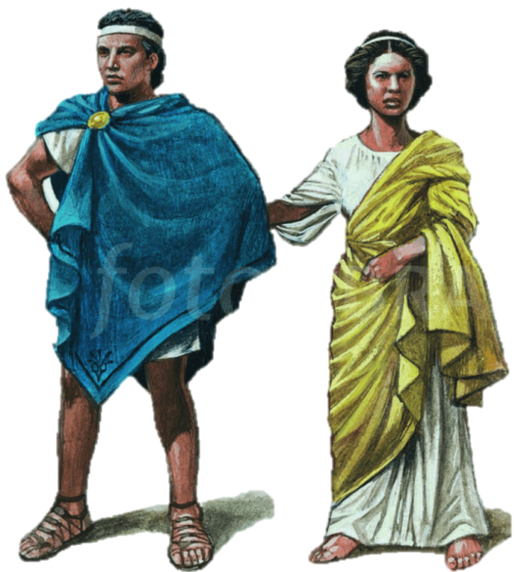
No, teacher. But I guess it may be the Greeks.

Slide 11
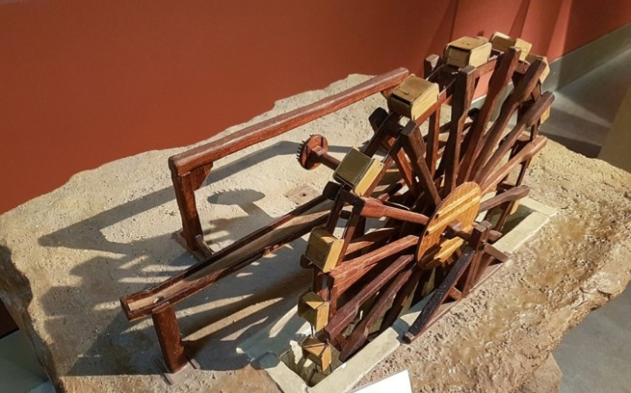
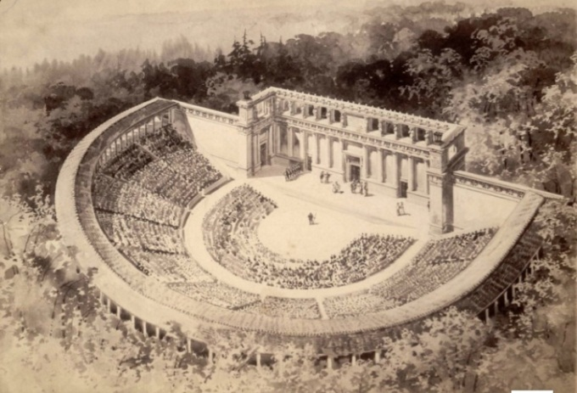
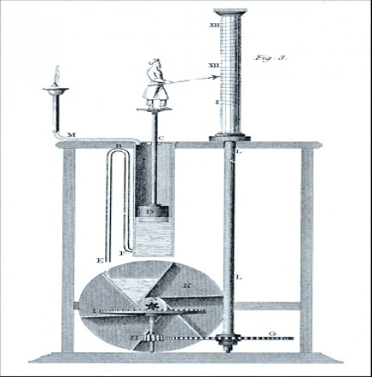
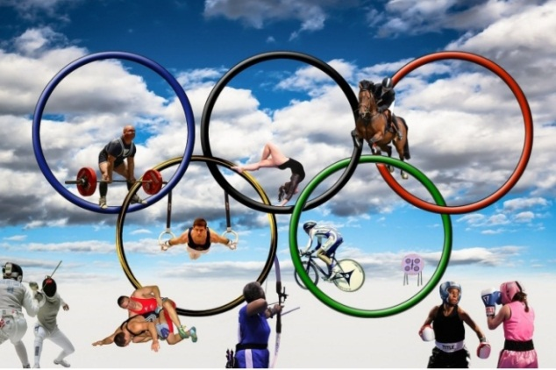
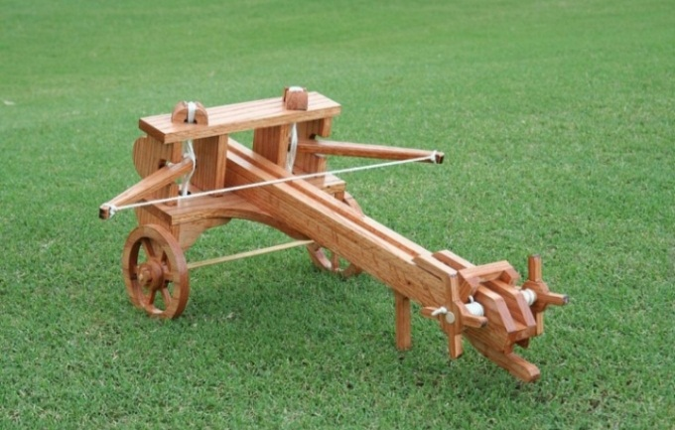
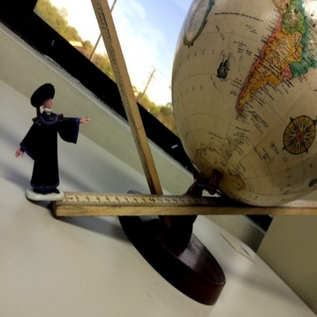
The Greeks were pioneers in many things.

Slide 12
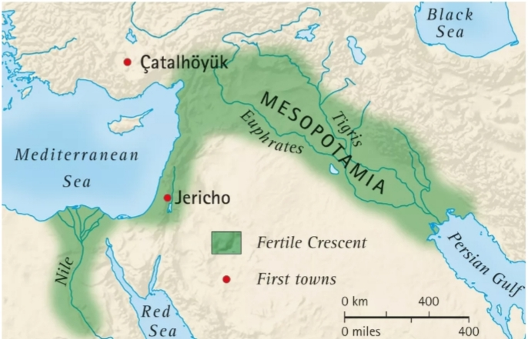
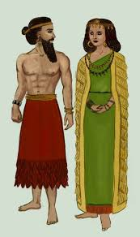
But in this case, however, the Mesopotamians were the first.

Slide 13
The oldest wheel was discovered in Mesopotamia. It was in 3500 B.C.

Slide 14
Where is Mesopotamia?
?

Slide 15
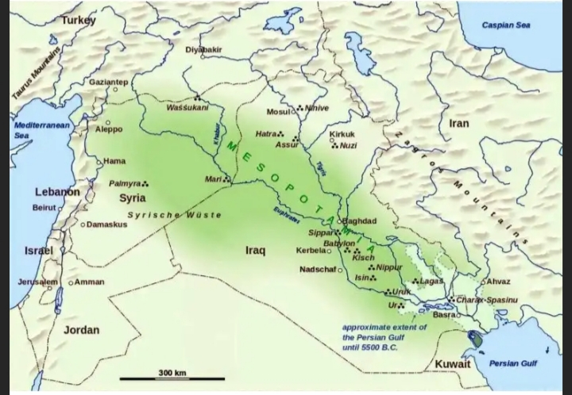
Well. Mesopotamia is in ancient Iraq.

Slide 16
It was along the valley of rivers Tigris and Euphrates.

Slide 17
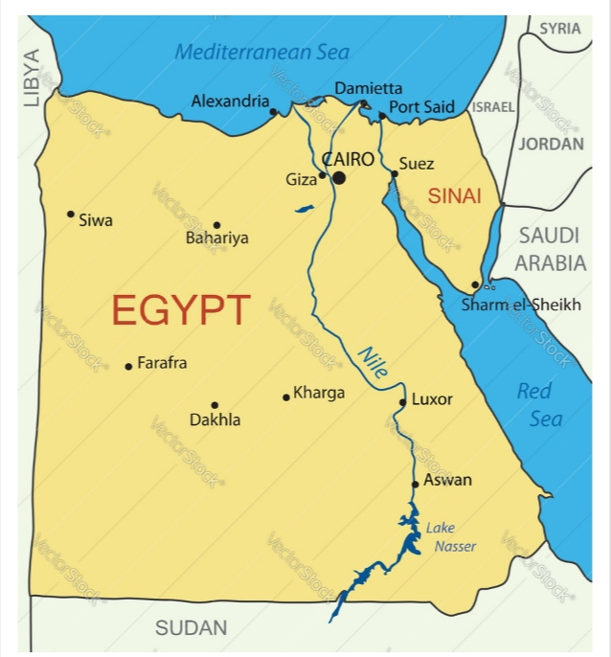
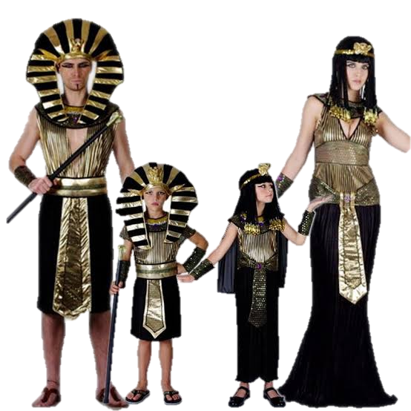
After the Mesopotamians, the wheel was further improved by the Egyptians.

Slide 18
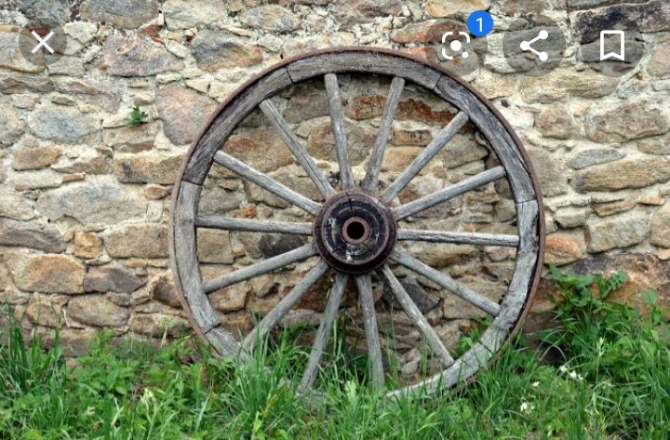
They first made wheels with spokes.

Slide 19
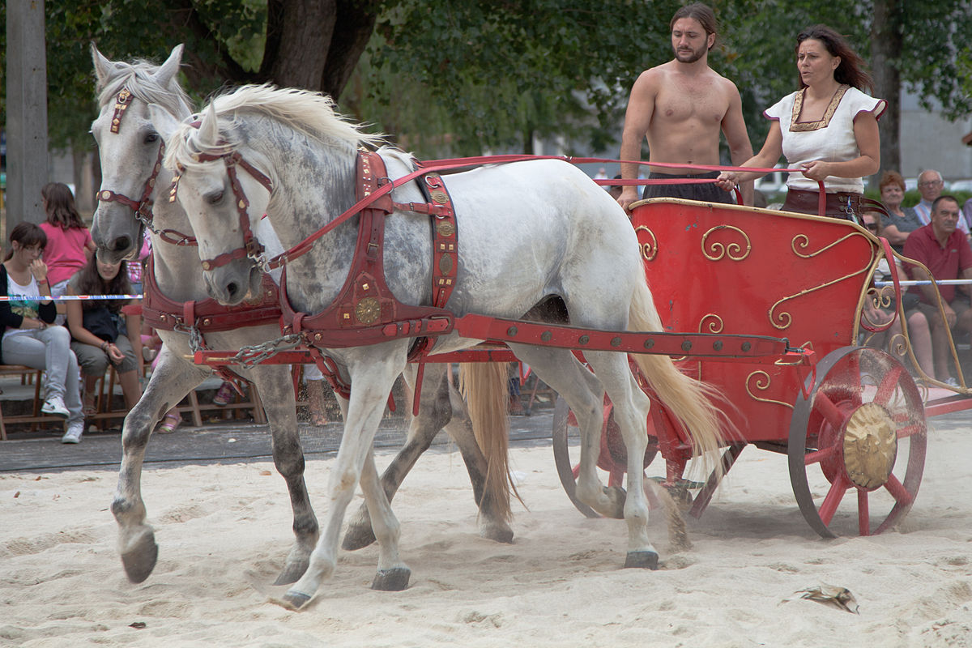
Then they used them on chariots around 2000 B.C.

Slide 20
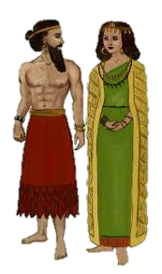
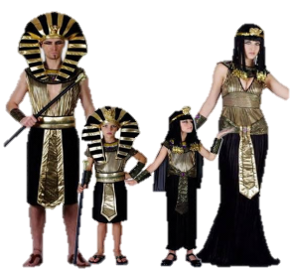
So the wheel travelled to Egypt from Mesopotamia?

Slide 21
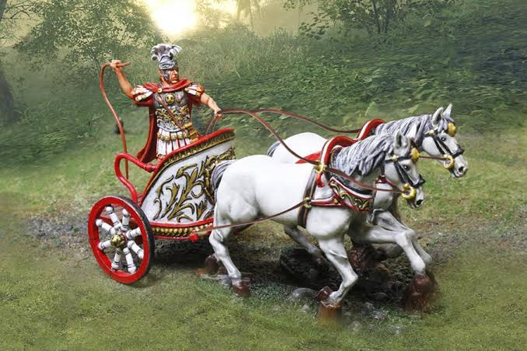
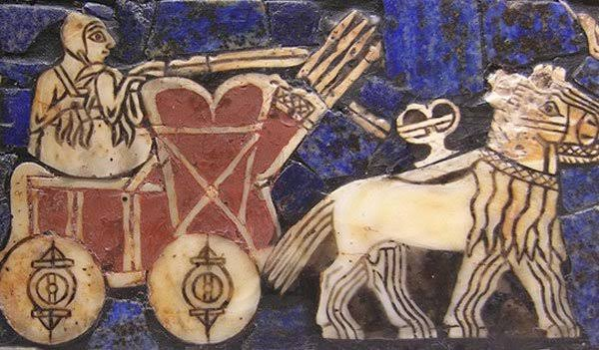
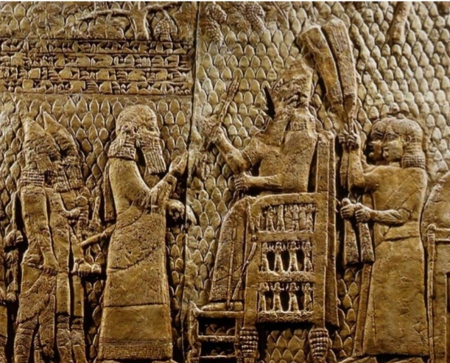
Exactly. But it travelled eastwards too. Wheels reached the Indus valley by 300 B.C.

Slide 22
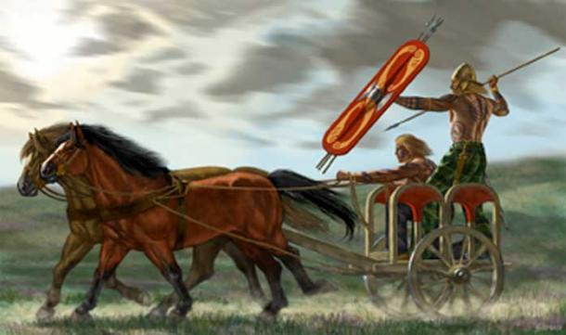
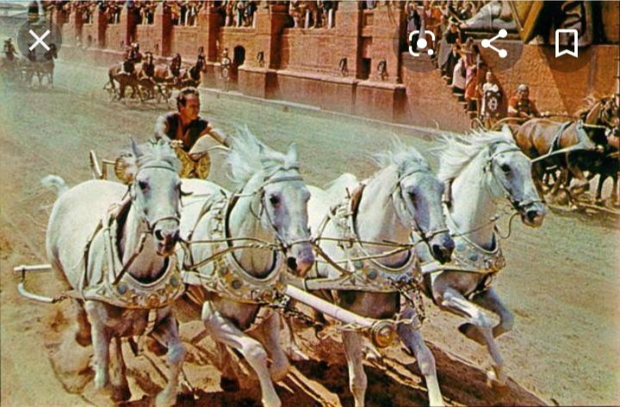
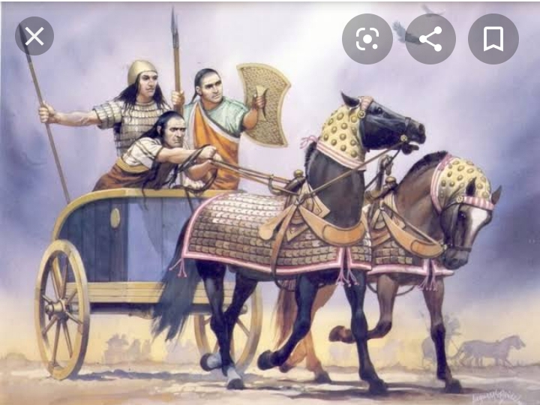
But chariots with spoked wheels were made in India around 1500 B.C. They were used for war , hunting and racing.

Slide 23
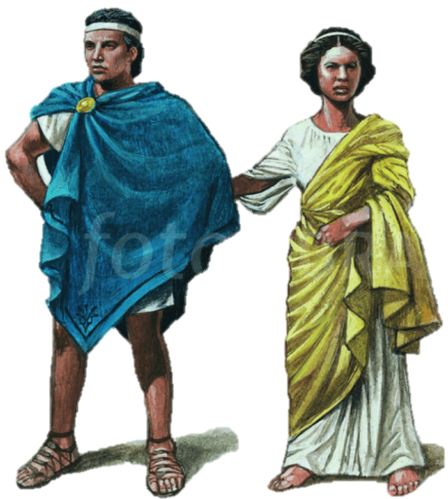
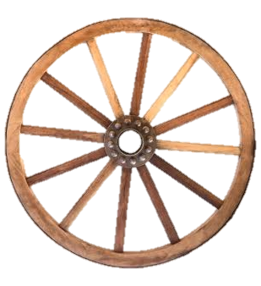
What about Greeks , teacher? Didn’t they use wheels?

Slide 24
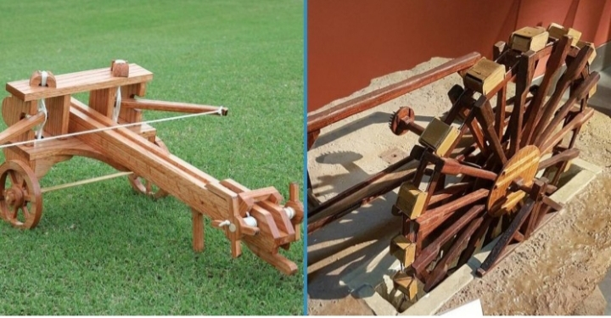
They definitely did. In 1500 BC, the Greeks too learnt the idea of wheel-making from the Egyptians. They also made further improvements on it.

Slide 25
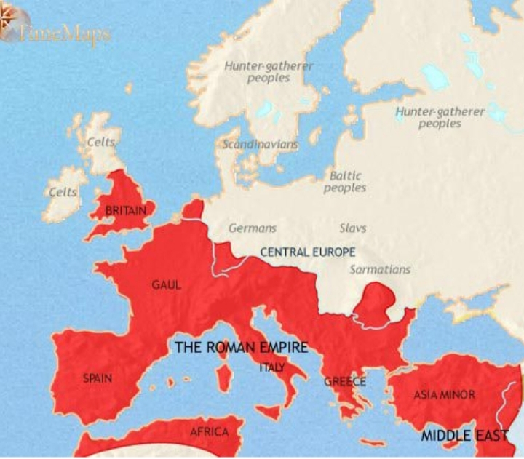
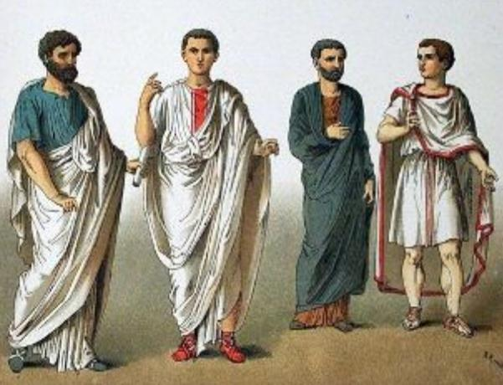
Later, Romans did the same too

Slide 26
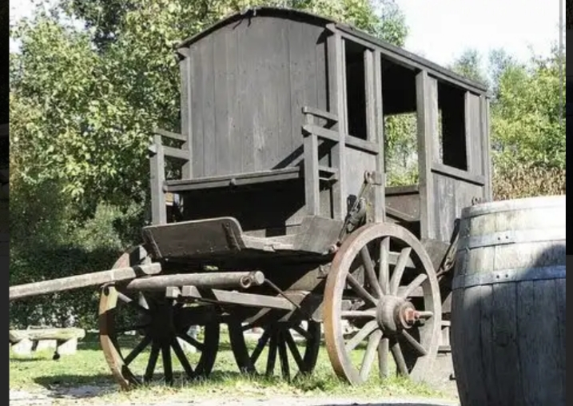
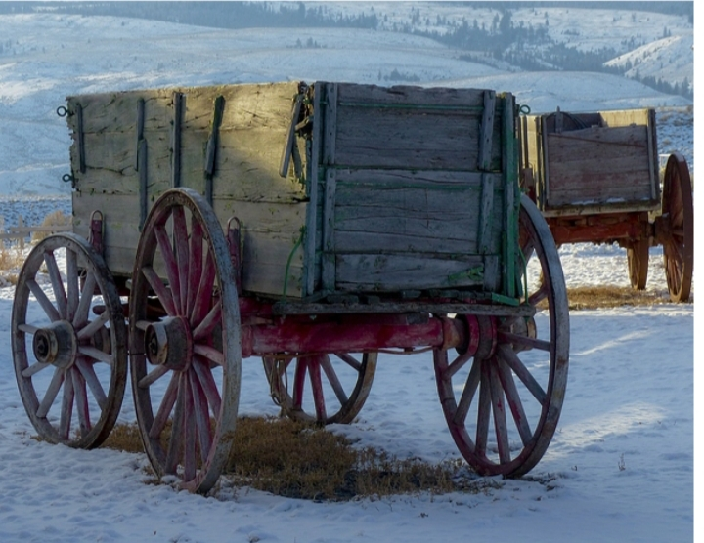
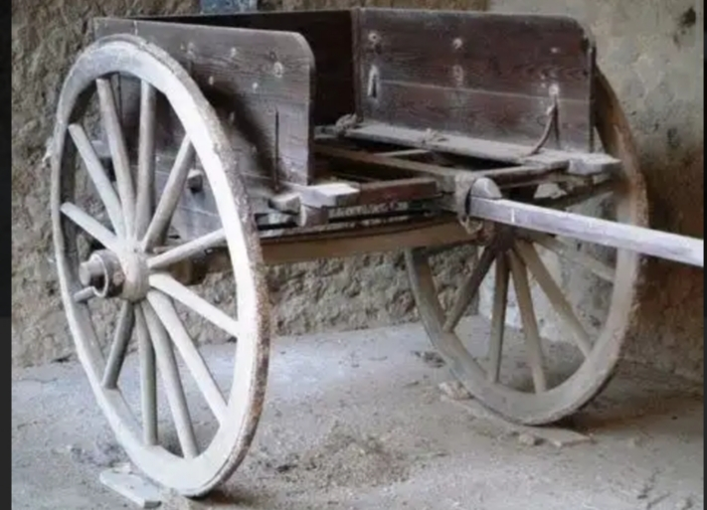
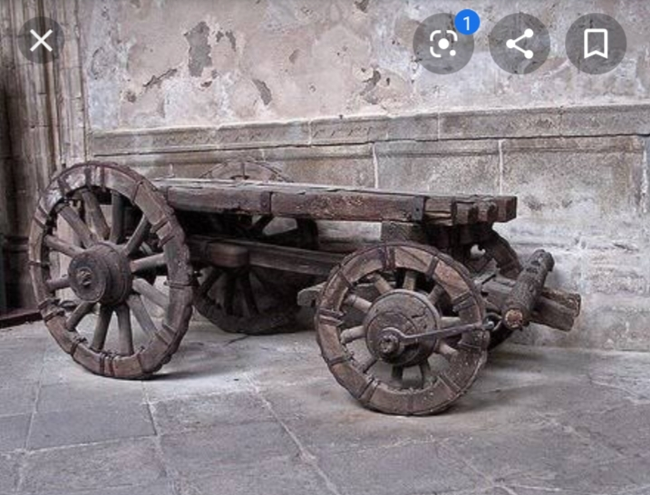
and produced a variety of wheeled vehicles

Slide 27
Individual Work
Read the statement below and say whether they are true or false. If false, give the right answer.
(1) The Greeks were the pioneers in developing spoked-wheels.
(2) The earliest wheel was discovered in 2000 B.C.
(3) The Egyptians first used wheels for chariots.
(4) The Romans first wheeled chariots for warfare.
(5) The ancient Indians used wheels before the ancient Romans did.

Slide 28
Pair work
Fill in the gaps with appropriate word:
The Greeks were pioneers in many things. But in this case, however, the (a) ----------------------- were the first. The (b) ----------- ever wheel was discovered in Mesopotamia. It was in 3,500 B.C. Mesopotamia was in ancient (c) --------. It was long along the valley of the rivers Tigris and Euphrates. After the Mesopotamians, the wheel was further improved by the Egyptians. They first made wheels with (d) ----------. Then they used them on (e) ---------------- around 2000 B.C.
Mesopotamians
oldest
Iraq
spokes
chariots

Slide 29
Vocabulary
Word
Meaning
To crate something new
Invent

Slide 30
Low land between high lands or mountains
Valley

Slide 31
Belonging to very distant past
Ancient

Slide 32
A person who is the first to study or develop a particular area of knowledge methods, ideas etc. That other people then continue to develop.
Pioneer

Slide 33
The activity of fighting a war, especially using particular weapons or methods
Warfare

Slide 34
A two-wheeled vehicle that was used in ancient time
Chariot

Slide 35
Group Work
Where is Mesopotamia?
Which invention has helped to create a new civilization?
Who first used the wheels on chariots?

Slide 36
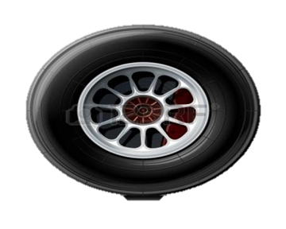
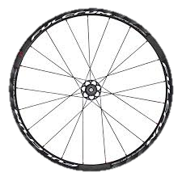
Home work
The wheel is a great invention for our civilization. It has long history. Now write a paragraph on “ The history of wheels” in 150 words.

