Slide 1
Welcome

Slide 2
Introduction
MST. UMME SALWA
SENIOR TEACHER
SANTAHAR B.P. HIGH SCHOOL
SANTAHAR, ADAMDIGHI,BOGURA

Slide 3
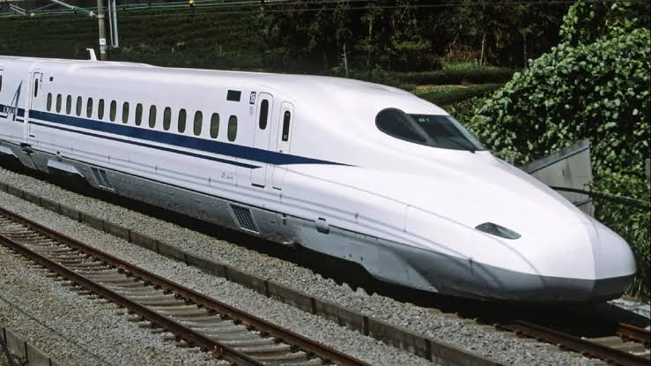
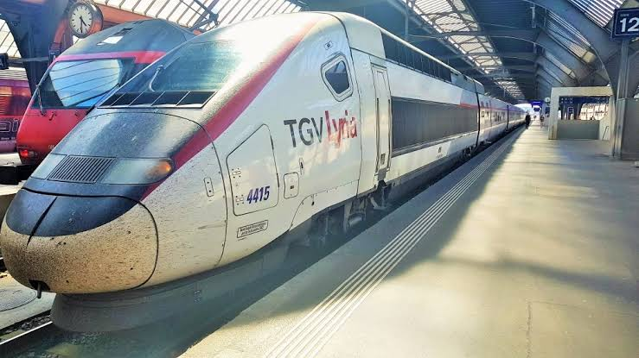
Look at these pictures.

Slide 4
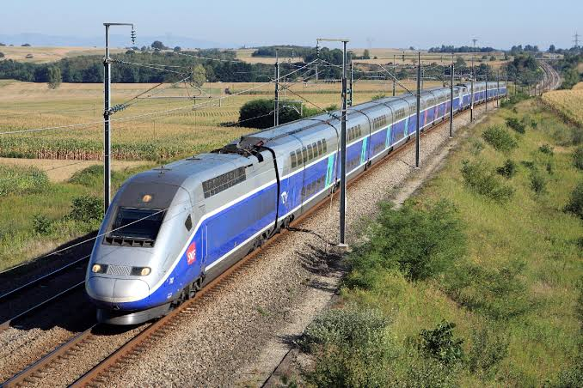

Slide 5
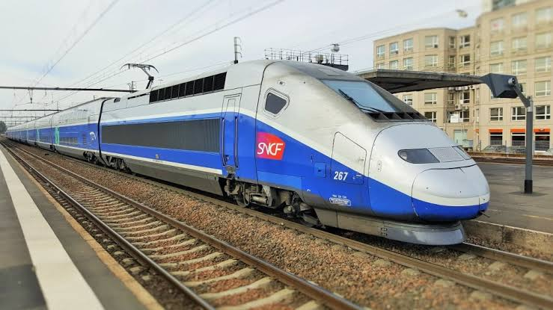
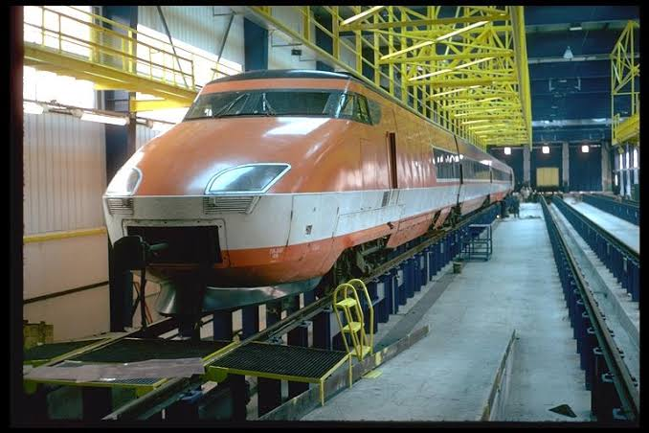

Slide 6
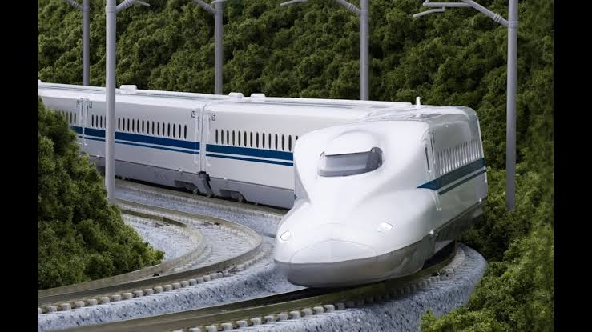

Slide 7
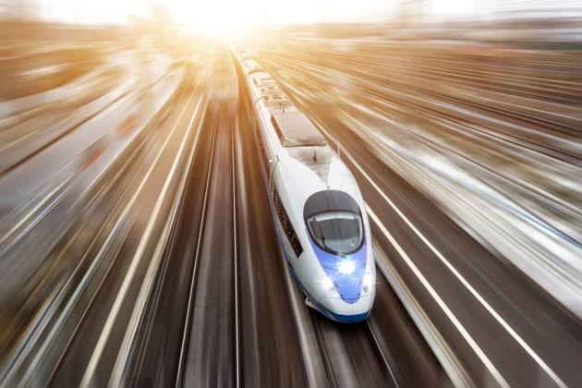
Today our lesson is --
“ The fastest wheel on earth ”
Class - Eight
Subject - English First Paper
Unit - Nine
Lesson - Three

Slide 8
Learning Outcomes
After we have studied this lesson we will be able to-
read and understand texts.
Fill in the blank
Write down paragraph.
Write down composition with clues

Slide 9
The TGV (Train à Grande Vitesse)
It means high speed train. It is France’s high-speed rail service.

Slide 10
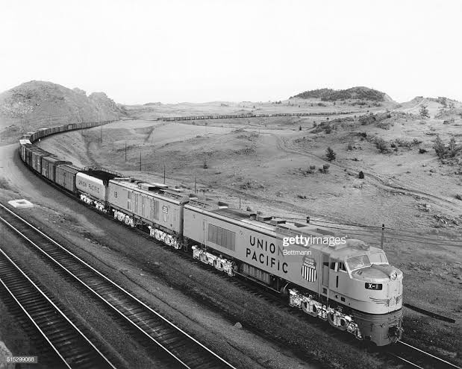
France started this train in 1970 by gas turbine.

Slide 11
The TGV was changed into electric train in 1973. The first root of the TGV started between Paris and Lyon in 1981. Later the network connected other cities in France with Paris.

Slide 12
A TGV test train set the world record for the fastest conventional wheeled train in 3 April 2007. It reached the speed of 574.8 km/h (357.2m/h) on the test run. But the regular TGV trains operate at the highest speed of 320 km/h (200 m/h). It is the present world record of speed of a conventional commercial train.

Slide 13
The Bullet train
It is the network of high- speed train service in Japan.

Slide 14
It started operation started in 1964 on a limited route. But at present, most major cities of Japan come under the network.

Slide 15
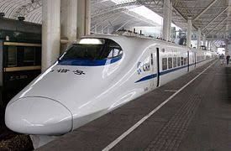
The Bullet Trains runs at a maximum speed of 300 km/h (186 mph). Japan set the world record for unconventional magnetic train sets in 2003. In a test run the speed was 581 km/h (361 mph). Its plan to increase speed up to 320 km/h (200 mph).

Slide 16
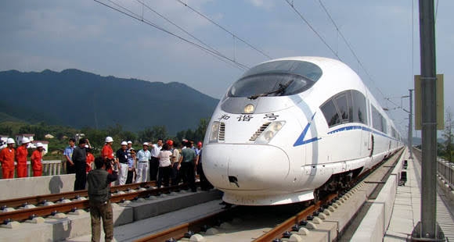
High speed Train
The High-speed Rail service in China started operation on April 18, 2007. Currently China started building a high-speed passenger rail network.

Slide 17
The usual top speed of China’s conventional quick trains is 300 km/h(186mph). China has set world record of a speed of 487.3 km/h (303moh). In 2011, this record was set by an unconventional magnetic trainset called “Harmony Express”. This is the highest speed of an unconventional magnetic trainset in regular commercial operation.

Slide 18
Read the above text in section B again. Now discuss with your partner to fill in the blank slots in the following grid with the information about high-speed trains.
Name of the country | Name of the train/Network | Year of introduction/start | Top speed of conventional train | Top speed of unconventional train | Holds world records for
574.8 km/h (357.2 m/h)
Conventional commercial train
France
TGV
1970
300 km/h (186 m/h).
unconventional magnetic train sets.
The Bullet train
Japan
1964
The High-speed Rail
April 18,
2007
300 km/h (186 mph)
China
Harmony express
487.3 km/h (303 mph).
487.3 km/h (303 mph).
China
2011

Slide 19
Vocabulary
Word
Meaning
High-speed
Quick in motion

Slide 20
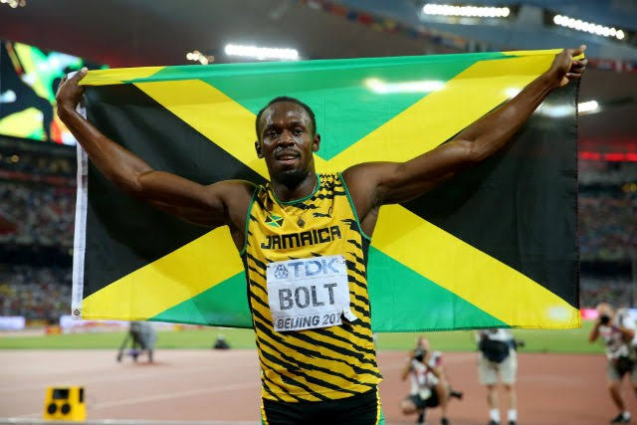
Greater than ever before
Record - breaking

Slide 21
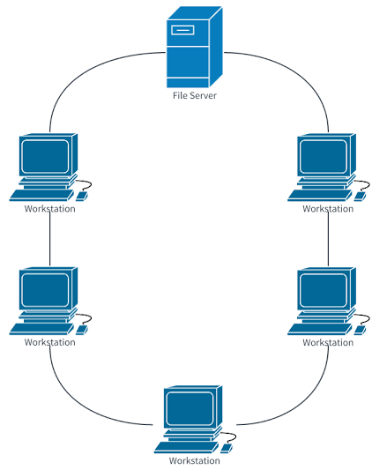
Great system covering something
Network

Slide 22
Make bigger
Expand

Slide 23
Tending to follow what is generally done
Conventional

Slide 24
Unconventional
Tending to follow what is generally undone

Slide 25
Behaving like a magnet
Magnetic

Slide 26
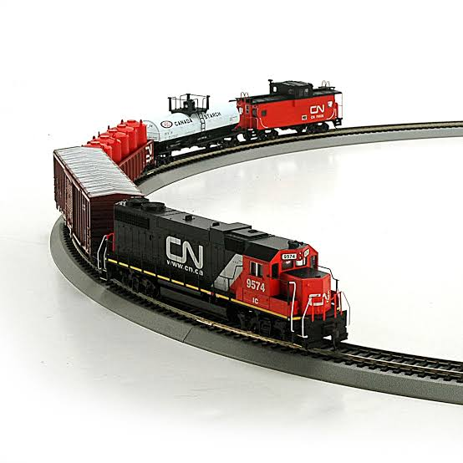
A set of railway wagons and carries
Train set

Slide 27
Pair Work
Fill in the blanks:
TGV is France’s high-speed rail(a) -----------. France started this train in 1970 by gas (b) ------------. The TGV was (c) ------------ into electric train in 1973. The first (d) --------------- of the TGV started between Paris and Lyon in 1981. Later the network (e) ----------------- other cities in France with Paris.
service
turbine
changed
root
connected

Slide 28
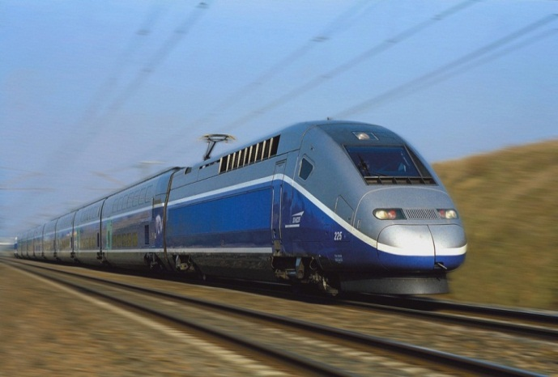
Group work
Discuss in groups to decide which of the above three rail services you like best and why. Finally write a paragraph and present it in the class.
TGV France
High-speed, China
Bullet train, Japan

Slide 29
Home work
Name: | Bangladesh Railway
Headquarters: | Dhaka
Zones: | Eastern and Western
Numbers of stations: | 459
Number of engines: | 284
Number of passenger carries: | 1245
Number of wagons: | 12984
Total length of railroad: | 2855 kilometers
Passengers transported annually: | 42 millions
Total number of employees: | 34168
Nature of present operations : | International (Dhaka-Kolkata); inter-city; local
Read the basic information about Bangladesh Railway beside. Write a composition using the information.

Slide 30
Thanks for all

