Slide 1
Welcome

Slide 2
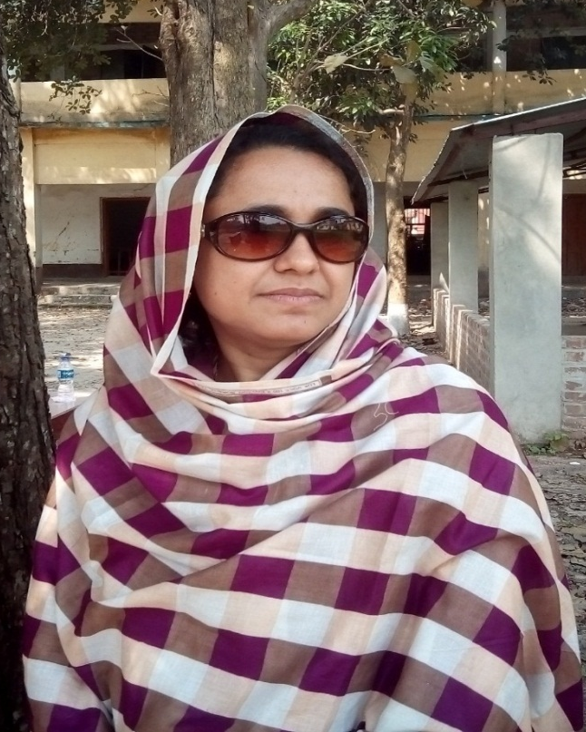
Introduction
MST. UMME SALWA
SENIOR TEACHER
SANTAHAR B.P. HIGH SCHOOL
SANTAHAR, ADAMDIGHI,BOGRA

Slide 3
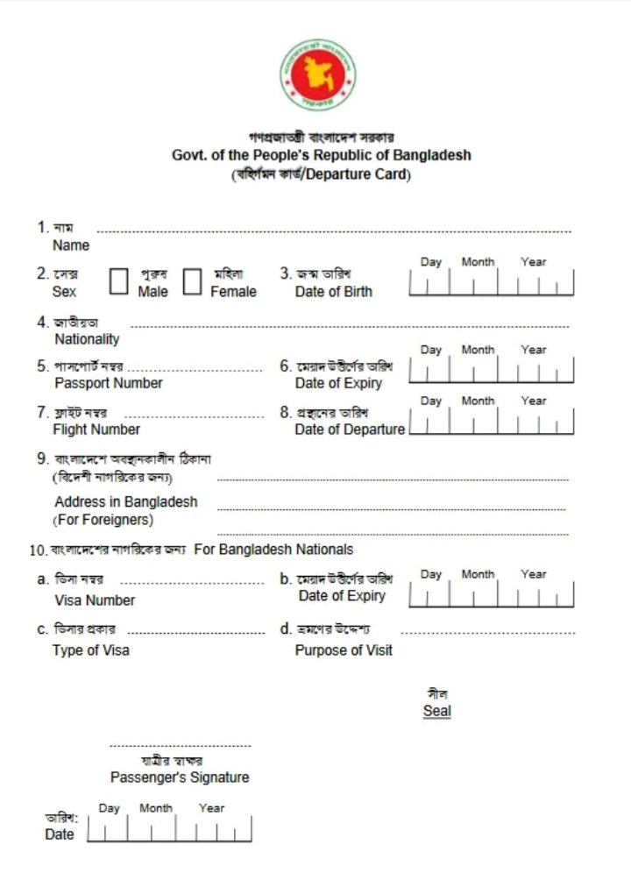
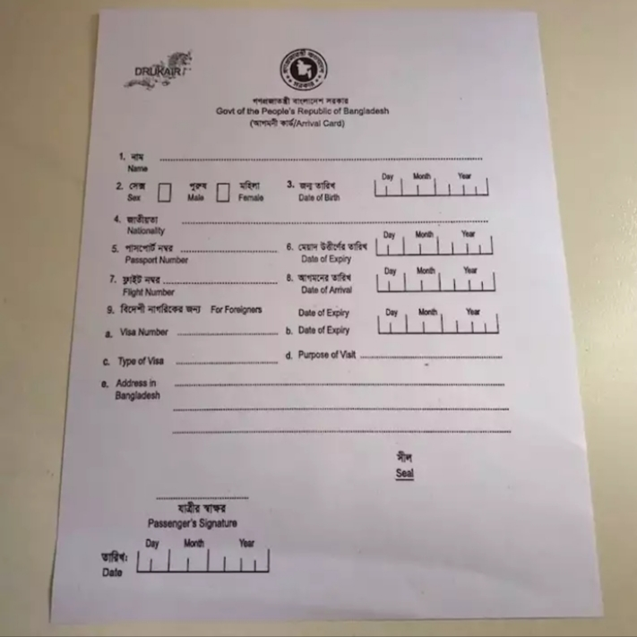
What can you see in these picture?
Departure card

Slide 4
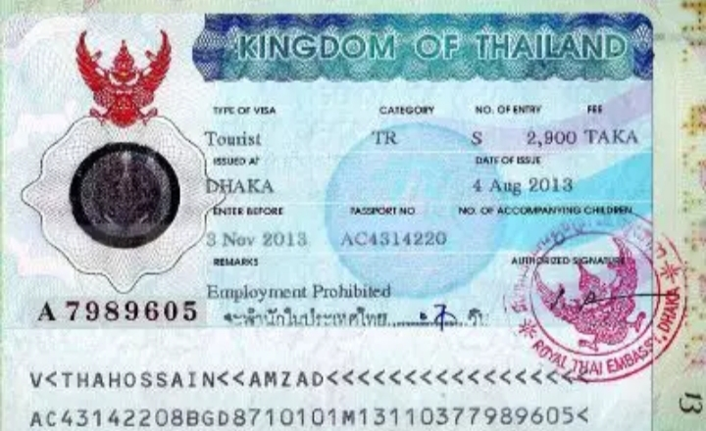
What is this?
A Visa

Slide 5
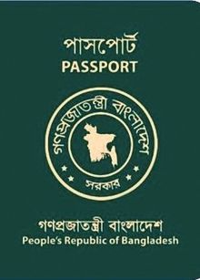
And what is this in this picture?
A Passport

Slide 6
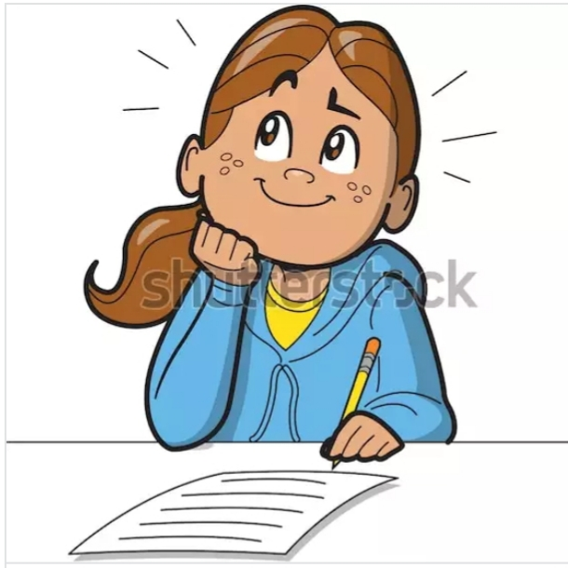
Today our lesson is ---
“Filling a form”
Class - Eight
Subject - English First Paper
Unit – Six
Lesson - Two

Slide 7
Learning outcomes
After we have studied this unite , we will be able to--
Listen for information
Ask and answer the question
Write answers to questions
Write the main ideas

Slide 8
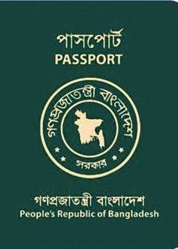
Mita’s full name is Mita Sultana Ahmed. She was born on 6 May 1998. She got her passport on June 09, 2010. It’s a five – year passport. It will expire on 8 June 2015. After that she has to renew her passport. Her passport number is AB9842251.

Slide 9
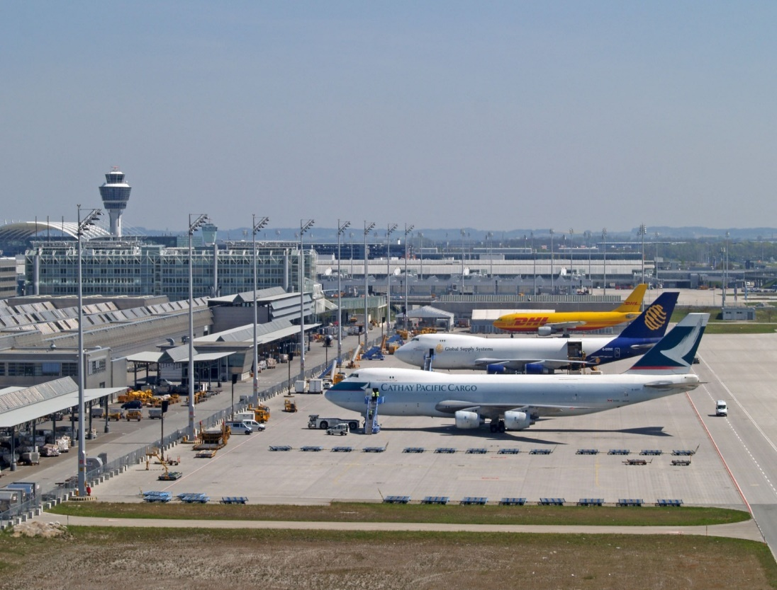
She is going to Thailand By Bangladesh Biman, Flight number BG 88 on 14 July 2012.

Slide 10
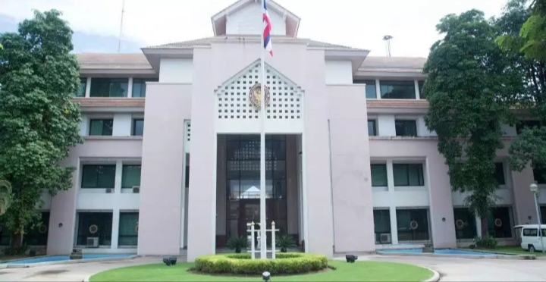
Mita got her visa from Royal Thai Embassy in Dhaka.

Slide 11
Her visa number is T 9115138. The visa was issued in Dhaka on 29 June 2012. The visa is valid for three months. It will expire on September 27, 2012.

Slide 12
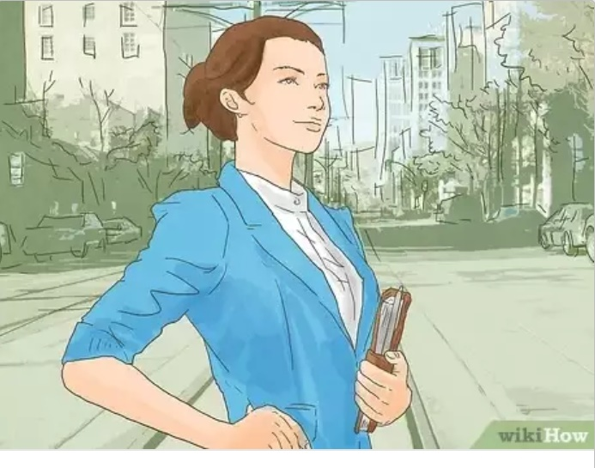
It is a tourist visa. If you are travelling on a tourist visa, you are not allowed to study or work there.

Slide 13
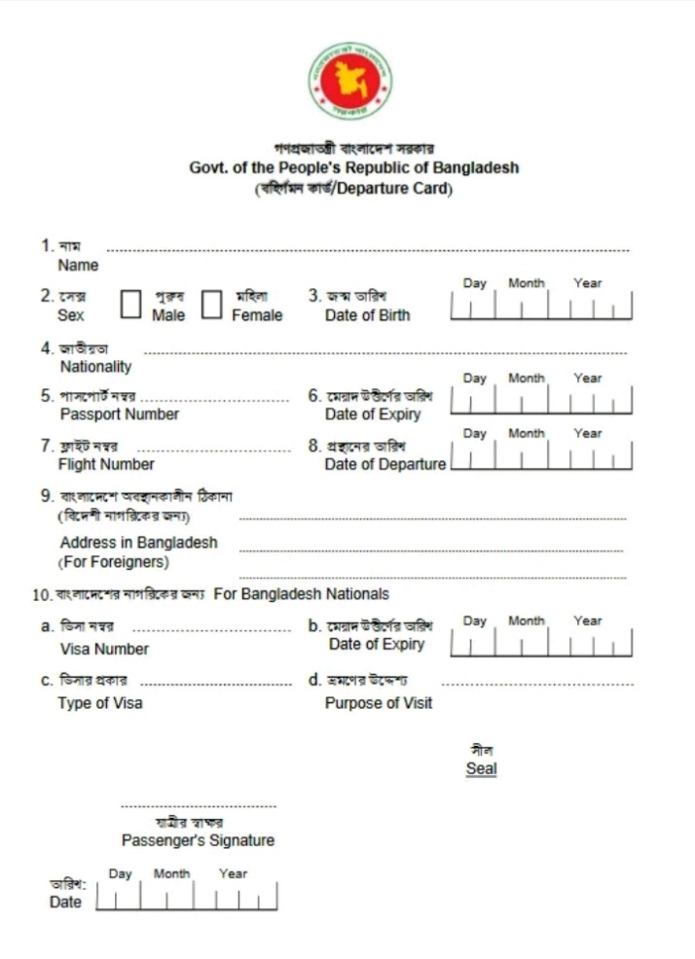
Vocabulary
Word
Meaning
A card to be filled up in immigration
Departure Card

Slide 14
To come to or go to a place
Visit

Slide 15
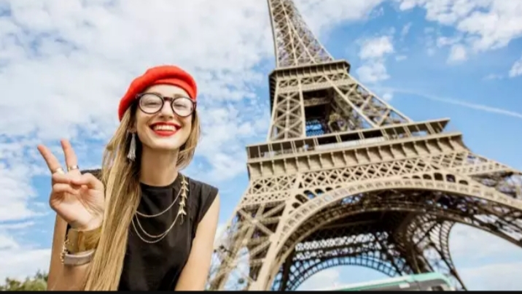
A person who travels for pleasure
Tourist

Slide 16
To spend time learning about a subject by reading, going to college etc.
Study

Slide 17
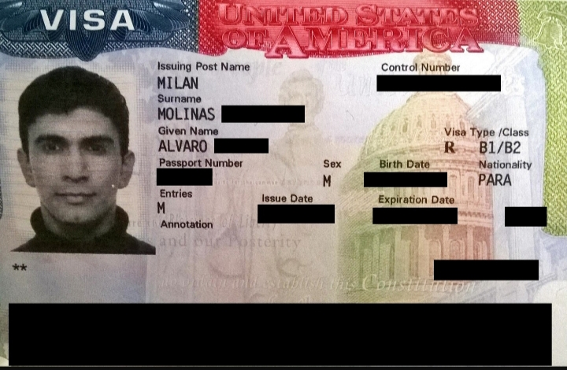
An official permission to go to a foreign country
Visa

Slide 18
Individual work
Choose the best answer:
Where is the Royal Thai Embassy in Bangladesh?
i.In Chattogram ii. In Khulna iii. In Dhaka iv. In
Jashore
(b) What does the word ‘Flight’ refers to?
i. Train ii. Boat iii. Plane iv. Bus
(c) The person whongets a tourist visa of Thailand cannot study or ----- there.
i. Work ii. Take food iii. Drink iv. Enjoy

Slide 19
Pair Work
Fill in the gaps:
Mita’s full name is Mita Sultana Ahmed. She was born on 6 May 1998. She got her (a) ------------- on June 09, 2010. It’s a five-year passport. It will (b) --------- on 8 June 2015. After that she has to (c) --------- her passport. Her passport number is AB9842251. She is going to Thailand (d) ---------- Bangladesh Biman, Flight number BG 88 on 14 July 2012. Mita got her visa from Royal Thai Embassy in Dhaka. Her visa number is T 9115138. The visa was (e) ------------ in Dhaka on 29 June 2012.
passport
expire
renew
By
issued

Slide 20
Home work
Where did Mita get her visa from?
When did she get the passport?
How long will the visa remain valid?
Why is not Mita allowed to study or work in Thailand?
What is the flight number?

Slide 21
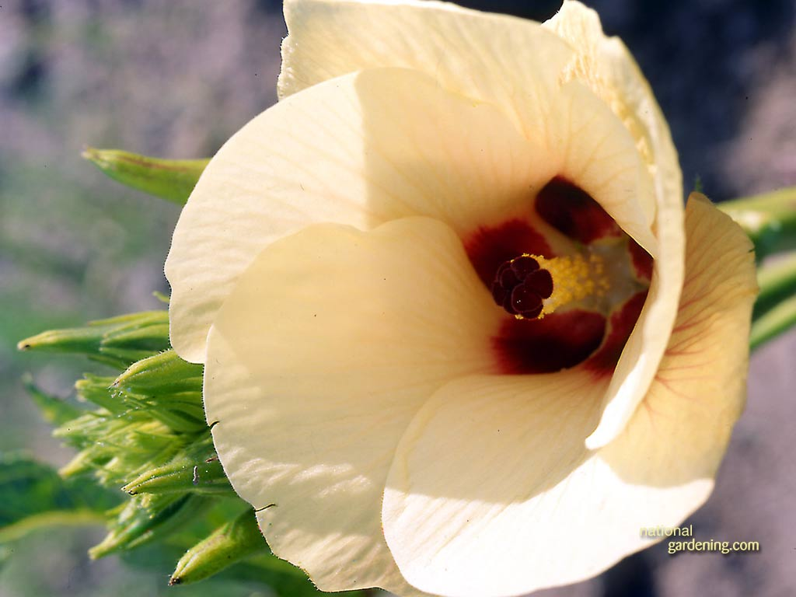
Thanks

