Slide 1
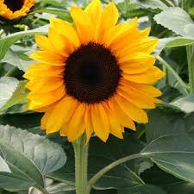
Welcome

Slide 2
Personal details
Time:45m
Class:8
Subject:English
Unit : 3
Lesson-3 Hygiene
Name : Ferdous Ara Begum
English Teacher
(Birinchi Sufia Nuria Alim Madrasah)
Feni Shadar-Feni

Slide 3
Our Topic
Health

Slide 4
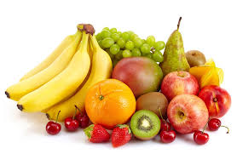
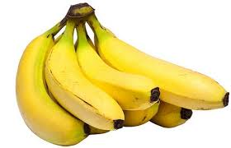
Protein food

Slide 5
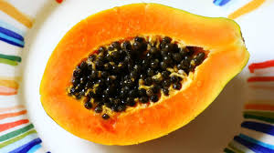
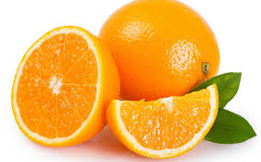
Vitamin c

Slide 6
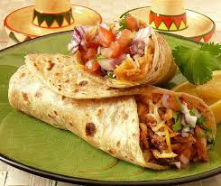
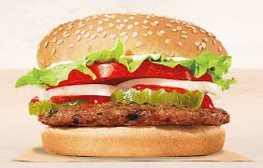
Fat food

Slide 7
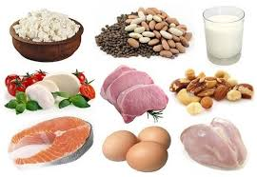
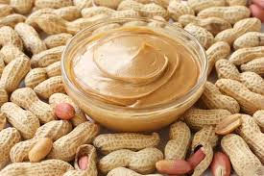
Protein food

Slide 8
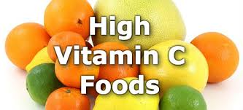
High vitamin c

Slide 9
* * Open your English book – page no 18 & 19. ** Read the text.
Do the pair work.
Make a group consisting of 6 members.
Discuss the issue with each other.
Share your views and thoughts.

Slide 10
Vocabulary
Hygiene=cleanliness
Godliness=adoration
Achieve= attain
Spiritually= religious
Soul= spirit

Slide 11
Choose the best answer from the alternatives.
1. The word hygiene is related with---.
Truthfulness
Happiness
Cleanliness
religion
2.Health means the condition of---.
Our body
Our mind
Our body and mind
Our environment
Ans:Cleanliness
Ans. Our body and mind

Slide 12
3.A healthy person is one who---.
Eats good food
Has a lot of wealth
Is physically and mentally sound
Is over weight
4.We need to eat---.
Rich food
Balanced food
Little food
Lot of food
5.We need to eat ---food to keep fit.
Rich
Little
Much
balanced
Eats good food
Has a lot of wealth
Ans.is physically and mentally sound.
Ans.balanced food.
Ans. balanced

Slide 13
Answer the following questions.
Why is good health essential for us ?
Why is physical exercise necessary?
What do you understand by ‘Good Health’?
What certain things should we do to be healthy?
What does it mean by ‘Health is wealth’?
Ans 1 : Good health is essential for us , because good health makes a man sound and fit for work.
Ans 2 : For being a healthy man, physical exercise is must. By taking physical exercise , his body and mind can be refresh.
Ans 3 : Good health means healthy body free from diseases.
Ans 4 :To be healthy we should eat a balanced diet and take exercise.
Ans 5 :Health is wealth means health is equally valuable as gold or any other personal possessions.

Slide 14
Home Work
Write a paragraph on how to maintain good health in 90-100 words.

Slide 15
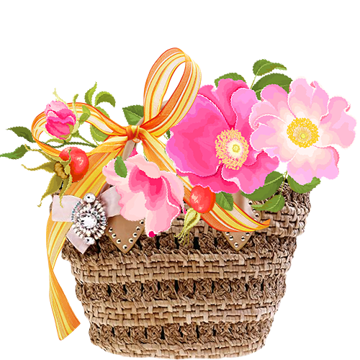
Thank you everyone

