Slide 1
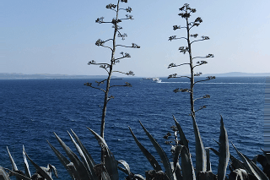
Welcome to our English class

Slide 2
Edited by:
Md.Firoj Hossain
Asst.Teacher(Social Science)
Subrajpur High School
Patnitola,Naogaon
Mob.no-01716697972
E-mail:firojpatnitola@gmail.com

Slide 3
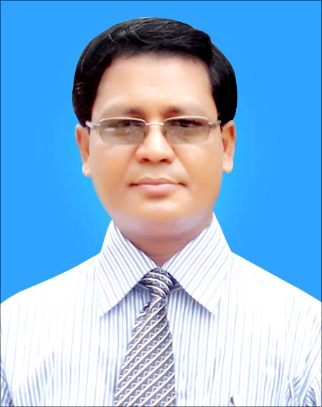
Introduction
Abdul Mannan
Senior Assistant Teacher
Ataturk Model High School.
Mobile: 01816 83 01 55
E-mail:
abdulmannanamhs@gmail.com

Slide 4
Lesson Introduction
Class : Nine
English for Today
Unit : 3
Lesson : 3
Time : 50 Minutes
Date : 25/ 03/ 2020

Slide 5
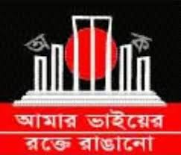
21 February
1. What’s the picture about?
1.➢Ans: Shaheed Minar.
2. Why was it built?
2. ➢ Ans: For the Symbol of Shaheed who sacrifices of the
martyrs for the rightful place of Bangla.
3. Why ${21}^{st}$ February is a red letter day?
3. ➢ Ans: The ${21}^{st}$ February is a red letter day of
International Mother Language Day.

Slide 6
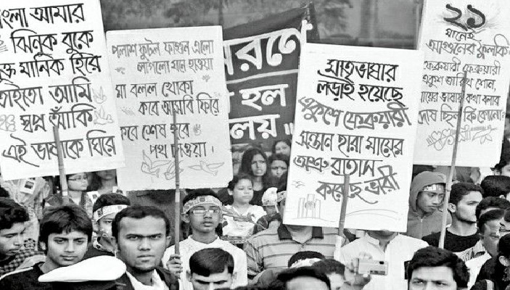
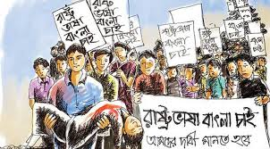
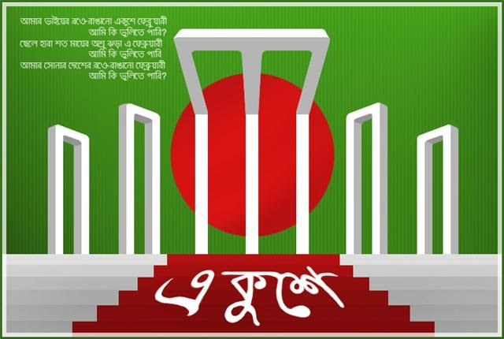
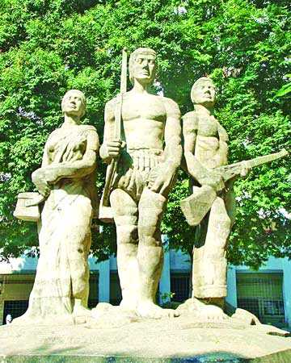
Look at the picture below :

Slide 7
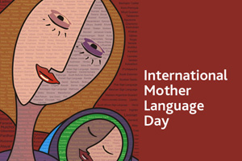
21 February
International Mother Language Day-1

Slide 8
Learning Outcomes
After studied this lesson, students will be able to ---
1 . Speaking skill through talking about
21 February.
2. Ask and answer questions and give opinions in a logical sequence.
3. Reading skill through matching information with pictures and filling an extract with words kept in a box.

Slide 9
International Mother Language Day-1
21 February is a memorable day in our national history. We observe the day every year as International Mother Language Day. The day is a national holiday. On this day, we pay tribute to the martyrs who laid down their lives to establish Bangla as a state language in undivided Pakistan in 1952. This is known as the Language Movement.
The seed of the Language Movement was sown on 21 March 1948 when Mohammad Ali Zinnah, the then Governor General of Pakistan, at a public meeting in Dhaka declared that Urdu would be the only official language of Pakistan. The declaration raised a storm of protest in the eastern part of the country. The protest continued non-stop, gathering momentum day by day. It turned into a movement and reached its climax in 1952. The government outlawed all sorts of public meetings and rallies to prevent it.
The students of Dhaka University defied the law and they brought out a peaceful protest procession on 21 February 1952. When the procession reached near Dhaka Medical College, the police opened fire on the students, killing Salam, Rafiq, Barkat and Jabbar. This kindled the sparks of independent movement of Bangladesh.
A.Read the text

Slide 10
Vocabularies

Slide 11
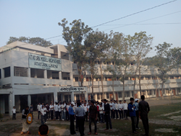
Vocabularies
1. Establish =
= Set up
❖ Our school was established in 1939.

Slide 12
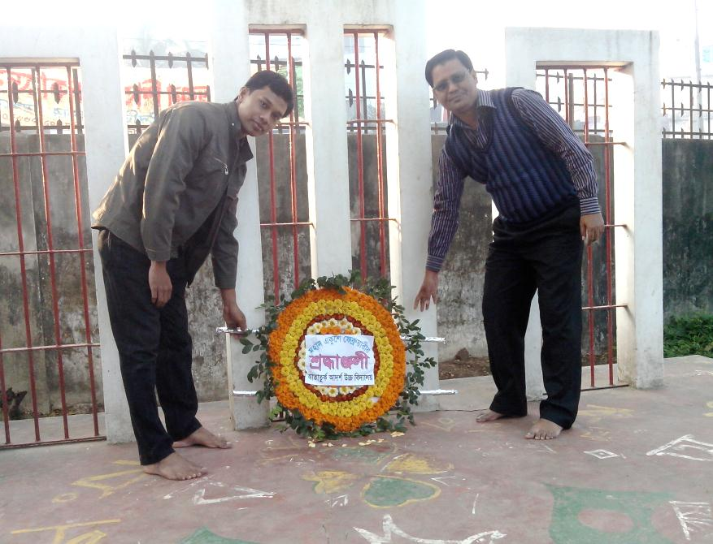
Vocabularies
2. Tribute =
= Honour.
❖ We pay honour to the language martyrs.

Slide 13
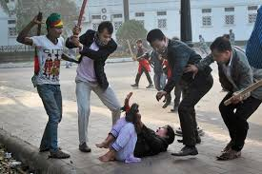
Vocabularies
3. Defy =
= To refuse to obey.
❖ We should not defy the law of our country.

Slide 14
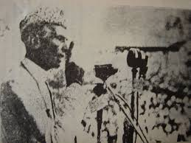
Vocabularies
4. Undivided =
= whole, not divided.
❖ Mohammad Ali Zinnah declared that Urdu would be the only official language of undivided Pakistan.

Slide 15
Individual works
Give short answer to the following questions.
(a) What language do you speak?
(b) Whu do we observe 21 February as the
International Mother Language Day?
(c) What did Zinnah declare in a public
meeting in 1948?

Slide 16
Individual works
Answer
We speak in Bangla.
(b) The UNESCO has proclaimed 21 February as
the International Mother Language Day in 1999.
So we obserbe 21 February as International
Mother language Day.
(c) Zinnah declared in a public meeting in 1948
that Urdu would be the only official language
of Pakistan.

Slide 17
Match the words with their meanings.
Words
Meanings
(a) Tribute
(a) to have a particular effect
(b) climax
(b) to refuse to obey
(c) outlaw
(c) to give in
(d) defy
(d) the ability to keep increasing or developing
(e) Provoke
(e) an act to show respect or admiration
(f) relent
(f) the most exciting point in time
(g) momentum
(g) to ban

Slide 18
EVALUATION
Time: 7 minutes
Time: 7 minutes
1.What happened when Urhu was declard as the only
official language of Pakistan?
Ans: The declaration raised a storm of protest in East Pakistan. It continued non-stop. The government banned all types of public meeting.
2. Choose the best answer :
Q. The police opened fire on the students of ……… .
Dhaka Medical College ii) Dhaka University.
iii) Dhaka Dental College iv) Dhaka College.

Slide 19
EVALUATION
Complete the chart :
Time
What happened
1947
Pakistan and India became independent.
Mohammad Ali Zinnah declared that Urdu would be the only official language of Pakistan at a public meeting in Dhaka.
1948
The students of Dhaka University brought out a procession on ${21}^{st}$February 1952.
1952

Slide 20
Home
works
❖ Write a paragraph on $′{21}^{st}$ February’ .(15 sentences)

Slide 21
Thanks all student

