Slide 1
মাল্টিমিডিয়া ক্লাসে স্বাগতম

Slide 2
শিক্ষক পরিচিতি
Bhabatosh Das
Asisst-teacher
Zinda govt primary school
Rupganj,Narayanganj

Slide 3
ALPHABET
UNIT : 2-6
Lesson : 4 - 6

Slide 4
Learning outcomes : Students Will be able to
Listening :
Reading :
1.1.1 Become familiar with English Sounds by listening to common Englsih words.
1.1.1 Recognize and read the alphabet both small and capital. (non-cursive)
Speaking :
Writing :
1.1.1 Repeat after the teacher simple words and phrases.
1.1.2 Say simple words and phrases.
1.1.1 To practice letter Shapes/simple Writing patterns, etc.
1.1.2 Write Non-cursive Capital and small.

Slide 5
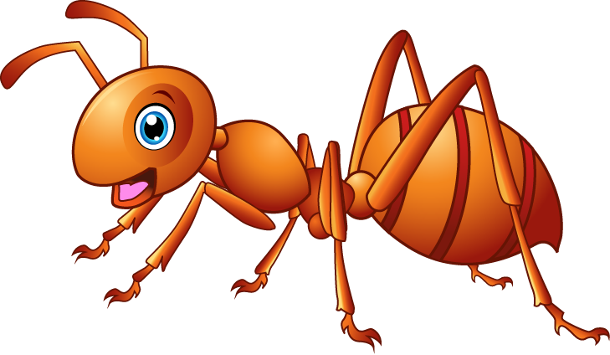
ALPHABET
UNIT-2
ant
apple
What is this ?

Slide 6
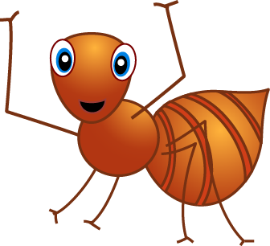
ALPHABET
UNIT-2
A a
apple
ant

Slide 7
ALPHABET
UNIT-2
apple

Slide 8
ALPHABET
UNIT-3
ball
What is this ?

Slide 9
ALPHABET
UNIT-3
B b
ball

Slide 10
ALPHABET
UNIT-3
B b

Slide 11
ALPHABET
UNIT-4
What is this ?
cat
cap
What is this ?

Slide 12
ALPHABET
UNIT-4
C c
Cat
cap

Slide 13
ALPHABET
UNIT-4
Cc

Slide 14
ALPHABET
UNIT- 5
Dog
What is this ?

Slide 15
ALPHABET
UNIT- 5
D d
Dog

Slide 16
ALPHABET
UNIT- 5
D d

Slide 17
ALPHABET
UNIT- 6
elephant
What
is this ?

Slide 18
ALPHABET
UNIT- 6
E e
elephant

Slide 19
ALPHABET
UNIT- 6
E e
elephant

Slide 20
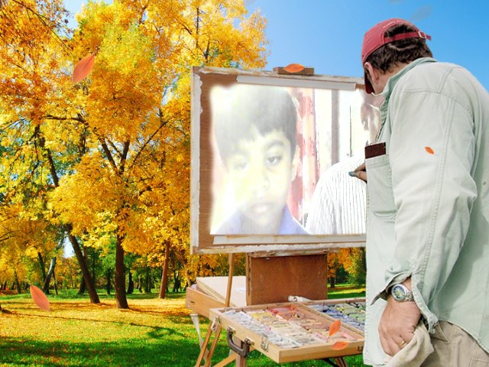
THANK YOU
FOR ALL

