Slide 1
WELCOME

Slide 2
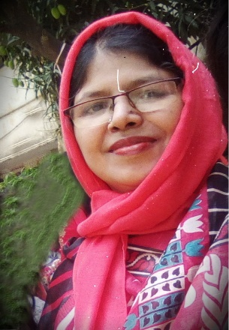
INTRODUCTION:
TEACHER:
LESSON:
Asma Huq
Asst. Teacher, English
Motijheel Govt. Girls’ High School, Dhaka.
Class: Six
Subject: English 1st Paper
Unit:01,Lesson:01

Slide 3
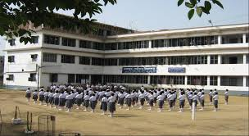
SEE THE PICTURE
What can you see in the picture?
Ans: It is a picture of a school.
Notes:
sch

Slide 4
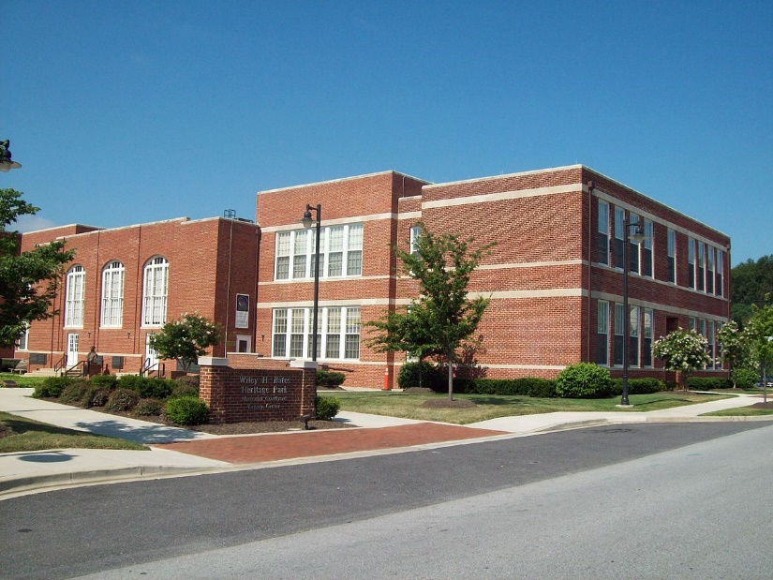
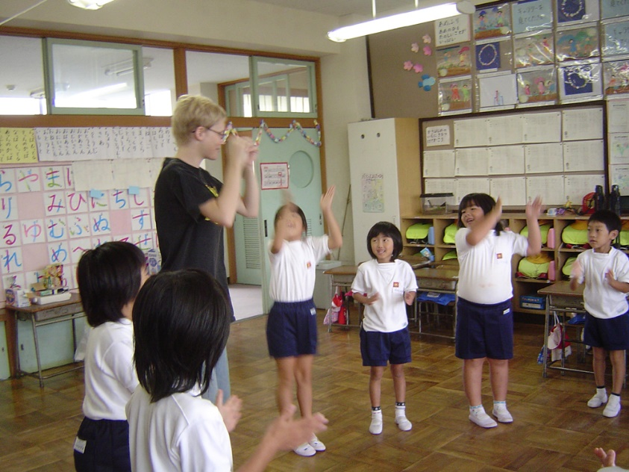
ANNOUNCEMENT OF THE LESSON:
TODAY OUR LESSON IS
‘GOING TO A NEW SCHOOL’

Slide 5
AIMS & OBJECTIVES:
After completing the lesson students will be able to
read & understand texts
talk about people,places and familiar objects in short and simple sentences
write short paragraphs

Slide 6
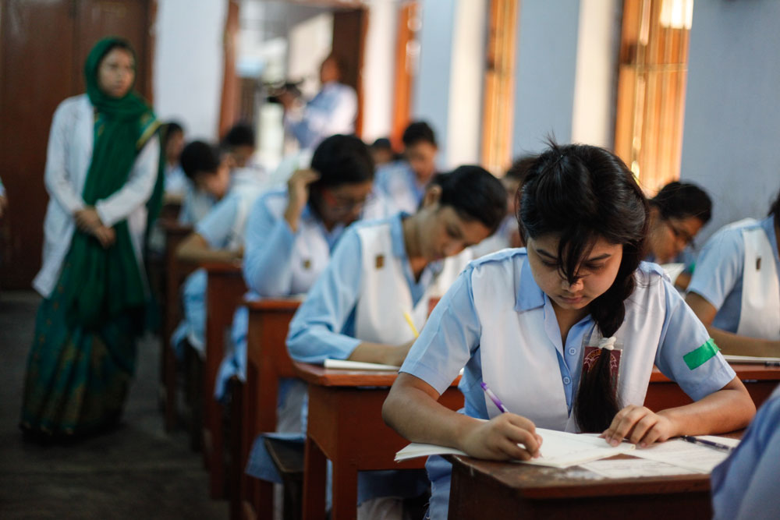
SILENT READING OF THE TEXT
Read the text silently

Slide 7
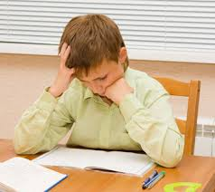
INDIVIDUAL WORK
Read the form and see what Tarun has written about himself.
Now write down similar information about yourself.

Slide 8
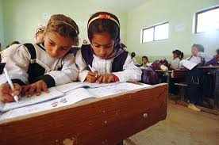
PAIR WORK
Read the passage about Tarun’s first day in the new school.
Now ask and answer questions in pairs.

Slide 9
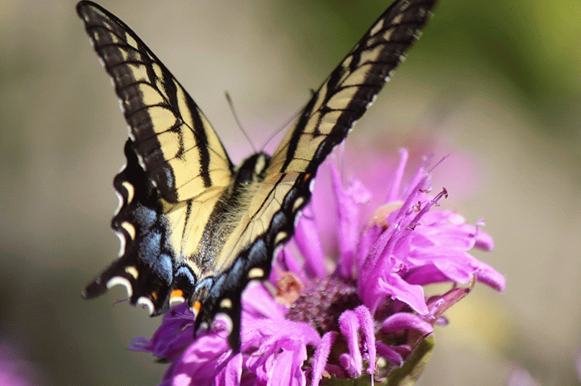
EVALUATION
Talk about your first day at school with your partner sharing your feelings how you felt that day:
happy/frightend/shy.

Slide 10
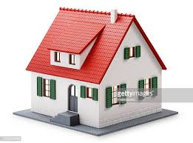
HOME WORK
Write a
paragraph on
Your School

Slide 11
THANK
YOU

