Slide 1
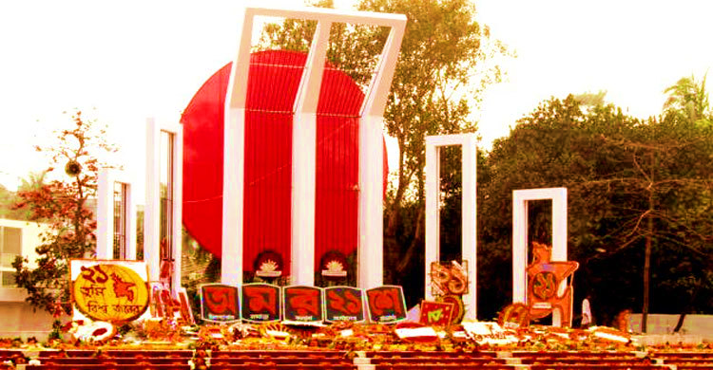
Welcome to all

Slide 2
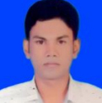
INTRODUCTION
Class : Nine
Subject : English 1st paper
Unit : Three
Lesson : 3
Time : 50 min.
Date : 07/03/2020
Samir kumar
Assistant teacher
Faltita s.s.k High school
Fakirhat.Bagerhat
Mobile no: 01788902566
Email:drnarayanbiswas@yahoo.com

Slide 3
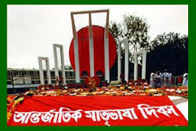
International Mother Language Day-1

Slide 4
Learning Outcomes
After studying the lesson we will be able to…
1. talk about event;
2. ask and answer questions;
3. infer meanings from the context.

Slide 5
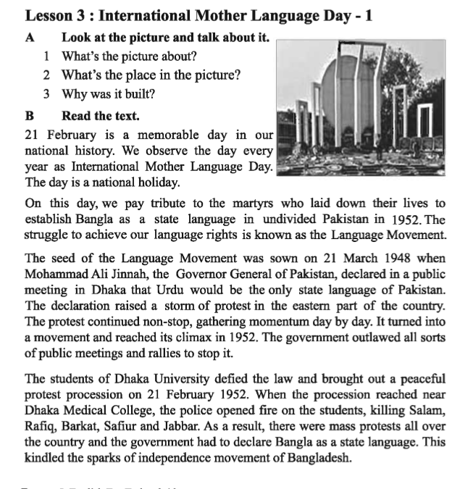
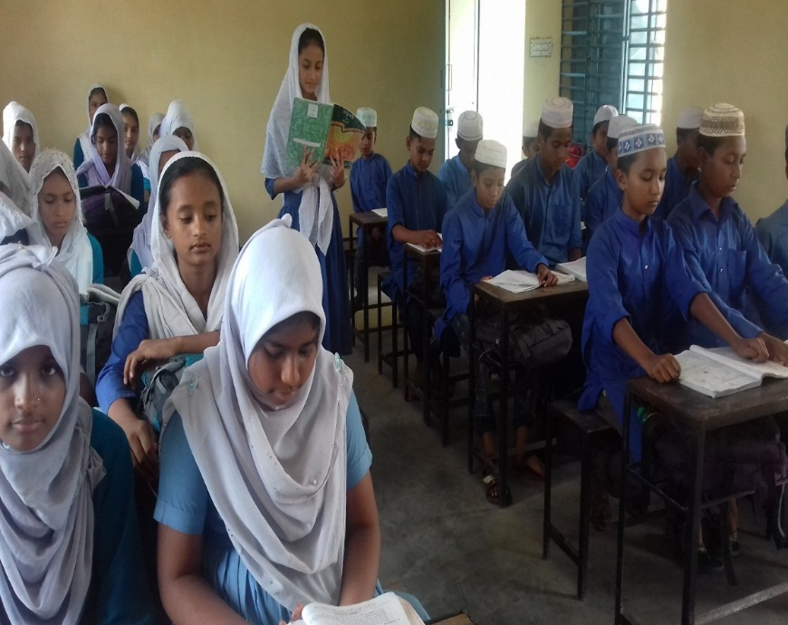
Proper learning
Dear students open your English book page no 33 & read any one.

Slide 6
Individual work
1. What’s the picture about?
2. Why was it built?

Slide 7
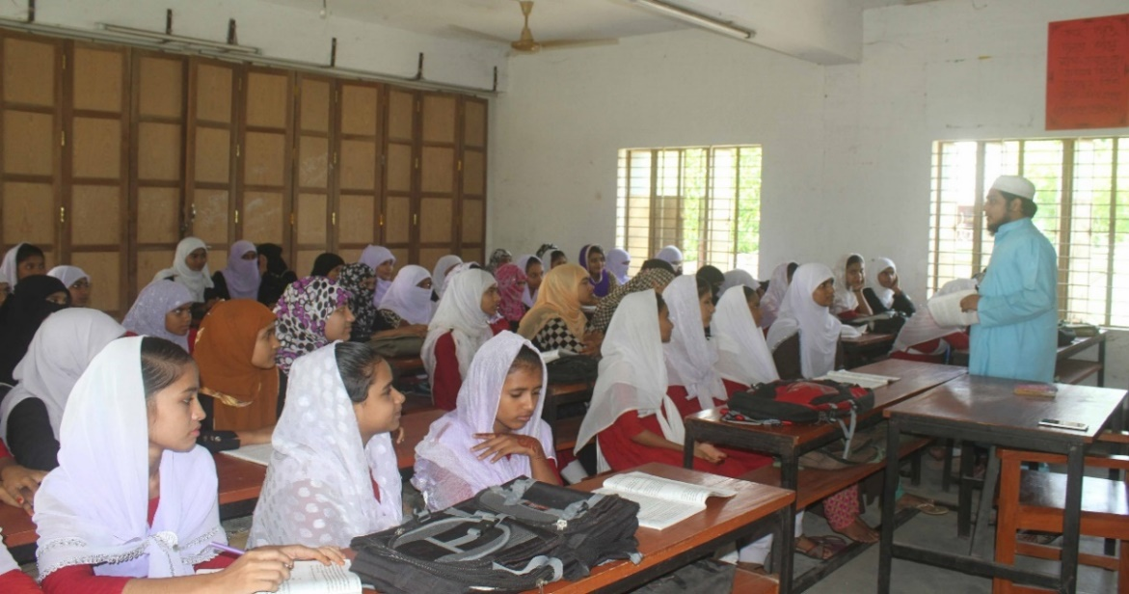
Silent reading
Dear students open your English book page no 33 & read attentively.

Slide 8
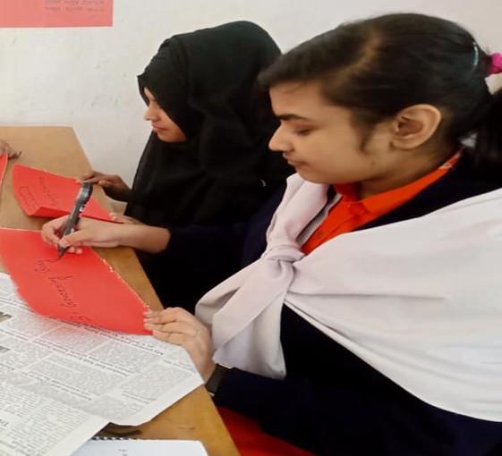
Pair work
1.Why do we observe 21 February as the International Mother Language Day?
2.What happened when Urdu was declared as the only state Language of Pakistan?
3.What was the result of the language movement?

Slide 9
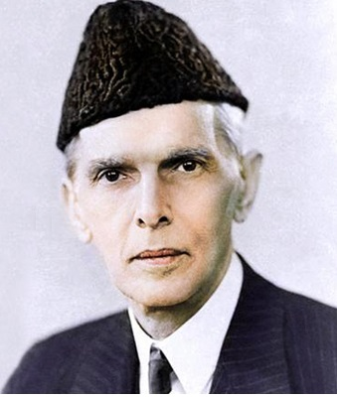
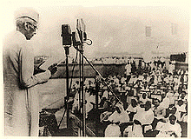
Let's know the history of the language movement
21 March 1948 when Mohammad Ali Jinnah The Governor General of Pakistan, declared in a voiceless voice in the rally of the student teachers at the Curzon Hall of Dhaka University that "Urdu" would be Pakistan's only state language.

Slide 10
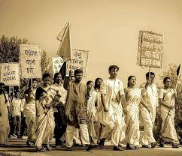
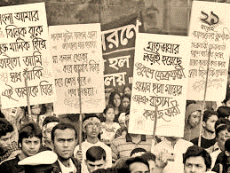
Let's know the history of the language movement
Students of Governor General Mohammad Ali Jinnah's announcement immediately protested.

Slide 11
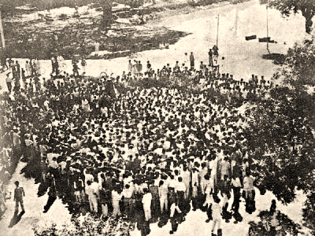
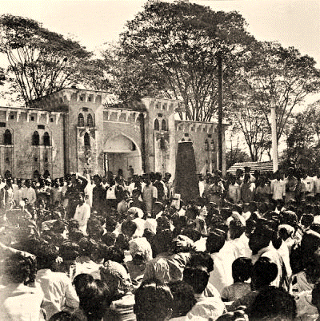
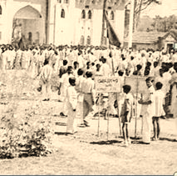
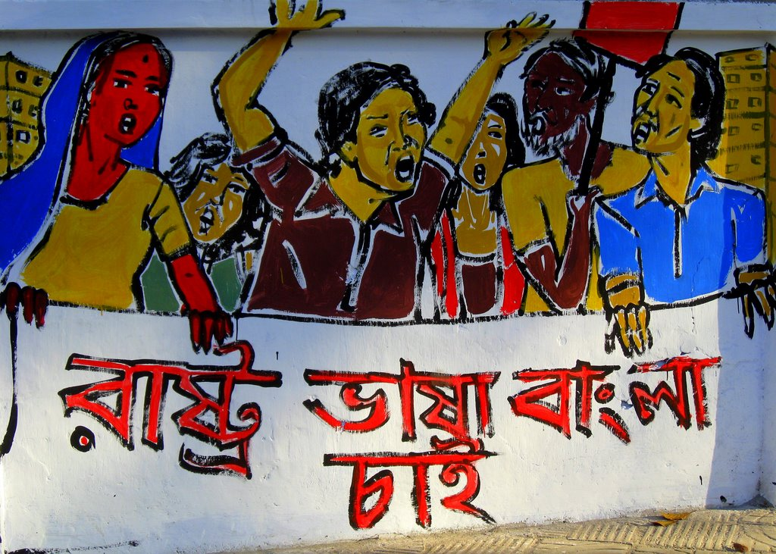
Let's know the history of the language movement
Peaceful protest of the students of Dhaka University.

Slide 12
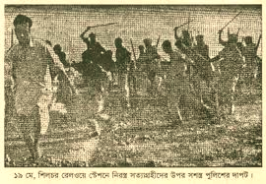
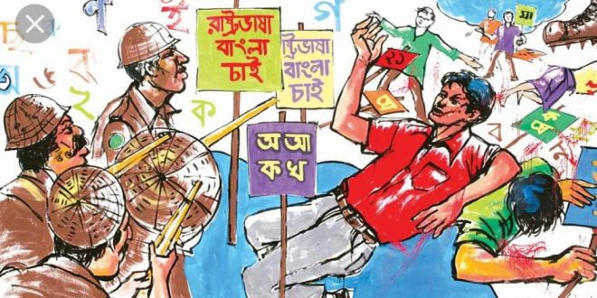
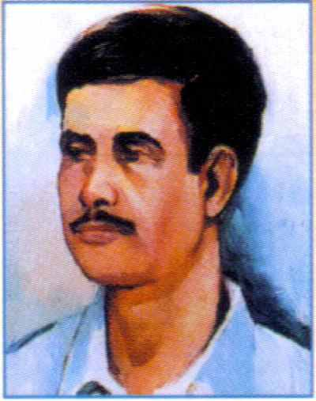
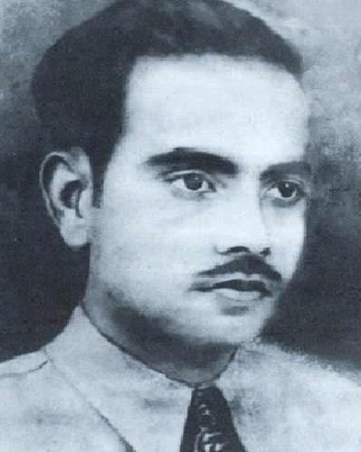
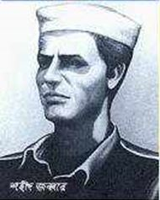
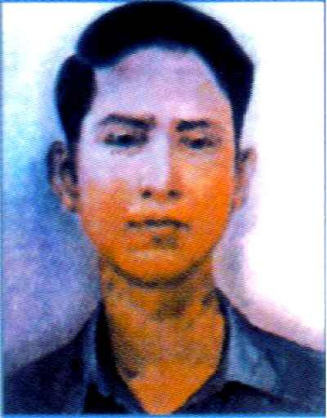
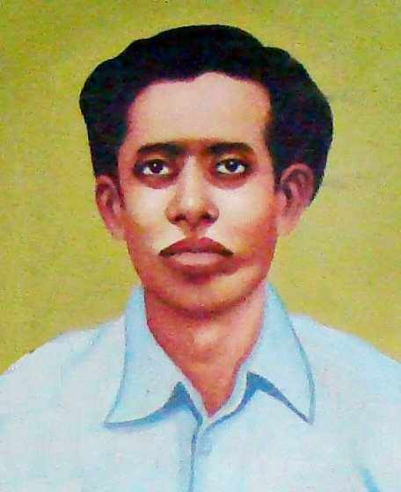
Let's know the history of the language movement
Police opened fire on students who were protesting for Bangla language.
Salam, Barkat, Rafiq, Jabbar, Shafiur and many others were killed in police firing.

Slide 13
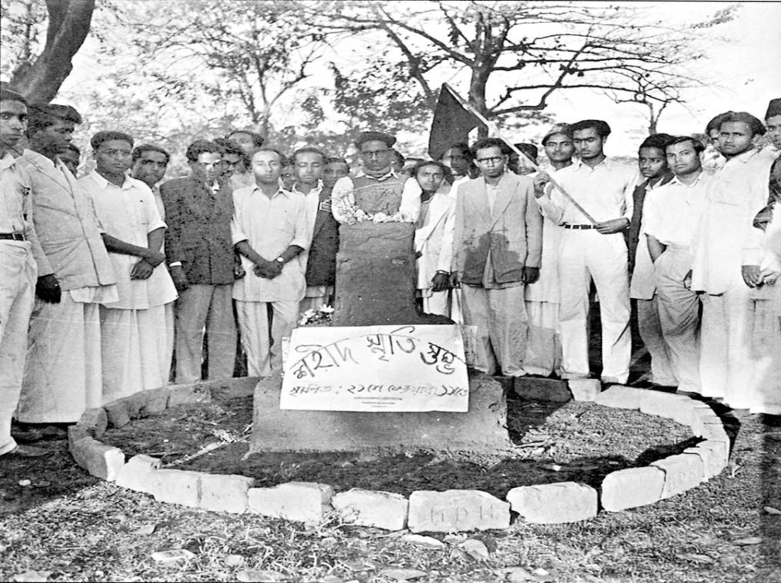
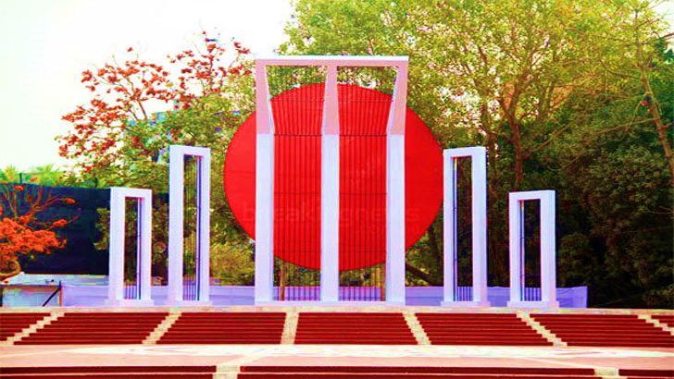
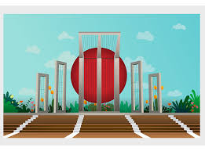
Let's know the history of the language movement
This is the central Shaheed Minar.
As a result of the language movement, both Bangla and Urdu gained the status of the official language of Pakistan.

Slide 14
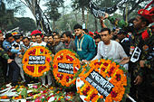
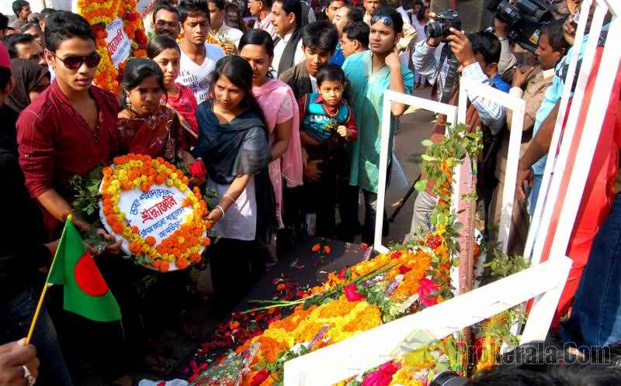
Follow the pictures
People are paying homage to the language martyrs.

Slide 15
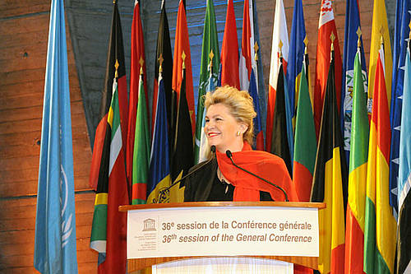
Follow the pictures
Announcement of 1999 of 17 November 21 February as The International Mother Language Day.

Slide 16
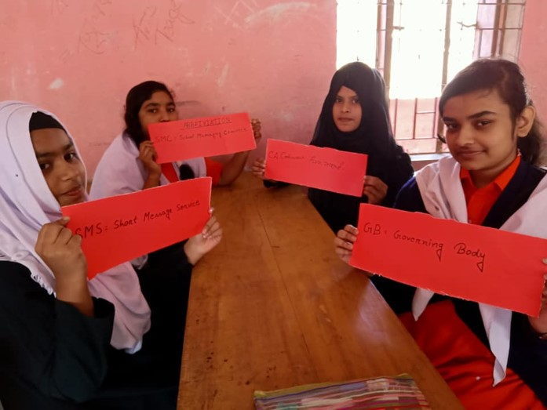
Group work
Write a summary of the text in your own words.

Slide 17
Evaluation
Answer is right
1.The than Government--all sorts of public meeting to prevent the protest?
a. permitted
b. agreed
c. allowed
d. banned
2.What does the word “climax” mean in the passage?
a.The most exciting point in time
b.The most exciting point in time
c. Natural situation
d. Success
3. The protest against the declaration of Jinnah was going on---
i. powerfully
ii.slowly
iii.contiously
Which of the following is correct?
a. i
b. ii
c. i & iii
d. i, ii & iii

Slide 18
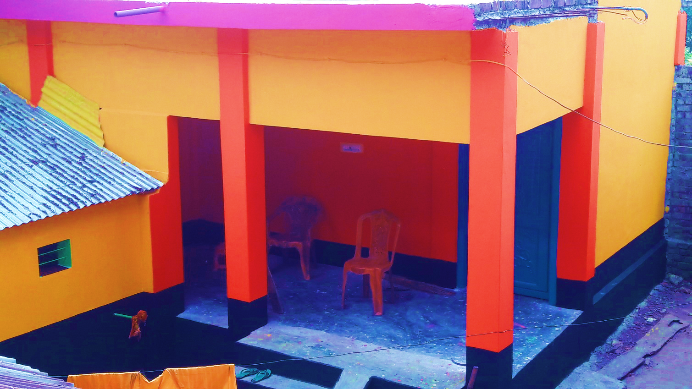
Home work
Home Work
Write briefly how you will observe this year 21 February at your Madrasha?

Slide 19
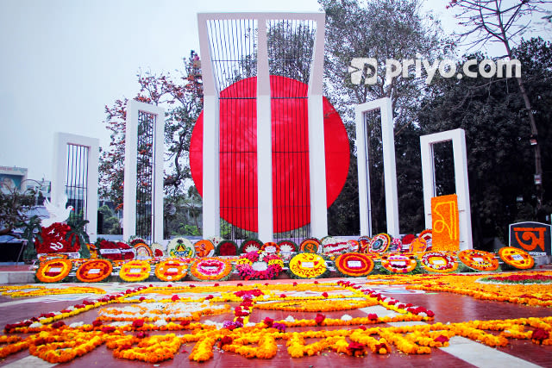
Thank’s to all

