Slide 1
পাঠ পরিচিতঃ লগারিদম
শ্রেণীঃ নবম/দশম
অধ্যায়ঃ চতুর্থ
4.2
উদাহরণঃ ০৯

Slide 2
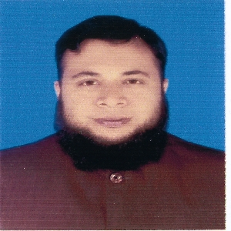
আজকের ক্লাসে সবাইকে স্বাগতম

Slide 3
পাঠ পরিচিতঃ লগারিদম
শ্রেণীঃ নবম/দশম
অধ্যায়ঃ চতুর্থ
4.2
উদাহরণঃ ০৯

Slide 4

সমাধানঃ
$$\frac{\log_{10}{\sqrt{27}+}\log_{10}{8−}\log_{10}{\sqrt{1000}}}{\log_{10}{1.2}}$$
$$=\frac{\log_{10}{\sqrt{27}+}\log_{10}{\sqrt{?}}−\log_{10}{\sqrt{1000}}}{\log_{10}{1.2}}$$
64
8

Slide 5


= $\frac{\log_{10}{\sqrt{27}+}\log_{10}{\sqrt{64}−}\log_{10}{\sqrt{1000}}}{\log_{10}{1.2}}$
$\sqrt{x}$=$x^{\frac{1}{2}}$
$$\sqrt{x^{3}}={\left(x^{3}\right)}^{\frac{1}{2}}$$
=$x^{\frac{3}{2}}$
$$\sqrt{3^{3}}=3^{\frac{3}{2}}$$
27=3$×$3$×$3
27=${ 3}^{3 }$
$$=\frac{\log_{10}{\sqrt{3^{3}}+}\log_{10}{\sqrt{4^{3}}}{−log}_{10}{\sqrt{{10}^{3}}}}{\log_{10}{1.2}}$$
=$\frac{\log_{10}{3^{\frac{3}{2}}+\log_{10}{4^{\frac{3}{2}}−}\log_{10}{{10}^{\frac{3}{2}}}}{.}}{\log_{10}{1.2}}$

Slide 6
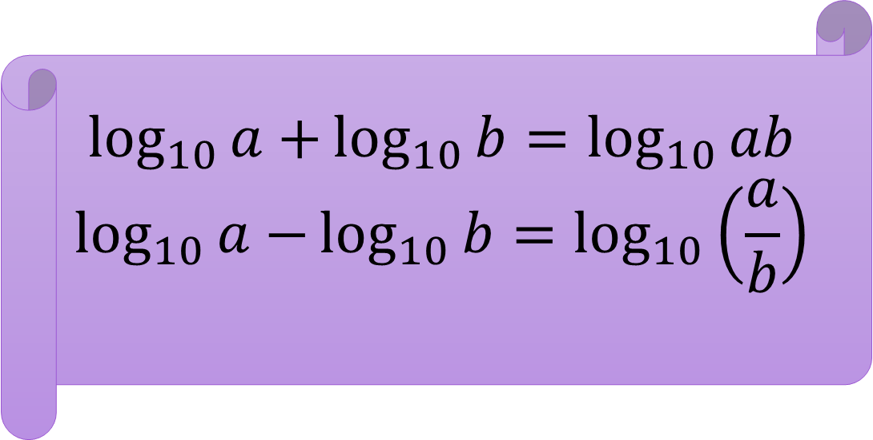
$$=\frac{{\frac{3}{2}log}_{10}{3+}\frac{3}{2}\log_{10}{4}−\frac{3}{2}\log_{10}{10}}{\log_{10}{1.2}}$$
= $\frac{\frac{3}{2}\log_{10}\left(\frac{3×4}{10}\right)}{\log_{10}{1.2}}$
$$\log_{10}{a+}\log_{10}{b}=\log_{10}{ab}$$
$$\log_{10}{a−}\log_{10}{b}=\log_{10}\left(\frac{a}{b}\right)$$

Slide 7
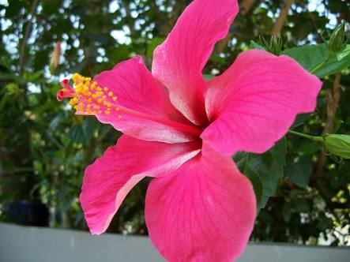
= $\frac{\frac{3}{2}\log_{10}\left(\frac{12}{10}\right)}{\log_{10}{1.2}}$
= $\frac{\frac{3}{2}\log_{10}\left(1.2\right)}{\log_{10}{1.2}}$
= $\frac{3}{2}$
(Ans.)

Slide 8
Thank you
For watching

