Slide 1
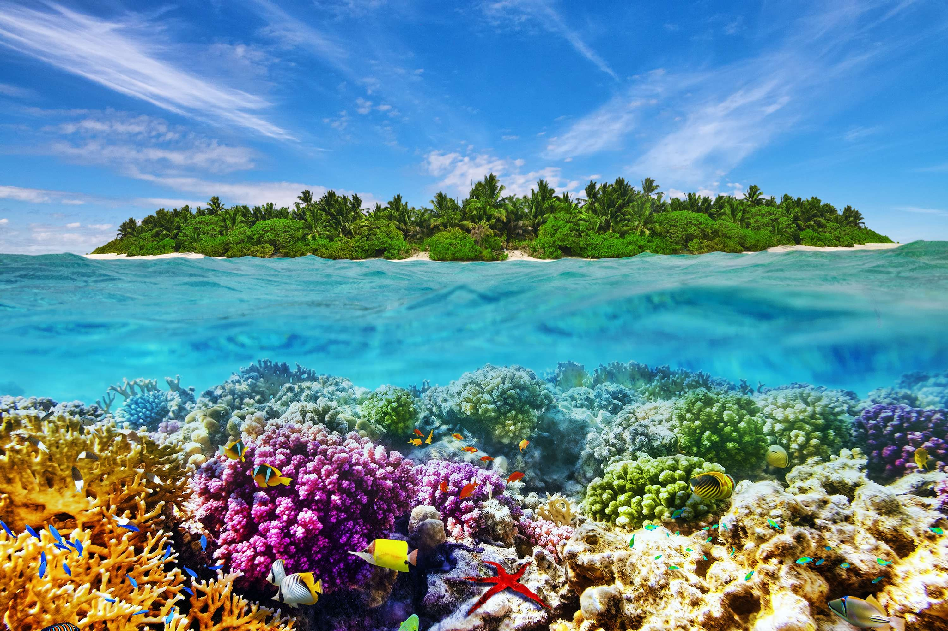
Welcome to all.

Slide 2
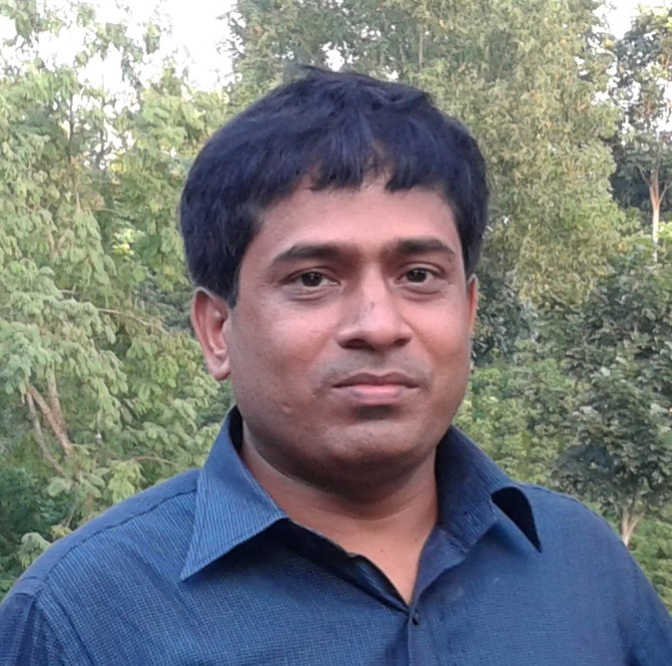
Conducted by
S. M. Monirul Islam
Assistant teacher in English
Govt. Model Secondary School,
Khulna Sadar, Khulna-9100,
Phone – 01711-397 309
E-mail: monirmodel@gmail.com
Subject : English 1st Paper
Class – IX-X,
Sunday, November 24, 2019
2:35:33 PM

Slide 3
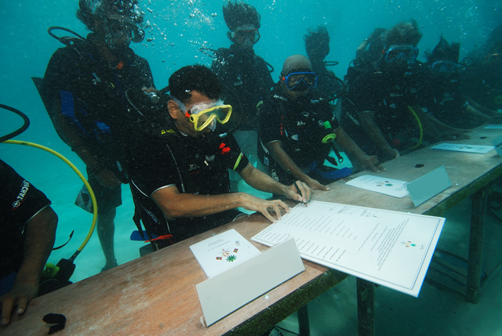
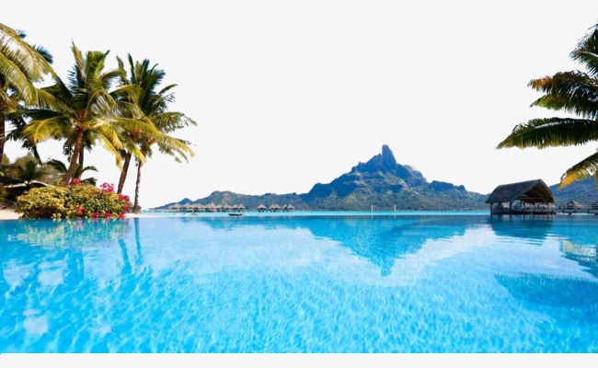
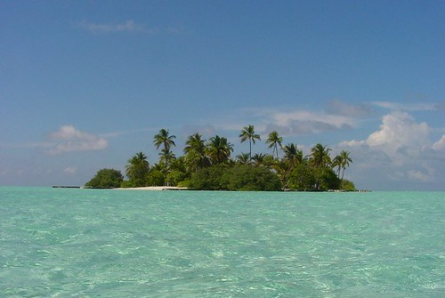
Let’s see some pictures.

Slide 4
A: Discuss the questions in pairs.
1. Did you ever visit any island or see any island on TV?
2. Have you ever heard of a coral island? Is there any coral island in Bangladesh?
3. What do you know about the Maldives?

Slide 5
Please click here to go to the link to enjoy the video.

Slide 6
Our lesson -
The Maldives
Unit : VI
[Our Neighbours]
Lesson : 3

Slide 7
Learning outcomes
After the students have studied this lesson, they will be able to
read, comprehend and summaries texts.
ask and answer questions.
write letters to friends describing places of interest.

Slide 8
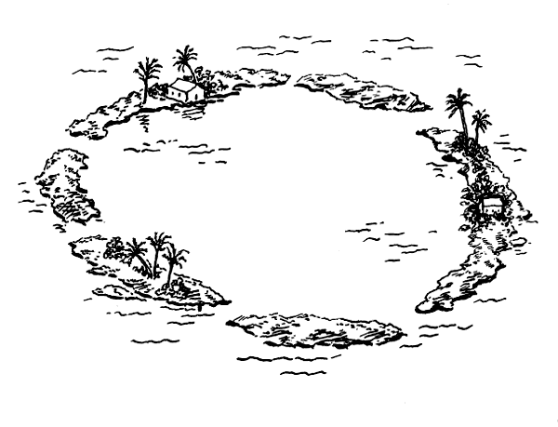
Atoll (N)
Vocabulary
Meaning:
A ring shaped coral island, reef or chain if islands.
Syn.= isle, reef,

Slide 9
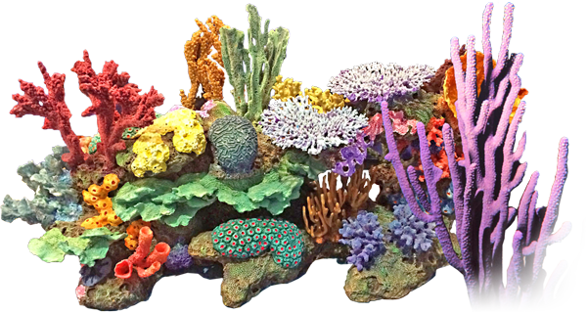
Reef (N)
Meaning:
A line of rocks or sand near the surface of the see.
Syn.= isle, reef,

Slide 10
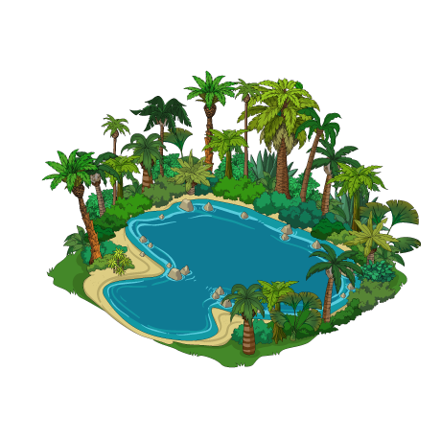
Lagoon (N)
Meaning:
A lake that contains sea water.
Syn.= lake, pool,

Slide 11
B: Now read the text and answer the questions that follow.
1. What is an atoll?
2. How many countries in the world are smaller than the Maldives in size?
2. How many countries in the world are smaller than the Maldives in size?
3. When was Islam introduced in the Maldives?
4. What makes the Maldives an ideal place for the tourists?
5. What dangers of climate change might affect the Maldives?
6. Do you support the idea of having a cabinet meeting underwater? What could be the reason for holding such a strange meeting?
TEXT

Slide 12
The Republic of Maldives is an island country in the Indian Ocean. It has 1199 islands that are clustered into 26 major atolls. An atoll is a ring-shaped coral reef or a string of closely spaced coral islands. The natural coral reefs of Maldives surrounded by lagoons make each island stand out as a pearl in the Indian Ocean. The Maldives stand at eighth position amongst the smallest countries in the world with an area of 300 square kilometres only. It is also the smallest Asian country with respect to population and size.
People have been living on the islands of the Maldives from as long as 3000 years ago. They set sail from different parts of the world- Asia, Arabia, Europe and the Americas- to come to these islands. The earliest settlers of the Maldives were probably from southern India and Sri Lanka who came to these islands in the fourth and fifth centuries BC. In the 12th century AD, sailors from East Africa and Arab countries came to the Maldives. As a result, the Maldivians who were originally Buddhists were converted to Sunni Islam in the mid-12th century. In 1344 Ibn Batuta, a famous Arab historian and scholar travelled around the Maldives.
In the 16th century, the Portuguese conquered the Maldives and they ruled the country for 15 years. Although governed as an independent Islamic sultanate for most of its history from 1153 to 1968, the Maldives was a British colony from 1887 to 1965. Following independence from Britain in 1965, the sultanate continued to operate for another 3 years. On November 11, 1968, it was abolished and replaced by a republic and the country assumed its present name.

Slide 13
The Maldives is famous as a tourist destination because of its enjoyable weather, heavenly beaches and lagoons, luxurious holiday resorts and the peace-loving people. Being an island country, it enjoys a pleasant weather throughout the year. The Maldives has been ranked as the best country brand for beach, rest and relaxation in 2008.
The Maldives is well known for being the lowest country in the world. Unfortunately, this small country with idyllic natural beauty is under threat from rising sea levels due to global warming. Most of the country is just 1.5 metres above sea level with a highest point of 2.3 metres! Many predictions have been made with respect to Maldives being swept away by the rising water level in the Indian Ocean. It was even seen during the tsunami of2004, that many of the island's dry parts were flooded by waters shrinking the island. The government of the Maldives has begun to purchase land from nearby countries in case the islands go under water! In order to highlight the threats of global warming to its low lying islands, the government of Maldives held a cabinet meeting underwater in 2009. That was the first ever cabinet meeting in the world that took place underwater. The meeting took place about 5 meter underwater, in a blue-green lagoon on a small island. While underwater, the cabinet signed a document calling on all nations to cut their carbon emissions.
BACK

Slide 14
D: Complete the table with no more than two words and/or numbers.
Time | Facts
4th and 5th centuries BC | The early inhabitants of the Maldives arrived and settled from Southern India and Sri Lanka.
12th Century | The sailors from African and Arab countries started to settle in the islands. Buddhism was --- --- --- --- by Islam.
--- --- --- --- | A famous scholar and historian named Ibn Batuta visited the islands of the Maldives.
16th century | the Portuguese occupied the Maldives and they became the --- --- --- of the country for 15 years.
1887 | Beginning of the British --- --- --- era.
--- --- --- | Maldives became independent from the British rule.
1968 | End of Islamic sultanate and --- --- --- of the Republic of Maldives.
replaced
1344
ruler
colonial
1965
the birth

Slide 15
E: Say if the statements are true or false. Give the true information in case of a false statement.
Group Work
Answer to the question no-1:
True
1. Only seven countries in the world are smaller in size than the Maldives.
2. No other South Asian countries has a smaller population than that of the Maldives.
Answer to the question no-2:
True
Answers on-3: False. People began to live here from 4th to 5th BC.
3. The islands of the Maldives were inhibited in the 12th century.
4. The Maldives was an independent Islamic sultanate from 1153 to 1968.
Answers on-4: False. From 1887 to 1965, it was a British colony.
Answers on-4: False. The Maldives was ranked as the best country for beautiful beaches and facilities for recreation in 2008.
5. The Maldives was ranked as the second best country for natural beauty in 2008.

Slide 16
HOME WORK
Write a letter to your friend describing the present situation of Maldives.

