Slide 1
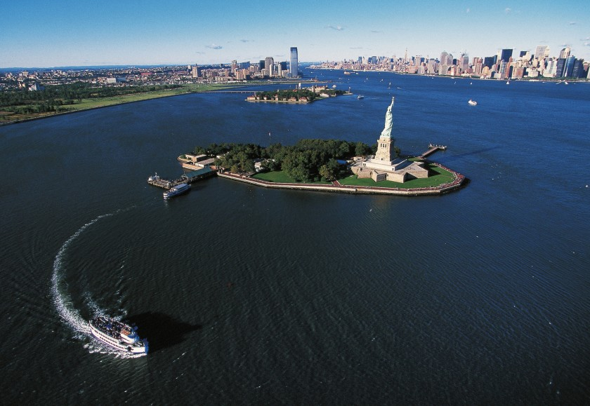

Slide 2
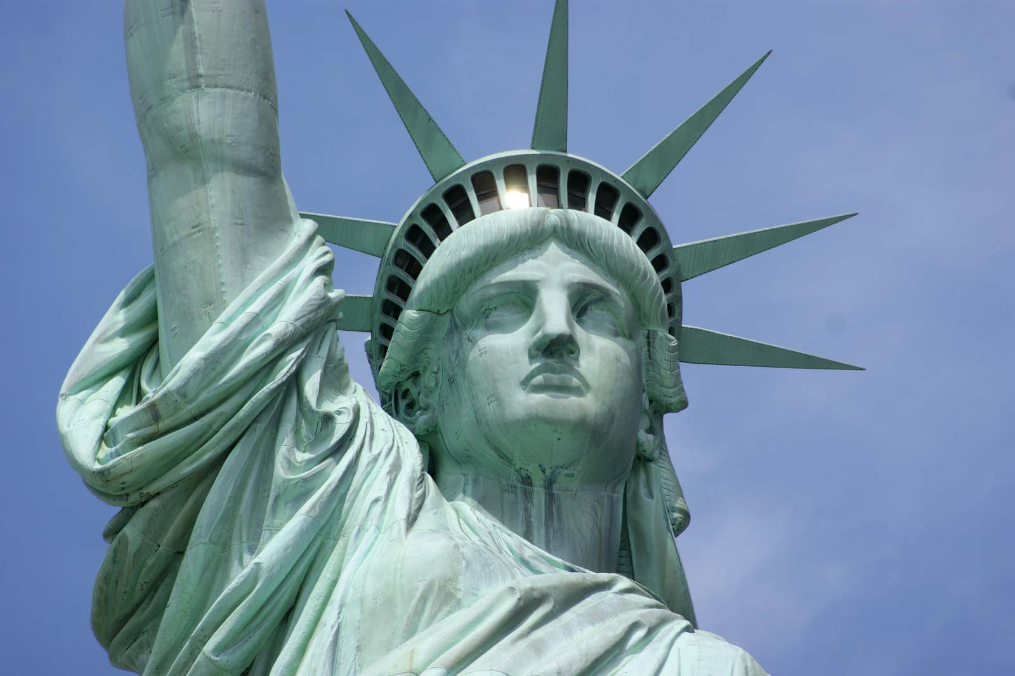
Welcome to all.

Slide 3

INTRODUCTION
S. M. MONIRUL ISLAM
Assistant Teacher in English
Govt. Model Secondary School, Khulna-9100
monirmodel@gmail.com
Mobile: 01711-397 309
Friday, May 1, 2020

Slide 4
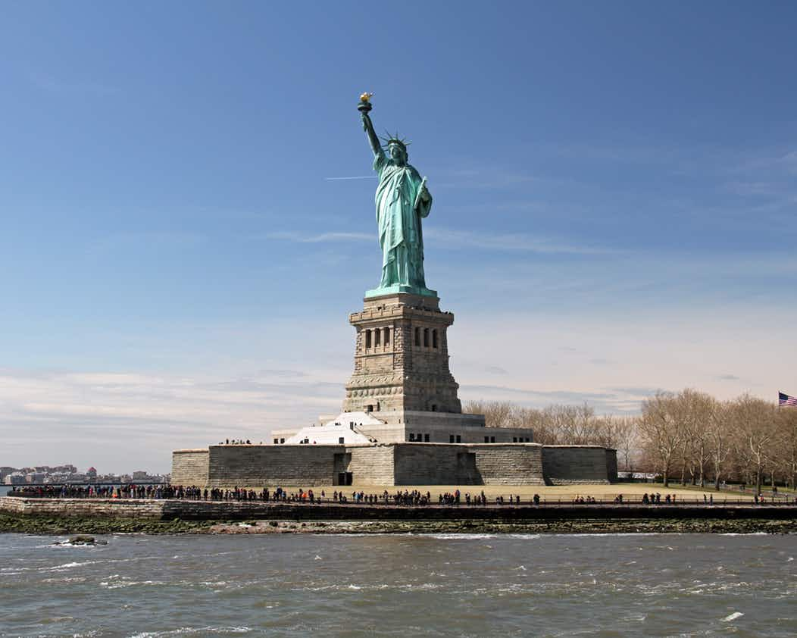
A: Look at the following pictures.

Slide 5
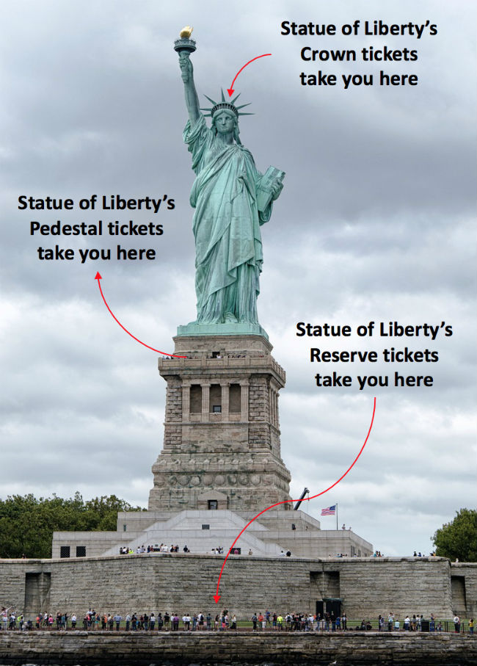

Slide 6
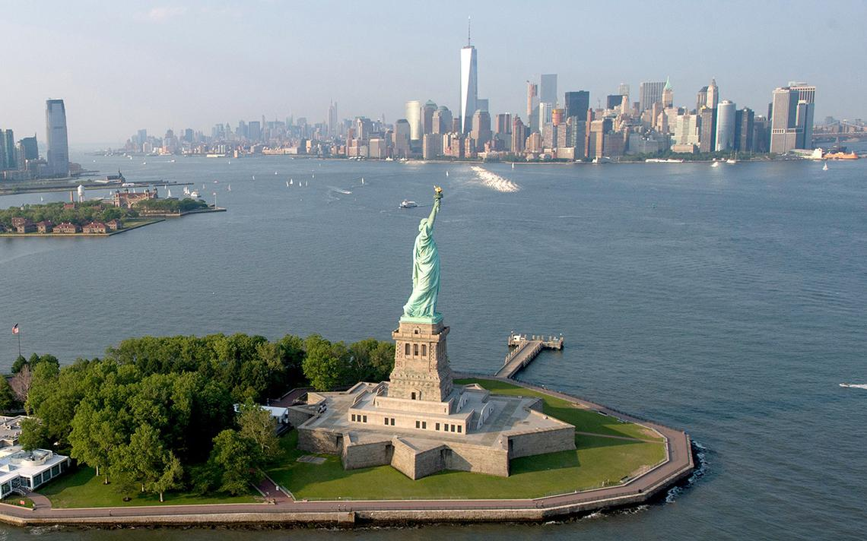

Slide 7
Let us watch the video.
Click here to watch the video from INTERNET.

Slide 8
A: Now talk about it in pairs.
1. Do you know what it is?
2. Discuss what stands out in the picture?
3. Do you think it is a man or a woman?

Slide 9
So, our topic is-------
The Statue of Liberty
Unit : VIII
[World Heritage]
Lesson : 3

Slide 10
Learning outcomes
After the students have studied the lesson, they will be able to --- ---
summarize the context,
tell meaning of the new words,
complete the chart given below the text,
write about a mosque using a photo and clues.

Slide 11

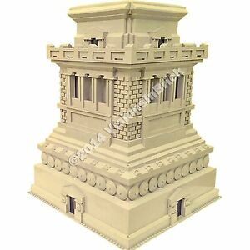
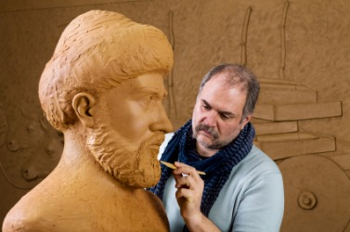
To bring together
Assemble
Vocabulary
The base that a column or statue rests on
Pedestal
A person who makes sculpture
Sculptor

Slide 12
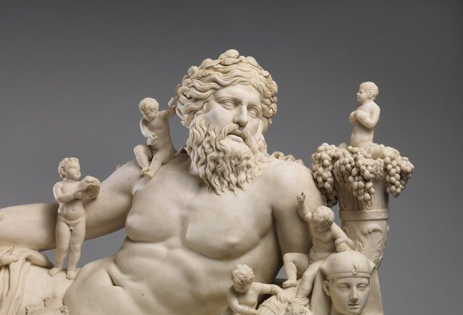
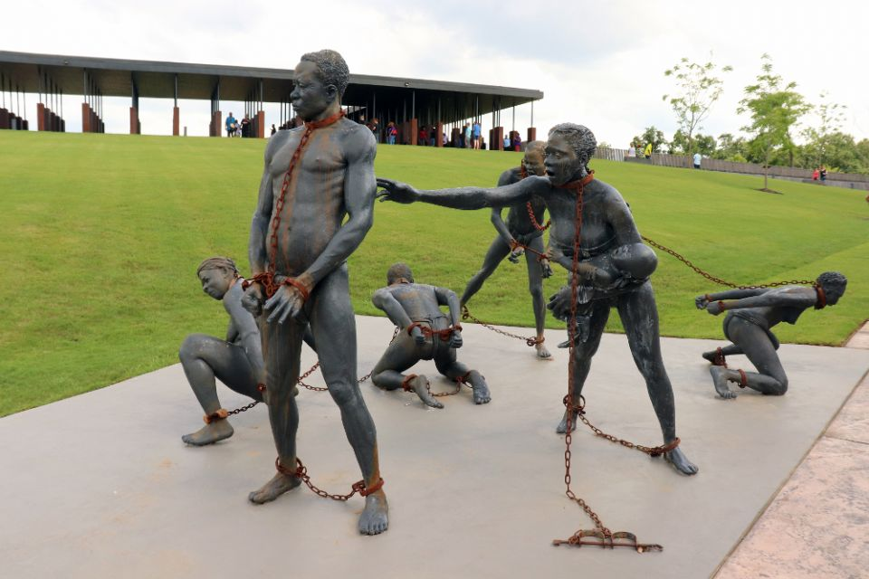
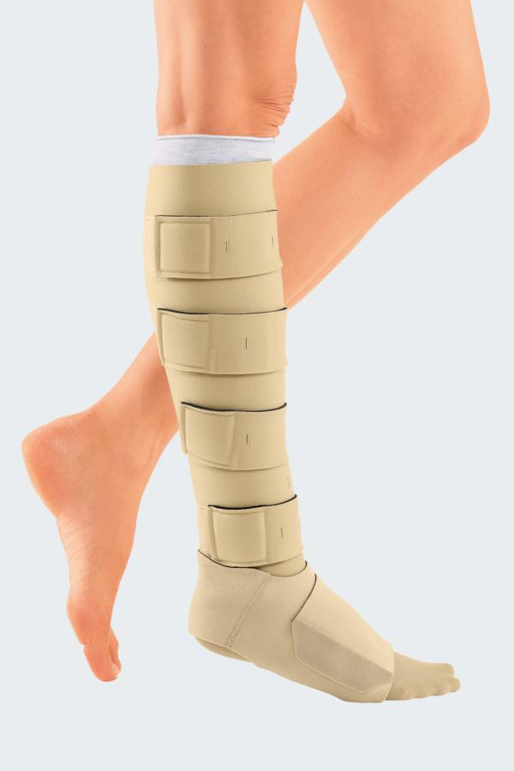
Sculpture
A figure or object made by shaping wood, stone, metal etc.
Slavery
The state of being a slave
Wrap
To cover something in paper/materials

Slide 13
B: Read the following questions first.
1. Where is the Statue of Liberty situated?
2. Which country gave the statue as a gift?
3. The gift was meant for which country?
4. On what occasion was it given?
5. When was the statue given?
6. What does the statue represent?
Now listen to the audio about the Statue of Liberty and answer the above questions.

Slide 14
C: Listen to the text again and complete the chart.
Statue of Liberty | Information
Situated
artist
gift from
reason for the gift
presented on
Occasion
the statue symbolizes
framework made of
amount of copper used
weight
year of UNESCO World Heritage Site

Slide 15
D: Read the text and answer the following questions.
The French Sculptor Fredic Auguste Bartholdi was assigned --- --- --- access to the web cam’s live feed of The Statue of Liberty from anywhere in the world.
1. On what occasion did the French government give the Statue of Liberty to the USA?
2. When did she reach her destination?
3. How was she transported?
4. How has new technology made it possible for people to see the statue from anywhere they are?
5. What do you understand by the expression ‘enlightening the world’?
EVALUATION
Go to TEXT

Slide 16
The French Sculptor Fredic Auguste Bartholdi was assigned to design and complete a sculpture Liberty Enlightening the World within 1876, so that it could be a gift for the Americans on the occasion of celebrating the hundred years of the American Declaration of Independence. The statue was a joint venture between the USA and France. The French people would build the statue and assemble it in the States, and the people of the USA were to build the pedestal for the statue.
Raising money for the pedestal was completed in August 1885. The construction of the pedestal was finished in April 1886. In the meantime, France completed the Statue in July 1884. They sent it to New York on board the French war ship ‘Isere’ in 1885. While transporting the statue, it was split up into 350 individual pieces and packed in 214 crates.
It took four months to put the Statue together and place it on the pedestal. Thousands of people saw the unveiling ceremony of the Statue of Liberty on October 28th 1886. It was centennial gift ten years late.

Slide 17
The Freedom that the Statue stands for is not stationary. The broken chain wrapped around her feet, protruding from the bottom of her robe, symbolizes her free forward movement, enlightening the world with her torch, free from oppression and slavery.
The Statue's original torch was the first part constructed in 1876. It was replaced by a new copper torch covered in 24K gold leaf in 1984. The torch is lighted by flood light at night. The original torch is currently located in the lobby of the monument. Access to the torch has been closed since 1916.
From October 28, 2011, on her 125th anniversary, the Statue of Liberty was named “Liberty Enlightening the World Wide Web”. The credit goes to a series of new web cams placed around her torch. Several amazing views will be just a click of a mouse away. On clear days, three cameras provide unobstructed scenes and views. Two cameras provide an ultra wide-angle interactive view of the famous golden torch. The remaining camera looks downwards towards the crown of The Statue of liberty, her face, the tablet she is holding from your computer or smart phone. So a person can have access to the web cam’s live feed of The Statue of Liberty from anywhere in the world.
BACK

Slide 18
Fill in the gaps with appropriate words in the gaps.
Prominent French artist Frederic Auguste Bartholdi was assigned --- --- --- - a sculpture as a gift for the Americans. He designed a sculpture as a --- --- --- of freedom of mankind. The copper was made in the form of the Roman goddess Liberatas who would carry a torch and a --- --- of law. The work was a joint venture. The French built the body and the USA built the --- --- --- . It is now located in the --- --- --- of New York and it is now called ‘The Liberty Enlightening the World Wide Web’.
to design
symbol
book
pedestal
harbour

Slide 19

Summarize the given text in not more than 150 words.
H
Om
e Wo
R
k

Slide 20

Thank you all.

