Slide 1
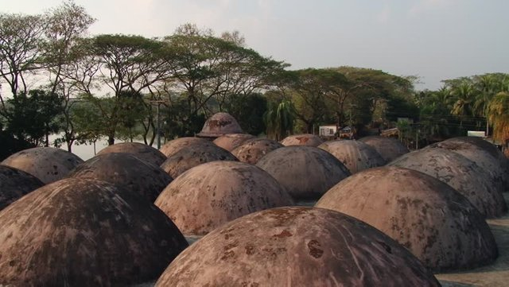

Slide 2
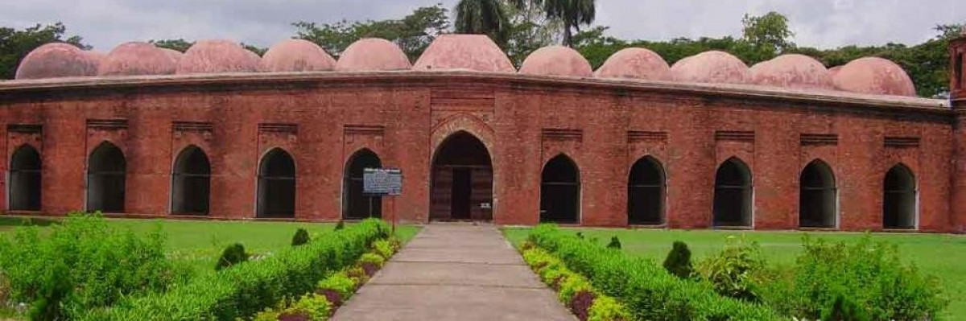
Welcome to all.

Slide 3

INTRODUCTION
S. M. MONIRUL ISLAM
Assistant Teacher in English
Govt. Model Secondary School, Khulna-9100
monirmodel@gmail.com
Mobile: 01711-397 309
Friday, May 1, 2020

Slide 4
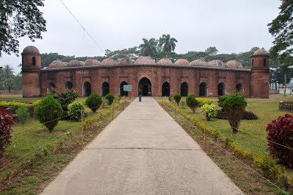
A: Look at the following pictures.

Slide 5
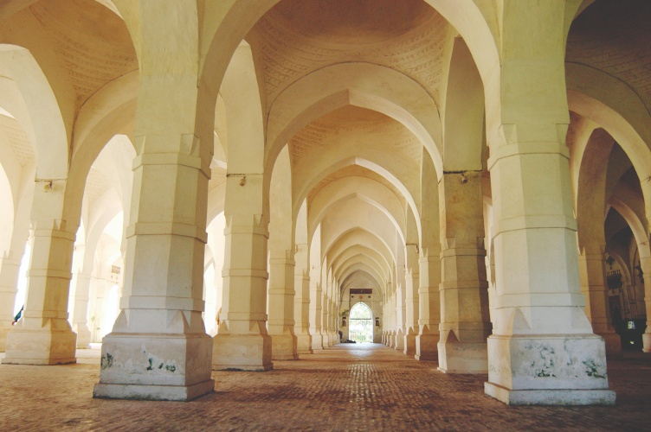

Slide 6
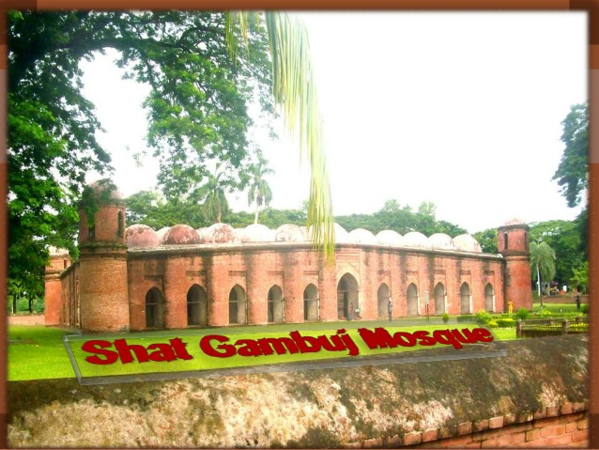

Slide 7
Let us watch the video.
Click here to watch the video from INTERNET.

Slide 8
The Shat Gambuj Mosque
Unit : VIII
[World Heritage]
Lesson : 1

Slide 9
Learning outcomes
After the students have studied the lesson, they will be able to --- ---
describe the Shat Gambuj Mosque from a picture,
tell meaning of the new words,
complete the chart given below the text,
write about a mosque using a photo and clues.

Slide 10
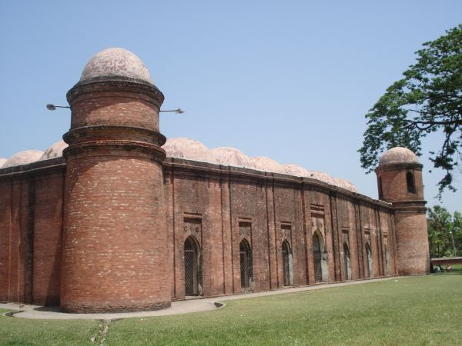
Look at the picture .Work in pairs .talk about the picture and ask and answer the following questions.
5 minutes
What is this building?
Ans. I think, this is the Shat Gambuj Mosque.
2. Do you have a building like this in your town/ village?
Ans. Yes. But it does not have so many domes.
3. What do we call it ?
Ans. we call it mosque.
4. What is it used for?
Ans. It is used for saying prayers.

Slide 11
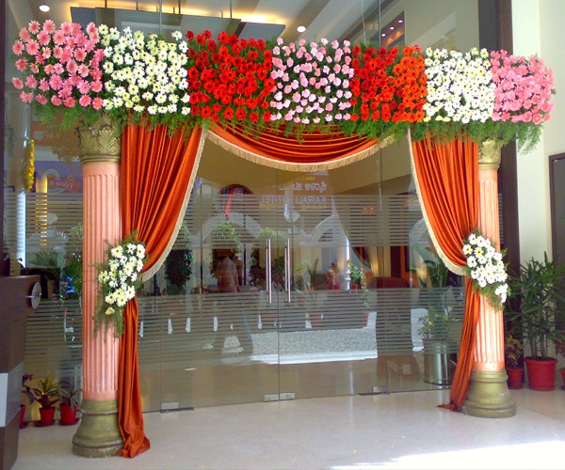

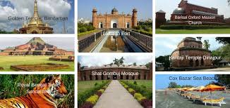
Beautification
Decoration
Vocabulary
Inherit
Succession
Heritage
Tradition

Slide 12
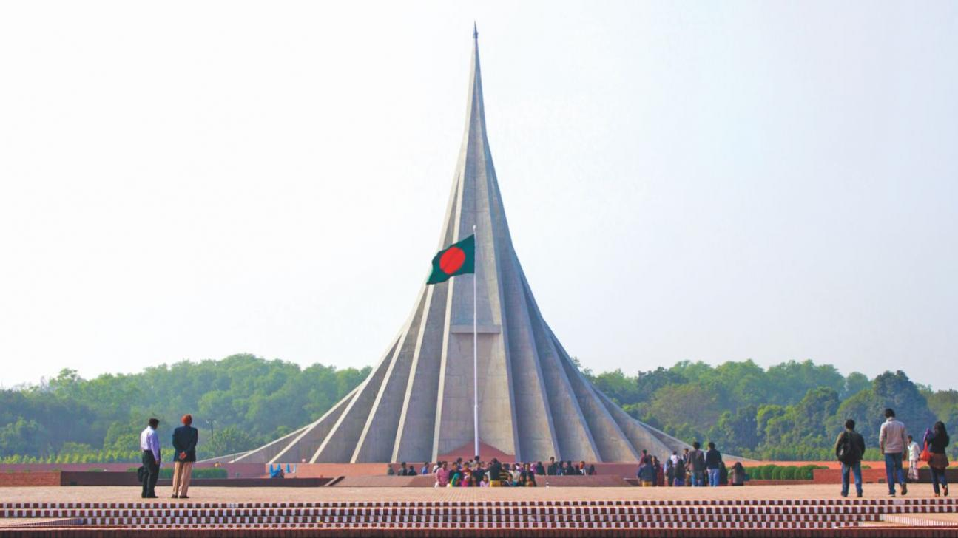
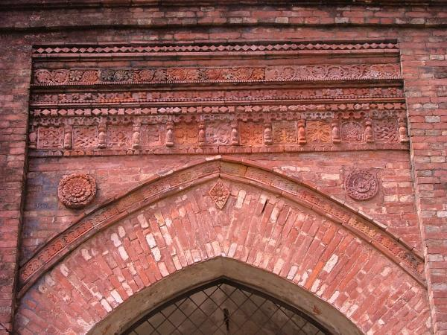
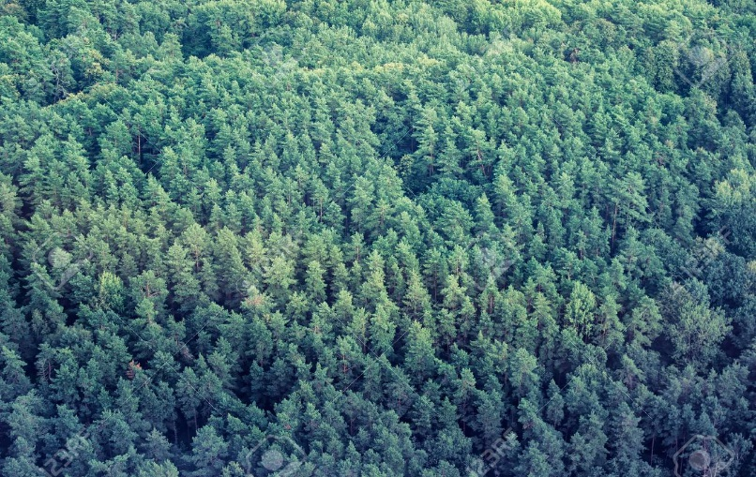
Monument
Memorial
Backed reddish-brown clay
Terracotta
Dense
Thick

Slide 13
Read the text silently and complete the chart given after it . (individual work). 15 minutes
‘Heritage’ is what we inherit from the past, live with in the present and then pass on to our children or future generation.----------------------------------------------------------
Besides being used as a prayer hall, Khan Jahan used the mosque as his court also. Today, it is one of the greatest tourist attractions and one of the best architectural beauties of Bangladesh.
TEXT

Slide 14
‘Heritage’ is what we inherit from the past, live with them in the present and then pass on to our children or future generation. Our unique source of life and inspiration is our cultural and natural heritage. When we speak of ‘World Heritage’, it indicates places and sites that we got from the past and pass on to the future generation of the entire world.
The ‘Shat Gambuj Mosque’ in Bagerhat is such a heritage. It became a UNESCO World Heritage Site in 1985.
Originally, the historic Mosque City was known as ‘ Khalifatabad’. It is situated at the outskirts of Bagerhat town--- not very far from the dense mangrove forest of the Sundarbans. Khalifatabad was a Muslim colony. It was founded by the Turkish general, a saint warrior Ulugh Khan Jahan in the 15th century. The infrastructure of the city reveals significant technical skills in many mosques as well as early Islamic monuments. Baked bricks are used for the construction of the buildings. The planning of the city is distinctly dominated by Islamic architecture and the decorations are a combination of Mughal and Turkish architecture.

Slide 15
Khan Jahan built a network of roads, bridges, public buildings and reservoirs to make the city habitable. There are about 360 mosques in the city. Among them the most remarkable is the multi-domed Shat Gombuj Mosque. The mosque is unique in the sense that it has 60 pillars that support the roof, with 77 low height domes. The 4 towers at 4 corners have smaller domes on the roof as well. The vast prayer hall has 11 arched doorways on the east and 7 each on the north and south for light and ventilation. It has 7 aisles running along the length of the mosque and 11 deep curves between the slender stone columns. These columns support the curving arches created by the domes. The thickness of the arches is 6 feet and have slightly narrowing hollow and round wall. The west wall in the interior has 11 ‘mihrabs’ (niche in mosque pointing towards Makkah). These mihrabs are decorated with stonework and terracotta. The floor of the mosque is made of brick.
Besides being used as a prayer hall, Khan Jahan used the mosque as his court also. Today, it is one of the greatest tourist attractions and one of the best architectural beauties of Bangladesh.
BACK

Slide 16
Complete the chart
Shat Gambuj Mosque | information
Founded by
When
Number of domes
Number of pillars
Arches
Thickness of the arches
Mihrabs
Khan Jahan Ali
In the 15th century.
77
60
25
6 feet
11

Slide 17
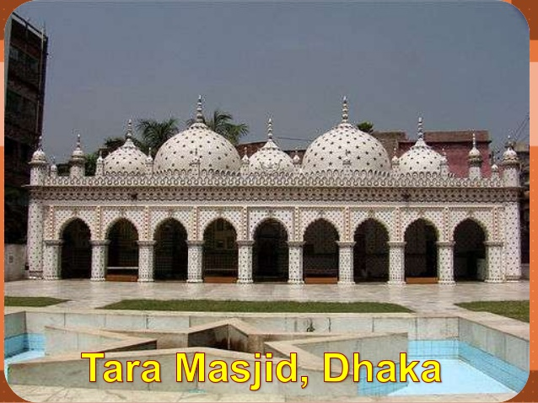
Look at the picture and read the information and write a description of the mosque with the help of given clues. Your time 15 munites.
Location: Dhaka Abul Khairat Road
Style: Mughal
Materials: chinaware and white cement.
Built by:Mirza Ghulam Pir- a respectable Zamindar of Dhaka
Number of domes:5
Time: early 18th century
Interior of the mosque: mosaic floor, floral tiles on the wall.
Decoration: different sizes of stars on domes and wall.

Slide 18
C. Answer: the star Mosque which is an architectural beauty of Mughal, is situated at Abul Khairat Road in Dhaka. It has five domes. There are different sizes of stars on domes and outside wall. Chinaware and white cement are used to building it. It has mosaic floor and floral tiles on the wall. This mosque was built by Mirza Gulam Pir, a respectable Zaminder of Dhaka. It was built in the early 18th century.

Slide 19
Evaluation time :5 minutes
What is heritage?
Why did Khan Jahan Ali do to make the city livable?
Why is Shat Gambuj Mosque a world Heritage Site?

Slide 20
Home work
Write a paragraph in ten sentences describing your local mosque.

Slide 22

Thank you all.

