Slide 1

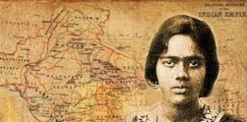
Welcome to all.

Slide 2
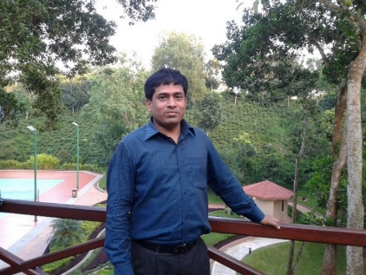
INTRODUCTION
S. M. MONIRUL ISLAM
ENGLISH FOR TODAY
Class : IX-X
Assistant Teacher in English
Govt. Model Secondary School, Khulna-9100
monirmodel@gmail.com
Mobile: 01711-397 309
Friday, May 1, 2020

Slide 3
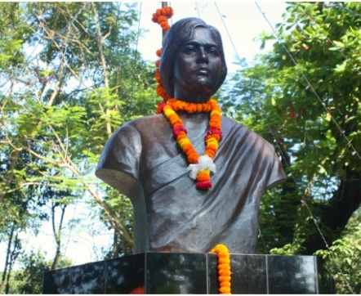
A: Look at the following pictures. Are you familiar with them?

Slide 4
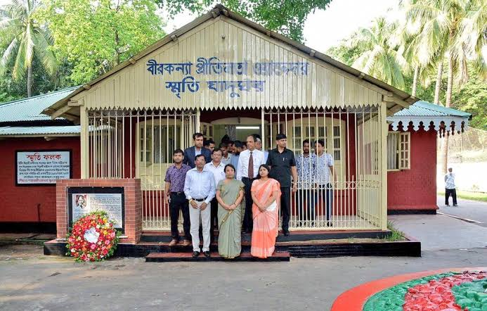

Slide 5
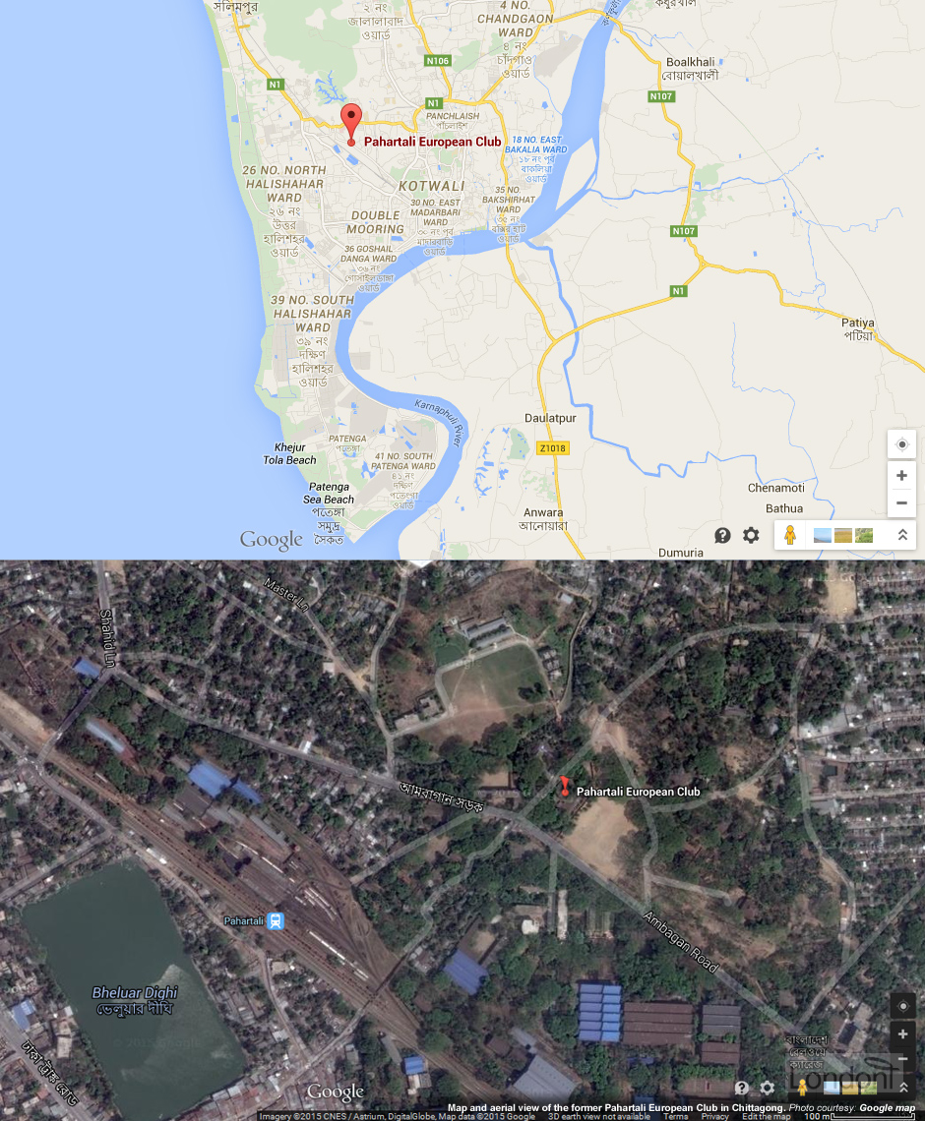

Slide 6
Let us watch the video.
Please click here to go to internet for watching Video.
Discuss with your partner how they are related to the field of our nationality.

Slide 7
They had Dreams 1
Unit : X
[DREAMS]
Lesson : 3

Slide 8
Learning outcomes
After the students have studied the lesson, they will be able to --- ---
participate in conversations and discussions.
exchange personal information.
understand and narrate problems.
take and give interviews.

Slide 9
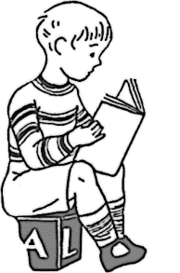



Slide 10
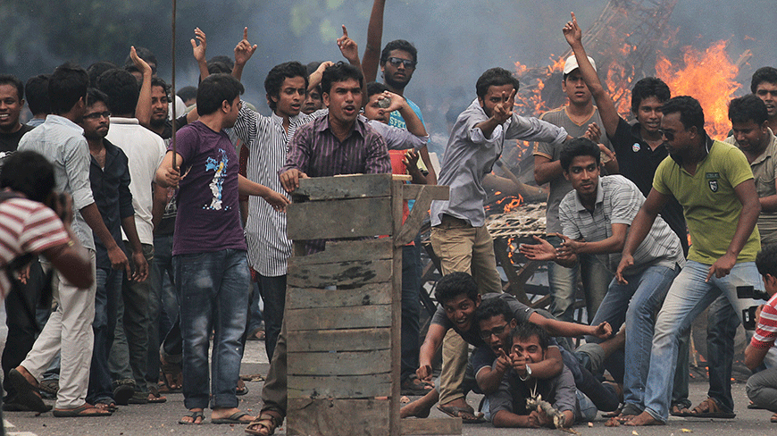
New Word
Movement
A group of people with the same belief of working together to achieve something
Syn.: agitation, commotion

Slide 11
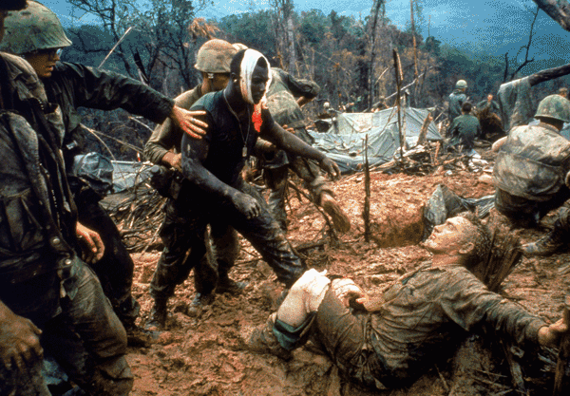
Combat
Fighting between armed forces
Syn.: battle, warfare,
Ant.: agreement, peace, harmony

Slide 12
A: Shanta was catting with one of her foreign friends Jenny. Read the dialogue and tell what the subject matter is in their conversation.
Jenny: Shanta, what’s your dream for future?
Shanta: To be a good human being at first and then work for my country. No matter whether I become a social worker, or an artist, or a professional.
Jenny: Wow! I really appreciate your ideas! By the way, Shanta, does anyone inspire you in your dreams?
Shanta: Definitely yes. I’m always influenced by the great personalities in our country and abroad. Whenever I read any great people’s biography, I try to understand how their dreams could help them to be what they have been.
Jenny: Would you please tell me about some of your favourite dreamers?
Shanta: Sure! Read the following texts to know about some dreamers in my country. They are my icons as well.

Slide 13
B: Open at page no. 134-135 from the text and read it to answer the questions that follow.
Pritilata was born in Chittagong on 5 May 1911. She was a meritorious student --- ----- --- --- --- --- --- --- --- --- --- --- --- --- --- --- --- --- --- --- --- --- British rule came to an end though she couldn’t see it during her lifetime.
GO TO TEXT

Slide 14
Pritilata was born in Chittagong on 5 May 1911. She was a meritorious student at Dr Khastagir Government Girls’ School in Chittagong and Eden College, Dhaka. She finally graduated in philosophy with distinction from Bathune College in Kolkata. In her college days, Pritilata was an activist in the anti British movement. All through her life, she dreamt of two things: a society without gender discrimination, and her motherland without British colonial rule.
So she received combat training to fight against the British rule. Soon after, Pritilata became the head teacher of Nandankanon Aparna Charan School in Chittagong. Gradually she involved herself in Surya Sen’s armed resistance

Slide 15
movement. Surya Sen was a famous anti-British movement organizer and activist in Cittagong area that time. In 1932, Surya Sen planned an attack on the Pahartali European Club. The club was well-known for its notorious sign Dogs and Indians not allowed. Surya Sen assigned Pritilata to lead a team of 10-12 men to attack the Club. The raid was successful but Pritilata dressed as a man failed to get out of the Club. She committed suicide by taking potassium cyanide to avoid arrest. She proved that women can work like men. She also proved that women too needed to be prepared to sacrifice their lives for freedom from the British colonial rule. Her dream came true. The British rule came to an end though she couldn’t see it during her lifetime.
GO BACK

Slide 16
C:Read the words in Column A and match them with the meanings in Column B.
Column A | Column B
graduated | a member of a certain social or political group
activist | fight
movement | took a university degree
gender discrimination | rule by another country
colonial rule | battle
combat | difference between male and female
gradually | slowly
resistance | give responsibilities
notorious | activities
assign | dishonourable
ANSWER

Slide 17
Column A | Column B
graduated | took a university degree
activist | a member of a certain social or political group
movement | activities
gender discrimination | difference between male and female
colonial rule | rule by another country over a weaker country
combat | Fight
gradually | slowly
resistance | battle
notorious | Dishonourable
assign | give responsibilities
GO BACK

Slide 18


Slide 19
D: Now answer the questions.
1. Where did Pritilata fight?
2. When did she fight?
3. Why did she fight?
4. What was Pritilata’s profession?
5. What do your learn from Pritilata’s life?

Slide 20
E: Now make questions from the substitution table and match the answers. One is done for you.
When Where What Why What Who How | was did | she graduate in? | On 5 May 1911.
 |  | Pritilata born? | In Chittagong.
 |  | assigned Pritilata to attack the club? | Philosophy.
 |  |  | To fight against the British rule.
 |  | Pritilata die? | For its notorious sign -Dogs and Indians not allowed.
 |  | the Pahartali European club famous for?
 |  |  | Surya Sen.
 |  | she born? | She committed suicide by taking potassium cyanide.

Slide 21
We can see the answers of the questions.
1. What did she graduate in?
-Philosophy.
On 5 May 1911.
2. When was Pritilata born?
-Surya Sen.
3. Who assigned Pritilata to attack the club?
-She committed suicide by taking potassium cyanide.
4. How did Pritilata die?
-For its notorious sign -Dogs and Indians not allowed.
5. Why was the Pahartali European club famous for?
In Chittagong.
6. Where was she born?

Slide 22
D: Choose the best answers.
1. Pritilata was born to be a/an
a) musician, b) activist,
c) society reformer, d) patriot,
2. She came of a/an ------- family.
a) political, b) royal, c) ordinary, d) ethnic,
3. Professionally she was a ------ .
a) doctor, b) philosopher,
c) combatant, d) teacher,
4. What is potassium cyanide?
a) A medicine, b) A poison,
c) An explosive, d) A cigar,
√ b) activist,
√ c) ordinary,
√ d) teacher
√ a) A poison

Slide 23

Every student will write a summary of the passage B in your own words.

Slide 24
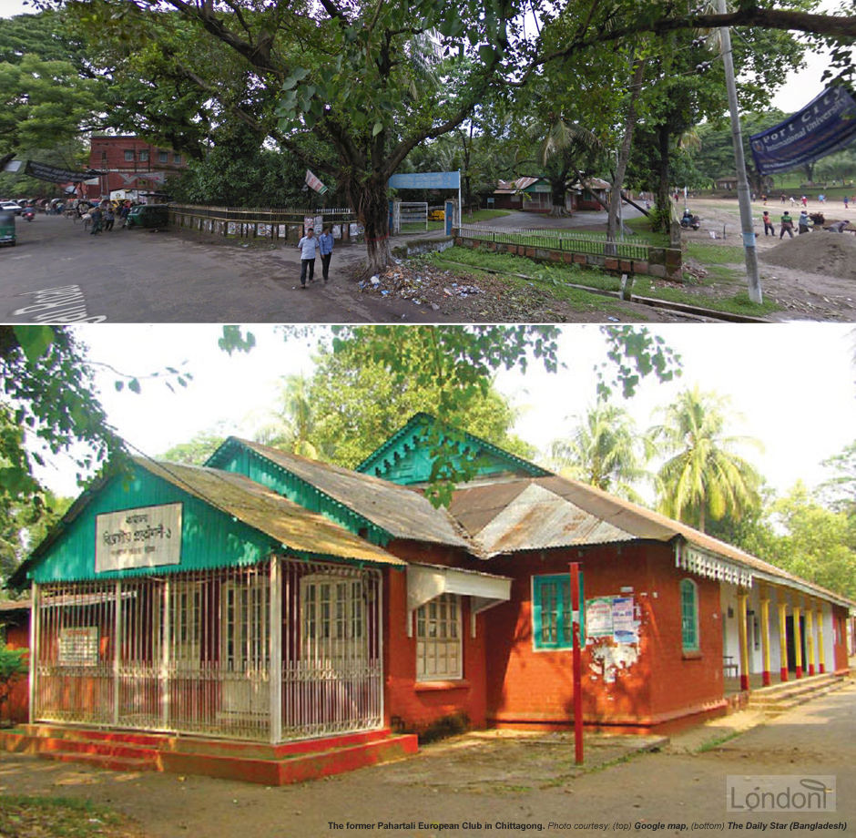
Thank you all.

