Slide 1
Everybody
Good morning

Slide 2
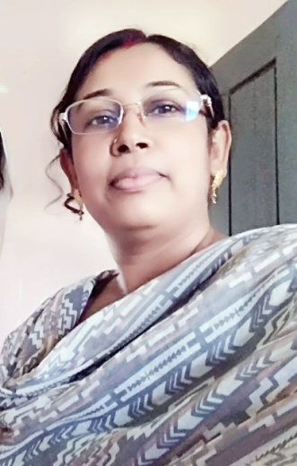
Kakali Tikader
Assist Teacher
Narail Town Govt Primary School
Narail Sadar Narail
shrabon01909@gmail.com

Slide 3
Class:Five
Unit:10, (My home district).
Lesson : 1-2
Part of the lesson :
(My home----Chandrabati.)
Time: 45 minute

Slide 4
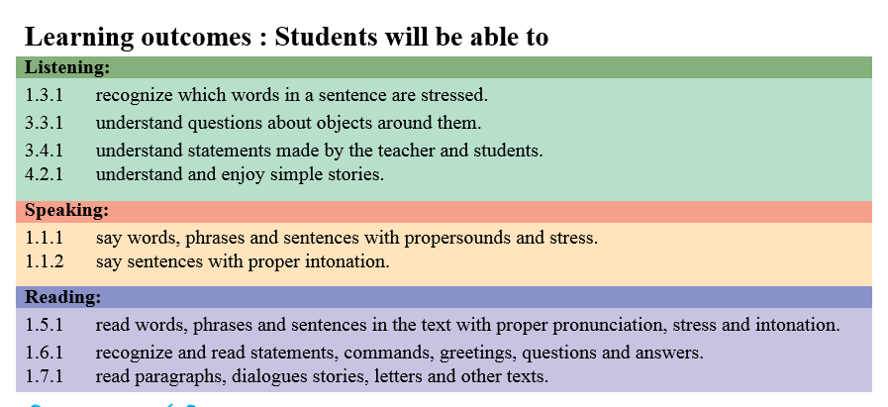
Learning outcomes

Slide 5
Teacher’s activities :Congenal environment :
Exchange greetings.
Teacher : How are you students ?
Students: Fine thank you teacher.
How are you teacher?
Teacher : I’m also fine. Thank you
Creat emotion : Morning song.

Slide 6
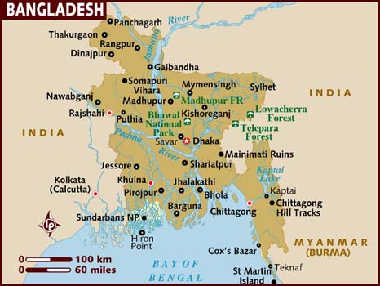
Look at the map .
Whole class work

Slide 7
Today we’ll read ‘My home district.’

Slide 8
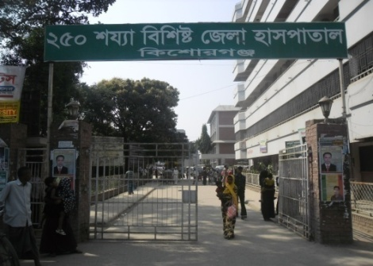
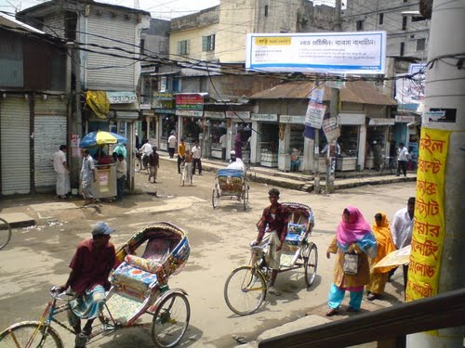
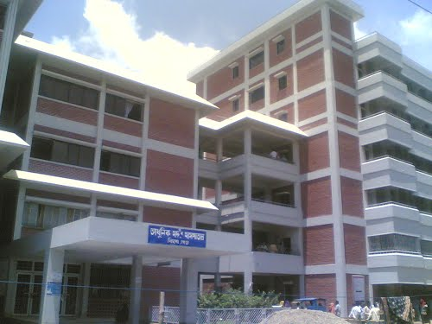
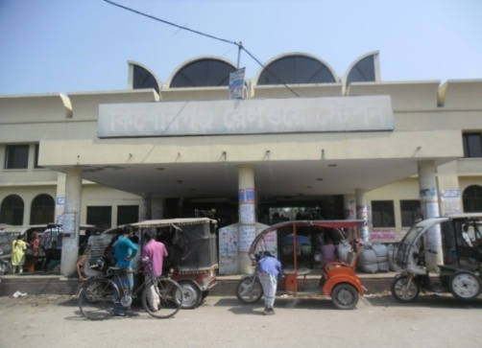
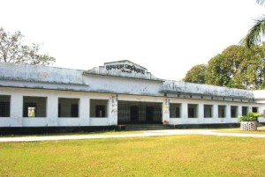
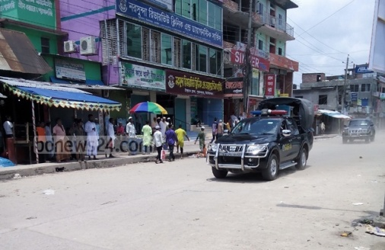
Ss what can you see the picture ?
Pair work

Slide 9
These pictures are of Kishoregonj town .Now we’ll read Mamun’s home district, Kishoregonj.
Ss let’s know some information about Kishoreganj

Slide 10
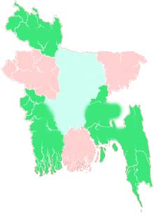
Kishoreganj
145km
Dhaka

Slide 11
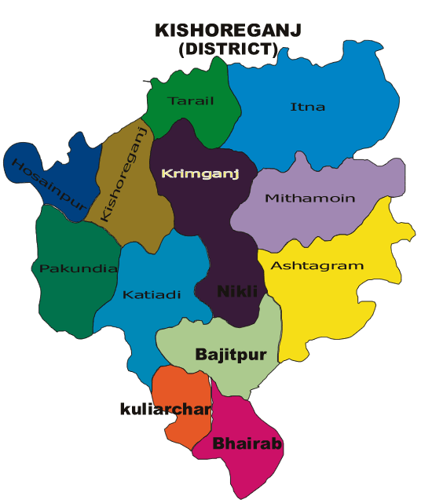
You see 13 upazilas are here

Slide 12
Kishoreganj
Municipalities
8
Upazila
13
Union
108
Village
1745

Slide 13
SS, now we’ll see some important places in Kishoreganj town.

Slide 14
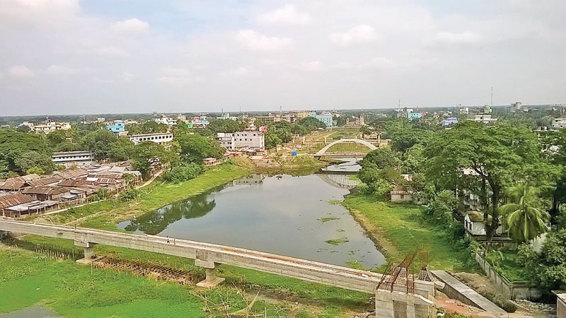
Narasunda River

Slide 15
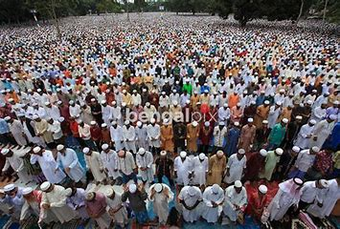
Solakia Eid Ground

Slide 16
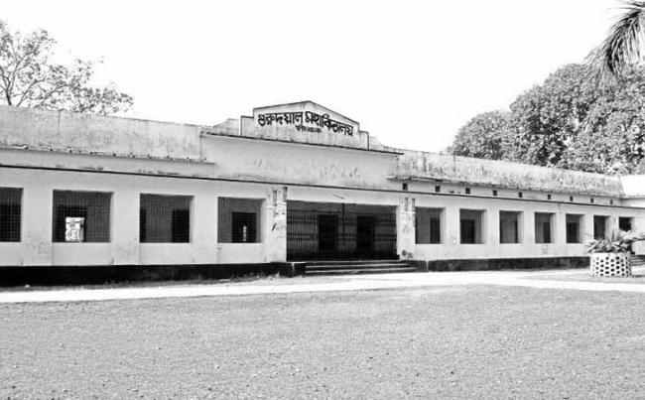
Government Gurudayal College

Slide 17
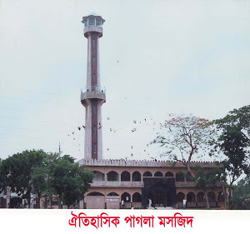
Pagla Mosque

Slide 18
We’ll see some important places outside the town

Slide 19
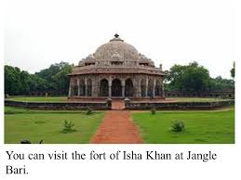
Fort of Isah Khan
A building is built to defend the attack of enemy

Slide 20
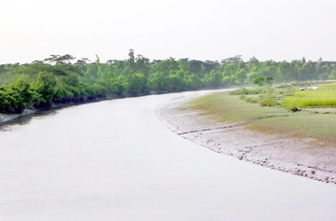
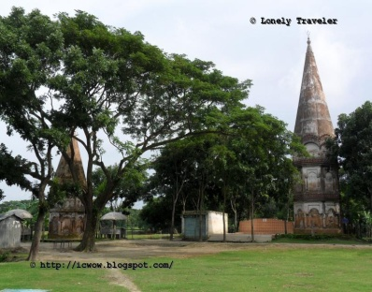
Fuleshwari River
Shiva Temple of chandrabati

Slide 21
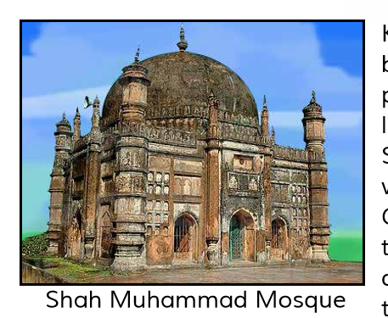

Slide 22
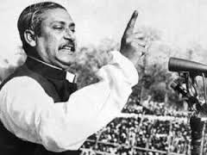
New words
Landloard : A person who has own vast property
Important : Having great value .
Mosque :A building where muslims say their prayers.
Well-known :Familiar

Slide 23
Open your book page at 38.
Teacher’s reading then student’s reading

Slide 24
Match column A with column B
A | B
Landloard | Educational institute
Important | Very familiar
Well-known | A great value
Mosque | Who has vast property
College | Where Hindu people say their prayers
Temple | Where Muslim people say their prayers
Group work

Slide 25
Ask answer (orally)
What is the name of Mamun’s home district ?
How far is it Dhaka ?
What did it get it’s name ?
Say some important places of Kishoreganj .
Checking learning individually

Slide 26
See you

