Slide 2
WELCOME

Slide 3
Teacher’s Identity
Asim Kumar Talukder
Lecturer in English
Fenchuganj Govt. College
Fenchuganj, Sylhet.
Email Id: aktalukder@gmail.com
01716348110

Slide 4
Class: Eleven
Subject: English 2nd Paper
Use of Indefinite Articles
Time: 50 Minutes
Date:
Introduction of the lesson

Slide 5
Learning outcomes
Students will be able to…….
# Identify the Indefinite Articles
# Use Indefinite Articles

Slide 6
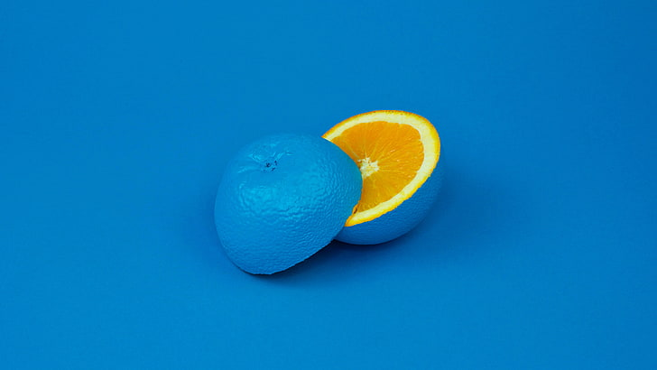
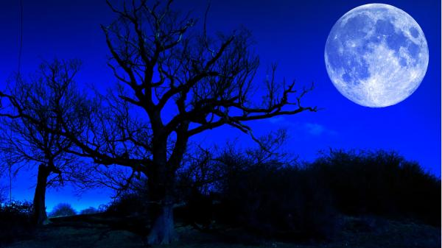
Articles
A Book
An Orange
The Moon
Why is ‘A’ used before ‘Book’?
Why is ‘An’ used before ‘Orange’?
Why is ‘The’ used before ‘Moon’

Slide 7
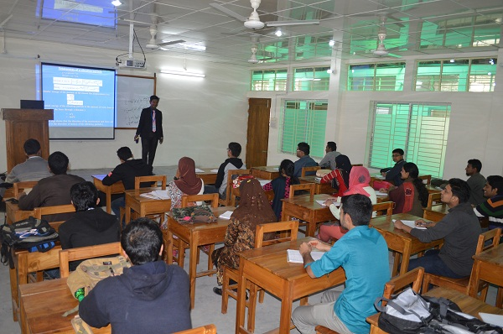
Announcement of the Lesson
Use of Articles

Slide 8
Basic Idea of Articles
Indefinite
A/An
Singular
Countable
The
Definite
‘Noun’ or
‘Noun Phrase’
Plural
Indefinite
X
Uncountable
The
Definite

Slide 9
From the basic idea of Articles, we have come to know that ‘A’ and ‘An’ are called articles.
Do you know what kind of Articles can we tell them?
Yes, they are called indefinite articles and today we will learn the use of indefinite articles.

Slide 10
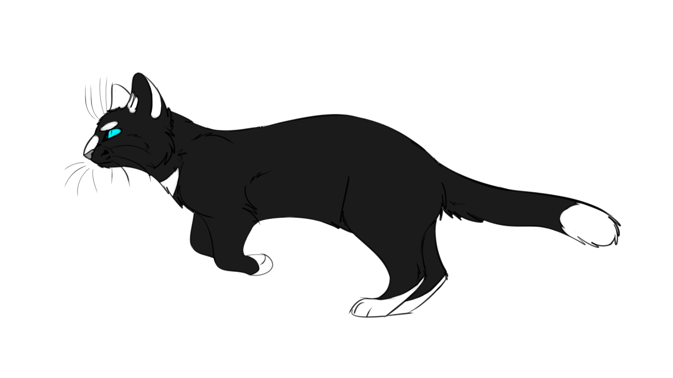
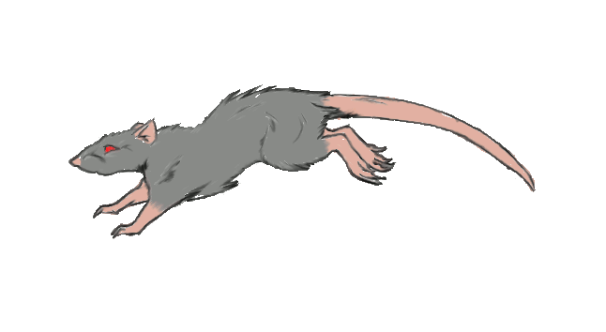
Yes, you are right. ‘A’ is used before a consonant sound.
Why is ‘A’ used before ‘cat’ and ‘mouse’?
What have you seen here?
A cat is running after a mouse.
Now see more examples

Slide 11
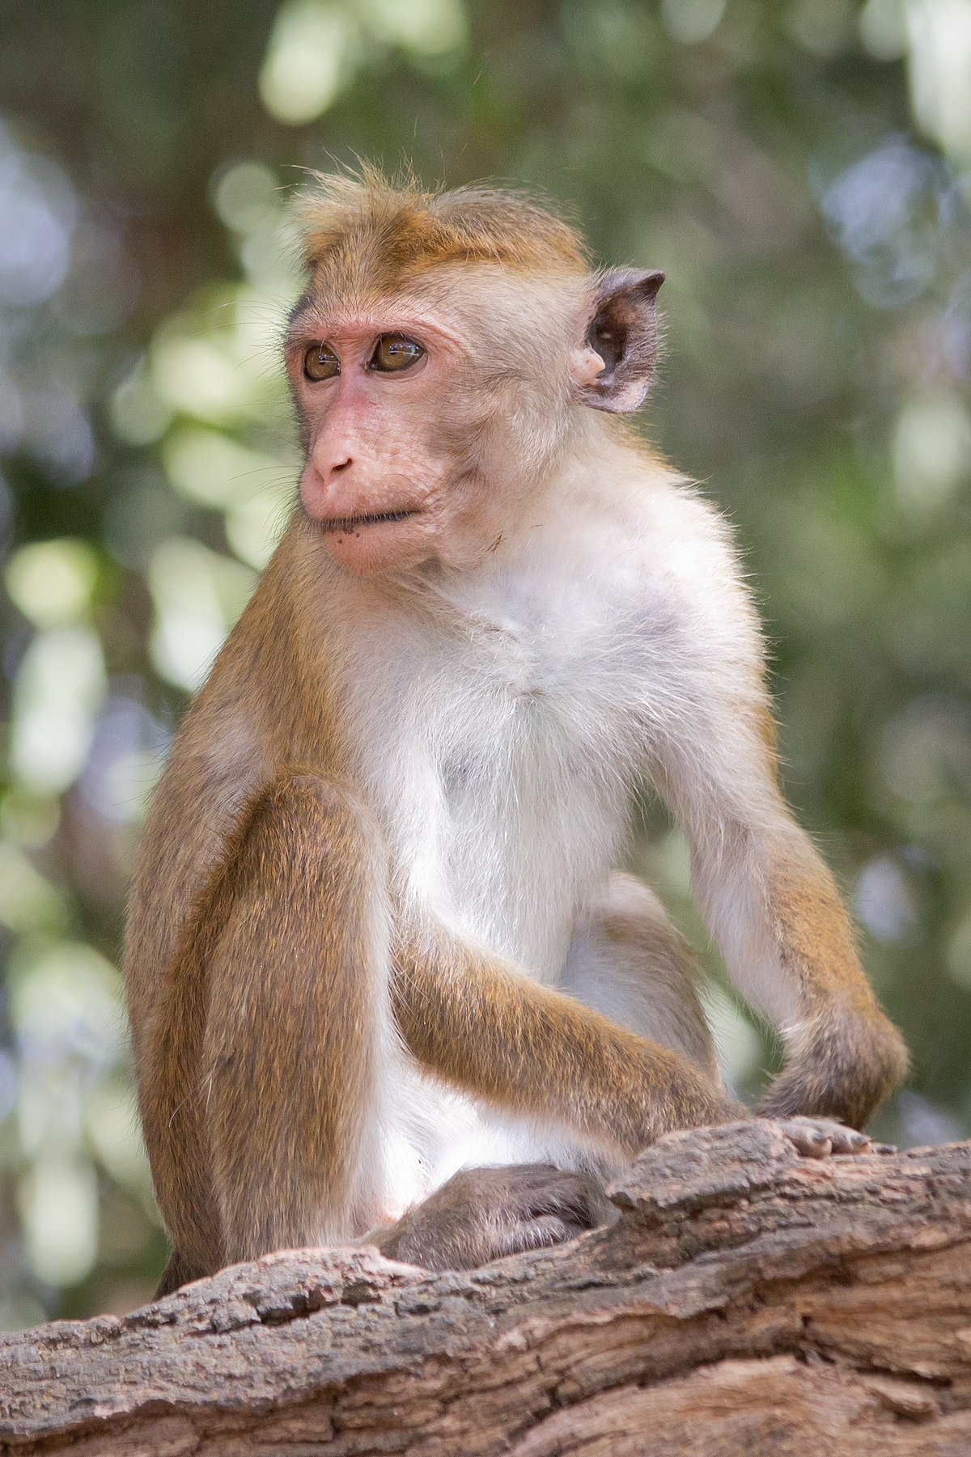
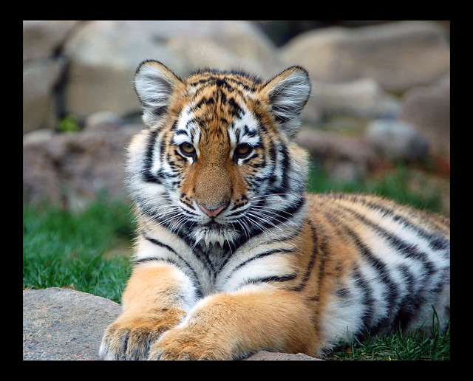
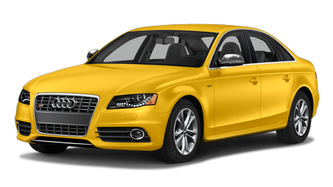
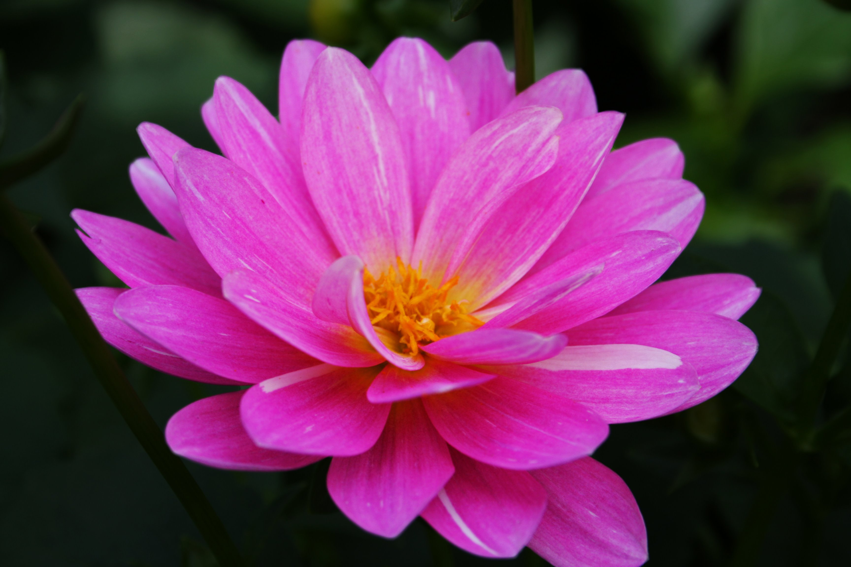
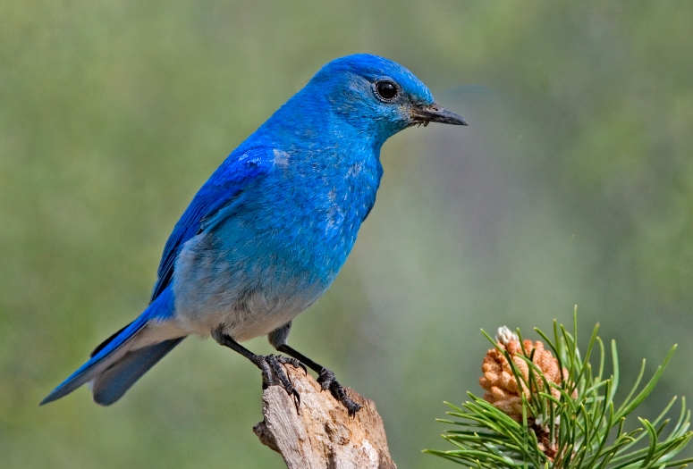
A tiger
A monkey
A book
A car
A bird
A flower

Slide 12
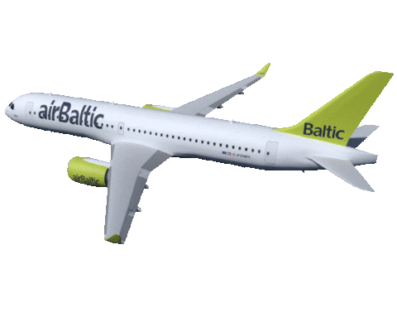
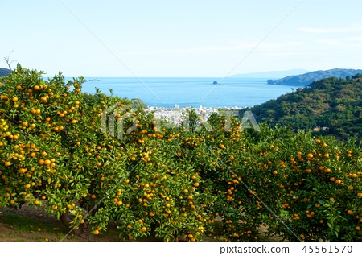
An aeroplane is flying over an orange garden.
Yes, you are right. ‘An’ is used before a vowel sound.
Why is ‘An’ used before ‘aeroplane’ and ‘orange garden’?
What have you seen here?
Now see more examples

Slide 13
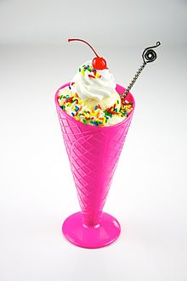
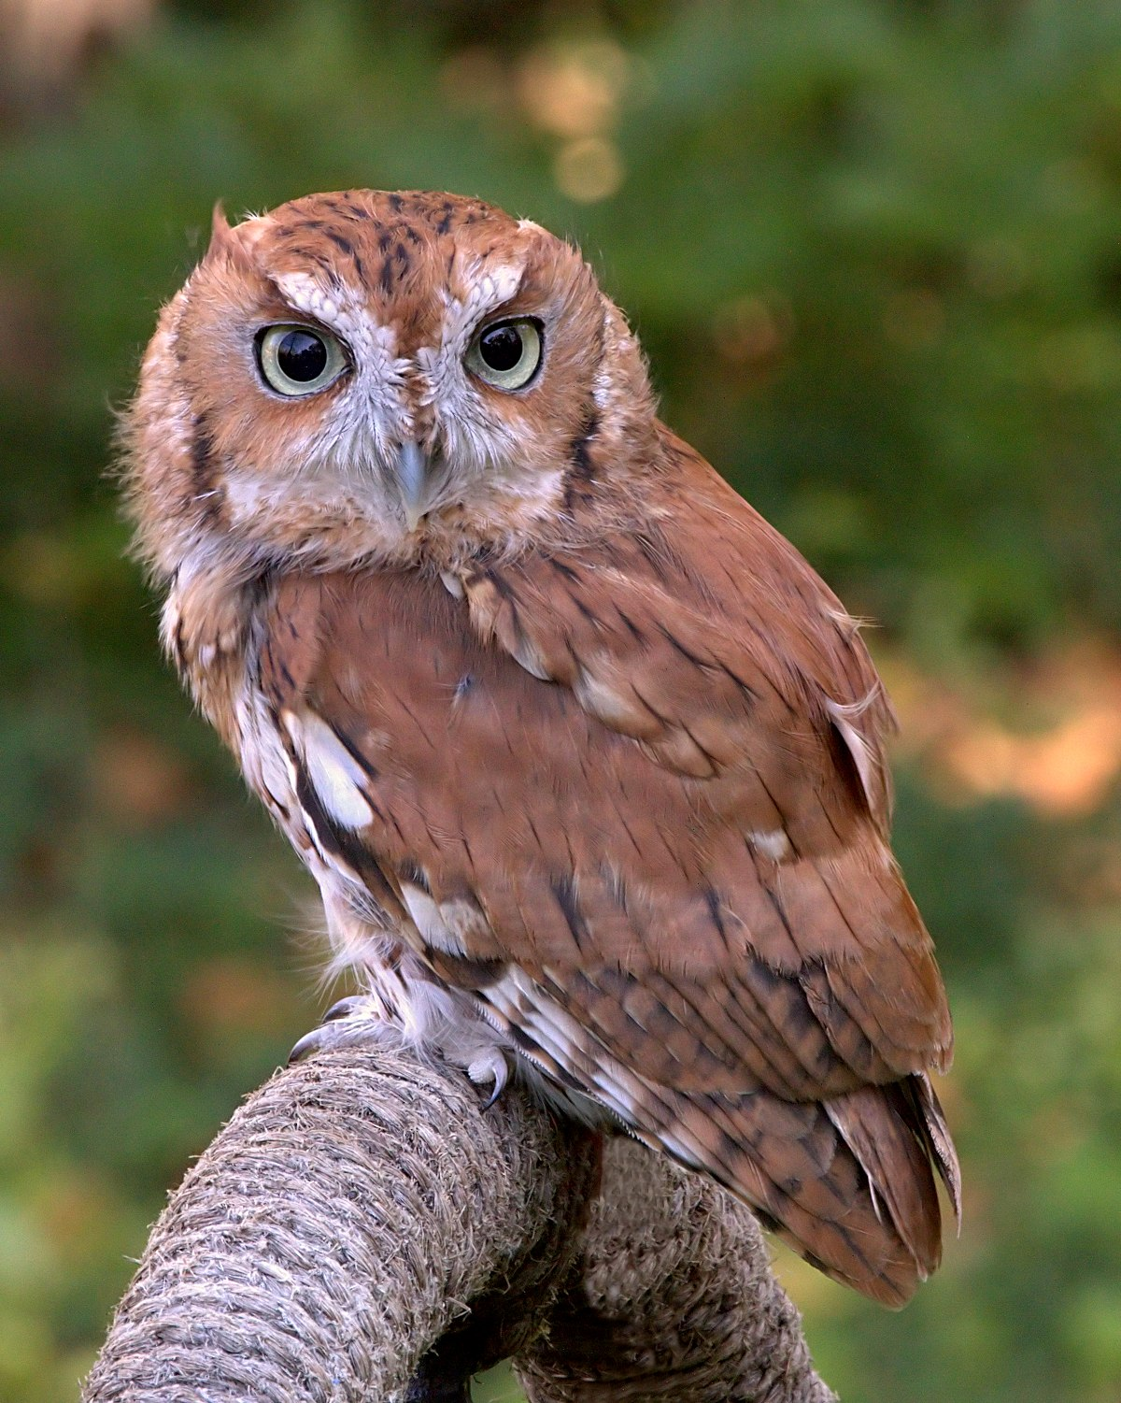
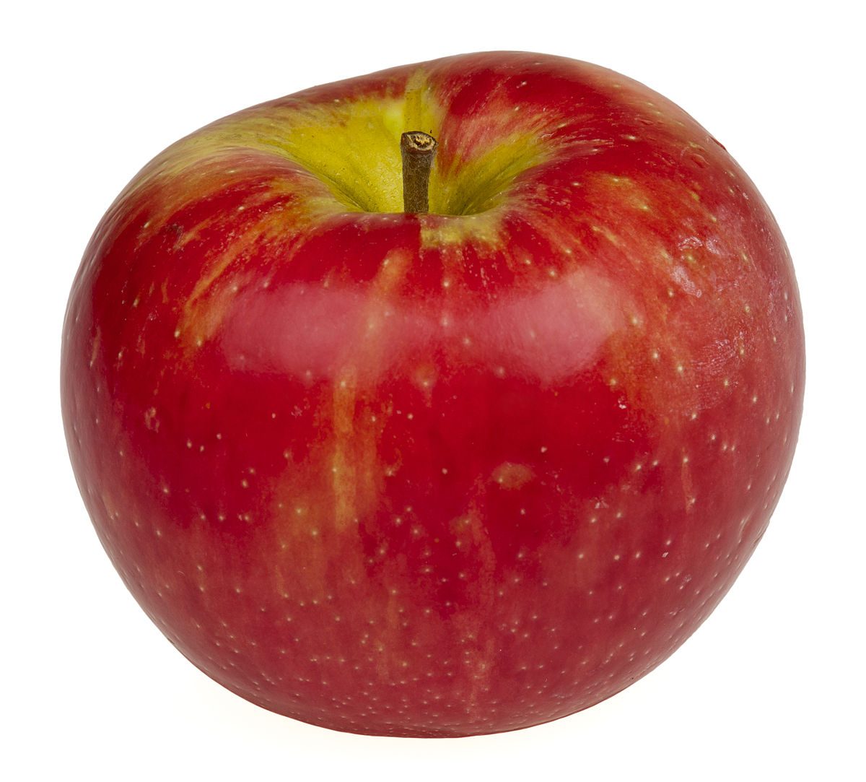
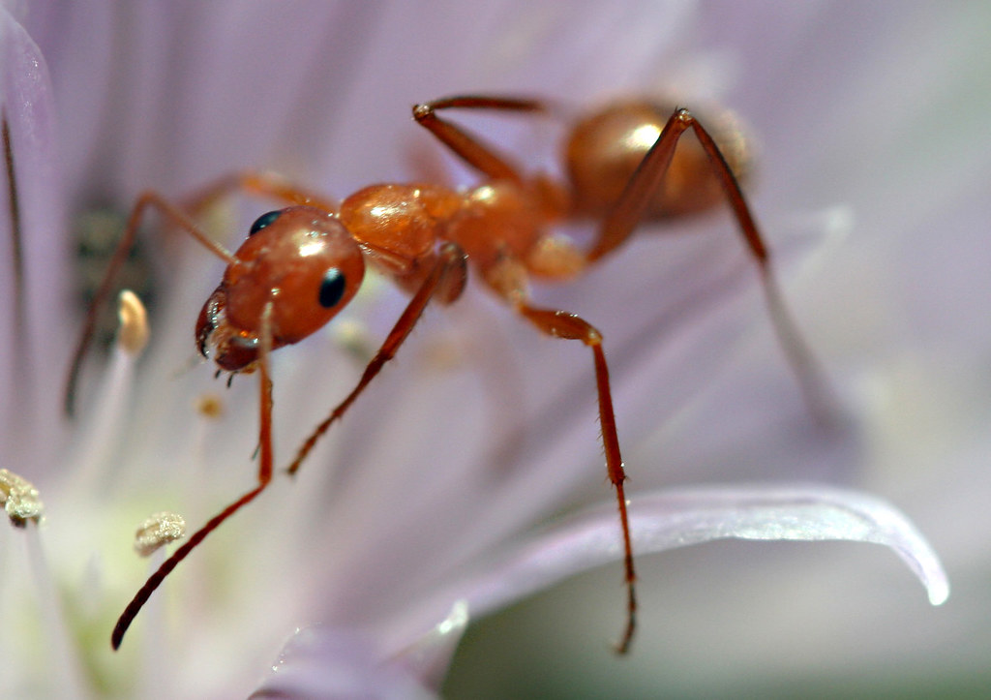
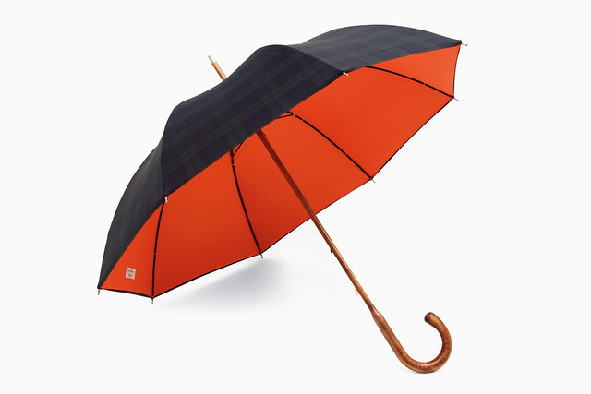
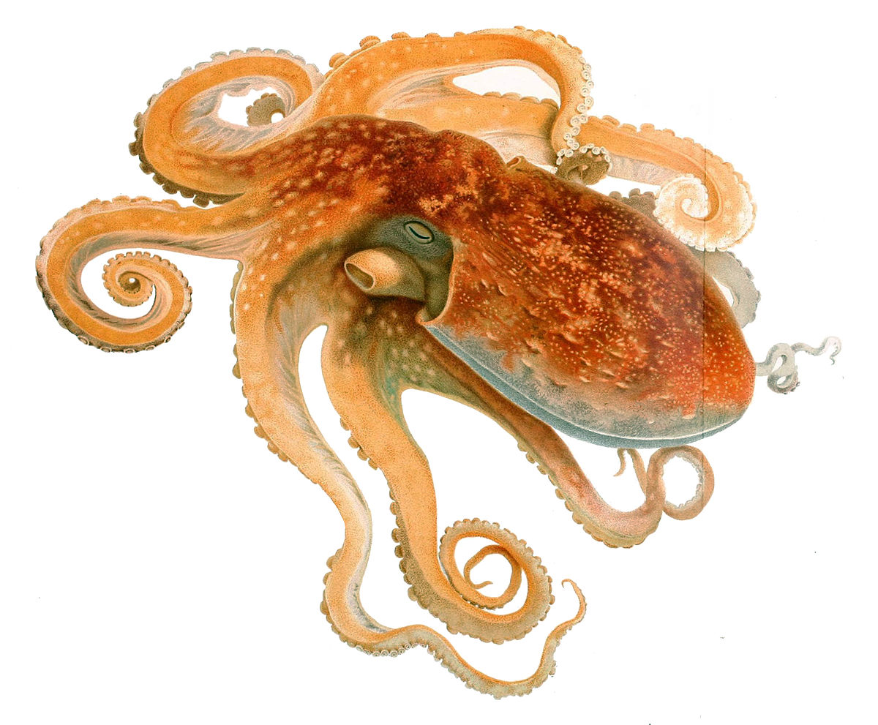
An apple
An ice-cream
An owl
An ant
An octopus
An umbrella

Slide 14
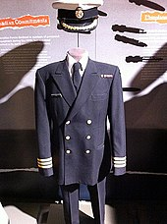
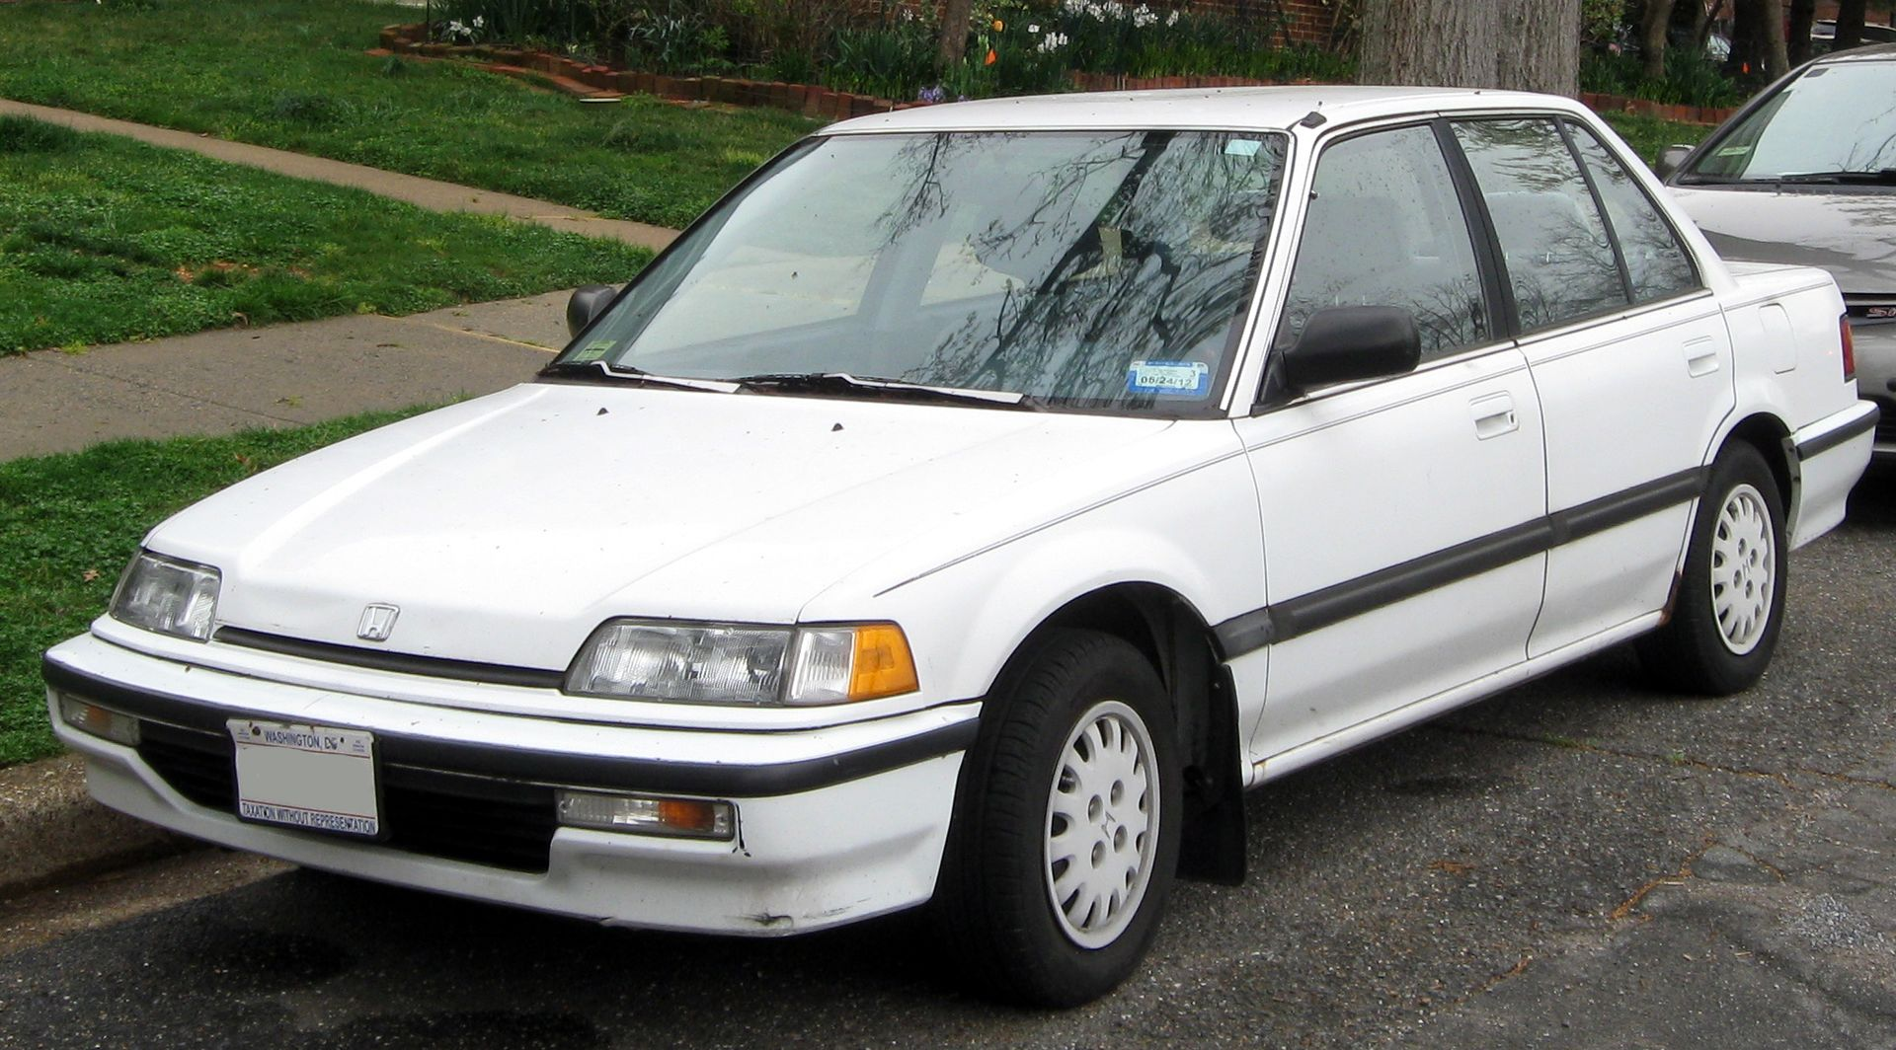
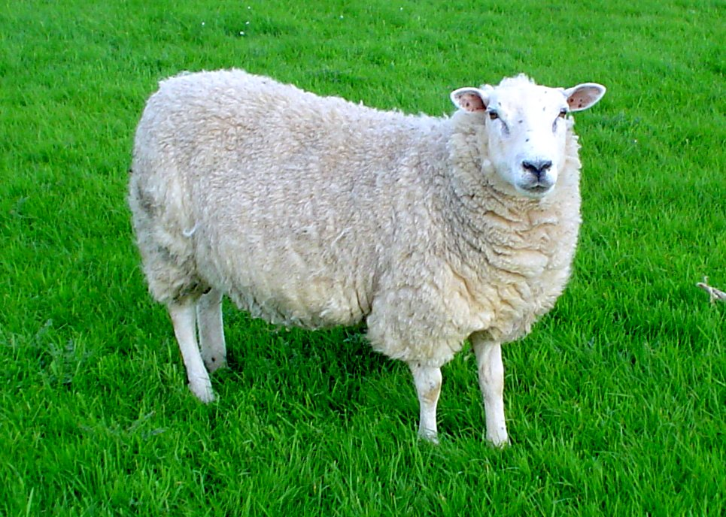
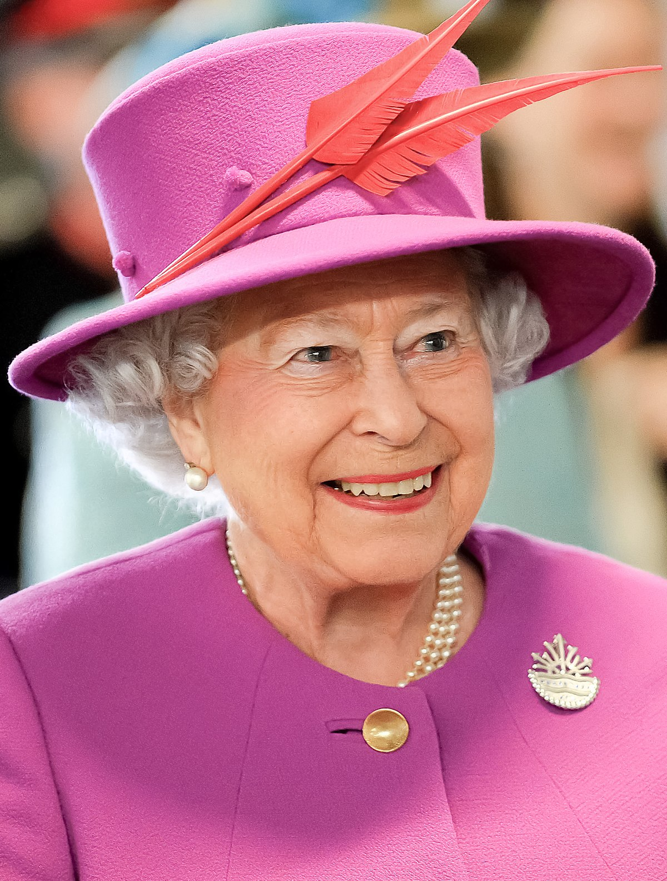
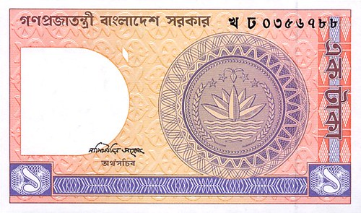
But it doesn’t mean that word started with vowel will have a vowel sound. Let’s go through the words
Why is A used before these words though they start with vowel?
Let’s see the pronunciation of these words
A university
A used car
A uniform
A ewe
A one-taka note
A European

Slide 15
/j/ = Y
Let’s see more words that start with consonant
Word
Pronunciation
University
/ˌjuː.nɪˈvɜː.sə.ti/
Used
/juːst/
Uniform
/ˈjuː.nɪ.fɔːm/
Ewe
/juː/
One
/wʌn/
European
/ˌjʊə.rəˈpiː.ən/
/w/ = W

Slide 16
/a/ = A
An hour
An honourable person
An heir
An honest man
Word
Pronunciation
Hour
/aʊər/
Honourable
/ˈɒn.ər.ə.bəl/
Heir
/eər/
/e/ = E
Honest
/ˈɒn.ɪst/
/ɒ/ = O

Slide 17
Individual Work
Choose the correct Articles

Slide 18
There's ___ mouse in the garden.
a
an

Slide 19
2. We saw ___ ostrich in the zoo.
a
an

Slide 20
3. Meet me in __ hour.
a
an

Slide 21
4. The clown was riding ___ one-wheel bike.
a
an

Slide 22
5. Is that a picture of ___ unicorn?
a
an

Slide 23
6. She said I had __ ugly dog.
a
an

Slide 24
7. Her parents bought her __ horse for her birthday.
a
an

Slide 25
8. We all had __ unbelievable day.
a
an

Slide 26
9. It was __ honour meeting you.
a
an

Slide 27
10. She lived on ___ island for many years.
a
an

Slide 28
A CD
An SP
Here CD and SP are Abbreviations and before an indefinite abbreviation use ‘A’ or ‘An’ according to the sound.

Slide 29
Select a seen comprehension from your text book called ‘English for Today’ and underline the indefinite articles in the passage and then justify their usages.

