Slide 1
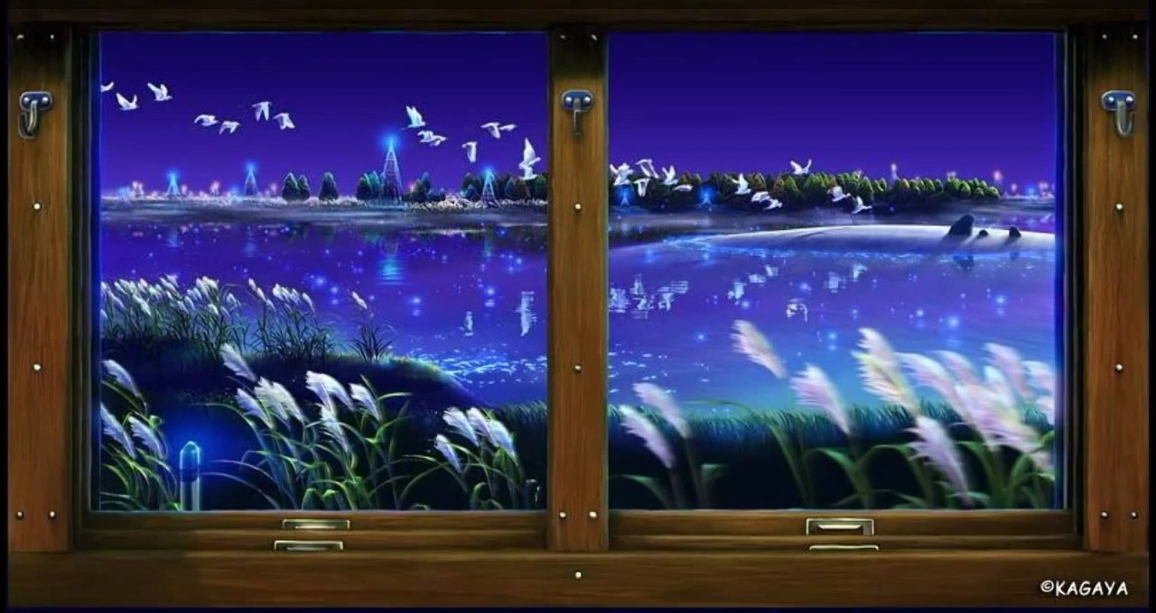
WELCOME

Slide 2
Introduction & Lesson
Hosne Ara Basry
(Lecturer in English)
Bhaktiarpara Charpir Aulia Alim
Madrasah, Anowara, Ctg.
Cell no: 01816001006
Email:
hosnearaamir94638@gmail.com
Subject :
English first paper
H.S.C/Alim
Duration:45m

Slide 3
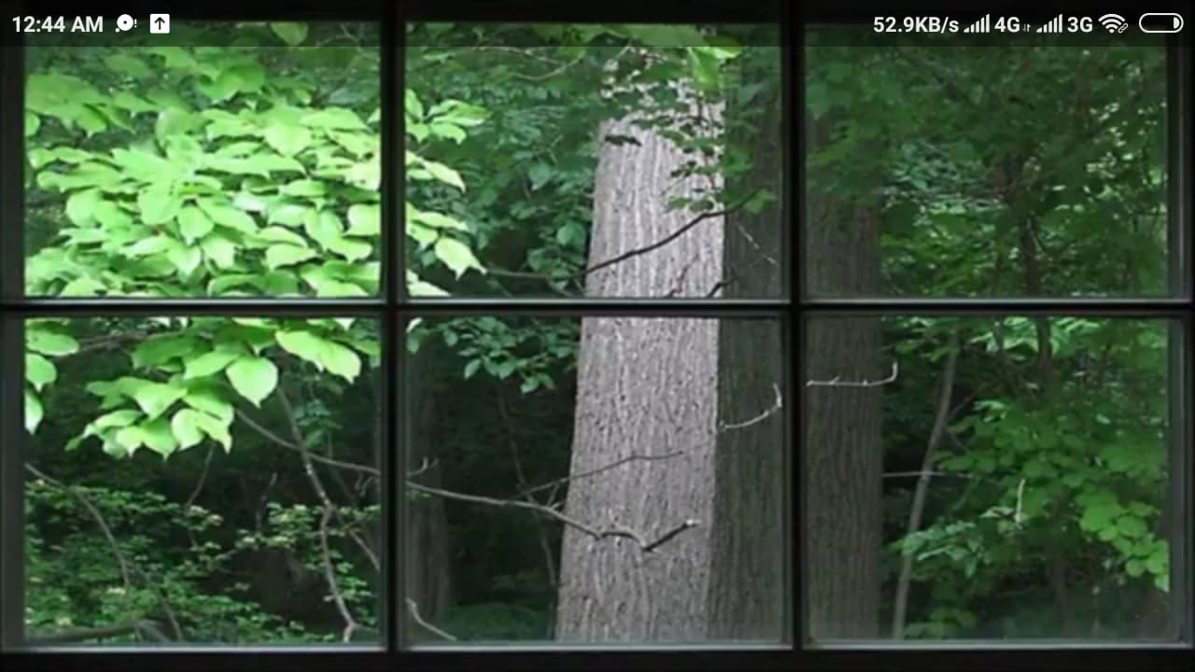

Slide 4
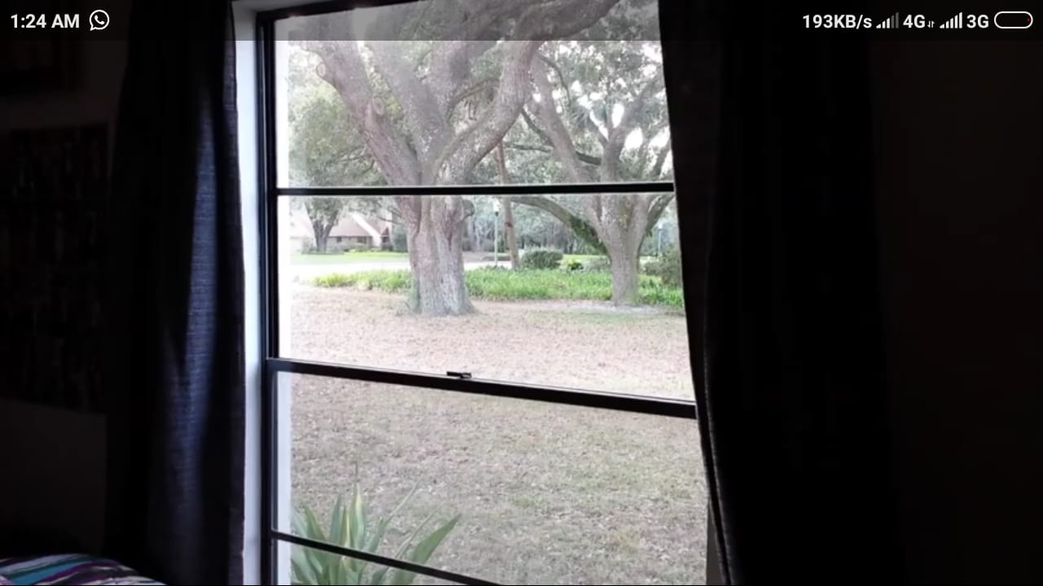

Slide 5
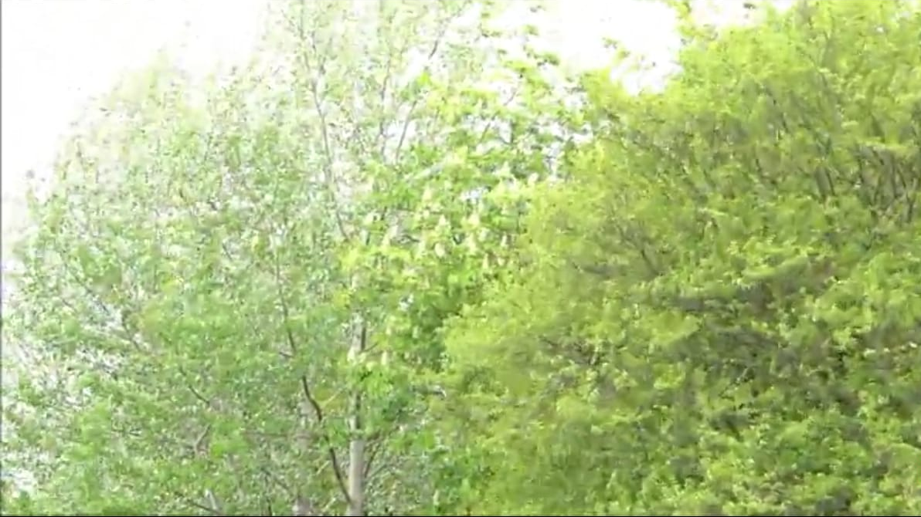

Slide 6
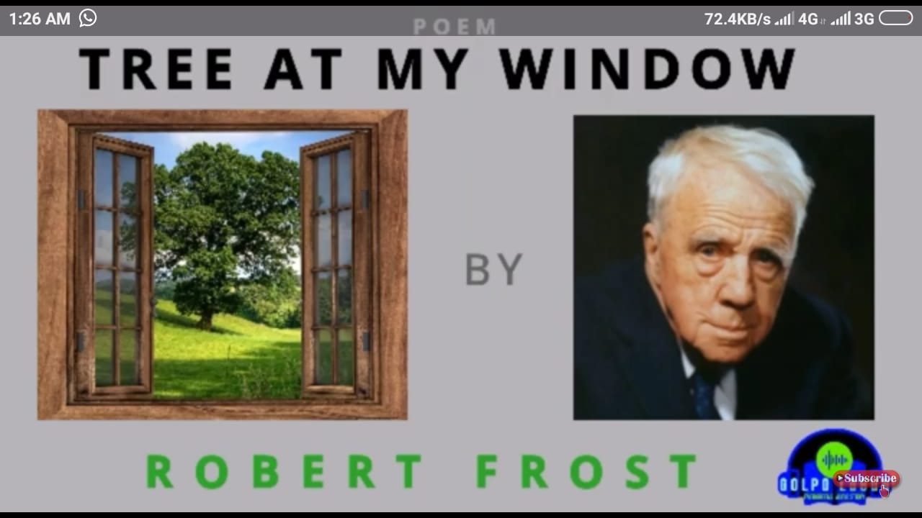
Today's Lesson-
Non-textual poem for summary/theme
po

Slide 7
Learning Outcomes
After the end of the lesson the students will be learn
about -
★The poet
★The poem
★Critical analysis
★Summary

Slide 8
About the poet

Slide 17
Summary

Slide 18
Group Work
★What do you mean by window and tree
according to this poem

Slide 19
Evaluation
★Discuss about the inner meaning of the poem. .
★What do you mean by window and tree
according to this poem ?

Slide 20
Home Work
★Learn word meaning of the poem.
★Write a theme of the poem in your own words.

Slide 21
THANK YOU

