Slide 1
WELCOME

Slide 2
Rupa Mollik Rupu
Assistant Teacher
T and T gate Government primary school, Khagrachari

Slide 3
Mita’s day
Unit: 14, Lesson: 1-2 page no: 28

Slide 4
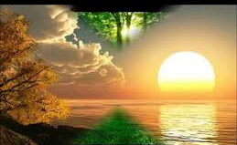
Let’s see some picture’s
The Sun is rising at morning

Slide 5
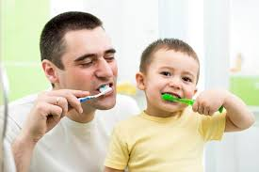
Both are brushing their teeth

Slide 6
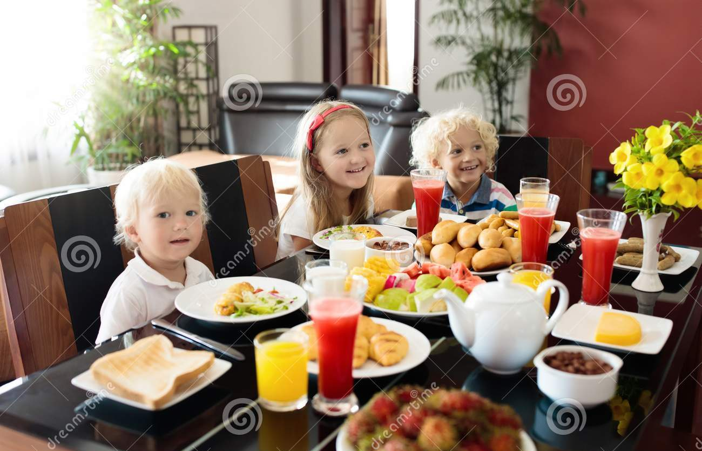
They are taking breakfast.

Slide 7
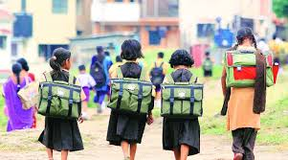
Girl's are going to school

Slide 8
What do you understand from the pictures?
Activities of morning

Slide 9
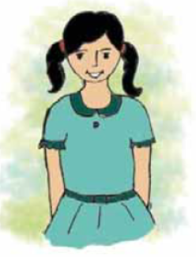
Today’s Lesson is----
Mita’s day
Unit: 14, Lesson: 1-2 page no: 28

Slide 10
Learning Outcomes:

Slide 11
Words Meaning (English to English)
Get up
Rise from bed
Breakfast
Meal in the morning
School
Building for education
Grandmother
Mother of parents

Slide 12
Words Meaning (English to Bengali)
Get up
ঘুম থেকে উঠা/ জাগা
Breakfast
সকালের নাস্তা
School
বিদ্যালয়
Grandmother
দাদী/নানী

Slide 13
Listen the text dialogue attentively
o’clock.

Slide 15
Answer the questions
1. What class is Mita in ?
Ans: Class 4.
2. When does Mita go to school?
Ans: At 9 o’clock.

Slide 18
Answer the questions
3. When does she visit her grandmother?
Ans: At 3 o’clock.
4. When does Mita return home?
Ans: At 5 o’clock.

Slide 19
What did Mita do?
7 o’clock/ Have breakfast
9 o’clock/
Go to school
6 o’clock/
Get up
Mita
3 o’clock/
Visit her grandmother
5 o’clock/ Return home

Slide 20
Do you know what is am or pm ?
am: Ante Meridiem
pm:Post Meridiem,
From night’s 12 o’clock to day’s 12 o’clock is call a.m. and from day’s 12 o’clock to night’s 12 o’clock is call p.m.

Slide 21
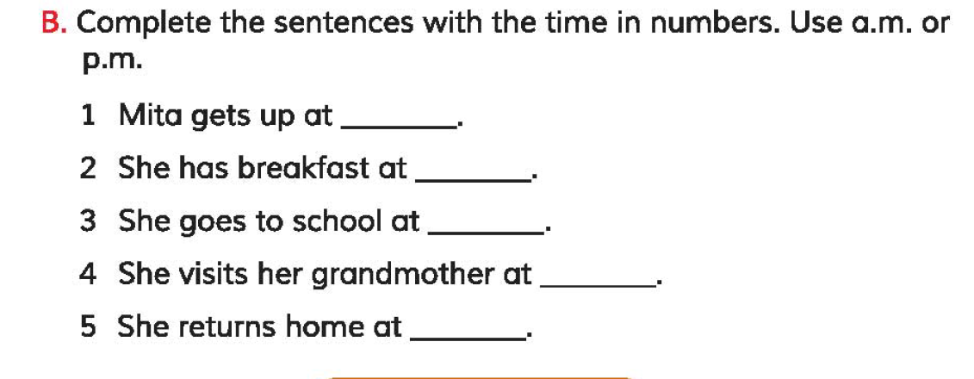
Fill in the blanks from the text
6 am
7 am
9 am
3 am
5 am

Slide 22
Say three sentences about Mita’s Daily Activities
Mita gets up at 6 o’clock.
She goes to school at 9 o’clock.
She return home at 5 o’clock.

Slide 23
One day one word
Get up
জেগে উঠা
Sentence making:
I get up early in the morning.

Slide 24
Home Task
Write 5 sentences about
Your Daily Routine.

Slide 25
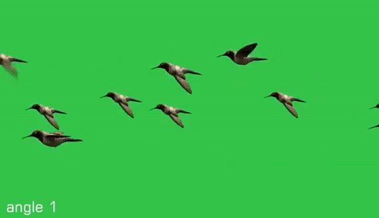
GOOD BYE

