Slide 1
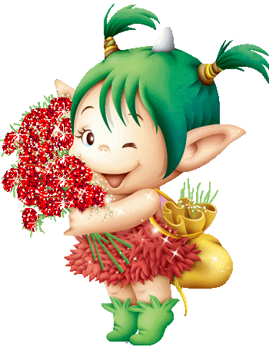
Welcome

Slide 2
Presented by...
Amitosh Mallick,
Assistant Teacher,
Nirali govt Primary School,
Narail Sadar ,Narail
Contact : 01720-997638
Email : amitoshbd2000@gmail.com

Slide 3
Lesson Introduce...
English For Today
Class -Two
Unit -01
Page-03
Time: 40 minutes

Slide 4
Safty environment by greetings song
Hello! Hello! How are you?
I’m well, I’m good.
I’m great, I’m wonderful.
Hello! Hello! How are you?
I’m fine! I’m great today.

Slide 5
Checking homework and justify the previous lesson.

Slide 6
Lesson Declaration
Our today’s lesson is--
Alphabet (A-E)
Activity-A

Slide 7
Learning Outcomes...
Students will be able to...
Listening:1.1.1 become familiar with English sounds by listening to common
English words.
Speaking: 1.1.1 repeat after the teacher simple words and phrases with proper sounds
and stress.
1.1.2 say simple words and phrases with proper sounds and stress.
Reading: 1.2.1 recognize and read the alphabet both small and
capital (non-cursive)
1.3.1 recognize and read the names of objects having the same initial and
final sounds

Slide 8
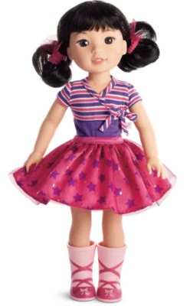
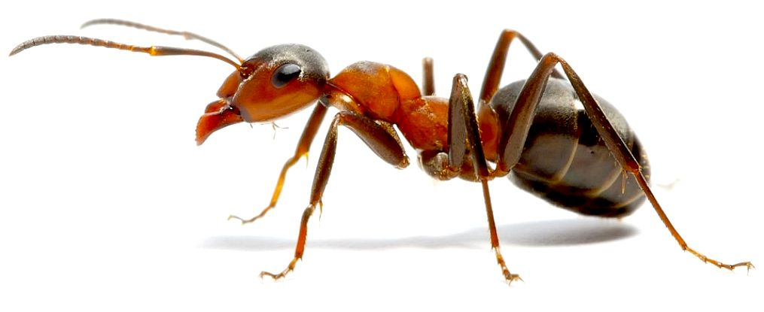
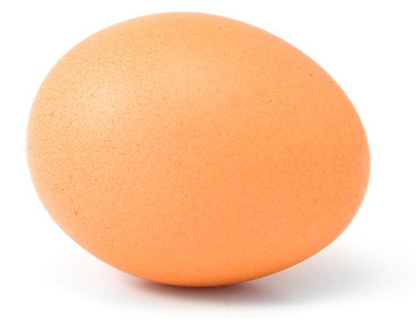
Look, listen and say
What is this?

Slide 9
Open your EFT book at page-3 and see the Activity-A
Look, listen and say.
A a
B b
C c
D d
E e
ant
bat
cup
doll
egg
Now repeat after me.
Spell out the words. (SGW)

Slide 10
Capital letters
A
a
B
b
C
c
D
d
E
e
Small letters

Slide 11
What is this?
ant
What is the letter’s name?
What is the letter’s sound?

Slide 12
What is this?
bat
What is the letter’s name?
What is the letter’s sound?

Slide 13
What is this?
cup
What is the letter’s name?
What is the letter’s sound?

Slide 14
What is this?
doll
What is the letter’s name?
What is the letter’s sound?

Slide 15
What is this?
egg
What is the letter’s name?
What is the letter’s sound?

Slide 16
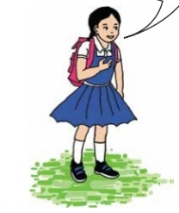
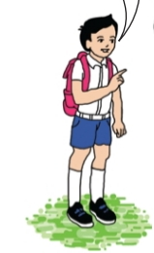
Pair work
What’s the letter’s name/sound?
a
One more

Slide 17
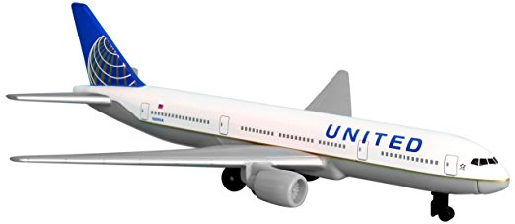
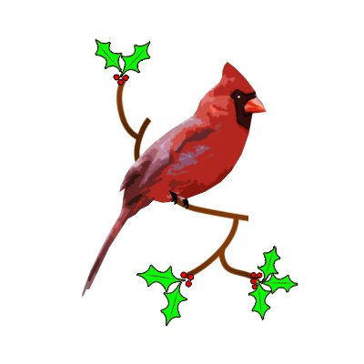
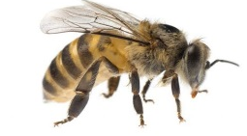
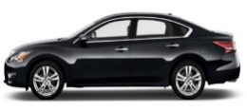
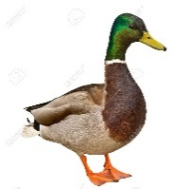
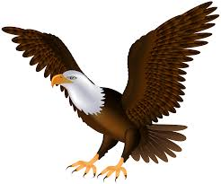
Say 2/more other words for each letter.
axe
airplane
a
bee
b
bird
clock
car
c
duck
d
dolphin
ear
e
eagle
Let’s see.

Slide 18
Read and say.
bat
cup
egg
ant
doll
egg
bat
cup
ant
doll
doll
egg
cup
ant
bat
bat
cup
egg
doll
ant
Identifying weak students and taking to cure.

Slide 19
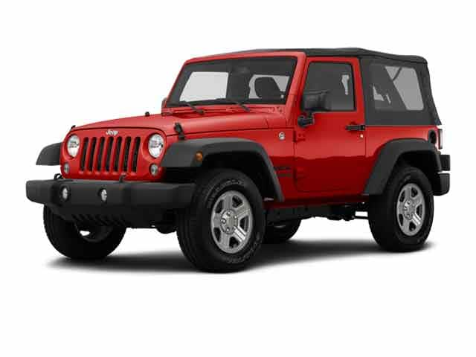
One day one word
What is this?
jeep
জিপ গাড়ি
Spell out the word - SGW

Slide 20
Find out the letters that are made by the word-----.
i
e
w
r
e
x
j
k
n
p
Find out the right word--------.
jump
jeep
jute
jam

Slide 21
Say the missing letter.
j-ep
jee-
-eep
je-p
Write the word to your notebook.
jeep
জিপ
জিপ গাড়ি

Slide 22
Home work
Activity-A will be well read and written.

Slide 23
Thank you all.

