Slide 1
WELCOME

Slide 2
TEACHER IDENTITY
A.K.M. SHARIFUL ALAM
HEADTEACHER
MUKTARPUR AM-JAMTALA SECONDARY SCHOOL
CHOWGACHA, JASHORE
Cell- 01717251605
Email-shariful251605@gmail.com

Slide 3
LESSON INTRODUCTION
SUBJECT-ENGLISH 2ND PAPER
CLASS-NINE/TEN
UNIT-COMPOUND TO SIMPLE
TIME-45 MINUTES
DATE-00-00-2020

Slide 4
Classification of Sentence
Simple Sentence: Because of his being ill, he could not play.
Compound Sentence: He was ill and he could not play
Complex Sentence: As he was ill, he could not play

Slide 5
Our Today’s topic is-----
Compound
Simple Sentence

Slide 6
Learning outcomes
The students will be able to
identify simple and compound sentences,
make structures of each form of sentences,
change the compound to simple.

Slide 7
Rule-1. And যুক্ত Compound Sentence এর Subject একই ব্যক্তি/বস্তু/প্রাণী হলে- Structure: মুল verb এর Present form এর সাথে ing যোগ+বাকী অংশ+Comma+ ১ম Clause এর Subject+ ২য় Clause.
B.COMPOUND Sentence TO SIMPLE sentence
Compound: I jumped out the bed and went out.
Simple: Jumping out the bed, I went out.

Slide 8
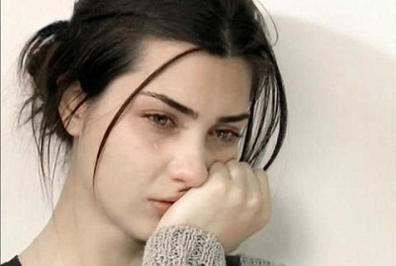
Com: Della finished her cry and attended to her cheeks with the powder rag.
Sim: finishing her cry , Della attended to her cheeks with the powder rag.
Com: I ate rice and went to school.
Sim: Eating rice, I went to school.

Slide 9
Rule-2. And যুক্ত Compound Sentence এর উভয় Subject ভিন্ন হলে এবং Auxiliary Verd থাকলে- Structure: 1st Subject+am/is/are/was/were এর পরিবর্তে beung এবং have/has/had এর পরিবর্তে having+১ম Clause এর বাকী অংশ+ Comma+ ২য় Clause.
Compound: The sun had set and we started for home.
Simple: The sun having set , we started for home.
Com: The marriage ceremony was over and the guest were all going to the feast.
Sim: The marriage ceremony being over, the guest were all going to the feast

Slide 10
Rule-3. And যুক্ত Compound Sentence এর Subject ভিন্ন হলে এবং ১ম Sentence কারণ বুঝালে- Srtucture: Because of+Subject এর possessive form+am/is/are/was/were এর পরিবর্তে being এবং have/has/had এর পরিবর্তে having+ 1ম Sentence এর বাকী অংশ+ Comma+ 2য় Sentence.
Compound: He is ill and he can not move one inch.
Simple: Because of being ill, he can not move one inch.
Or. Because of illness, he can not move one inch.
Com: He has much money and he can buy a car.
Sim: Because of his having much money, he can buy a car.
Com: He worked diligently and so he succeed.
Sim: He succeed because of worked diligently.

Slide 11
Rule-4. Or যুক্ত Compound Sentence কে Simple করার নিয়ম। Structure: Without+ মুল verb এর সাথে ing যোগ + verb এর পরের অংশ+ or এর স্থলে comma+ 2য় Sentence.
Compound: Work hard or you will not prosper in life.
Somple: Without working hard , you will not prosper in life.
Com: Read attentively or you will not pass the examination.
Sim: Without reading attentively , you will not pass the examination.
Com: Read or fail.
Sim: without reading, you will fail.
Com: Do or die.
Sim: Without doing, you will doe.

Slide 12
Rule-5. But যুক্ত Compound Sentence কে Simple করার নিয়ম। Structure: In spite of + Subject এর possessive form+am/is/are/was/were এর পরিবর্তে being এবং have/has/had এর পরিবর্তে having+verb এর সাথে ing যোগ+ but এর স্থলে comma+ ২য় Sentence.
Compound: He is ill but he can run fast.
Simple: In spite of his being ill , he can run fast.
Or. In spite of his illness , he can run fast.
Com: I ran fast but I could not get the train.
Sim: In spite of my running fast , I could not get the train.

Slide 13
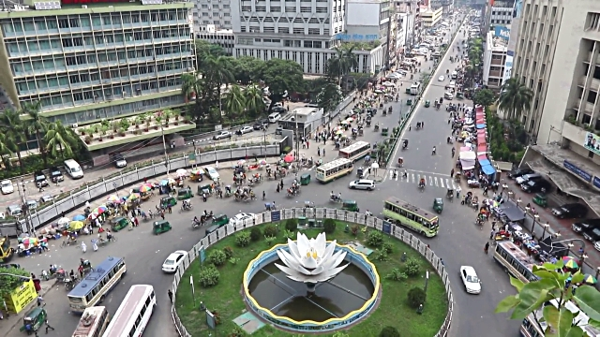
Rule-6.সময় নির্দেশক Compound Sentence কে Simple করার নিয়ম। Structure: Sub ও verb উঠে যায়+ সময়বাচক শব্দ+and এর স্থলে comma+ 2nd Clause.
Compound: I was twenty years ago and I was living in Paris.
Simple: Twenty years ago, I was living in Paris.

Slide 14
Rule-7. And যুক্ত Compound Sentenceটি Imparative হলে Simple করার নিয়ম। Structure: By+verbএর সাথে ing যোগ+ comma+ you will+ ২য় clause.
Compound: Read and pass.
Simple: By reading, you will pass.
Com: Do and die.
Sim: By doing(it) , you will die.
Or. In case of your doing (it), you will die.

Slide 15
Rule-8. Not only—but also যুক্ত Compound Sentence কে Simple Sentence করার নিয়ম। Structure: Besides+ not onlyএর পরের verb + ing+comma+ 1st Sub+but also এর পরের অংশ।
Compound: They not only cursed him but also hung the dead Albatross body round his neck as a punishment.
Simple: Besides cursing him, they hunged the dead albatross round his neck as a punishment.
Com: They had not only the blush of an innocent girl but also the rich tone of an italian landscsape.
Sim: Besides the blush of an innocent girl they had the rich tone of an italian landscape.

Slide 16
HOME TASK
She jumped into the cab and cried gaily. ( Simple)
He took the purse and ran away.
The water was very cold and there was no birds in scow covered country.
Work hard and you will prosper.
Work hard or you will not prosper in life.
He behaved rough but he was not punished.
Walk fast or you will not get the train.
Write much or you will not write well.
The sun having set and we went home.
The sun rose and the fog dispersed.

Slide 17
Thank FOR all

