Slide 1
Wellcome to my multimedia class

Slide 2
IDENTITY
Nahid akhtar parvin.assistant Teacher.
jagodishpurGovt.
Primary school.
Email ID:nahidprimary@
gmail.com
Class : Five
Subject : English
Lesson: .
unite : 13(A)
Page No.: 50
Time : 40 minutes.
Date 12/05/2020

Slide 3
LEARNING OUTCOMES
Students will be able to-
Listening:
1.2.1 recognize which words in a sentence are stressed.
1.4.2 recognize use intonation petternsfor greetings and statements.
3.4.1 understand statements made by the teacher and students.
4.3.1 understand and injoy simple poems.
Speaking:
1.1.1 to say words phrases and sentences with proper sounds and stressed.
1.1.2 say sentences with proper intonation.
5.1.1 tell the time(hours and minutes) and mention a.m/p.m,half past ,quarter past,quarter to etc.
4.1.1 recite poems.
8.1.1 take oart in conversations on appropriate topics.
Reading:
1.5.1 to read words phrases and sentences in the text with proper pronounciation,stress and intontion.
3.2.1 read the clock (ours and minutes) and mention a.m/p.m,half past ,quarter past,quarter to etc
Writing:
2.1.3 to make sentences using words and phrases, following instructions.

Slide 4
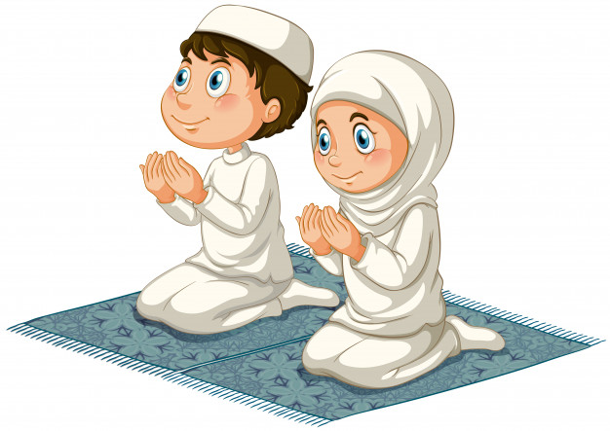
Students what are they doinging in this picture?
Usually at what time they are praying?

Slide 5
Todays lesson is
Telling the time

Slide 6
new words
wash
ধৌত করা।
popular
pray
প্রার্থনা করা।
tourist
Clock
ঘড়ি।
waterfall

Slide 7
Teachers model reading

Slide 8
Students look at the clock and read
Tick-tock! Tick –tock!
It’s 5 o’clock.5 o’clock!
Wash yourself and pray.
Tick-tock!Tick –tock!
Look at the clock.

Slide 9
Tick-tock!Tick-tock!
It’s 9 o’clock.9 o’clock
Take your bag and go to school.
Tick-tock!Tick-tock.
Look at the clock.

Slide 10
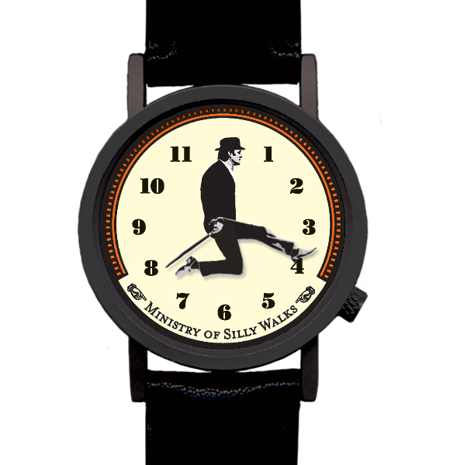
Tick-tock!Tick-tock!
It’s 4 o’clock.4o’clock!
Now it’s time to go back home.
Tick-tock!Tick-tock!
Look at the clock.

Slide 11
Students open your book page no-50 .read silently the poem by seeing the clock.

Slide 12
Pronunciation
wash
wa
sh
yourself
your
self
tourist

Slide 13
Group work
Group- morning
Write the next line
Tick –tock !tick-tock!
----------------------------------
Wash yourself and pray.
---------------------------
-----------------------.
It’s 5 o’clock.5 o’clock!
Tick-tock!Tick –tock!
Look at the clock

Slide 14
Group-afternoon
See the clock .write first two lines of the poem:
----------------------------------------------
----------------------------------------------
Tick-tock! Tick – tock!
─
4 o’clock. 4 o’clock!
─
─

Slide 15
evaluation
Students look at those clocks. and say the time.
5 o’clock
4 o’clock

Slide 16
Home work.
Write first five lines of the poem.

Slide 17
One day one ward
time
Now its time to sleep.

