Slide 1
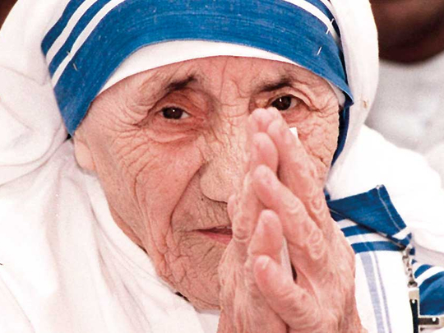

Slide 2
Welcome to all.

Slide 4
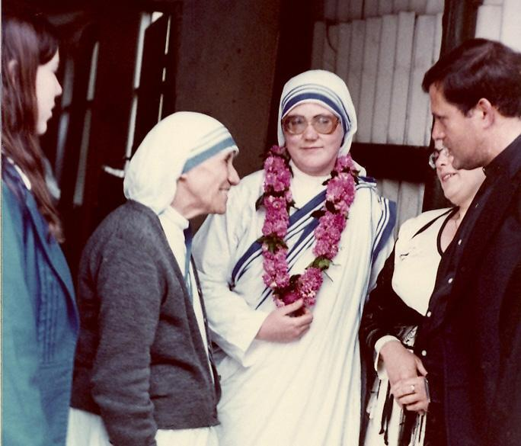
A: Look at the picture.

Slide 5
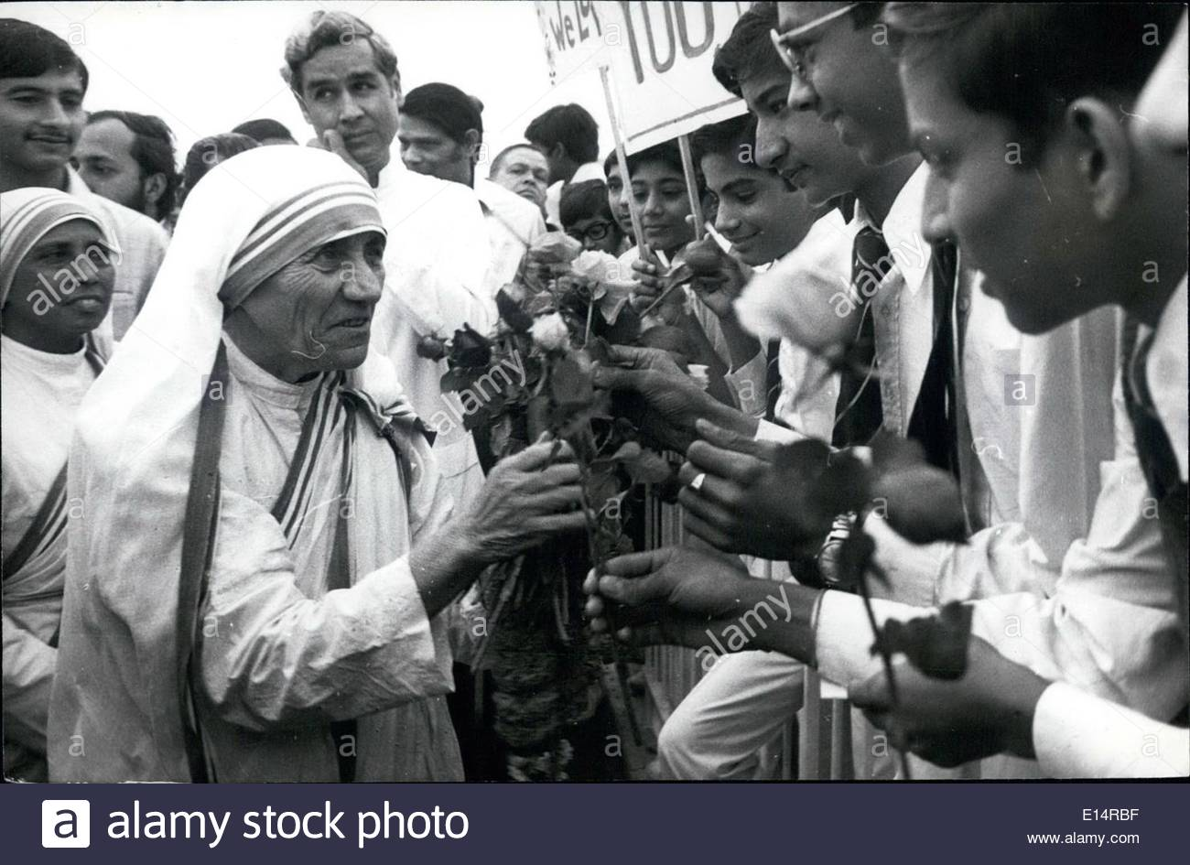

Slide 6
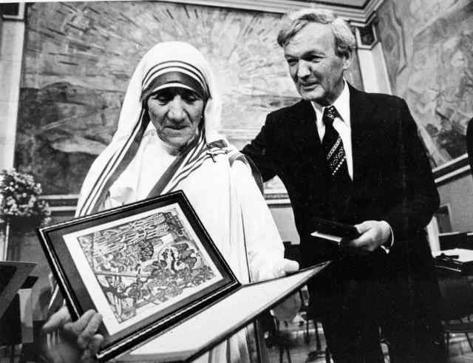

Slide 7
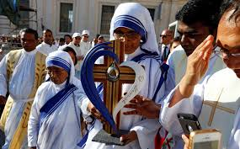

Slide 8
Let us watch the video.
Please click here to go to internet for watching Video.

Slide 9
Love for Humanity
Today’s topic of the class is----
Unit : VII
[People who stand out]
Lesson : 6

Slide 10
Learning outcomes
After the students have studied the lesson, they will be able to --- ---
read and understand text for specific information,
describe a person and occasion,
ask and answer questions.

Slide 11
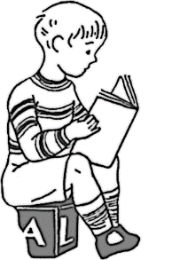
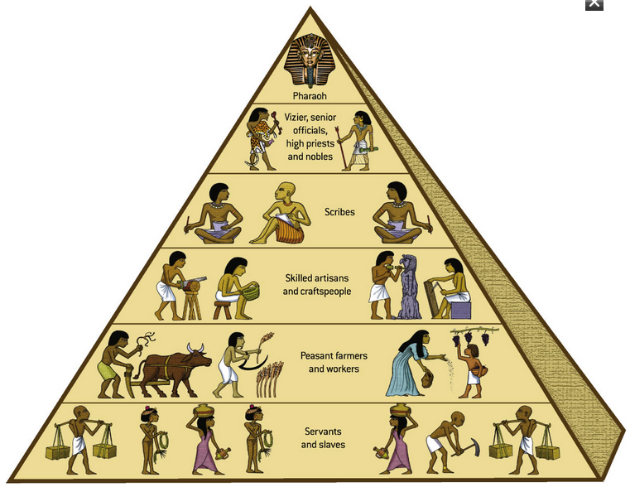
New Word
Caste
each of the hereditary classes of Hindu society, distinguished by relative degrees of ritual purity or population and of social status
Syn.: class, race, species

Slide 12
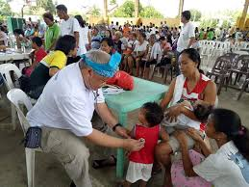
Charity
An organization set up to provide help and raise money for those
Syn.: fund, Foundation, philanthropy

Slide 13
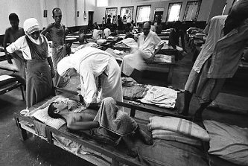
Destitute
Lacking necessities of live
Syn.: poor, penniless

Slide 14
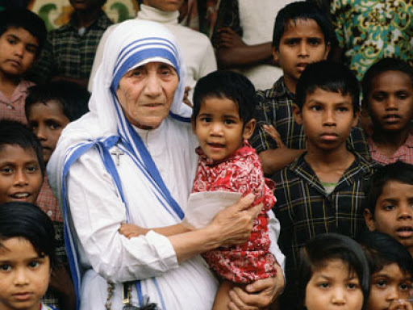
A: Look at the picture and talk about it in pairs.

Slide 15
A: Read the text (Page no. 117-118) and give the answer.
Mother Teresa was moved by the presence of the sick and dying on the streets of Kolkata. She founded the home for the dying destitute and named it ‘Nirmal Hridoy’, --- --- --- --- --- --- --- --- --- --- --- --- --- --- --- --- --- --- --- --- --- --- --- --- --- --- irrespective of creed, caste and religion. Draped in a white and blue-bordered sari, wrinkled face, ever soft eyes and a saintly smile, is the picture of Mother Teresa in our mind.
TEXT

Slide 16
Mother Teresa was moved by the presence of the sick and dying on the streets of Kolkata. She founded the home for the dying destitute and named it ‘Nirmal Hridoy’, meaning ‘Pure Heart’. She and her fellow nuns gathered the dying people off the streets of Kolkata and brought them to this home. They were lovingly looked after and cared for. Since then men, women and children have been taken from the streets and carried to Nirmol Hridoy. T hese unloved and uncared for people get an opportunity to die in an environment of kindness and love. In their last hours they get human and Divine love, and can feel they are also children of God. Those who survive, the Missionaries of Charity try to find jobs for them or send them to homes where they can live happily for some more years in a caring environment. Regarding commitment to family, Mother Teresa said, “ Maybe in our own family, we have somebody, who is feeling lonely, who is feeling sick, who is feeling worried. Are we there? Are we willing to give

Slide 17
until it hurts in order to be with our families, or do we put our interest first? We must remember that love begins at home and we must also remember that future of humanity passes through the family”.
Mother Teresa's work has been recognised throughout the world and she has received a number of awards. These include the Pope John XXIII Peace Prize (1971), the Nehru Prize for Promotion of International Peace & Understanding (1972), the Balzan Prize (1978), the Nobel Peace Prize (1979) and the Bharat Ratna (1980).
Mother Teresa died at the age of 87, on 5 September 1997.The world salutes her for her love and compassion for humanity. She has taught us how to extend our hand towards those who need our love and support irrespective of creed, caste and religion. Draped in a white and blue-bordered sari, wrinkled face, ever soft eyes and a saintly smile, is the picture of Mother Teresa in our mind.
BACK

Slide 18
C: Now say whether the following statements are true or false. If false, give the correct information.
1. Mother Teresa was moved to see the diseases that spread in the streets of Kolkata.
2. She opened a home for the orphans.
3. She and her group brought in the dying people from the streets of Kolkata.
4. ‘Nirmol Hridoy’ was founded so that the poor people who are dying can get love and care before death.
5. Mother Teresa said that humanity passes through charitable organization.
6. We have learnt how to come forward to help only those who belong to a special caste.
1. False. She was moved by the sight of sick and dying people in the secrets up Kolkata.
2. False. She opened a home for the dying destitute.
3. True
4. True
5. False. She she told that humanity passes through family.
6. False. We have learnt to help all irrespective of their creed, caste and religion.

Slide 19
D: Read the text in B again and write the answer to the following questions in your exercise book.
1. Why do you think Mother Teresa won so many awards?
2. What does ‘Nirmol Hridoy’ stand for?
3. Why do you think the home is named ‘Nirmol Hridoy’?
4. Why did Mother Teresa want the dying people to feel that they deserve care and love too?
5. What are things that we have learnt from Mother Teresa?

Slide 20
E: Read the text in B again and answer the following questions in Group.
When did Mother Teresa received Nobel Peace Prize?
When did she receive the Bharat Ratna?
What prize did she receive in 1972?
What prize did she get in 1971?
When did she die?
Why does the word salad her?
What has she taught us?

Slide 21
D: Write a summary of the above passage in your own words.

Slide 22
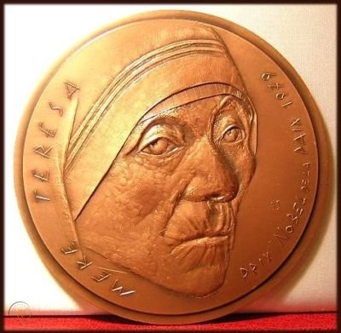
Thank you all.

