Slide 1
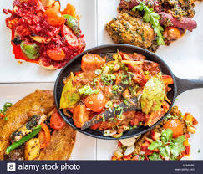
Welcome

Slide 2
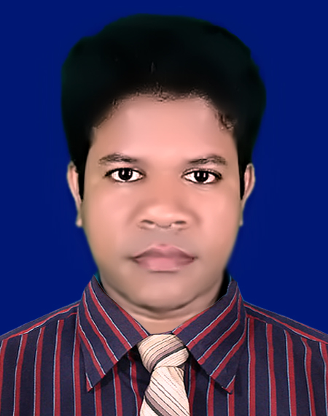
IDENTITY
Azizul Fakir
Assistant teacher
Dighijan Secondary School
Nazirpur, Pirojpur.
Email: azizul.nk@gmail.com
Mobile: 01710745128
Unit – Two
Lesson - 1

Slide 3
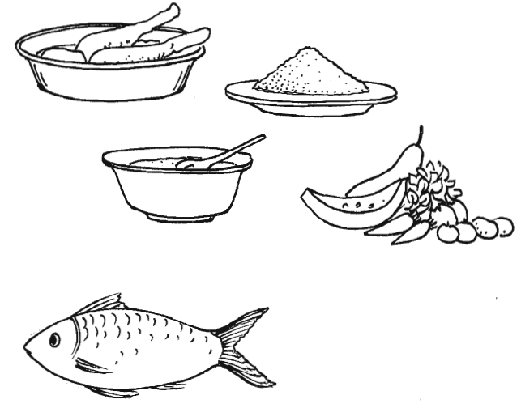
What do you see the pictures?
Look the pictures carefully.
Meat
Rice
Lentil soup
Vegetables
Fish
We see here some pictures of food.
Do you know the name of these food?

Slide 4
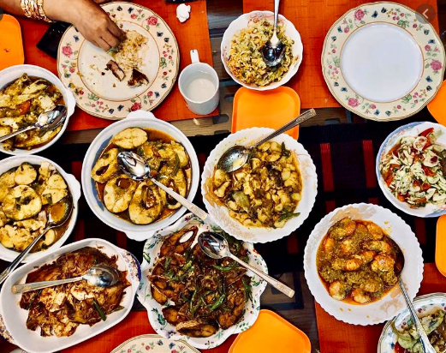
Our topic?
Good food
Unit – 2
Lesson - 1
So

Slide 5
Learning outcomes
After completing the lesson students will be able to
infer meaning from the context
1
2
talk about the picture and read the text.
3
write answer the questions
choose the best answer
4
5
fill the gap from listening CD

Slide 6
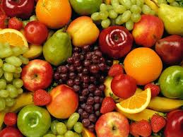
Key word
nutritious
adj
Meaning
nourishing
We need nutritious food

Slide 7
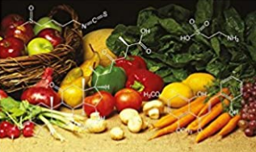
Key word
substances
noun
Meaning
element
Good food must contain natural substances that our body needs to grow properly and stay healthy.

Slide 8
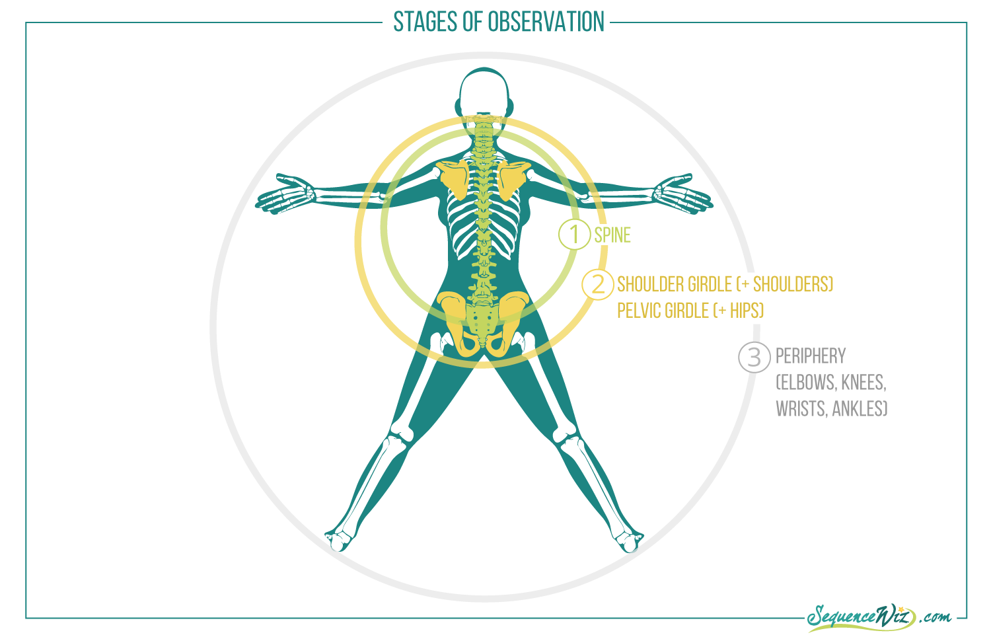
Key word
physical structure
noun
Meaning
the whole physical structure of a human or an animal
Eating amount food depends on our growth and physical structure.

Slide 9
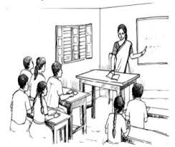
Open at page 9 in your text book and read the passage carefully.
Ms Rehana, the English teacher, is talking to the class about food.
“Food is very important for our body,” she says. “We can’t live without it. So you must always have good food.
“What’s good food, teacher?” asks a student.
“Good food means the right kind of food for good health,” says Ms Rehana. “It is nutritious. It must contain natural substances that our body needs to grow properly and stay healthy. But remember, you must not eat too much though the food is good. Eating too much is bad for health. You have to eat only a certain amount of food that your body needs. So we do not need the same kind of food in the same quantity. It depends on your growth and physical structure.”

Slide 10
Individual works 3mins.
Answer the following questions.
Q1. What is Ms. Rehana talking about?
Q2. Why do we ear food?
Correct your answer
Ans1. Ms. Rehana is talking about food.
Ans2. We eat food because it is important for our body and we can’t live
without it.

Slide 11
Complete these sentences.
Pair works 3mins.
We should eat good food to -----------------
We should not eat more than ---------------
Eating too much food is not -----------------
Good food means --------------------------
Correct your answer
1. We should eat good food to grow properly and stay healthy.
2. We should not eat more than our body needs.
3. Eating too much food is not good for health.
4. Good food means the right kind of food for good health.

Slide 12
Group work
5 mins
Answer the following questions
Q1. What is meant by ‘nutritious food’?
Q2. How much food does a person need to eat a day?
Q3. Does everyone need the same amount of food? Why?
Correct your answer
Ans1. ‘Nutritious food’ means good food which contains natural substances.
Ans2. A person needs to eat only a certain amount of food a day that his
body needs.
Ans3. No, everyone does not need the same amount of food. Because it
differs according to growth and physical structure.

Slide 13
Tick the best answer.
What is Ms Rehana talking about?
i. cleanliness ii. manner iii. food iv. physical exercise
(b) ‘important’ refers to ----
i. meagre ii. difficult iii. significant iv. overall.
(c) Our body needs a --- amount of food.
i. huge ii. particular iii. scanty iv. large.
(d) What does the word ‘student’ mean?
i. people ii. learner iii. examiner iv. examinee
(e) What is bad for health?
i. over-eating ii. nutritious food iii. natural substances iv. all of these
(f) The word ‘nutritious’ means ---
i. alimentary ii. poisonous iii. expensive iv. unlimited
(g) Good food should be.
i. costly ii. Proper growth iii. natural substances iv. nutritious
$$$$
$$$$
$$$$
$$$$
$$$$
$$$$
$$$$

Slide 14
Evaluation
Now fill in the gaps
Listen to the CD
Good food means the right kind of food for good health. It is nutritious. It must contain natural (a) --- that out body needs to grow properly (b) --- stay healthy. But remember, you must not (c) --- too much though the food is good. (d) --- too much is bad for health. You (e) --- to eat only a certain amount of food that your body need.

Slide 15
Correct your answers
Good food means the right kind of food for good health. It is nutritious. It must contain natural (a) substances that out body needs to grow properly (b) and stay healthy. But remember, you must not (c) eat too much though the food is good. (d) eating too much is bad for health. You (e) have to eat only a certain amount of food that your body need.

Slide 16
Homework
Stay home
Write the main idea of the text.

Slide 17
Thanks

