Slide 1


Slide 2

W
E
L
C
O
M
E

Slide 3
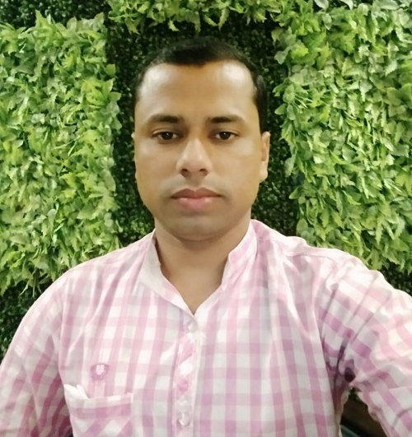

Identity
Khalidur Rahman Manik
Assistant Teacher
Khasgaon GPS
Chhatak, Sunamganj
Sub:English
Class:5
Unit:8
Lesson:4-5
Activity:B&C

Slide 4
Good morning students.
How are you today?
Let’s sing the good morning song together.

Slide 5
Recalling previous lesson
Dear students, can you remember what
we had learnt in our previous class?
Yes, we had learnt about the disease Flu

Slide 6
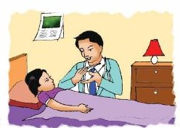
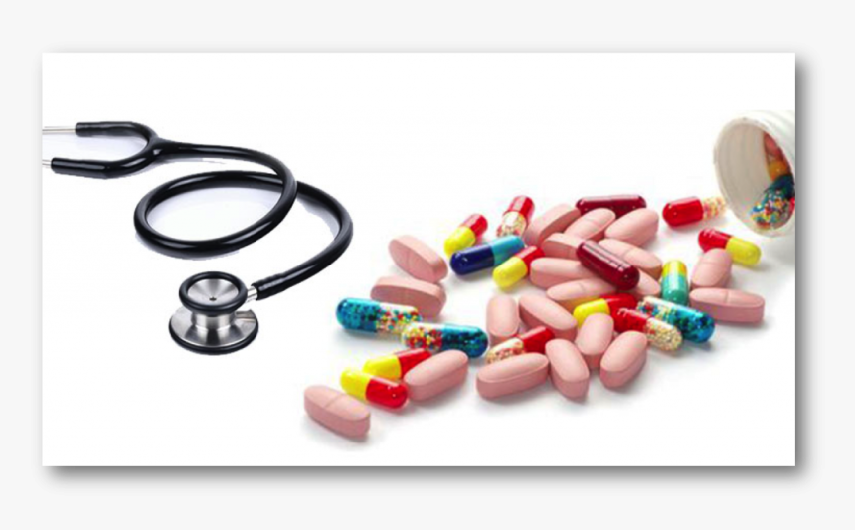
Let’s see some pictures.
Doctor and patient
Medicine
Can you guess about our today’s lesson?
What do you see in these pictures?

Slide 7


Our today’s lesson is…
Write to me soon!
Activity: B&C

Slide 8
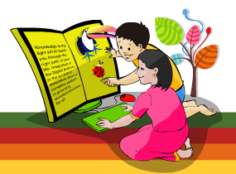
Learning outcomes
Students will be able to…
1.6.1 recognize and read statements, commands,
greetings, questions and answers;
5.1.1 read silently with understanding paragraph;
8.1.1 make sentences using words and phrases given
in the textbook.

Slide 9
Open at page 30 of your textbook and read the text silently.

Slide 10
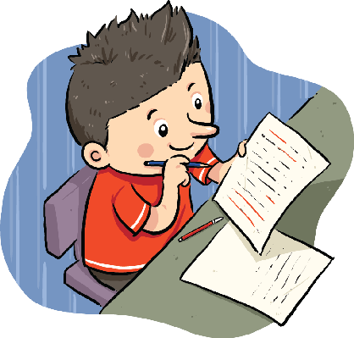
Individual Work
Read the following statement carefully and
say whether the statement is true or false.
Sima didn’t go to school because she
wanted to stay at home.
Ans:
F
Ans:
In the second sentence of page 30.
Where do you find the answer?

Slide 11
Now listen to the audio of activity : A
Listen to the audio again carefully.

Slide 12
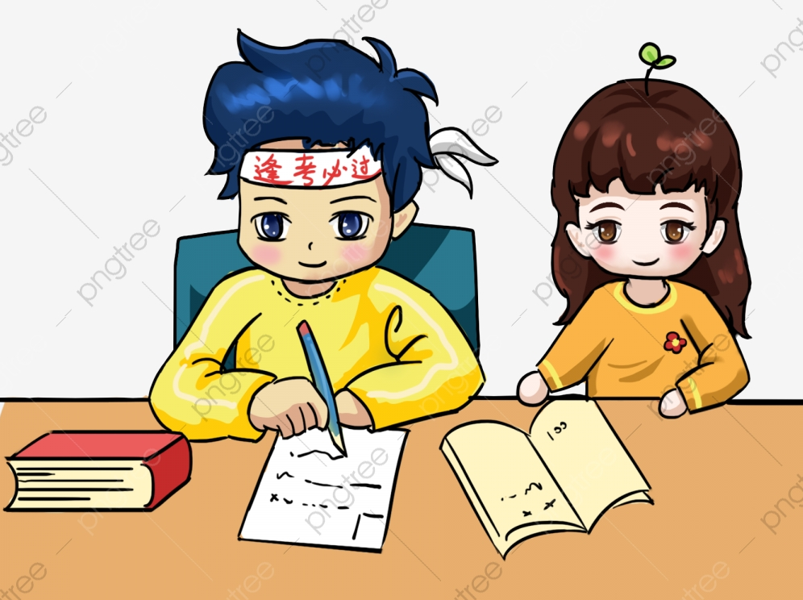
Pair Work
Read again. Write T for True and F for False.
Sima feels fine, but she has a sore throat.
Sima is warm because she has a fever.
Sima should eat, even if she doesn’t feel hungry.
Sima should try to go to school.
Sima and her brother should use the same cup
and glass.
Ans: 1) F 2) T 3) T 4) F 5) F

Slide 13
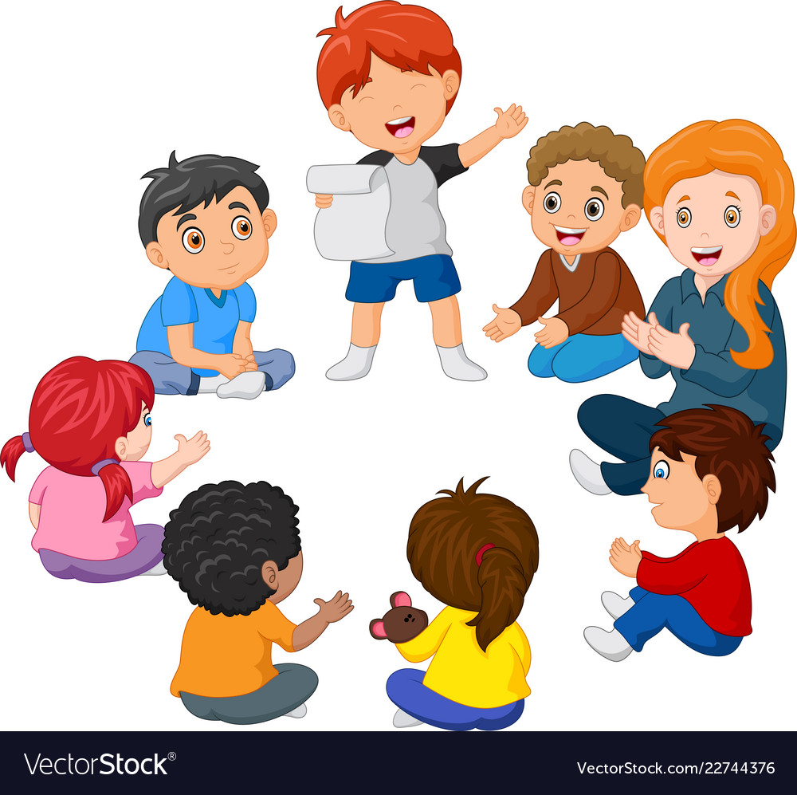
Group Work
Read the text again very carefully
and correct the false sentences.
Write them in your exercise books.
Sima feels fine, but she has a sore throat. F
C/A: Sima is ill and she has a cough and a sore throat.
Sima should try to go to school. F
C/A: Sima should stay at home
Sima and her brother should use the same cup and glass. F
C/A: Sima should use her own cup, glass and plate.

Slide 14
Checking Learning
Dear students, what have you learnt from today’s lesson?
We have learnt today…
How to stay healthy.
How to keep others healthy.

Slide 15
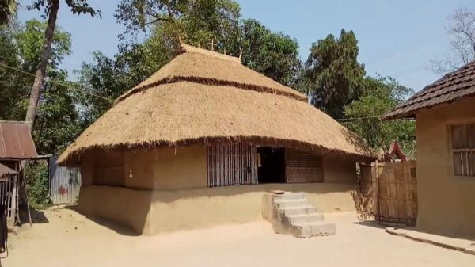
Homework
Rearrange the following words in the appropriate
order to make meaningful sentences.
today/ home/ at/ sima/ is
flu/ has/ the/ she
food/ gives/ that/your/ eat/ energy/ body
at/ home/ stay
your/ wash/ regularly/ hands

Slide 16



Thank you

