Slide 1
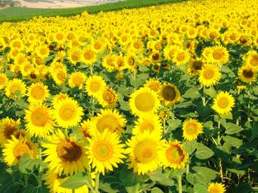
WELCOME

Slide 2
Presented by-
Md.Ali Hossain Pathan
Assistant Teacher
Chowra Nayabari Gps.
Kaligonj, Gazipur.

Slide 3
Lesson Identity
Class:two
Subject: English
Unit:Four
Lesson:4-6(A)

Slide 4
Learning outcomes
At the end of the lesson students will be able to:
Listening
1.1.1 become familiar with English sounds listening to common English words.
Speaking
1.1.1 repeat after the teacher simple words and phrases with proper sounds and stress .
1.1.2 say simple words and phrases with proper sounds and stress.
Reading
1.2.1 recognize and read the alphabet both small and capital(non-cursive).
1.3.1 recognize and read the names of objects having the same initial and final sounds.

Slide 5
Let’s see the video.
https://www.youtube.com/watch?v=wDeZMAcuVyk
Link
Alphabet song.

Slide 6
Today’s lesson
Alphabet
Uu---Zz

Slide 7
What is this?
What is this?
Umbrella
Vase

Slide 8
What is this?
What is this?
Window
X-ray

Slide 9
What is this?
What is this?
Yoyo
Zebra

Slide 10
My dear student’s. Open your English book at page 2 and look activity A.

Slide 11
Loud reading by the teacher.
U umbrella | V vase
W window | X x-ray
Y yoyo | Z zebra

Slide 12
Look at the picture’s and fill in the gaps.
IW
window
umbrella
X-ray
vase
zebra

Slide 13
WCW
What can you see ?
umbrella
What is the letter’s name?
Uu
u
What is the letter’s sound?

Slide 14
WCW
What can you see ?
vase
What is the letter’s name?
v
Vv
What is the letter’s sound?

Slide 15
WCW
What can you see ?
window
What is the letter’s name?
w
Ww
What is the letter’s sound?

Slide 16
WCW
What can you see ?
xray
What is the letter’s name?
x
Xx
What is the letter’s sound?

Slide 17
WCW
What can you see ?
zebra
What is the letter’s name?
Zz
z
What is the letter’s sound?

Slide 18
Match the words with the letter
PW
Uu
yoyo
Vv
X-ray
Ww
umbrella
Xx
zebra
Yy
vase
Zz
window

Slide 19
Evaluation
What is this ?
window
What is this ?
vase
What is this ?
zebra

Slide 20
Evaluation.
Fill in the blanks.
Uu
Vv
Ww
Yy
Xx
Zz

Slide 21
Thank You

