Slide 1
Govt. Mujib College
Sakhipur, Tangail.
Sub: Political Science
Chapter-3

Slide 2
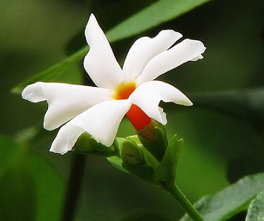
Good Morning

Slide 3
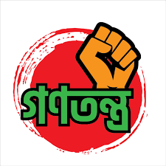
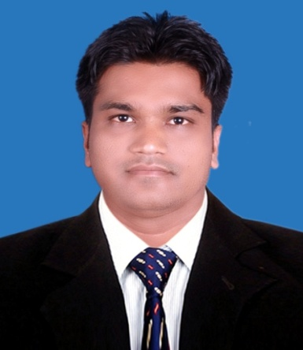
DEMOCRACY
Presented by...
Md. Alim Mahmud
Lecturer, Political Science
Govt. Mujib College, Sakhipur, Tangail.

Slide 4
What is Democracy?
Literally, Rule by the people.
History and Evolution of Democracy
The earliest democracy in the world began with the work of a man named Cleistheness, in Athens in 510bc.
2. Cleistheness is called the father of democracy.
3. In medieval Italy (venis & Florence), Switzerland, Flanders are seen as like democracy.
4. In Poland (1182) & Rise of perliamentary bodies in other European countries.
5. Rise of democratic perliament in England & Scottland.
6. 1760s-1790s Americans develop & apply concept of republicanism.
7. The end of 1st world war was a temporary victory for democracy in Europe.
8. After 2nd World war ultimately a victory for democracy in western Europe.

Slide 5
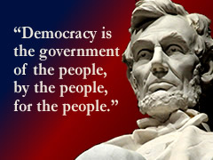
Definition...
That Shall be the democratic which shall be the
people, for the people-Klian (422bc)
of the people-elected politicians pass laws that the people obey.
by the people-everyone regardless of race, gender etc. should be allowed to stand for election.
for the people-elected politicians should govern on behalf of the people.
Democracy consists of four key elements:
A political system for choosing and replacing the government through free and fair elections; the active participation of the people, as citizens, in politics and civic life; protection of the human rights of all citizens, a rule of law, in which the laws and proceduresapply equally to all citizen.
Larry Diamond

Slide 6
Types of Democracy
Direct Democracy
Representative Democracy
Presidential Democracy
Parliamentary Democracy
Authoritarian Democracy
Participatory Democracy
Islamic Democracy
Social Democracy
Liberal Democracy
E- Democracy

Slide 7
The Pillars of Democracy
Elections.
Political tolerance.
Rule of law.
Freedom of expression.
Accountability and transparency
Decentralization
Civil society

Slide 8
Characterstics of Democracy
Elected representative.
Election are held to elect the representatives
Civil Liberties
Rule of Law
Independent juduciary
Organised Oposition party

Slide 9
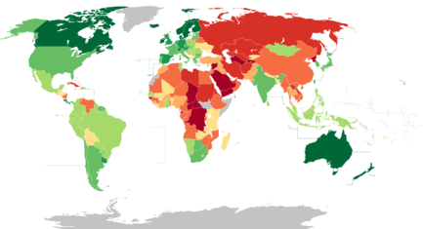
Democracy Index
The Economist Intelligence Unit Democracy Index map for 2018.
Full democracies 9.01–10 8.01–9 | Flawed democracies 7.01–8 6.01–7 | Hybrid regimes 5.01–6 4.01–5 | Authoritarian regimes 3.01–4 2.01–3 0–2

Slide 10
Democracy in Bangladesh
After the Independence of Bangladesh in 1971, the constitution was formed in 1972. The constitution had four fundamental principles which were 1.Democracy 2. Nationalism 3. Secularism and 4. Socialism. On 25 january, 1975 the president of Bangladesh Sheikh Mujibur Rahman established a one party state called BAKSAL.
The presidential form of government was introduced replacing the parliamentary system.
The powers of parliament were curtailed.

Slide 11
Democracy in Developing Countries-
India
Pakistan
Nepal
Bhutan
Sri Lanka

Slide 12
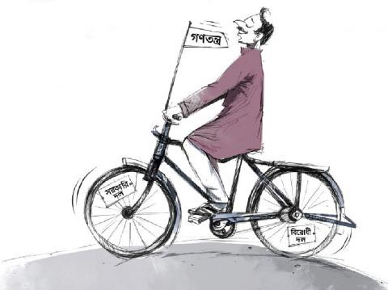
How Can Democracy be measured Best?
National elections are free & fair
Rule of law
Security of Voter
Influence of foreign powers on government
Capability of civil servants
Strong Institution
(election commision, judiciary, perliament)
7. Civil liberties
8. Control of corruption
9. Freedom of public opinion

Slide 13
Advantage | Disadvantage
1. Protects the Interest of citizen | 1. Mis uses of public funds.
2. Promots Equality | 2. Instigates Corruption
3. Makes a responsible & stable administration | 3. Risks the wrong choice of public servants.
4. Imparts political Education | 4. Allows not exercising the right to vote.
5. Helps makes good citizens | 5. Put more emphasis on quantity rather than quality.
6. Allows a little Chance of revolution | 6. Takes long time to make decisions.
7. Brings a feeling of Obligation | 7. Involve immoral practices during elections.

Slide 14
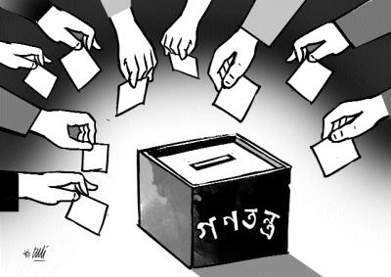
Pre-condition
of Democracy
1. Election and party democracy;
2. Participatory democracy and social capital;
3. NGO participation;
4. citizens' views on citizenship and their own
opportunities to influence;
5. Attitudes towards political institutions and
actors;
6. Criteria of informed citizenship;
7. Democracy education;
8. Municipal democracy;
9. Democracy and equality.

Slide 15
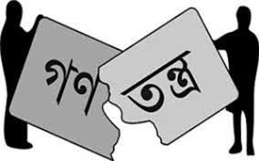
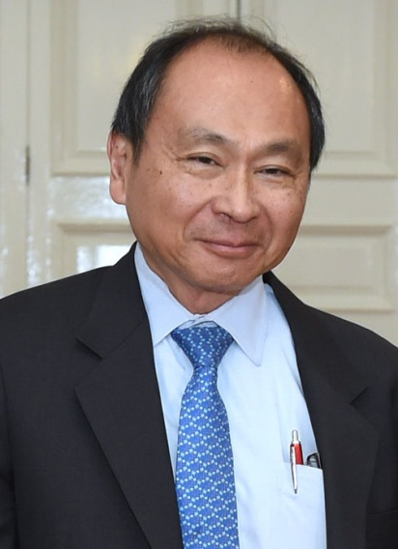
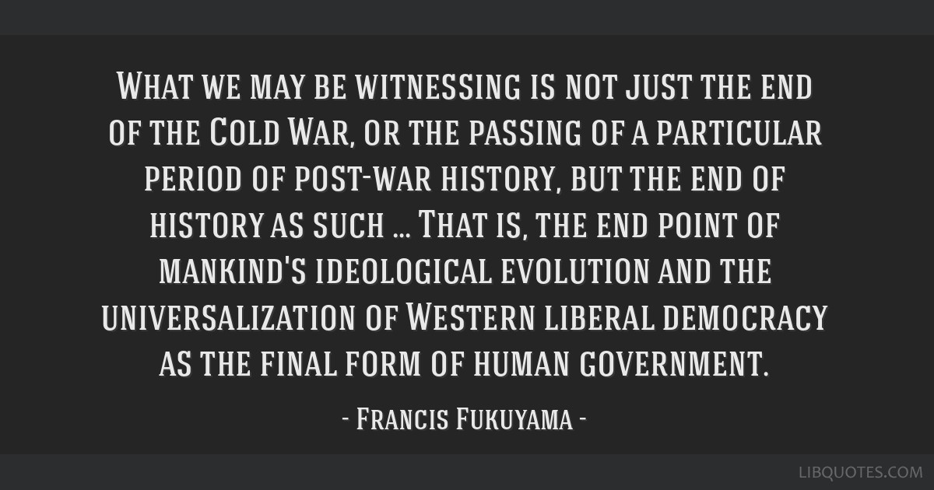
Quotation
1. The democracy of Bangladesh is going in the wrong way’-USA congress.
2. Democracy is in crisis in the middle ages’-David Runciman

Slide 16
Future of Democracy
* Globalization
* E-Democracy
* IT Revolution

Slide 17
Reference...
1. http//www.wikipedia.org
2. The encyclopedia of political Thought
3. https://scholar.google.com
4. www.google.com
5. academia.edu
6. “গণতন্ত্রের সংকট” – মাহমুদ শফিক
7. Gm.Gg. mvw` m¤úvw`Z, evOvwji MYZvwš¿K wPšÍvaviv; BZ¨vw` MÖš’cÖKvk, XvKv; †deÖzqvwi, 2010; c…ôv- 466| 'evsjv‡`k I wek¦cwiPq' 9g-10g †kÖYx|

