Slide 1
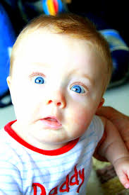
WELCOME TO MULTIMEDIA CLASS
Md.Alauddin,Assistsnt teacher,Pagla Govt.Model High School & college,Sunamganj

Slide 2
Introduction
Md. Alauddin
Assistant teacher Pagla Govt. Model High School and College SouthSunamgonj,Sunamgonj Mob.01765740395 | Class-8 English First Paper Unit-5,lesson-2 Date-00-05-2020
Md.Alauddin,Assistsnt teacher,Pagla Govt.Model High School & college,Sunamganj

Slide 3
Can you guess what is the picture about?
Md.Alauddin,Assistsnt teacher,Pagla Govt.Model High School & college,Sunamganj

Slide 4
Our Today’s Lesson is-
Flash Back
Md.Alauddin,Assistsnt teacher,Pagla Govt.Model High School & college,Sunamganj

Slide 5
Learning Outcome…
After the end of the lesson the Ss will be able to –
1.Read and understand through silent reading
2.Infer meaning through silent reading
3.Ask and answer the questions
4.Discribe a struggled person
Md.Alauddin,Assistsnt teacher,Pagla Govt.Model High School & college,Sunamganj

Slide 6
Key Words
Stunned
Stopped/motionless
Listening to her, we were stunned
Md.Alauddin,Assistsnt teacher,Pagla Govt.Model High School & college,Sunamganj

Slide 7
Key Words
Admiration
Praise/Delight
Our hearts were filled with admiration
Md.Alauddin,Assistsnt teacher,Pagla Govt.Model High School & college,Sunamganj

Slide 8
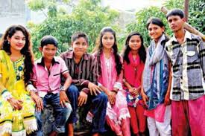
Key Words
Young/ preadult
adolescent
Shamima had all dreams of an adolescent.
Md.Alauddin,Assistsnt teacher,Pagla Govt.Model High School & college,Sunamganj

Slide 9
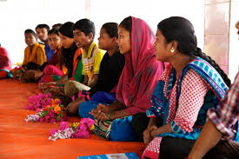
Key Words
Attention
heed
Shamima did not want to get married. But nobody paid any heed to her.
Md.Alauddin,Assistsnt teacher,Pagla Govt.Model High School & college,Sunamganj

Slide 10
A. Read the following text silently and take part in activities.
Shamima started to tell us her story. Listening to her, we were stunned and at the same time our hearts were filled with admiration for her. It was 1995. Shamima was 15 years old. She got promoted to class 8. Shamima had all the dreams of an adolescent. She wanted to bring about a change in her life. She wanted to see happiness in her family too. She knew she could fulfill her dream by completing her education and getting a good job. Fifteen-year old Shamima's dreams were nipped in the bud. Her father wanted to marry her off against her will. Marrying off a girl under 18 is against the law in Bangladesh. Shamima did not want to get married. But nobody paid any heed to her. They arranged her marriage with a man much older than her. All her tears and protests went in vain. Shamima was married off to Kamal Uddin Joardar.
Md.Alauddin,Assistsnt teacher,Pagla Govt.Model High School & college,Sunamganj

Slide 11
B. Choose the best answer.
1. Shamima's story ......... everyone.
a) Fascinated b) Astonished c) shocked d) worried
2. Shamima thought about the welfare of her ......
a) family. b) friends.
c) Cousins d neighbours.
3. Shamima did not want to get married because she wanted to complete her education but nobody...... her.
talked to b) listened to
c) took care of d) looked after
Individual work
3 minute
Md.Alauddin,Assistsnt teacher,Pagla Govt.Model High School & college,Sunamganj

Slide 12
C.Read the text again and answer the following questions
1. How long ago did Shamima begin to tell her story?
2. What did Shamima dream of?
3. Did Shamima's dream come true? What happened?
How old is Shamima now?
5. As an adolescent, what are your dreams?
Pair work
10 minute
Md.Alauddin,Assistsnt teacher,Pagla Govt.Model High School & college,Sunamganj

Slide 13
D. Write about a person who has suffered or struggled like Shamima.
Use the following phrases :
Group work
10 minute
pay heed to
nip in the bud
in vain
Md.Alauddin,Assistsnt teacher,Pagla Govt.Model High School & college,Sunamganj

Slide 14
Evaluation
What was her dream?
What is the cause of her dream breaking?
Who is Shamima?
When she was married off ?
What did she want to see ?
Md.Alauddin,Assistsnt teacher,Pagla Govt.Model High School & college,Sunamganj

Slide 15
Home work
Write ten sentences about Shamima”masires.
Md.Alauddin,Assistsnt teacher,Pagla Govt.Model High School & college,Sunamganj

Slide 16
Md.Alauddin,Assistsnt teacher,Pagla Govt.Model High School & college,Sunamganj

