Slide 1
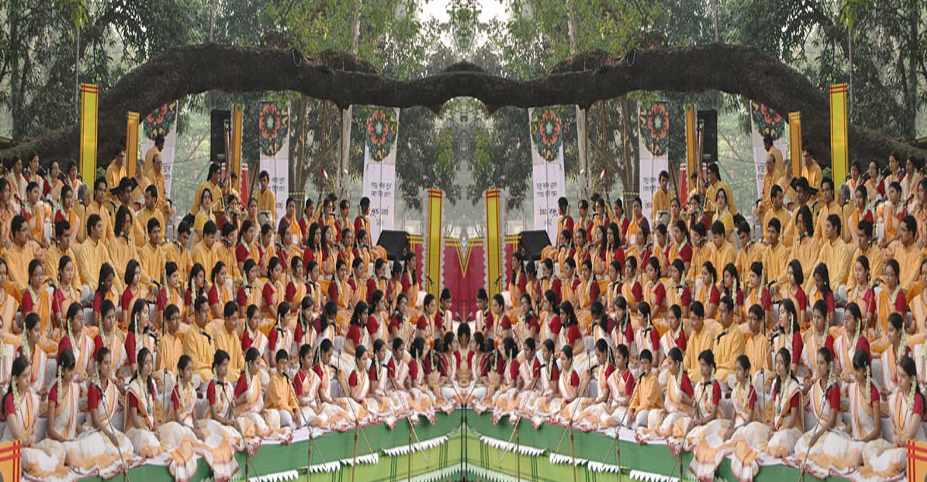

Slide 2
Welcome

Slide 3
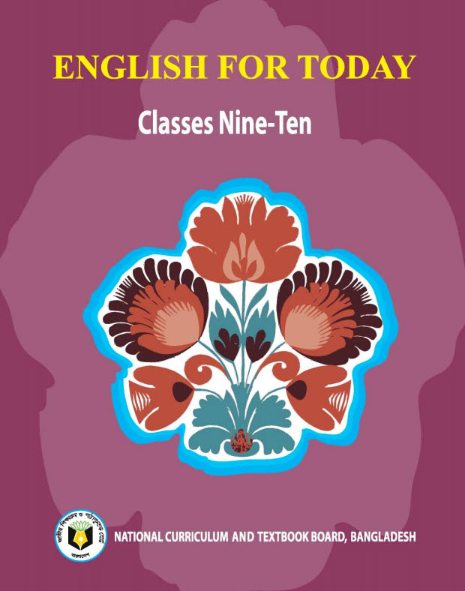
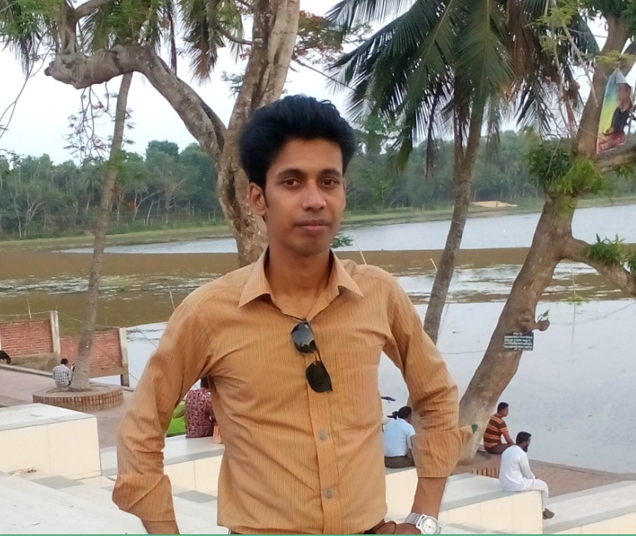
Introduction
Swandip Banerjee
Asst. teacher (English)
Pallimangal Secondary School
Sonadanga, Khulna,
Mobile: 01718503573
E-mail: swandipb1@gmail.com

Slide 4
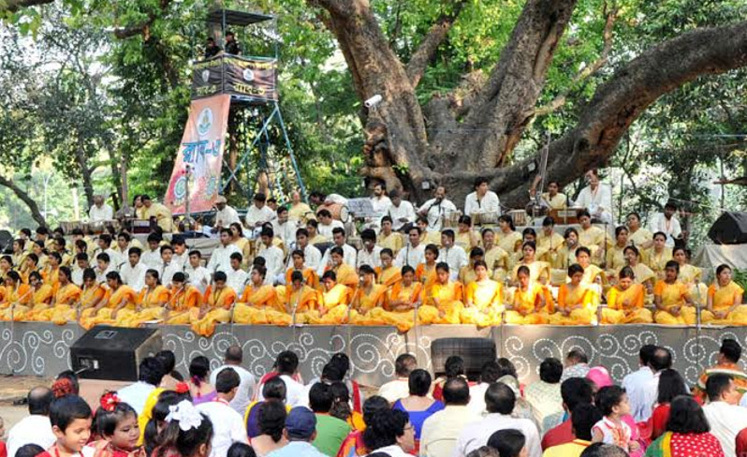
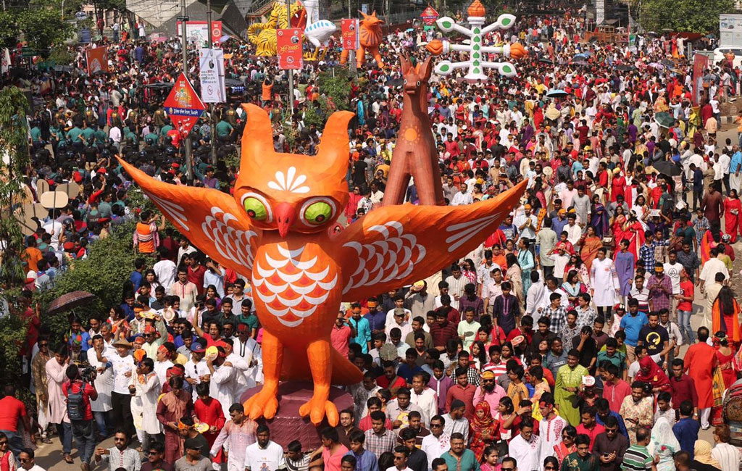
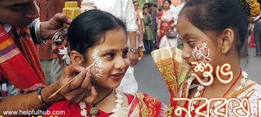
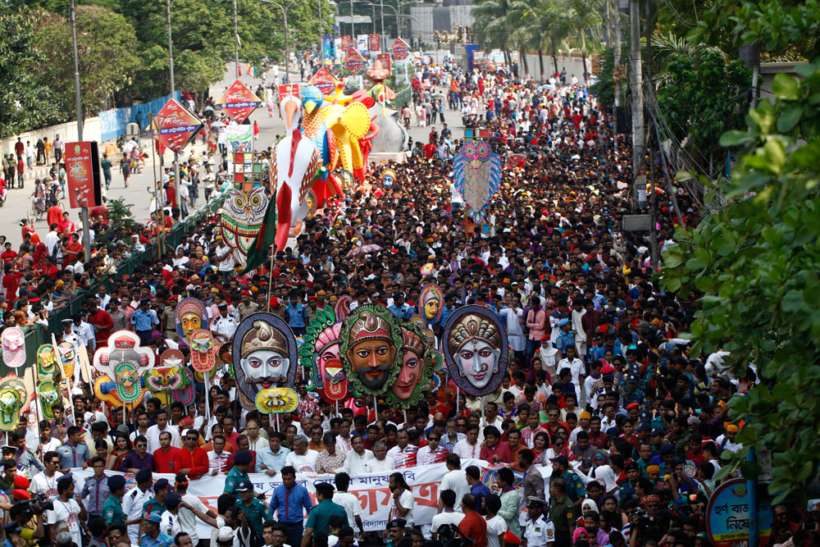
What do you see in each picture and listen to?

Slide 5
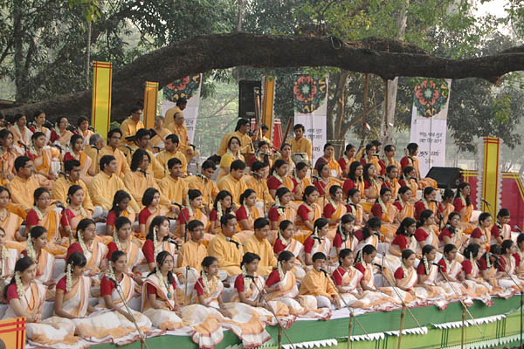
Our today’s lesson is…..
Pahela Boishakh
Unit: 3 Lesson: 6

Slide 6
Learning outcomes
After we have studied this lesson, we will be able to…
talk about events and festivals.
ask and answer questions.
infer meanings from the context.

Slide 7
Look at the picture. Then ask and answer the questions about it.
What’s the picture about?
Where do you think it is?
3. What are the people doing?

Slide 8
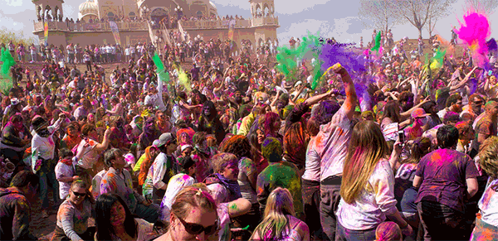
Unknown word and its meaning.
Festive
Typical of a special event or celebration.
Synonym: Delighted, Mirthful

Slide 9
Unknown word and its meaning.
Procession
A line of people or vehicles that move along slowly, especially as part of a ceremony.
Synonym: March, Train

Slide 10
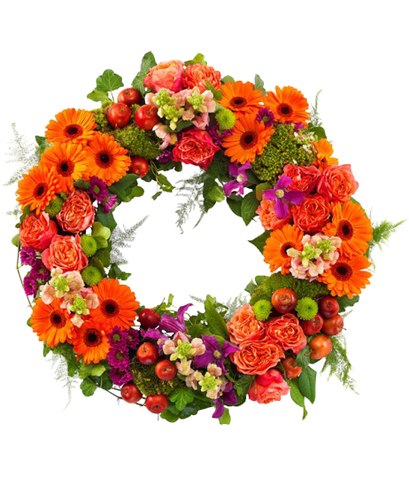
Unknown word and its meaning.
Wreath
An arrangement of flowers and leaves, especially in the shape of a circle.
Synonym: Garland

Slide 11
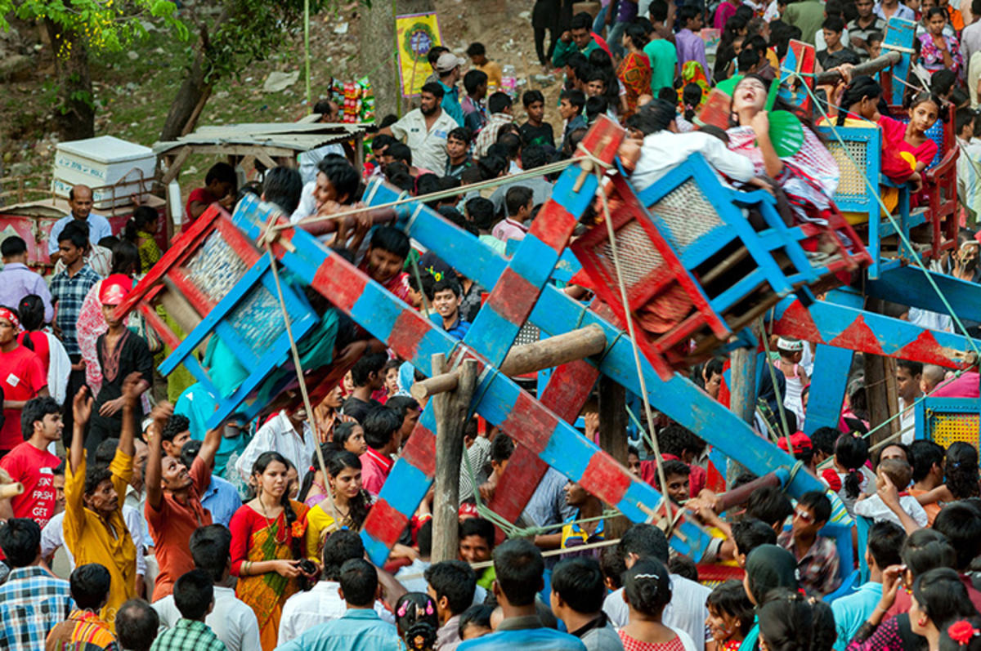
Unknown word and its meaning.
Carnival
A public festival that happens at a regular time each year for which people wear colourful clothes.
Synonym:
Festive gathering

Slide 12
Now, dear students open at page 39 pf your EFT and read the text. Then try to answer to the following questions in pairs.
‘Pahela Boishakh’ is the first day of Bangla new year. The day is………………………….. a day of cultural unity for the whole nation irrespective of caste and creed.
Text
Question

Slide 13
Read the text.
‘Pahela Boishakh’ is the first day of Bangla new year. The day is a public holiday. This day has a special significance for us as it forms a part of Bangalee culture and tradition. People from all walks of life, irrespective of their ethnic identity or religious beliefs, celebrate the day with traditional festivities. On this day, the whole of Bangladesh is in a festive mood. The day inspires people to start life with renewed hopes and inspirations.
Every year the day is celebrated traditionally. People wake up early in the morning, have a bath and wear their traditional clothes. Women wear white saris with red borders and adorn themselves with colourful churis and flowers, while men dress themselves with pajamas and punjabis. It is a day when people love eating traditional food.
This day the most colourful event is held in Dhaka. Early in the morning, people in hundreds and thousands pour in from all directions to attend the cultural function at Ramna Batamul organised by Chhyanata. The cultural programme begins just with sunrise and the renowned artists of the country take part in the program that starts with the famous Tagore-song Esho-he-Boishakh, Esho Esho ........ . Artists also sing traditional folk songs, and display classical dances with the rhythm of musical instruments.
Next

Slide 14
People also come to join the colourful processions, the biggest carnival of the country, organised by the Fine Arts students of Dhaka University. The procession usually displays the traditional practices of Bangalee culture. The masks and wreaths worn by the people are so fascinating! Often they symbolise contemporary worries or happiness in the national life. It attracts increasing number of foreign tourists every year.
The day is also observed all over the country. Different social and cultural organisations and educational institutions celebrate the day with their own cultural programmes.
On this day, newspapers bring out special supplements. There are also special programmes on the radio and television channels.
The celebration of Pahela Boishakh marks a day of cultural unity for the whole nation irrespective of caste and creed.
Back

Slide 15
C. Ask and answer these questions in pairs.
Do you go out in the morning of Pahela Boishakh? If you do, where do you go? If not, what do you do?
What kind of food do you eat in the morning of Pahela Boishakh?
Do you wear any special clothes on this occasion?
Text

Slide 16
Group work
D. Complete the passage with suitable words.
The word Pahela means the first and Boishakh is the (a) ----- month of Bangla calendar. The day is observed not (b) ----- in Bangladesh but (c) ------in some other parts of the world. It is celebrated in West Bengal , Assam and Tripura. It is also (d)------------in Australia and UK. In Australia, the largest (e) ------- for Bangla new year is the Sydney Boishakhi Mela held (f) ---- Sydney Olympic park. In England, the Bangalees (g) ------- celebrate the day with a street (h) -------------- in London. It is the (i) ----------------Asian festival in Europe, (j) ------------- Bangladesh and West Bengal.
first
only
also
observed
festival
in
also
procession
traditional
upholding

Slide 17
Evaluation
What do people do in the morning?
What do people love to eat in the morning of Pahela Boishakh?
What do the masks and wreaths symbolise?
On Pahela Boishakh, what do the radio and television do?
Where is the most colourful event of Pahela Boishakh held?

Slide 18
Home work
Describe your own cultural or religious festival that you celebrate. You can use the following words. You can also use other words relevant to the festival.
colourful special traditional religious dance
flowers food songs festive cultural

Slide 19
Thank you

