Slide 2
Mental Preparation

Slide 3
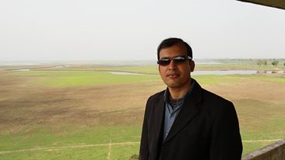
Md.Anowar Hossain Assistant Teacher. Pirpur Gouripur Govt. Primary School Chhatak, Sunamgonj.
Teacher's Identification

Slide 4
Warm up
Good morning ,student
Good morning, Teacher.
How are you?
Fine,
Fine thankyou ,and you

Slide 5
Learning outcomes:
Listening
4.2.1. Able to understand and enjoy simple story.
Speaking
6.2.1. Able to talk about people.
Reading
1.7. Able to read the paragraph with correct stress and intonation.
Writing
10.1.1. Able to write a short composition by answering a set of questions.

Slide 6
Today’s Lession
Sub-English. Class-Five
Unit:9.Occupations.Lesson1-2 Time-40 min

Slide 7
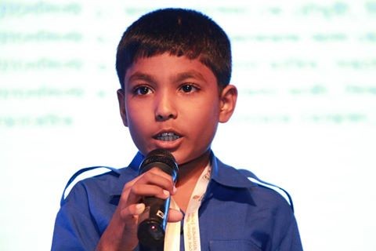
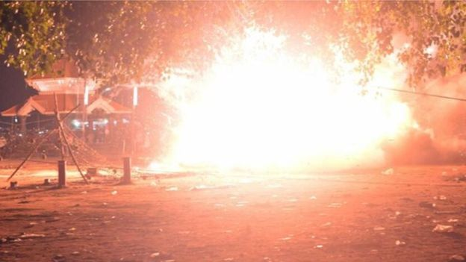
Raju
Long time ago, when Raju was in class 5, there was a fire in his school building.

Slide 8
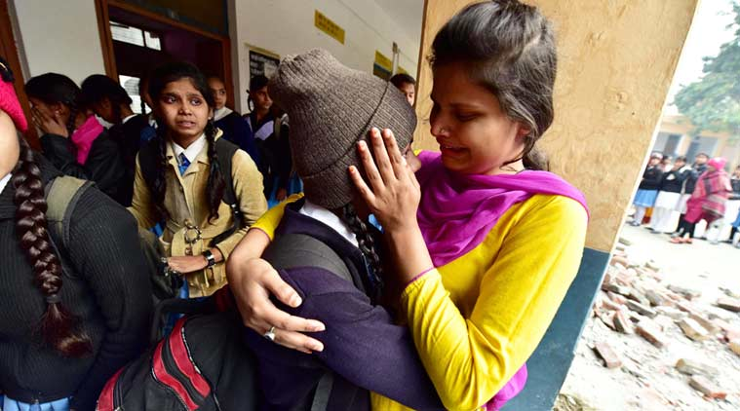
Everyone got panicked.

Slide 9
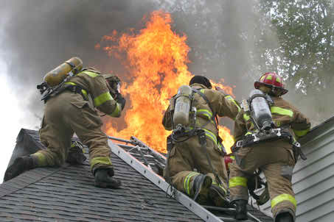
But soon a fire brigade came and put out the fire. Raju could not forget this for many days.

Slide 10
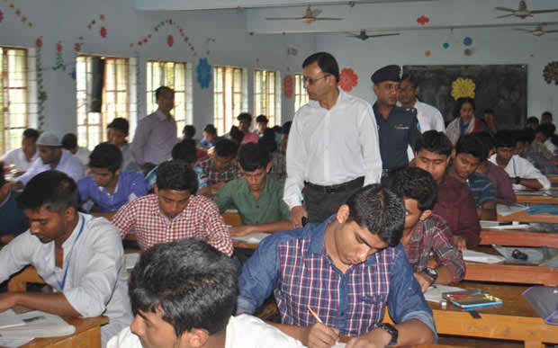
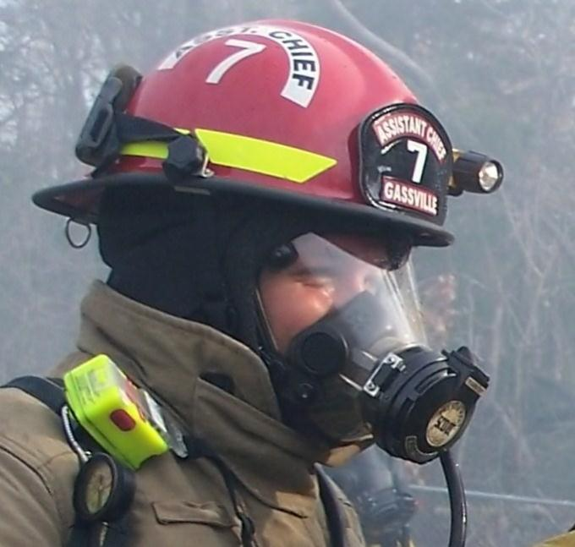
Raju
After his HSC, he joined a volunteer fire department.

Slide 11
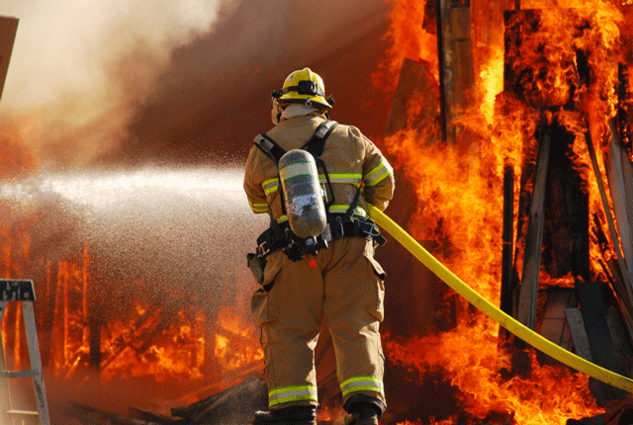
Now Raju is a full-time fire fighter. His main job is putting out fires.

Slide 12
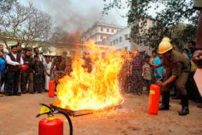
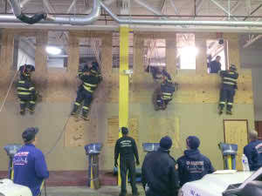
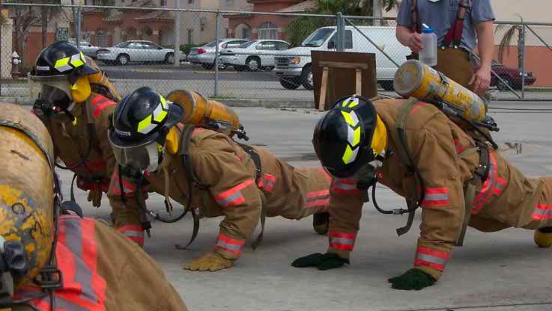
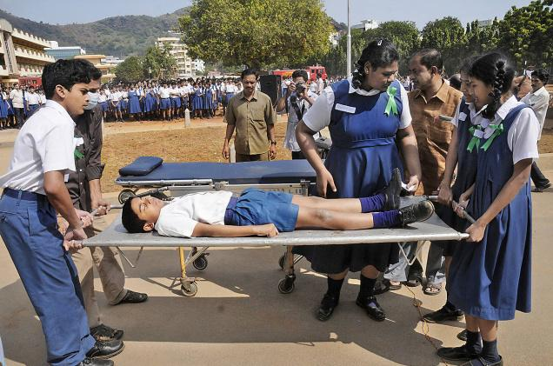
Raju
He also trains young people to become firefighter.

Slide 13
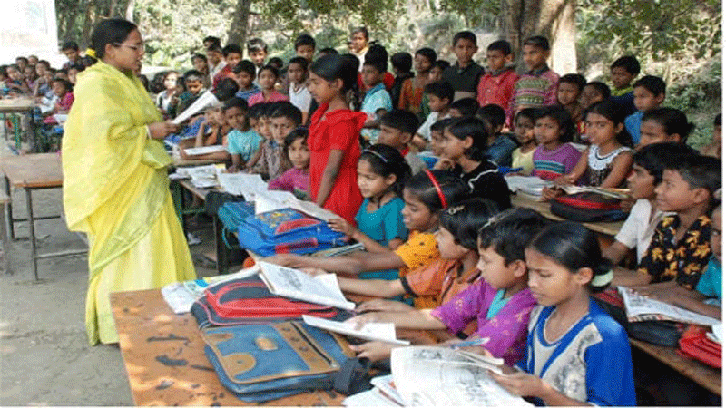
Now open your book at page 36 and read after me. Then read alone.

Slide 14
Panicked
He got panicked.
Put out
Put out the lamp.
Full-time
He is a full time teacher.

Slide 15
Group Work
Group-1
Write five sentences about Raju .
Group-2
Write five sentences about a teacher.
Group-3
Write the name of some professions you know.

Slide 16
Open discussion on text
Answer the questions:
Who is a firefighter?
Is Raju a part time firefighter?
What does a firefighter do?
true or false:
Raju is a doctor.
2. Raju is afraid of fire.
3. After HSC, Raju joined a volunteer fire department.

Slide 17
Now think about a firefighter and write a short composition by answering the following questions.
1. What does he do?
2. What time does he starts his work?
3. How does he do the work?
4. Do you like the job of a firefighter?

Slide 18
Group work
Group-A
Group-B
Write three sentence about fairfighter.
Write three occupation

Slide 19
Evaluation
Write the answer of following questions.
1.Where did the fire take place?
2.Who helped the students to leave the building? 3.Who put out the fire?

Slide 20
Home work
Write five occupation.

