Slide 1
To Multimedia Class

Slide 2
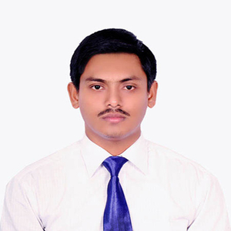
Teacher’s Identity
Md. Arafat Hossain
Assistant Teacher (English)
Haripur High School
Joypurhat Sadar, Joypurhat-5900.
E-mail: arifjoy1991@gmail.com
Contact: 01747994114

Slide 3
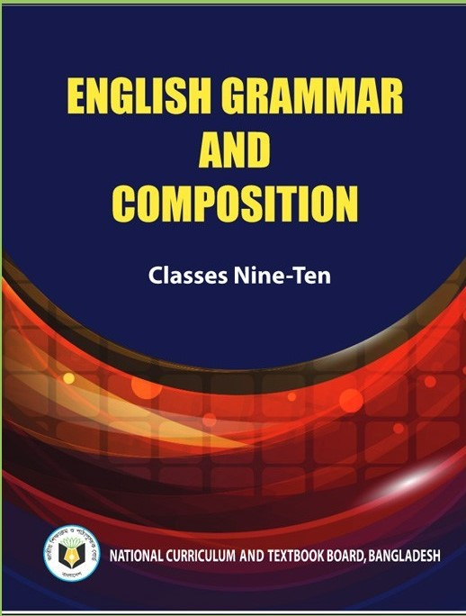
Lesson Introduction
Class: Nine Subject:English 2nd part (English Grammar and Composition) Time: 50 Minutes

Slide 4
What do you see in the stars?
A
D
G
M
P
Y
Yes, these are capital letters.

Slide 5
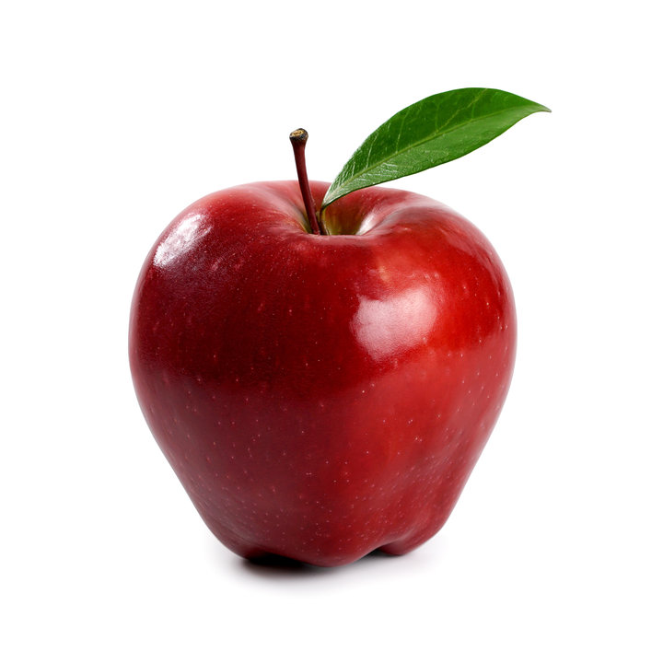
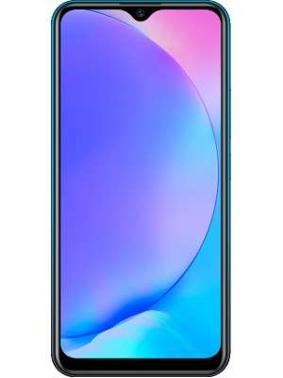
Rony wants an apple.
I lost my mobile phone.

Slide 6
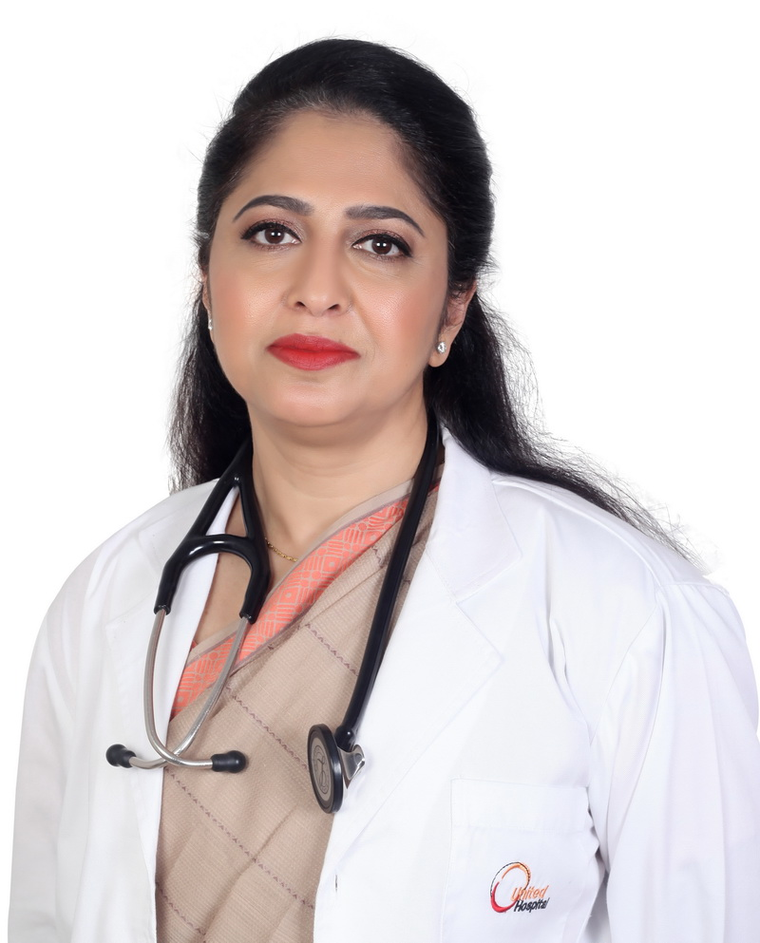
Her name is Dr. Shirin.
Can you guess our today’s topic?

Slide 7
Our today’s lesson is-
“Capitalization”

Slide 8
Learning Outcomes
Upon completion of this lesson, students will be able to:
list the rules for capitalization
identify errors in capitalization
use capitalization.

Slide 9
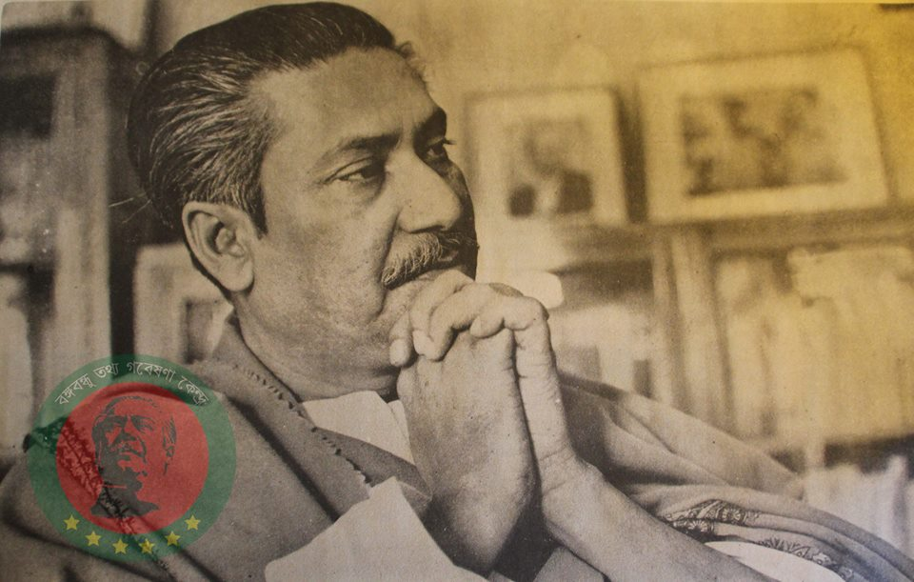
Capitalization means using a capital letter (for example, A instead of a).
Sheikh Mujibur Rahman was a Bangladeshi politician and statesman. He is called the "Father of the Nation" in Bangladesh.

Slide 10
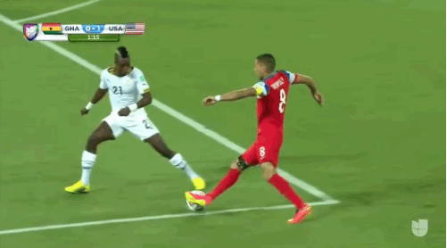
Capital letters have various uses:
To begin a sentence:
Incorrect: they are playing football.
Correct: They are playing football.

Slide 11
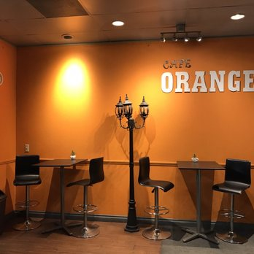
To begin proper nouns and proper adjectives:
Incorrect: café orange serves delicious food.
Correct:Café Orange serves delicious food.
Incorrect: We get indian foods in this restaurant.
Correct: We get Indian foods in this restaurant.

Slide 12
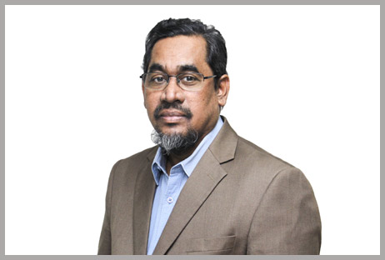
To begin people’s titles and their abbreviations:
Incorrect: My teacher’s name is prof. Zahangir Alam, ph.d.
Correct: My teacher’s name is Prof. Zahangir Alam, Ph.D.

Slide 13
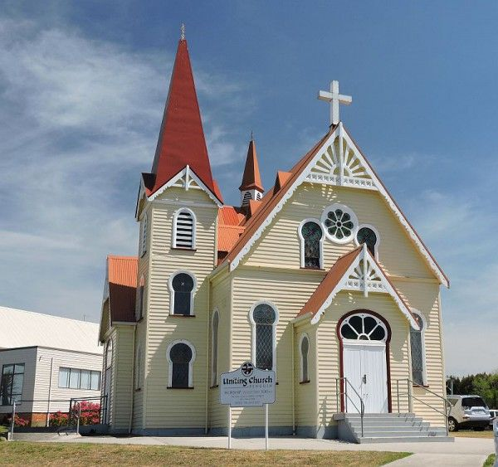
To capitalize the names of specific courses, religions, languages, and organizations:
Incorrect: There is one christian church in my town.
Correct: There is one Christian church in my town.
Incorrect: Learn english with a friend.
Correct: Learn English with a friend.

Slide 14
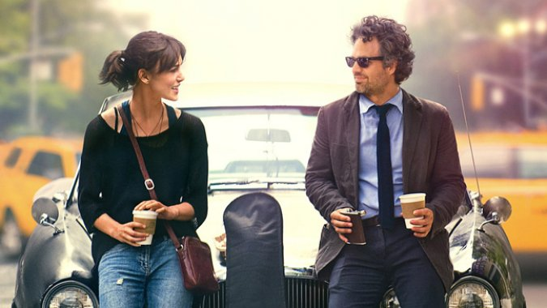
To begin the first word in a title:
'Begin Again’(movie title)

Slide 15
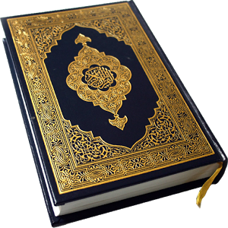
To begin the name of Allah or God and any pronoun referring to Him:
Incorrect: allah loves all his creations.
Correct: Allah loves all His creations.
Incorrect: god created us all.
Correct: God created us all.
To write name of religious book:
The Holy Quran
To write the pronoun ‘I’:
He and I are good friends.

Slide 16
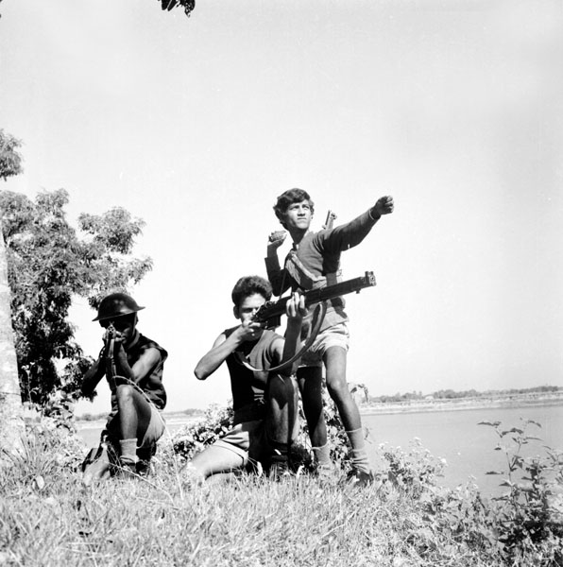
To begin each word describing a historical event:
Incorrect: The liberation war of bangladesh took place in 1971.
Correct: The Liberation War of Bangladesh took place in 1971.

Slide 17
The first letter of months, days, and holidays (but not seasons).
Today is June 8, 2020.
The shops are closed on Easter.
We visited on Monday.
This summer is going to be very hot.
Geographic areas: cities, states, countries, mountains, oceans, rivers, etc.
My destination is Paris, France.
Hawaii is in the middle of the Pacific Ocean.

Slide 18
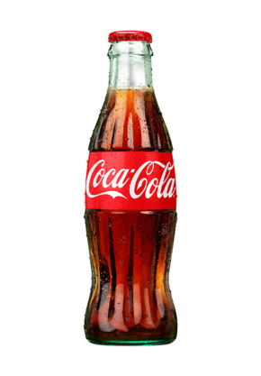
Individual Work
Find and correct the mistakes below.
rahel ate lunch with me.
Amy and i are going to the market.
My dog’s name is jony.
samantha has finished her task.
We are going to hawaii for vacation.
where is the school?
My birthday is in september.
We are going to rangamati in june.
We often eat italian food.
I like coca-cola.
S
R
I
J
S
I
H
J
W
C
C

Slide 19
Group Work
Correct the following passage using the rules of capitalization.
alexander, the great, was the king of macedonia. he was the son of philip, a mighty king of sparta. He invaded india about 327 years before the birth of christ. on the way, he defeated puru and marched towards punjab.
Alexander, the great, was the king of Macedonia. He was the son of Philip, a mighty king of Sparta. He invaded India about 327 years before the birth of Christ. On the way, he defeated Puru and marched towards Punjab.

Slide 20
Home work
Write a paragraph about ‘Your best friend’ using the rules of capitalization.

Slide 21
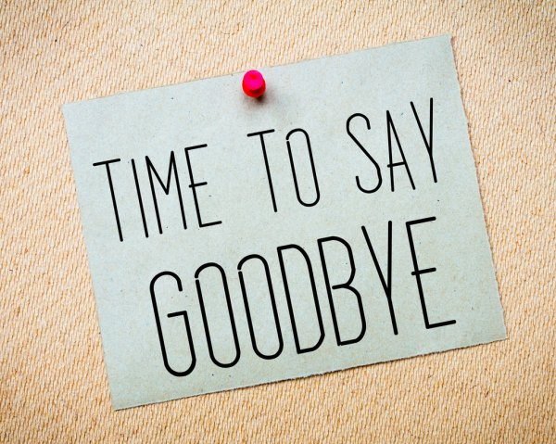
Thank you all for your attention.

