Slide 1
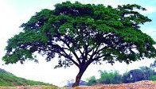
WELCOME

Slide 2
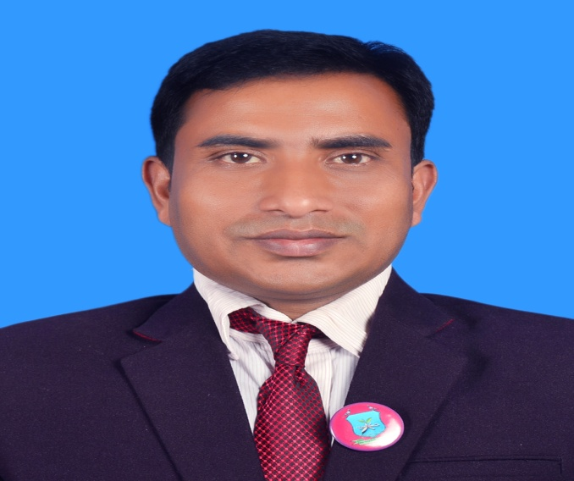
INTRODUCTION
Suranjit Talukder
( BA, B-Ed; MSS, M-Ed; C-in-Ed )
Assistant teacher
Voishber Govt. Primary School.
Sunamgonj Sadar , Sunamgonj.
Class: Five
Subject: English
Unit:14 ,Lesson: 1
Date:
Time:40 Minutes

Slide 3
CREATING EMOTION
Good morning , students.
Good morning , teacher.
How are you?
Fine . And you?
I’m also fine. Do you want to enjoy sing a song?
Let’s sing a song …

Slide 4
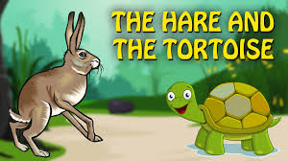
Today’s topic is ……..

Slide 5
LEARNING OUTCOMES
Students will be able to………
enjoy and understand simple stories.
say words, phrases and sentences with proper sounds, stress and intonation.
To read silently with understanding simple sentences , paragraphs and other texts.
To make sentences using words and phrases.

Slide 6
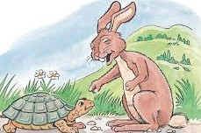
Please think about the picture and discuss in pair
What do you see in the picture?
The hare is teasing the tortoise

Slide 7
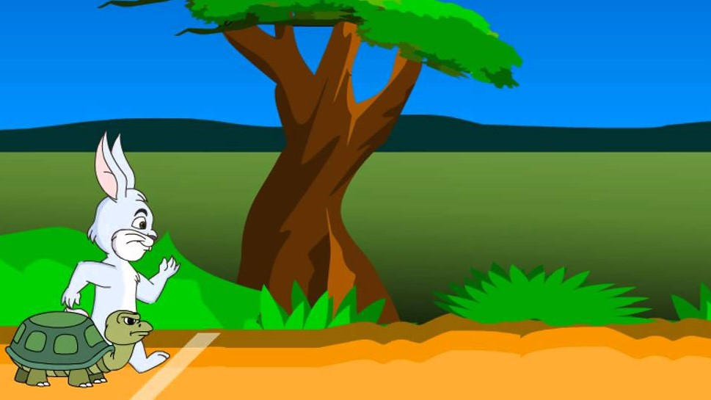
Please think about the picture and discuss in pair
What do you see in the picture?
The Hare and the Tortoise are ready to start their race.

Slide 8
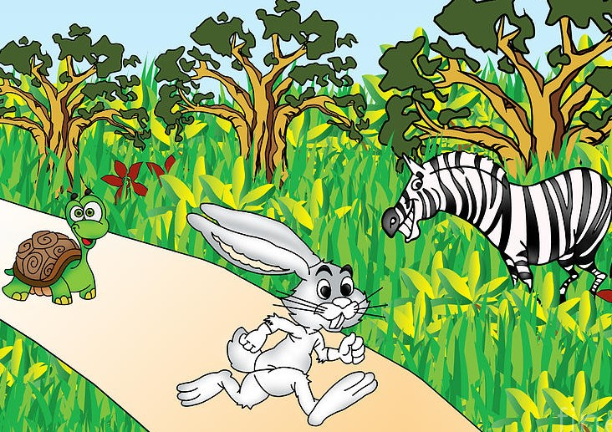
Please think about the picture and discuss in pair
What do you see in the picture?
The race has been starting between the hare and
the tortoise and others are enjoying .

Slide 10
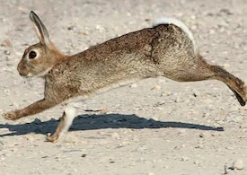
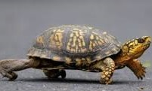
New Words Meanings
Hare : Rabbit
Tortoise : Turtle

Slide 11
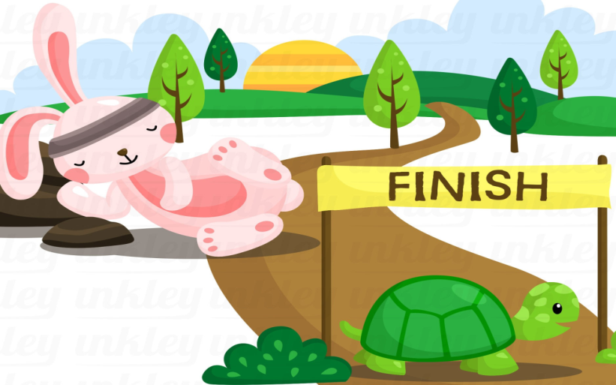
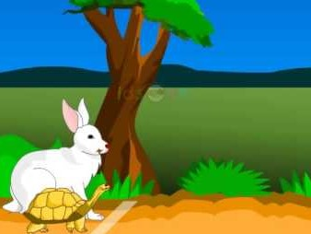
New Words Meanings
Finish : End
Began: Started

Slide 12
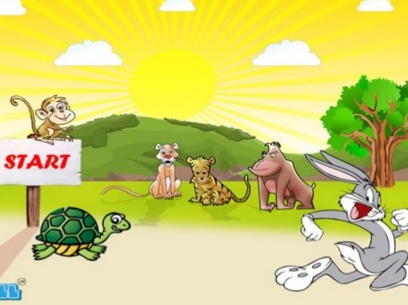
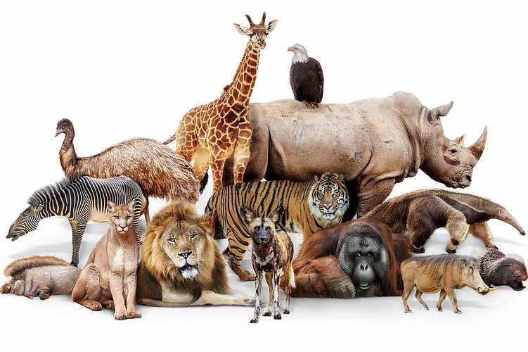
New Words Meanings
Start : Begin
Animals : Beast, Creature.

Slide 13
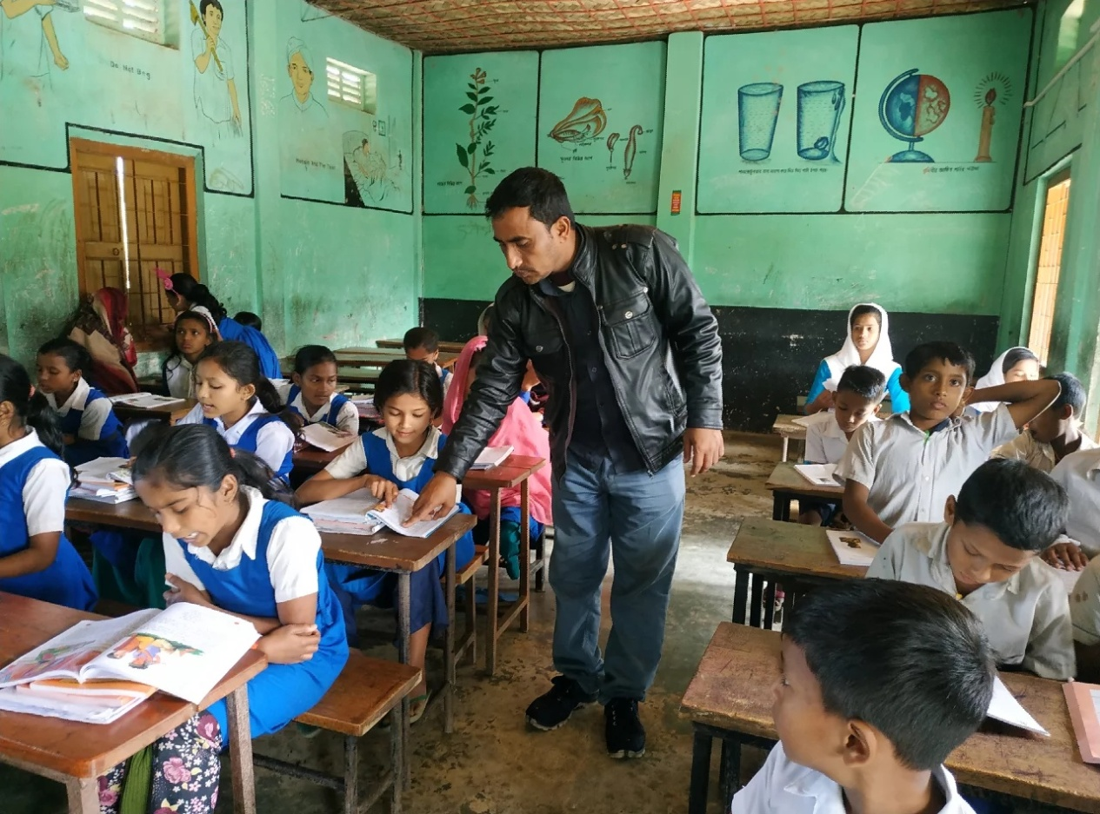
Listen to the text with me and put your finger under the line.

Slide 14
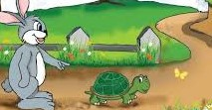
One day, a hare was walking in the forest when he saw a tortoise.The hare was the fastest animal in the forest . The tortoise was the slowest animal in the forest.The hare called out, “Hurry up ! You are so slow ! Can’t you walk faster ? Can’t you run?”
The tortoise felt angry and said to the hare , “Why don’t we have a race?May be I can win!”

Slide 15
The hare laughed and laughed .“Sure! I will win ” the hare said. They agreed to start next to a big tree and finish at the river.
Then they called their friends to watch . The hare stood beside the tortoise and the race began.

Slide 16
Now read loudly after me.

Slide 17
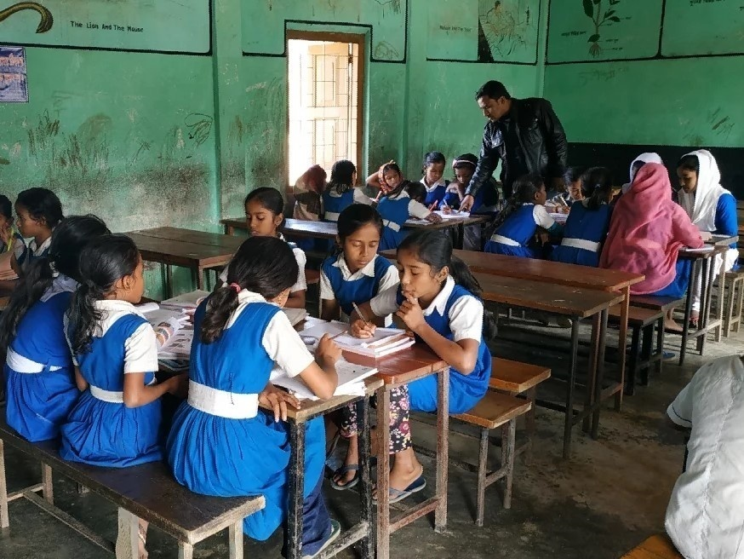
Now read the text in groups.

Slide 18
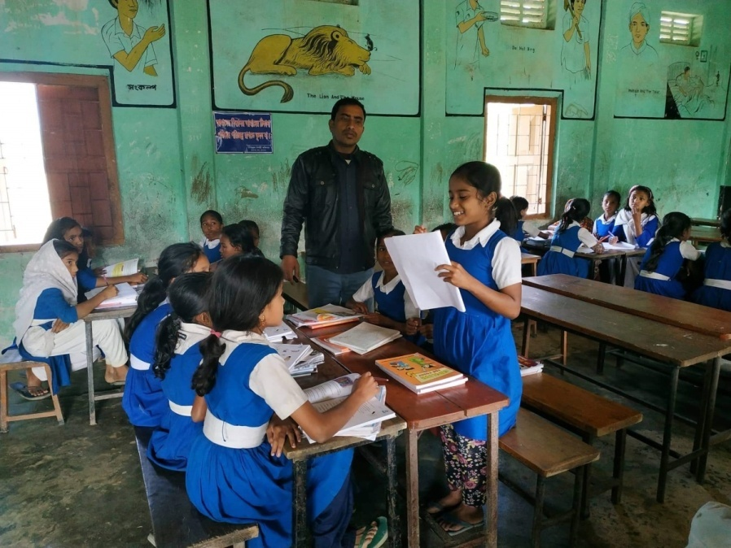
A student will be selected from every group to present their group work.

Slide 19
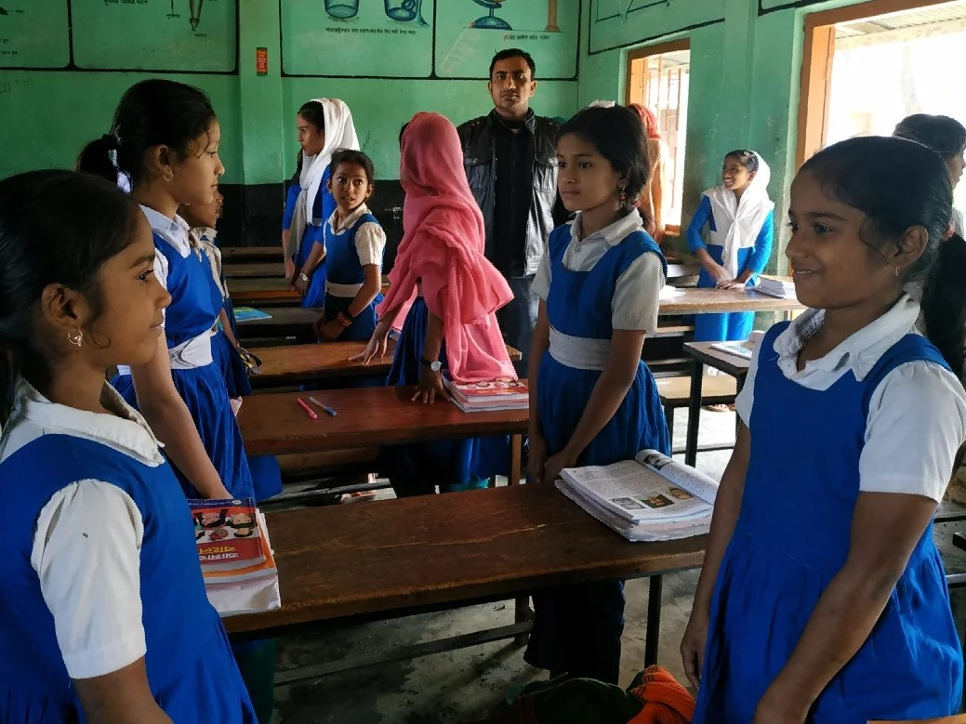
Pairwork.

Slide 20
Pairwork
Ask and answer.
1.Who was the fastest animal in the forest?
2.Who was the slowest animal in the forest?
3.Why do you think the tortoise want to have a race with the hare?
4.Where did they start the race from?
5. Where did they finish?

Slide 21
INDIVISUAL WORK
Write True or False
1.The tortoise was the fastest animal in the forest.
2.The hare was the slowest animal in the forest.
3.The tortoise felt angry .
4.They agreed to swim in the river.
5. Then they called their friends to watch their race’

Slide 22
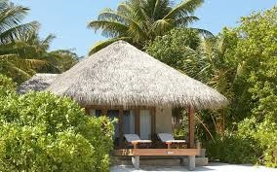
Homework
Write the meanings of the following words and then make sentences by using them.
Hare,Tortoise,Forest,Animal,Race.

