Slide 1
W
E
L
C
O
M
E

Slide 2
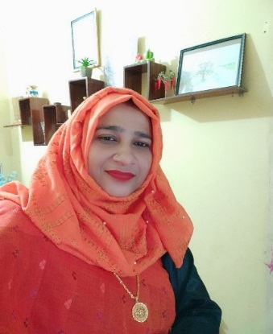
Introduction
Class: Two
Subject: English. Unit:2. Lesson:1-3
Page no : 4
Maksuda khatun
Assistant Teacher
S.M Govt. Primary School.
Meherpur sadar, Meherpur.

Slide 3
By the ends of the lesson students will be able to…
Listening: 1.1.1 become familiar with English sounds by listening to
common English words
Speaking: 1.1.1 repeat after the teacher simple words and phrases with
proper sounds and stress.
1.1.2 say simple words and phrases with proper sounds and stress.
LEARNING OUTCOMES
Reading: 1.2.1 recognize and read cardinal numbers up to 30.

Slide 4
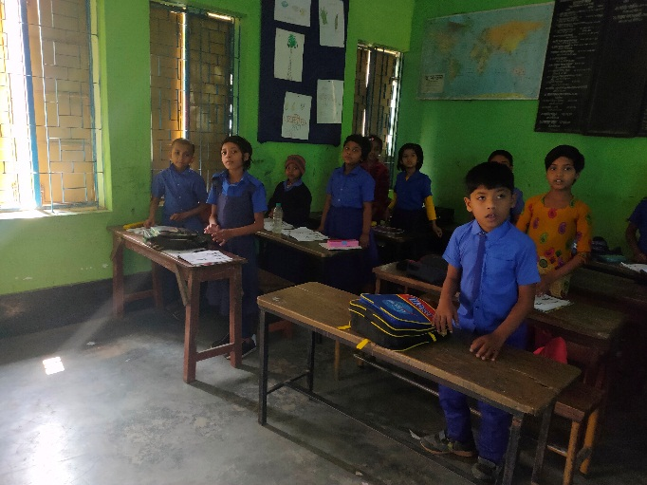
Greeting song
Now We sing the good morning song with action.

Slide 5
Let’s watch a video

Slide 6
Today’s Lesson
Numbers

Slide 7
Now, Look at the Picture.
1
What’s this?
How many ball?
one
ball

Slide 8
2
How many balls?
two

Slide 9
How many balls?
3
three

Slide 10
How many balls?
4
four

Slide 11
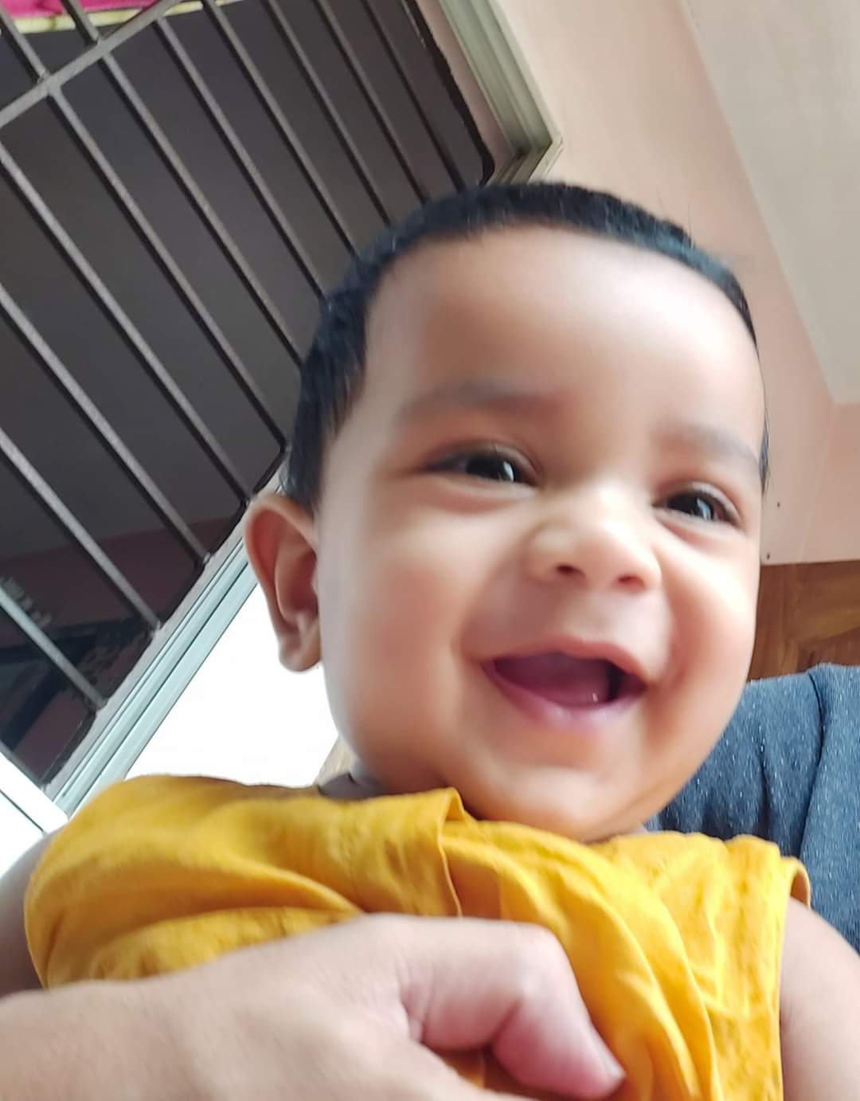
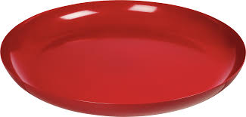
How many gems chocolate did the child eat?
Lets pay a game.
4
Look carefully

Slide 12
Reading practice
Number
Word
1
one
2
two
3
three
4
four

Slide 13
How many birds fly in here?
Individual Work

Slide 14
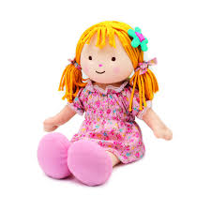
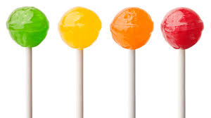
Count the pictures and say the numbers:
1
How many doll?
2
EVALUATION
How many flowers?
How many lolipops?
4

Slide 15
Match the numbers with words
3
four
1
TWO
EVALUATION
4
THREE
2
ONE

Slide 16
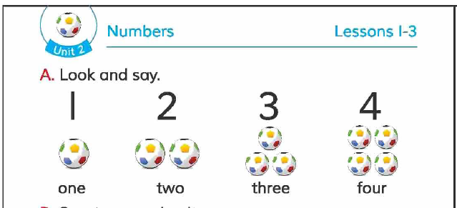
Open your book at page 4, See Activity A

Slide 17
Sit in groups and count the sticks.
Group Work

Slide 18
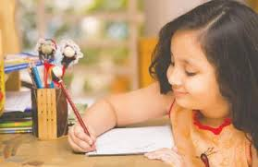
You will practice the numbers in your home.
1 | 2 | 3 | 4
one | two | three | four
Home work

Slide 19
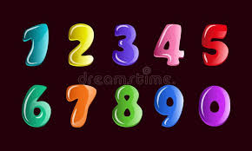
Thank you, Students
Goodbye

