Slide 1
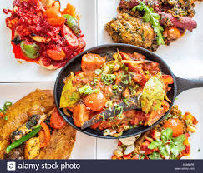
Welcome

Slide 2
IDENTITY
Azizul Fakir
Assistant teacher
Dighijan Secondary School
Nazirpur, Pirojpur.
Email: azizul.nk@gmail.com
Mobile: 01710745128
Unit – One
Lesson - 5

Slide 3
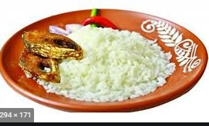
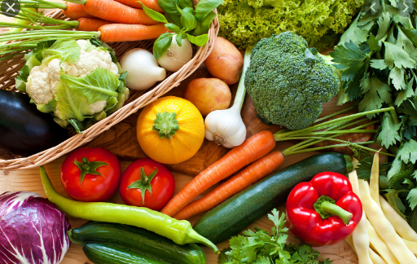
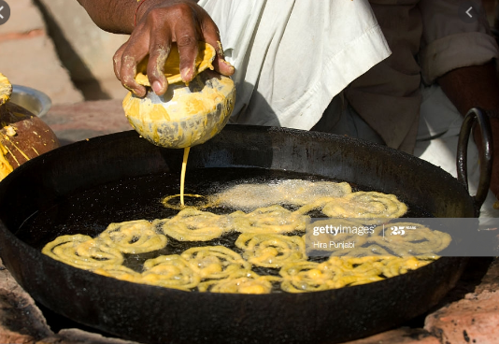
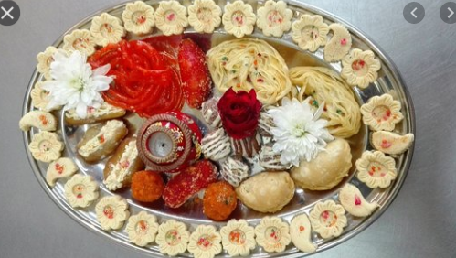
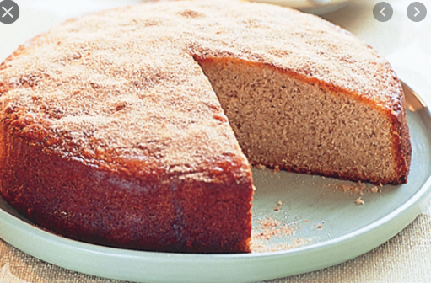
What do you see in the picture?
Panta ilish
Vegeetables
Sweetmeats
Cakes
We see a woman is cooking and a man is making sweets. And we also see panta ilish, some vegetables, some sweetmeats and cake

Slide 4
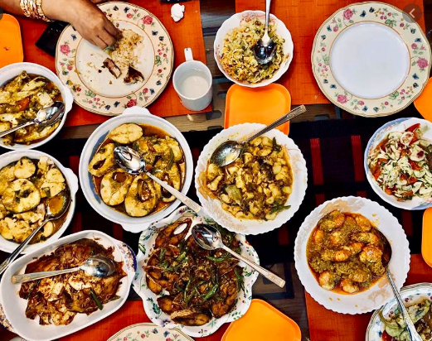
Our topic?
Bangladeshi cuisine
Unit – 1
Lesson - 5

Slide 5
Learning outcomes
After completing the lesson students will be able to
infer meaning from the context
1
2
talk about the picture
3
answer the questions
choose the best answer
4
5
fill the gap from listening CD

Slide 6
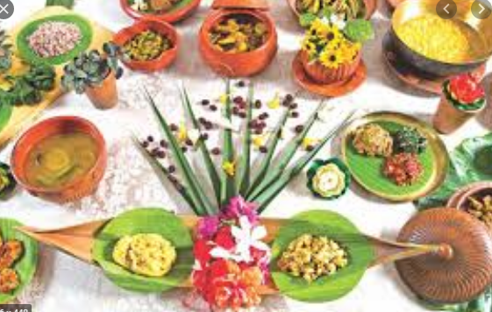
Key word
cuisine
noun
Meaning
cooking style
Bangladeshi cuisine is rich and varied with the use of many spices.

Slide 7
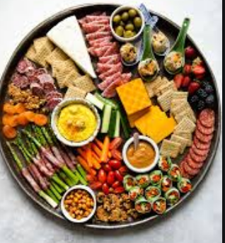
Key word
platter
noun
Meaning
serving dish
Panta ilish is a traditional platter of panta bhat.

Slide 8
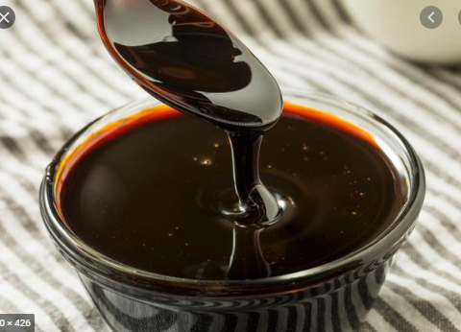
Key word
molasses
noun
Meaning
syrup from sugar refining
Making pitha, molasses is needed.

Slide 9
Open at page 08 in your text book and read the passage carefully.
Bangladesh cuisine is rich and varied with the use of many spices. We have delicious and appetizing food, snacks and sweets.
Boiled rice is our staple food. It is served with a variety of vegetables, curry, lentil soup, fish and meat. Fish is the main source of protein. Fishes are now cultivated in ponds. Also we have fresh-water fishes in the lake and rivers. More than 40 types of fishes are common. Some of them are carp, rui, katla, magur (cat fish), chingri (prawn or shrimp). Shutki or dried fishes are popular. Hilsha is very popular among the people of bangladesh.
Panta ilish is a traditional platter of Panta bhat. It is steamed rice soaked in water and served with a fried hilsha slice, often together with dried fish, pickles, lentil soup, green chilies and onion. It is a popular dish on the pohela boishakh.
The people of bangladesh are very fond of sweets. Almost all Bangladeshi women prepare some traditional sweets. Pitha, a type of sweets made from rice flour, sugar, syrup, molasses and sometimes milk, is a traditional food loved by the enter population. During winter Pitha Utsab, meaning pitha festival, is organized by different group of people.
Sweets are distributed among close relatives when there is good news like births, weddings, promotions, etc.
Sweets of Bangladesh are mostly milk based. The common ones are Roshgolla, Sandesh, gulap jamun, kalo jamun and chom-chom. There are hundreds of diffent varities of sweet preparations. Sweets are therefore an important part of the day-to-day life of Bangladeshi people.

Slide 10
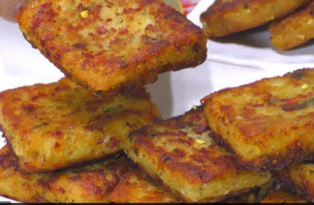
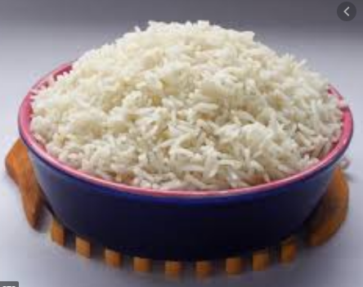
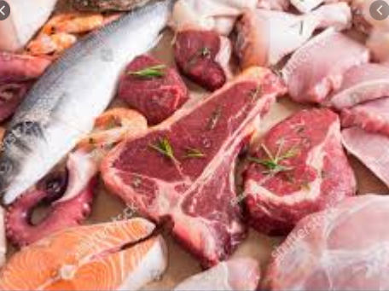
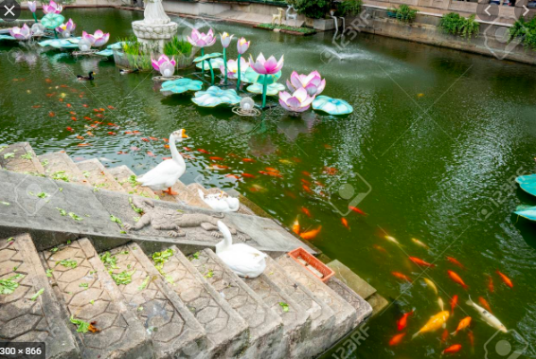
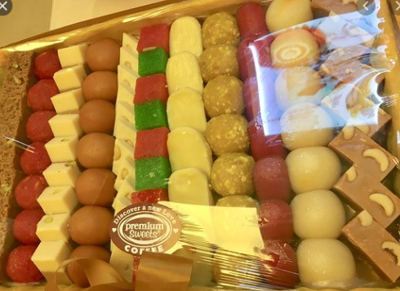
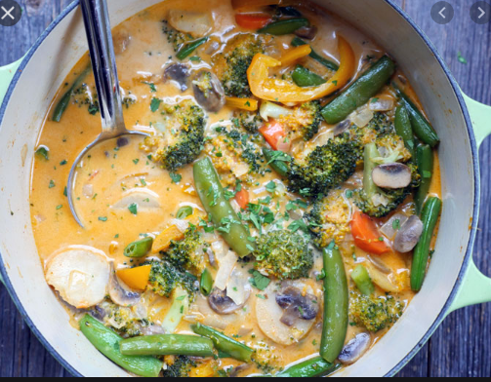
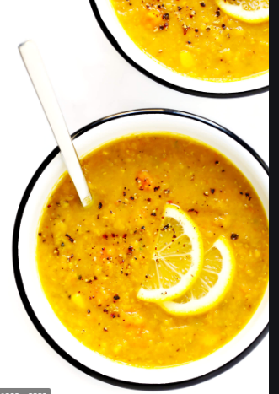
Snacks
Boiled rice
Fish and meat
Sweets
Vegetable and curry
Lentil soup
Pond
Bangladesh cuisine is rich and varied with the use of many spices. We have delicious and appetizing food, snacks and sweets. Boiled rice is our staple food. It is served with a variety of vegetables, curry, lentil soup, fish and meat. Fish is the main source of protein. Fishes are now cultivated in ponds. Also we have fresh-water fishes in the lake and rivers
Tell the name of the above pictures.

Slide 11
Individual works 3mins.
Answer the following questions.
Q1. What has made Bangladeshi food so special?
Q2. Where are fishes cultivated now?
Correct your answer
Ans1. The variation with the use of many spices has made Bangladeshi food
so special.
Ans2. Fishes are now cultivated in ponds.

Slide 12
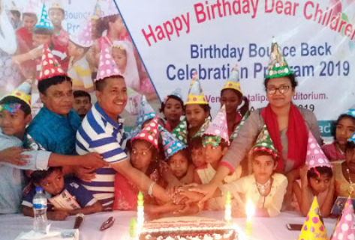
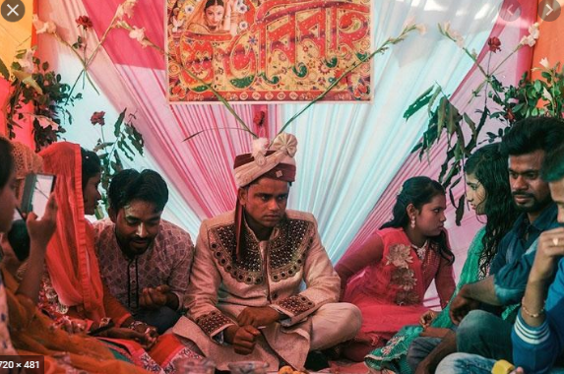
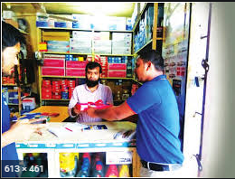
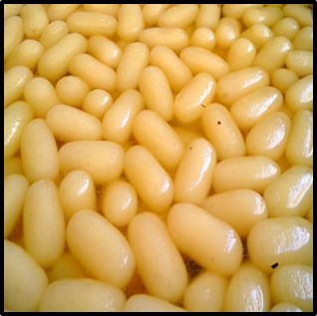
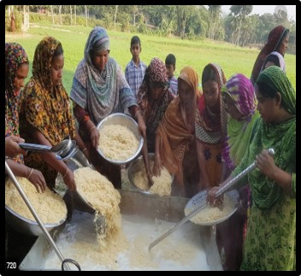
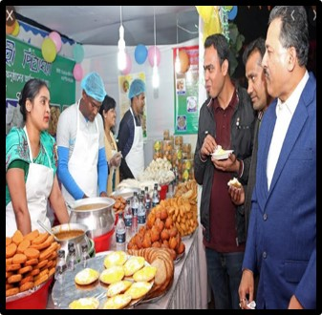
What do you see?
Sweets are distributed among close relatives when there is good news like birth day.
Sweets are distributed among close relatives when there is good news like weddings,
Sweets are distributed among close relatives when there is good news like promotions.
The people of Bangladesh are very fond of sweets. Almost all Bangladeshi women prepare some traditional sweets. Pitha, a type of sweets made from rice flour, sugar, syrup, molasses and sometimes milk, is a traditional food loved by the enter population. During winter Pitha Utsab, meaning pitha festival, is organized by different group of people. Sweets are distributed among close relatives when there is good news like births, weddings, promotions, etc.
The people of Bangladesh are very fond of sweets. Almost all Bangladeshi women prepare some traditional sweets. Pitha, a type of sweets made from rice flour, sugar, syrup, molasses and sometimes milk, is a traditional food loved by the enter population. During winter Pitha Utsab, meaning pitha festival, is organized by different group of people. Sweets are distributed among close relatives when there is good news like births, weddings, promotions, etc.
The people of Bangladesh are very fond of sweets.
Almost all Bangladeshi women prepare some traditional sweets.
During winter Pitha Utsab, meaning pitha festival, is organized by different group of people.

Slide 13
Pair works 3mins.
Q1. How do people celebrate their good news?
Q2. What are the ingredients of preparing pitha?
Correct your answer
Ans1. People celebrate their good news by distributing sweets to kith and
kin, near and dear ones.
Ans2. The ingredients of preparing pitha are rice flour, sugar syrup,
molasses and sometimes milk.

Slide 14
Group work
5 mins
Group 1. Make two lists of food one eaten by the urban and the other by the
rural people
Group 2. Make a list of the things you and your partner eat every day.
Correct your answer
Group 1. The urban people eat rice, vegetables, meat and fishes. Other than these, they
usually eat bread, butter, fast food like burger, hot dog, fruit juice, snacks,
soups, noddles etc. . On the other hand rural people eat food like, muri, pithas,
khai, chira, gur etc. other than the common foods.
Group 2. I generally eat bread and vegetables or eggs for break fast. For lunch or supper
usually I eat rice with vegetables, curry, lentil soups, fish, meat etc.

Slide 15
Tick the best answer.
Bangladeshi cuisine is rich with the use of ---
i. chilies ii. onion iii. mint iv. various spices.
(b) The word ‘appetizing’ refers to ---
i. costly ii. palatable iii. tasteless iv. repulsive.
(c) In the passage, the word, ‘close’ means ---
i. break ii. join iii. intimate iv. Attach
(d) Fish contains a lot of ---
i. carbohydrate ii. vitamins iii. protein iv. minerals
(e) ---- is our traditional food.
i. rice ii. Fish iii. pitha iv. all of these
(f) Which one is not fresh-water fish?
i. carp ii. rui iii. prawn iv. hilsha
(g) During winter, pitha utshab is --- in our country.
i. arranged ii. organise iii. hold iv. prepared
$$$$
$$$$
$$$$
$$$$
$$$$
$$$$
$$$$

Slide 16
Evaluation
Correct your answers
Now fill in the gaps
Listen to the CD
Bangladeshi food culture is very rich with delicious and appetizing items. For regular main meal, (a) boiled rice is served with vegetables, fishes, meat etc. with fishes (b) predominanc. Hilsha is one of the most popular fishes here (c) which is also our national fish. Sweet is also very (d) popular food here in our country. Moreover, various types of (e) pithas are very common and are prepared and liked domestically.
Bangladeshi food culture is very rich with delicious and appetizing items. For regular main meal, (a)---rice is served with vegetables, fishes, meat etc. with fishes (b) ---Hilsha is one of the most popular fishes here (c) --- is also our national fish. Sweet is also very (d) ---- food here in our country. Moreover, various types of (e) ---- are very common and are prepared and liked domestically.

Slide 17
Homework
Stay home
Answer the following questions
Q1: Why are sweets an important part of our life?
Q2: When and how is ‘panta ilish’ served?

Slide 18
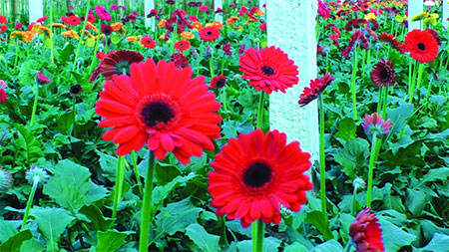
Thanks

