Slide 1
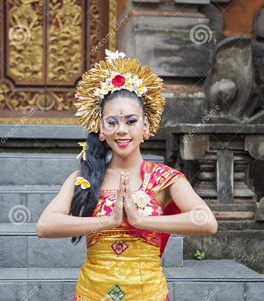

Slide 2
This session is conducted by
Indrajit Chakravorty
Assistant Headmaster
BGC Academy (School & College)
Chandanaish, Chattogram.
email: bheds06@gmail.com
Cell phone no: 01819-949355

Slide 3
English For Today
For Classes : 9-10
Time: 40 Minutes

Slide 4
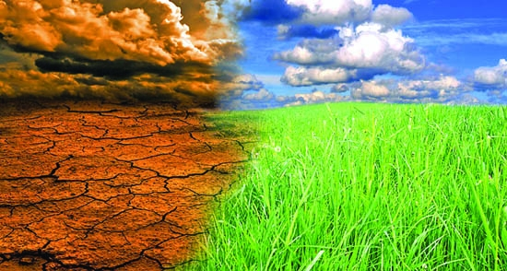
Look at the picture

Slide 5
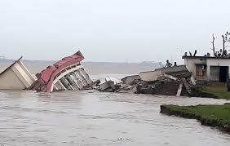
Look at the picture

Slide 6
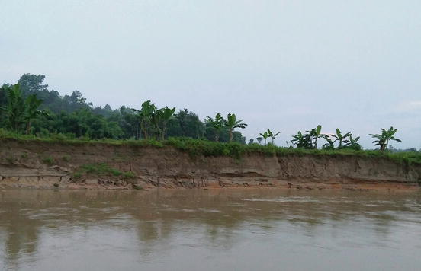
Let us watch a Video

Slide 7
Unit Five
Nature and Environment
Lesson - 1
The greed of the Mighty rivers
Page: 56

Slide 8
Learning outcomes
After studied this unit, we will be able to
comprehended and summaries texts
ask and answer questions
take part in role playing and conversations
write short compositions /slogans for posters
Notes:
This slide is only for teacher

Slide 9
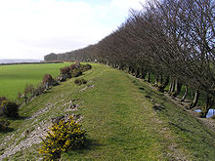
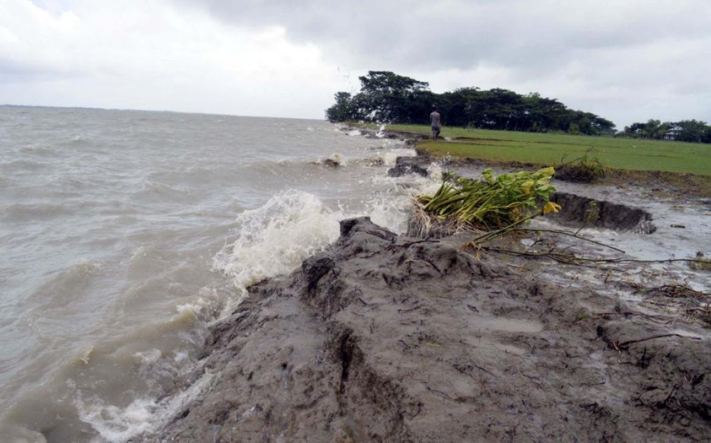
Vocabulary
a wall or bank of earth or stone built to prevent a river flooding an area.
embankment
Rahima lives on a slum near an embankment
The process of being eroded
erosion
Many people are sufferer of river erosion now.

Slide 10
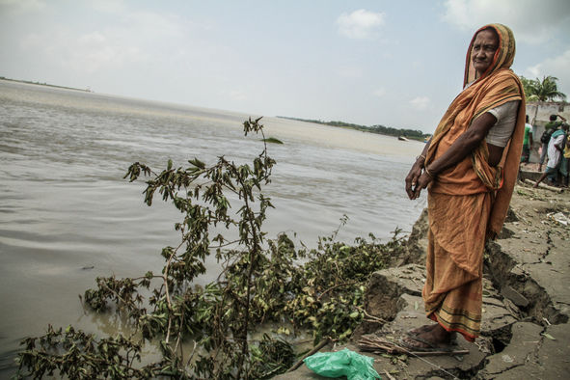
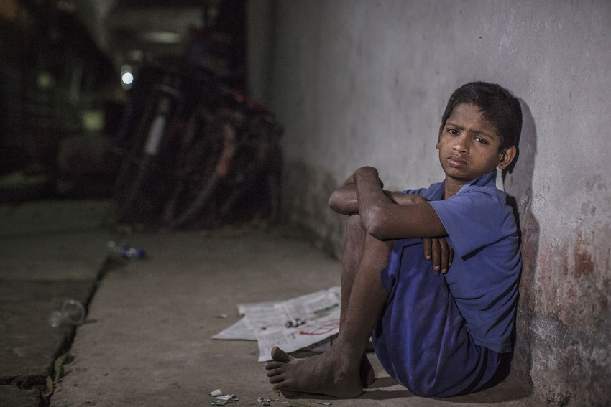
confusion, chaos
turmoil
This incident reminds her the turmoil's of life
Cruel, unkind
harsh
Erosion is a harsh reality for the people living along the river banks

Slide 11
Work in pairs, Ask and answer
the following questions.
a) Have you heard the word
“river erosion”?
b) In which season is river erosion
most likely to occur?
C) What do you know about river
erosion?

Slide 12
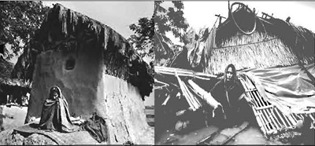
Read following the text and
answer the questions.
Meherjan lives in a slum on the Sirajgonj Town Protection Embankment. Her polythene-roofed shelter looks like a cage.

Slide 13
She is nearly 45 but looks more than her age. In front of her shelter, she is trying to make a fire to cook the day's only meal. Her weak hands tremble as she adds some fallen leaves and straw to the fire. The whispering wind from the river Jamuna makes the fire unsteady. The dancing flames remind Meherjan of the turmoil
in her life.

Slide 14
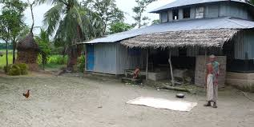
Not long ago Meherjan had everything a family, cultivable land and cattle. The erosion of the Jamuna gradually consumed all her landed property. It finally claimed her only shelter during the last monsoon. It took the river only a day to devour Meher's house, trees, vegetable garden and the bamboo bush.

Slide 15
She had a happy family once. Over the years, she lost her husband and her family to diseases that cruel hunger and poverty brought to the family. Now, she is the only one left to live on with the loss and the pain. The greedy Jamuna has shattered her dreams and happiness.

Slide 16
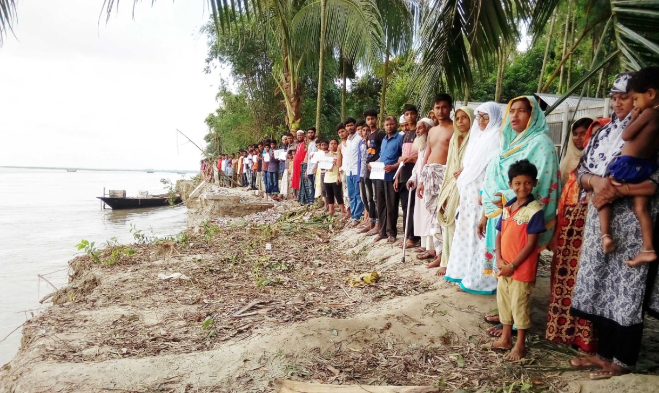
There are thousand others waiting to share the same fate like Meherjan. Bangladesh is a land of rivers, some of whose banks overflow or erode during monsoon. Erosion is a harsh reality for the people living along the river banks. During each monsoon many more villages are threatened by the mighty rivers like the Jamuna, the Padma and the Meghna.

Slide 17
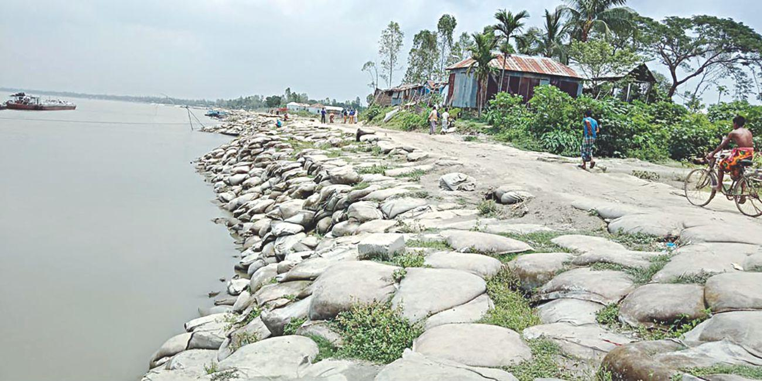
It is estimated that river erosion makes at least 100,000 people homeless every year in Bangladesh. In fact, river erosion is one of the main dangers caused by climate change. If we can't take prompt actions to adapt to climate change, there will be thousands of more Meherjans in our towns and villages every year.

Slide 18
B. Choose the correct answer from the following alternatives.
(i)What does the expression ”the turmoil in her life” in the 1st paragraph mean?
a) The pleasure of her life b) The thunderstorm in her life
c) The pangs and pains of her life d) The dreams of her life
(ii) Which of the following statement is true about Meherjan’s life?
a) Full of happiness b) Mixture of happiness and sadness
c) Full of turmoil d) Full of peace

Slide 19
(iii) In paragraph 3 ‘mighty rivers’ mean
a) rivers that have huge volumes of water and very strong currents.
b) rivers having many rowing boats in them
c) rivers that make people cry out
d) rivers that have strong banks
(iv) Which of the following best describes the similarity between the Jamuna and Padma in the light of the passage?
a) Protein diet b) Extinction of fish
c) largeness d) Erosion

Slide 20
B. Answer
(i) c) The pangs and pains of her life
(ii) b) Mixture of happiness and sadness
(iii) a) rivers that have huge volumes of water and very strong currents.
(iv) d) Erosion

Slide 21
C. Answer the Following questions.
What does Meherjan use to make fire for cooking her meals?
What property did Meherjan lose due to river erosion?
What do you know about Meherjan’s family?
Why is the phrase ”greedy Jamuna” used to describe the river?
What greed do you notice in the description?

Slide 22
C. Answer
a) Meherjan uses fallen leaves and straw to make fire for cooking her meals.
b) Due to river erosion, Meherjan lost her cultivable land, cattle, trees, house, vegetable garden and the bamboo bush.
C) Meherjan had a happy family once. She lost her husband and her family due to diseases.

Slide 23
c) Here, the river Jamuna has been compared to a greedy person who claims everything from the other people around him. That is why the phrase “greedy Jamuna” is used here.
e) I notice that the river has gradually consumed the cultivable land, trees, house, vegetable garden and bamboo bush of Meherjan greedily.

Slide 24
Feed Back
Write about a paragraph about Feroza based on learning.
If you have any
question ask me.

Slide 25
Who can Give the answer?
a) How many people become homeless in
Bangladesh every year?
b) Once Meherjan was----------------
C) The roof of her house is covered by------

Slide 26
Home work
Write about a paragraph about Feroza based on learning.
Write a paragraph
about Environmental Pollution of Bangladesh.

