Slide 1
MY DEAR STUDENTS

Slide 2
Rahima begum academy. Allardarga Daulatpur,kushtia
TEACHER IDENTITY
Md. Raziul haque
Assistant teacher.
. MOB no-01740972512
. email-mdraziulhaque@gmail.com

Slide 3
Lesson declaration
He is too black_________________
What is this?
He is too black to love
What is this?
So today we will discuss about

Slide 4
LEARNING OUTCOMES
BY THE END OF THE LESSON
Students will be able to learn the completing rules.
Students will be able to complete the sentence.

Slide 5
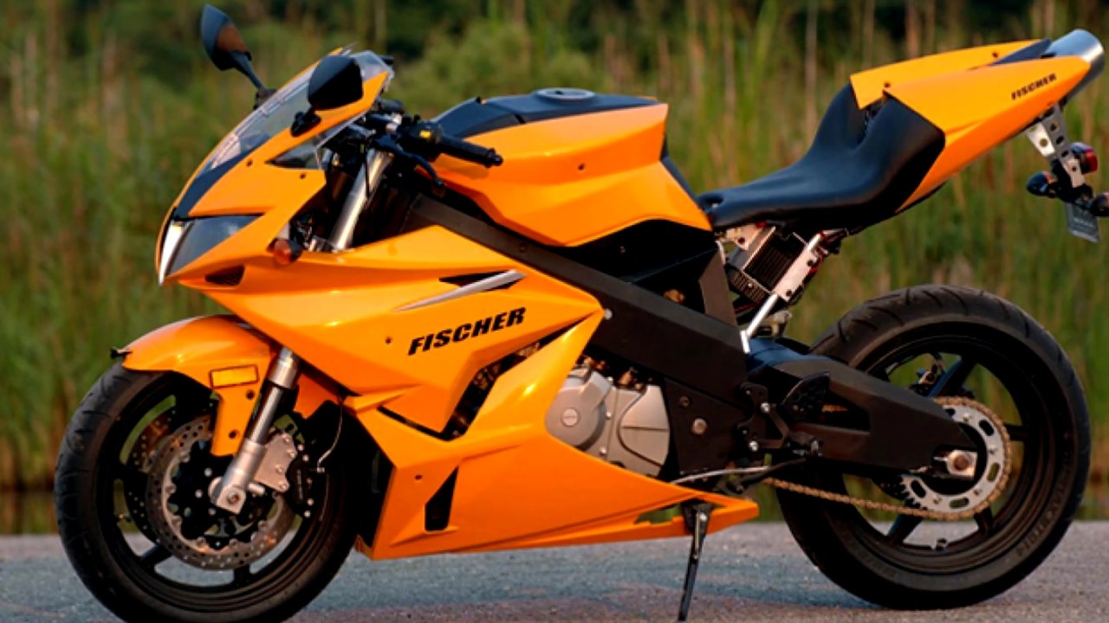
Completing sentence
So much/so many-------that
অনেক-----যে
Rule -26
Structure
Sub+a.v+so much/so many+noun
That+Sub+can/can not+v+obj
I have so many taka
that I can buy a motor bike .

Slide 6
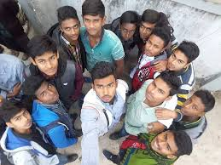
Let us practice the rule
I have so many friends ---------
you have so much skills ------------

Slide 7
Completing sentence
Had better
বরং ভালো
Rule -27
Structure
Sub+had better
Verb+obj
Had better
I had better
post the letter.

Slide 8
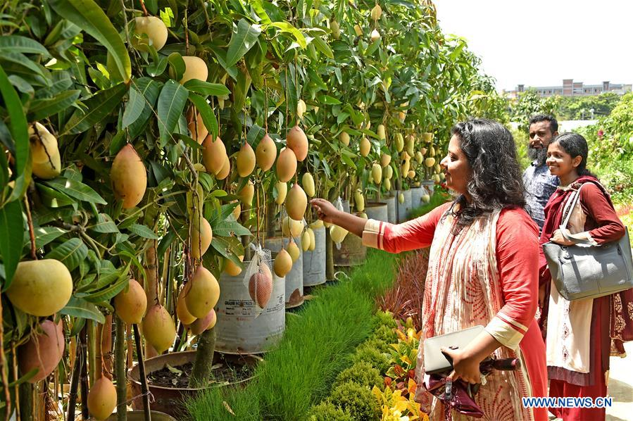
Let us practice the rule
You had better ---------
They had better ------------

Slide 9
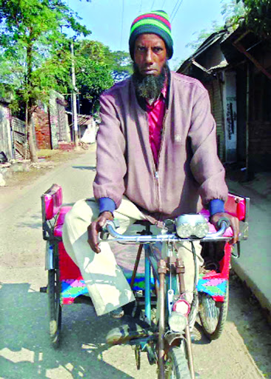
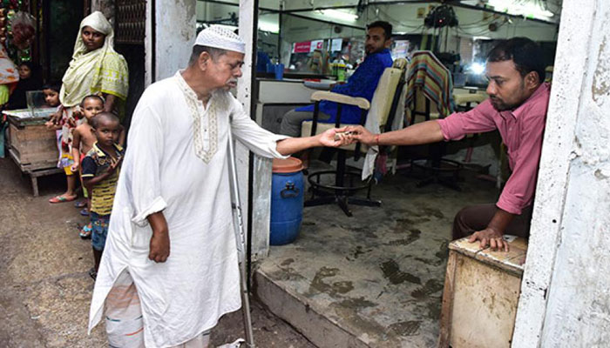
Completing sentence
Would rather------than
বরং-----তবুও
Rule -28
Structure
Sub+would rather+verb+
than +verb/noun
He would rather drive the van
than beg .

Slide 10
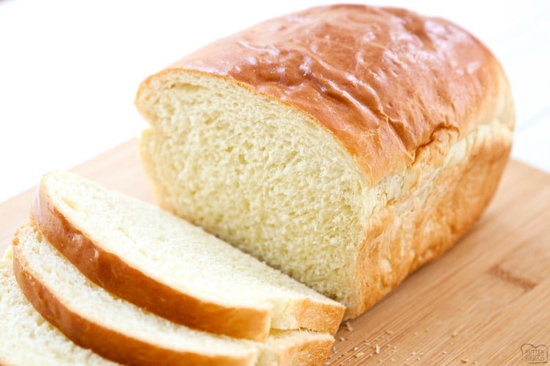
Let us practice the rule
I would rather eat bread ---------
Police would rather arrest the criminal ------------

Slide 11
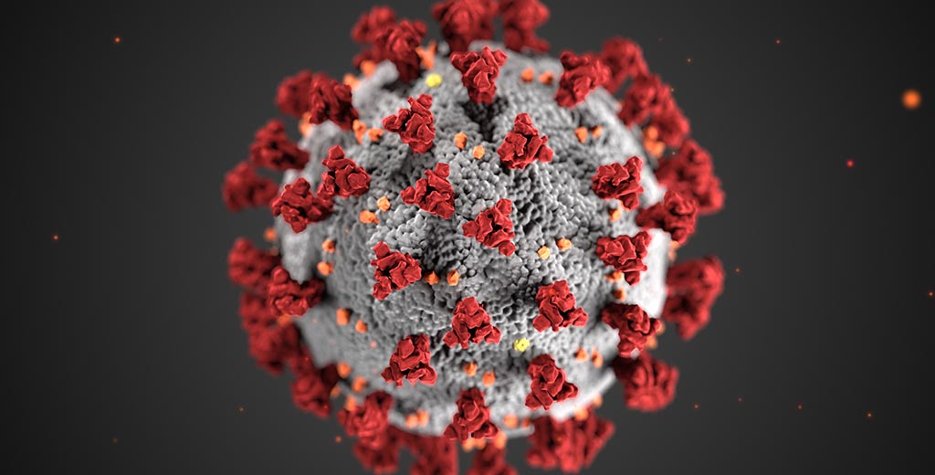
Completing sentence
That
যাতে
Rule -29
Structure
Sub+verb+obj+that
Sub+verb+obj
We clean the house that
It will be free from germs .

Slide 12
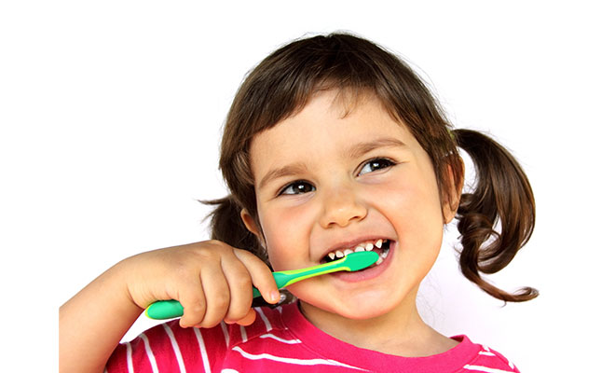
Let us practice the rule
We brush our teeth everyday that ---------
We watch T.V everyday that ------------

Slide 13
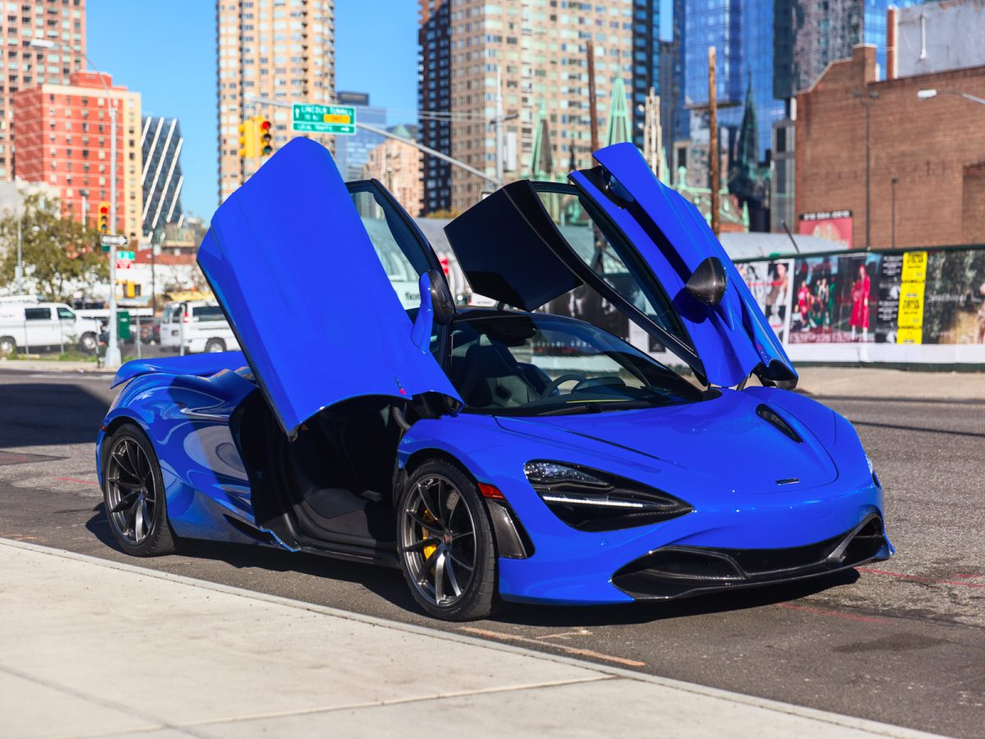
Completing sentence
Because of/on account of
owing to/due to
কারনে
Rule -30
Structure
Because of/on account of
owing to/due to +sub (possive)+noun+
Sub+verb+obj
Because of money
I can not buy a stylish car .

Slide 14
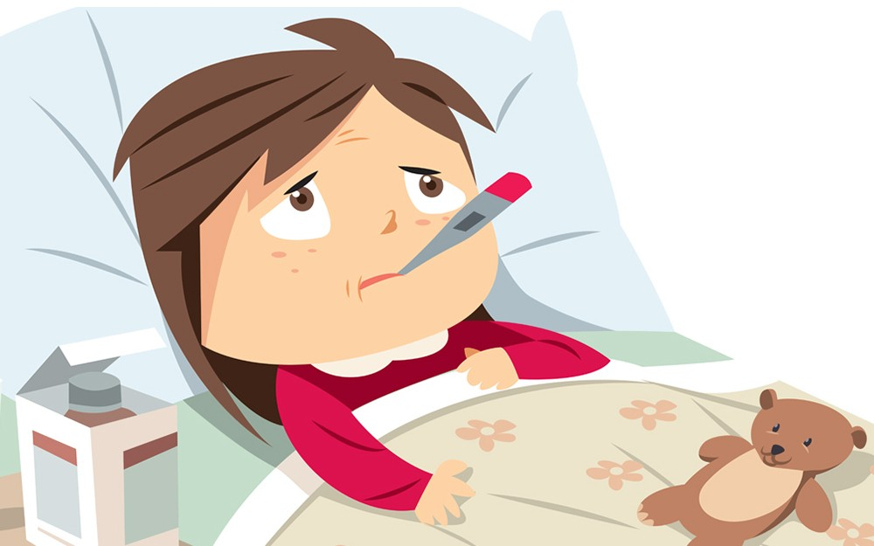
Let us practice the rule
We salute him on account of ---------
Because of his illness ------------

Slide 15
Home work
1.We love him because of,-------------
2. You had better --------------------------
3. I know that -----------------------
4.I have so many fricnds ------------
5. I would rather die ------------------
Practice makes a student perfect.

