Slide 1
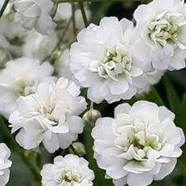
Welcome

Slide 2
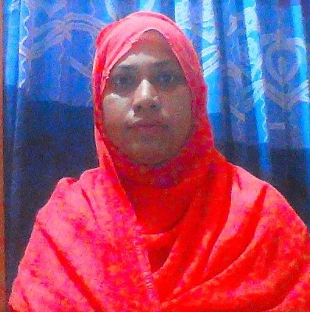
TEACHER’S IDENTITY
Anjuman Ara.
Nesbetgonj GOVERNMENT
PRIMARY SCHOOL.
Rangpur Sador.Rangpur

Slide 3
LESSON IDENTITY
CLASS:Five.
SUBJECT: ENGLISH.
LESSON:EAT HEALTHY
PART OF LESSON:(F)
Lesson Unit 06
TIME: 40 MINUTES.
DATE: 04/04/2020

Slide 4
Learning outcomes
Students will be able to:
Listening: 4.2.1 understand and enjoy simple stories.
Speaking: 3.1.1 ask and answer wh questions.
Reading: 5.1.1 read silently with understanding paragraph.
Writing: 10.2.1 write short and simple composition on familiar objects such as people place and events.

Slide 5
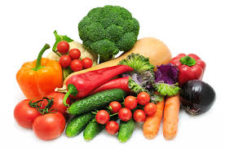
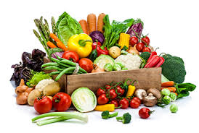
New words
Similar
Same

Slide 6
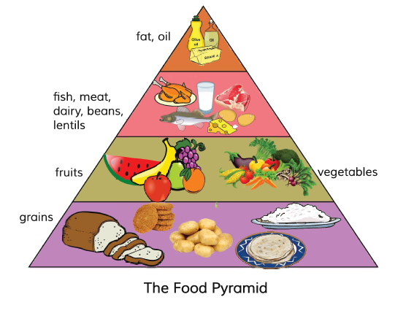
Bottom
Under

Slide 7
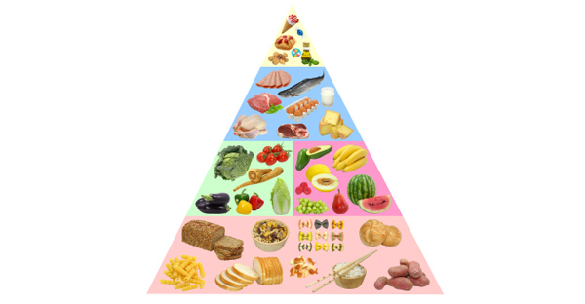
Above
Top

Slide 8
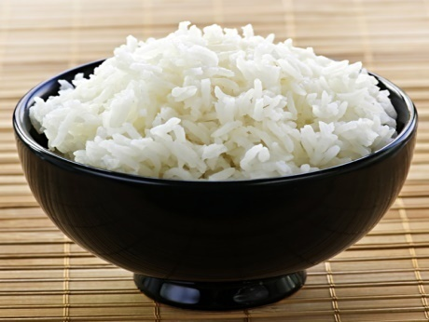
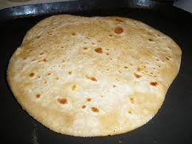
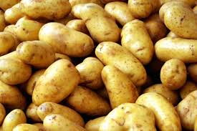
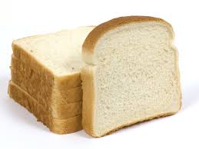
Grain
Corn

Slide 9
Our lesson
Eat healthy.

Slide 10
Open at page 24

Slide 11
What food is good food? Sometimes the food we like to eat isn’t the healthiest food for us .

Slide 12
The food pyramid helps us to understand the different food groups , and it tells us how much of each food group we should eat.

Slide 13
Look at the picture of the food pyramid. We eat more of the foods at the bottom of the pyramid . What foods do you see at the bottom?

Slide 14
These are things made from grain ,for example ,rice , ruti , and bread .potatoes are not grain , but they are similar .Grains give us energy.

Slide 15
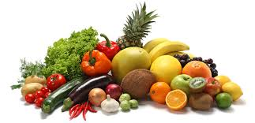
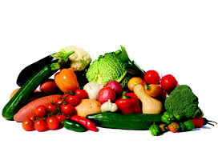
Fruits and vegetables are in the next level of the pyramid. These are also very important for us. They have vitamins They help our eyes and our health.

Slide 16
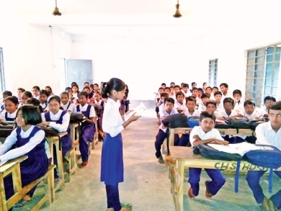
Student’s loud reading individually

Slide 17
Group -Top
Write the name of foods in vitamin.
Group-Bottom
Write 3 name of foods in grain.

Slide 18
Evaluation
Use punctuation and capital letters.
1.What is Food Pyramid?
2.Which food are important for health?
3.What food do you see at the base of the food pyramid?

Slide 19
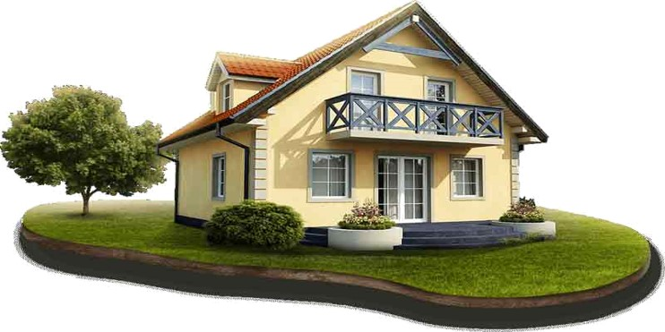
Home work
Write 5 sentences about Healthy food.

Slide 20
One day one word
শাক সবজি
Vegetables

Slide 21
Thanks

