Slide 1
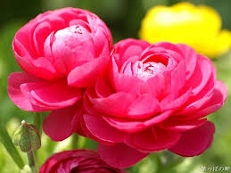

Slide 2
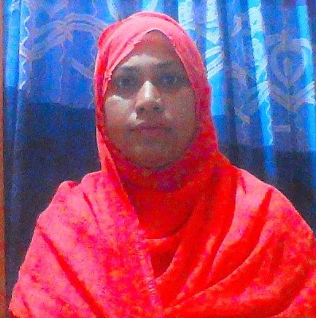
Teacher’s Identity
Name-Mrs.Anjuman Ara
Assistant Teacher.
Nesbetgonj Govt. Primary School
Sador. Rangpur.

Slide 3
Lesson’s Identity
Subject: English
Class : Five
Unit : 5, Lesson : 1-2, Page: 58
Lesson : Happy Birthday
Part of the lesson : A person’s birthday….out the candle.
Time : 35 Minutes.
Dated : 05/05/2020

Slide 4
Learning Outcomes
Student will be able to:
Listening:
4.2.1 understand and enjoy simple stories.
Speaking:
1.1.1 say words, phrases and sentences with proper sounds and stress.
1.1.2 say sentences with proper intonation
Reading:
1.5.1 read words, phrases and sentences in the text with proper pronunciation,
stress and intonation.
Reading:
8.1.1 make sentences using words and phrases given in the textbook.

Slide 6
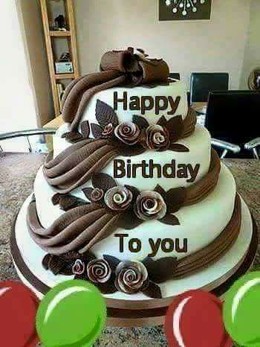
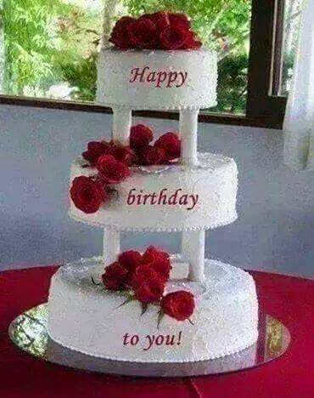
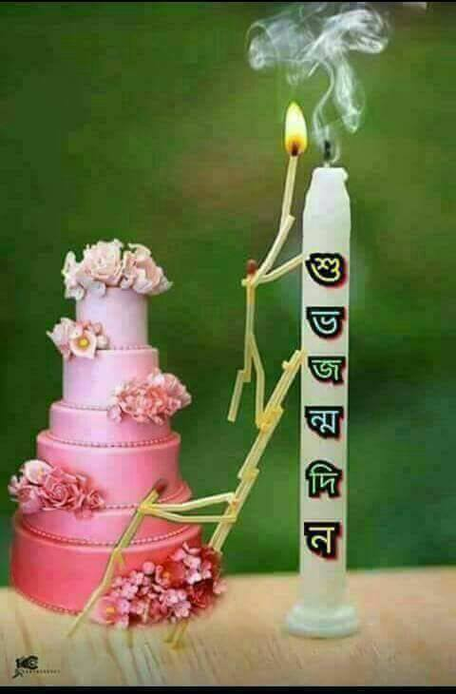
When we use cake ?
On someone’s Birthday Party

Slide 7
Happy Birthday

Slide 8
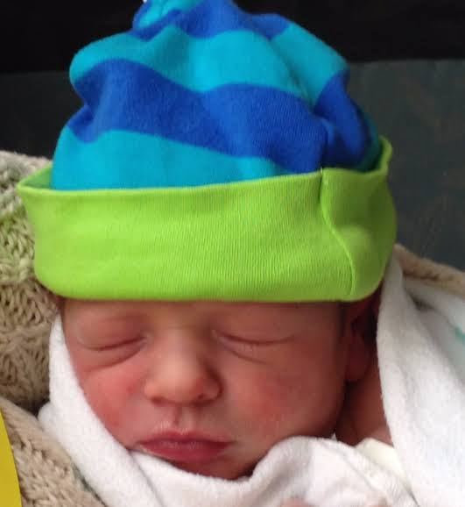
New words
Born
জন্ম
Candle
মোমবাতি

Slide 9
Gift
উপহার

Slide 10
Open at page 58

Slide 11
A person’s birthday is a special day. This is the date when the person was born.

Slide 12
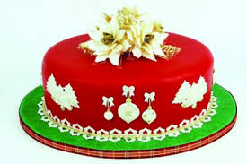
People around the world celebrate birthdays in different ways. In many countries ,people celebrate with a cake.

Slide 13
There are candles on the cake

Slide 14
There is one candle for each year of the person’s life.

Slide 15
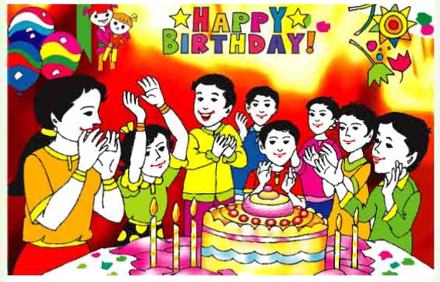
People sing a song for the person.

Slide 16
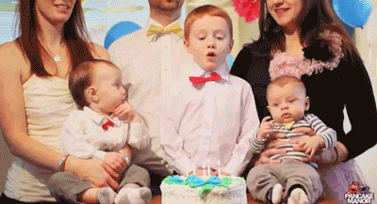
At the end of the song, the person blows out the candles

Slide 17
Group -Candle
True or False
1.A birthday is the date when a person was born --------------.
2.The friend and family blow out the candles on a birthday cake.-------------.
True
False

Slide 18
Group -Cake
Match the sentences
for the person
A person’s birthday is
People sing a song
The person blows out
Special day
The candles

Slide 19
Evaluation
1.What is a special day for a person?
2.What will people do in his birthday?
3.What the person do at the end of the birthday song?

Slide 20
Homework
Write 3 sentences about your birthday.

Slide 21
One day one word
Candle
মোমবাতি

Slide 22
Thanks

