Slide 1
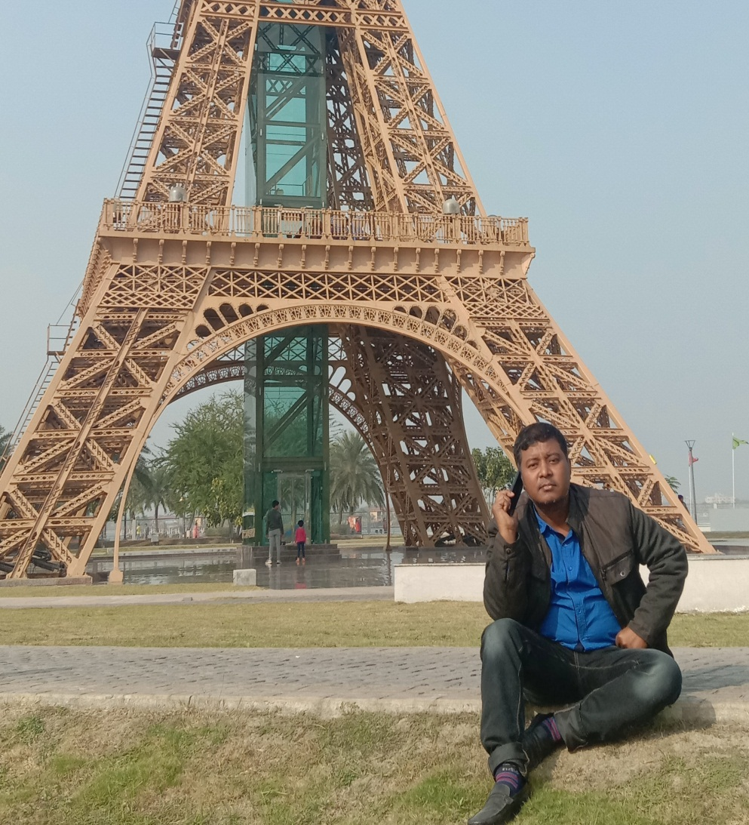
IDENFICATION
Sumon Barua
Assist Teacher
Guzra shyamacharan High School
P,K Sen Hat, Mogdai, Raozan
Chattogram
Email:sumonbarua8626@gmail.com
Mobile:01815645924

Slide 2
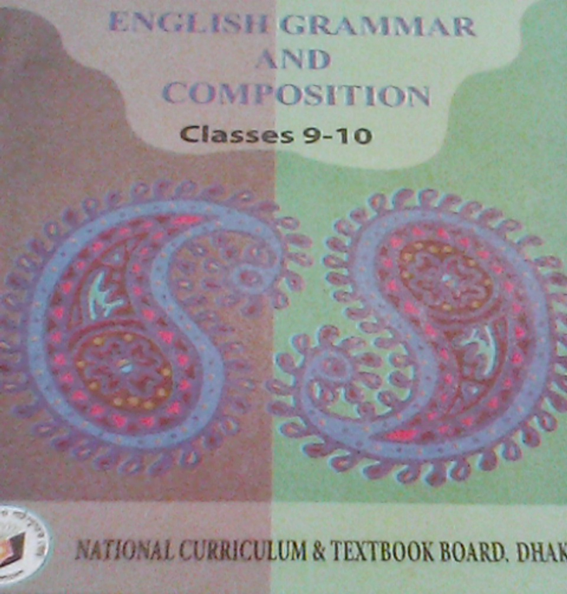
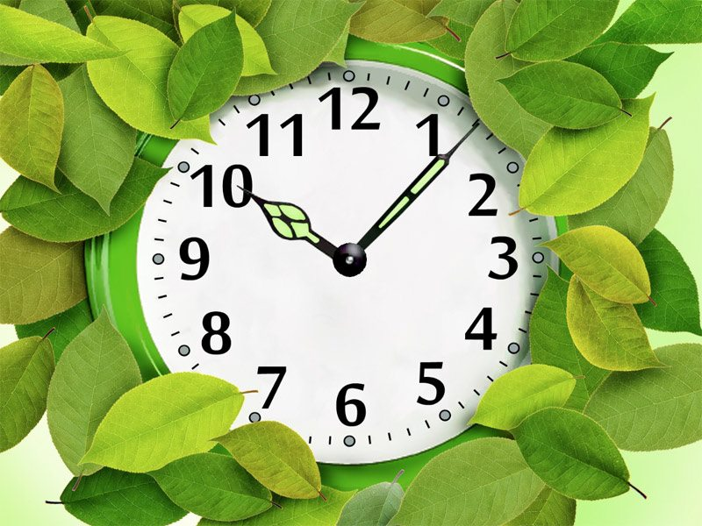
LESSON DECLARATION
Today’s lesson is-
UNIT: SIX, LESSON- 1
TIME : 50 MINUTES
TENSE

Slide 3
WHAT DO YOU SEE ?
She writes an E-mail.
She wrote an E-mail.
She will write an E-mail.
a)Which time indicates 3 sentences ? b) What is called the total action of time ?

Slide 4
OBJICTIVES:
By the end of the lesson you will have-
Learnt what tense means.
Learnt three chief tenses & their uses.
Asked & answered the questions.
To identify 3 tenses & apply it.

Slide 5
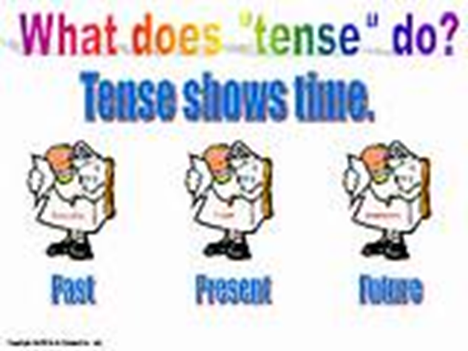
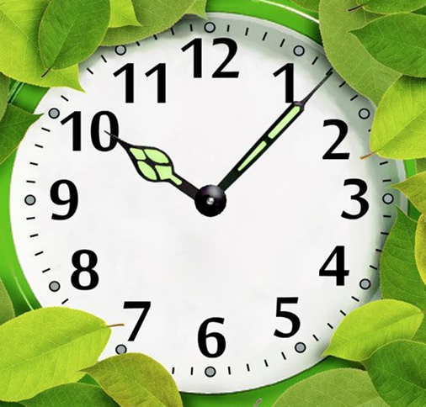
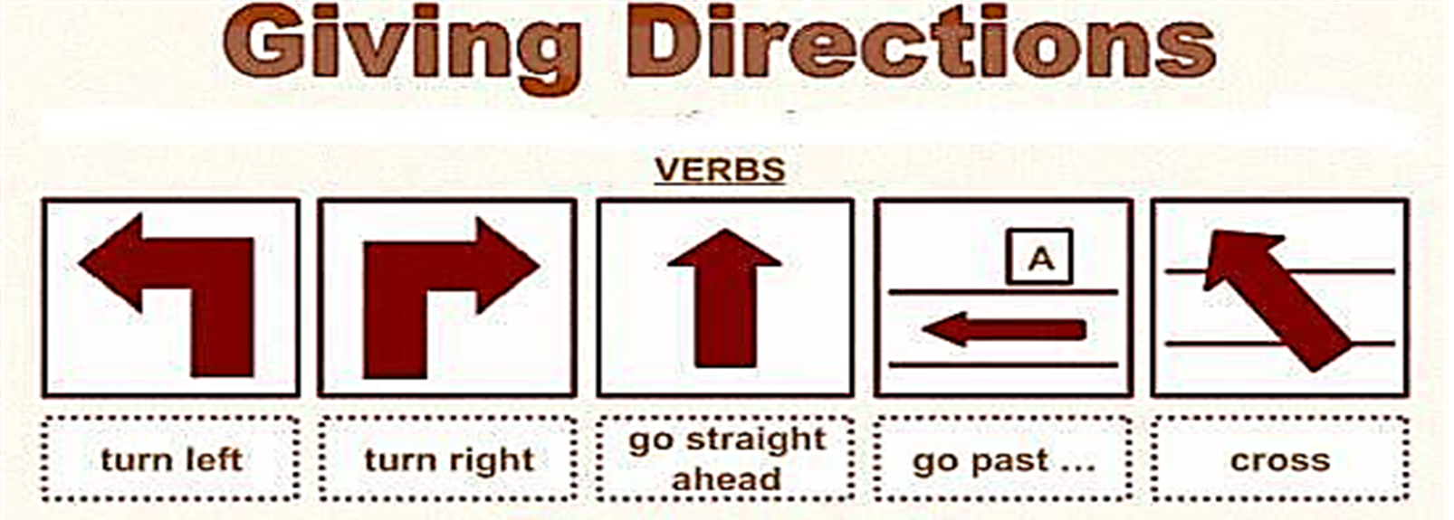

Slide 6
WHAT DO YOU SEE ?
She writes an E-mail.
She wrote an E-mail.
She will write an E-mail.
a)Which time indicates 3 sentences ? b) What is called the total action of time ?

Slide 7
Main classification of tense
PRESENT
She reads a book
I go to school
PAST
Ali was a farmer
He worked very hard
FUTURE
I shall go tomorrow
She will go to school
TENSE

Slide 8
LessonAnalysis:
1. I write this book.
2. I wrote the book.
3. I shall write another book.
“Tense denotes the time of verb”

Slide 9
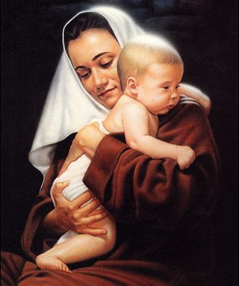
LET’S LEARN TENSE
☞ Mother loves her baby.
(Present Tense; describe an action of present time)
Structure: S + V+ s/es + O/Com
☞ I made a home.
(Past Tense; describe an action of past time)
Structure: S + V2 + O/Com
☞ I shall play football.
(Future Tense; describe an action of future time)
Structure: S + V + Shall/Will + O/Com

Slide 10
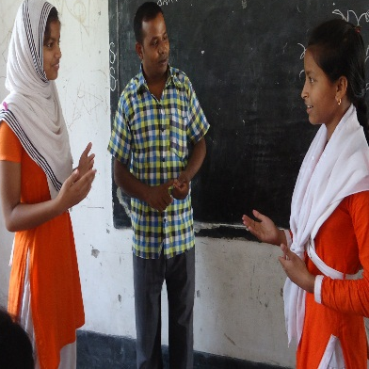
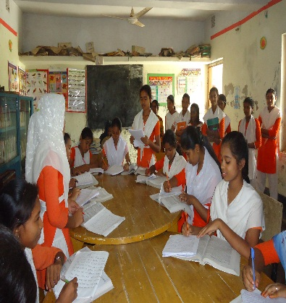
Pair work ( Read the passage,ask & answer)
 Mamun is in class nine. Last year he was in class eight. Next year he will be in class ten. He wants to prosper in life.
a)How many sentences in the passage belong to present tense ? b) Which sentence is past tense ? c) Which sentence is future tense ?
Cheek answer: a) Two sentences,
b) Last year he was in class eight,
c) Next year he will be in class ten.
Notes:
D

Slide 11
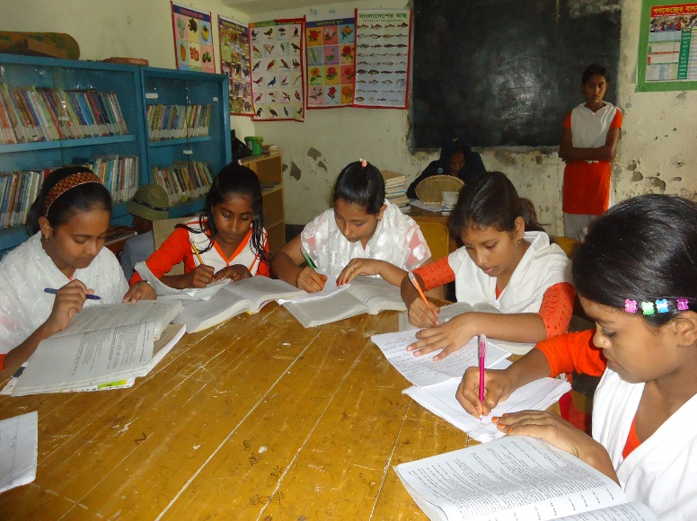
GROUP WORK
Fill in the gaps using right form of verbs in the box.
grow | to be | work | get | hope
use | know | believe | think | to use
Ali a)...... a farmer. He b)……very hard. He c)…... fertile land on which he d)…… different crops. He e) …..how to f).….fertilizer. Last year he g).…..the award of the best farmer in the village. The villagers h)…..that he will get the same award this year too. But Ali i)…..to become the best farmer in the district. He j)…..that diligence is the mother of good luck.
a)is b)works c)uses d)grows e)knew f)use g)got h)hope i)thought j)believes

Slide 12
INDIVIDUAL WORK
Follow & answer the questions-
Ans: a) takes

Slide 13
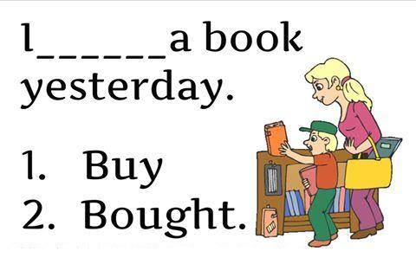
Which option is correct & which tense ?

Slide 14
Which option is correct ?

Slide 15
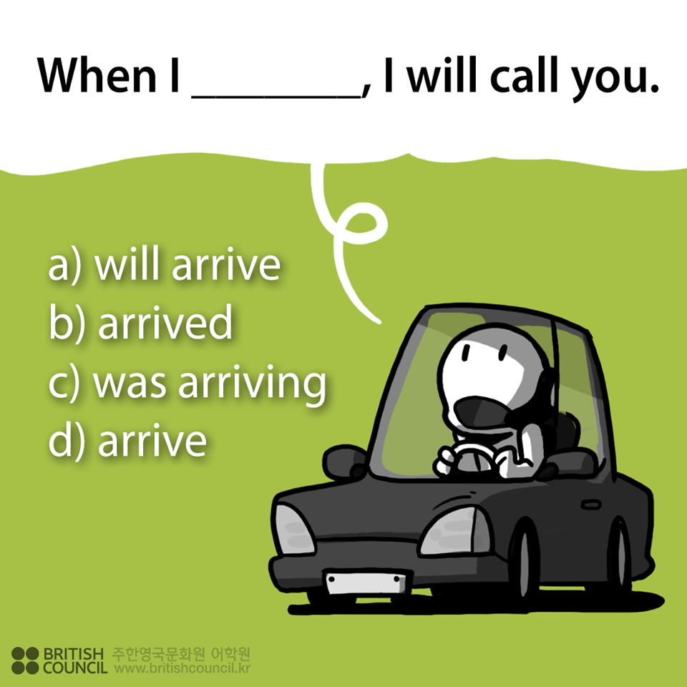
Ans: a)will arrive

Slide 16
Evaluation: (Find out which tense ?)
a)Shapla sang a song.
b)He visited our house.
c)Newton is a scientist.
d)The boy went to school.
e)He will arrive home.
Past tense
Past tense
Present tense
Past tense
Future tense
Notes:
re

Slide 17
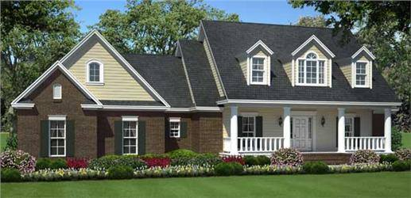
HOME TASK
Make meaningful ten sentences using present, past & future tense.

Slide 18
THANK YOU

