Slide 1
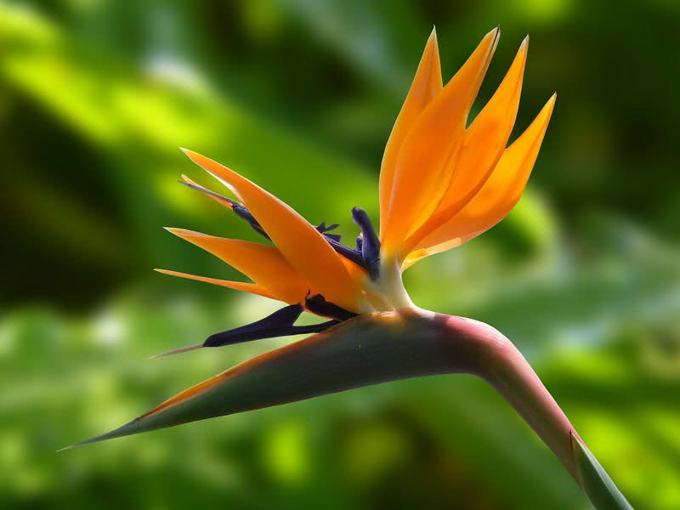
Welcome to My New Class

Slide 3
Big
Bigger
Biggest
Small
Smaller
Smallest

Slide 4
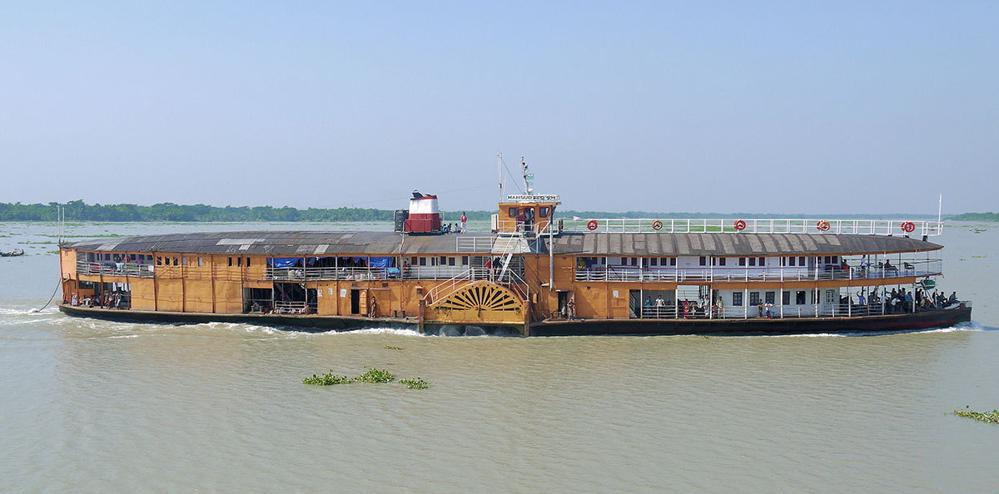
Today’s topic is
Degree of Comparison/ Adjective of Comparison

Slide 5
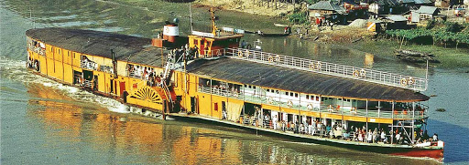
Learning outcome:
Know about Degree of Comparison
Able to identify degree
Change the form of Degree

Slide 6
Classification of Degree
Degree
Positive
Comparative
Superlative

Slide 7
Positive Form of Adj | Comparative Form of Adj | Superlative Form of Adj
good | better | best
bad | Worse | Worst
Big | Bigger | Biggest
Long | Longer | Longest
Large | Larger | Largest
Beautiful | More beautiful | Most beautiful
Useful | More useful | Most useful
Brilliant | More brilliant | Most brilliant
Wise | More wise | Most wise

Slide 8
Positive Degree
Structure-1: Very few + extension + Auxi verb + as + positive form of adj + as + sub(Noun/pronoun)
Ex,
1. Very few rivers in Bangladesh are as big as the padma.
2. Very few sea-beaches in the world are as long as the Cox’s Bazar.
3. Very few inventions in the world are as famous as Computer.

Slide 9
Structure-2: No other + extension + Auxi verb + as + positive form of adj + as + sub(Noun/pronoun)
Ex,
1. No other students in the class is as brilliant as Tamim.
2. No other men is as wise as Hazrat Mohammad (S.M)
3. No other fruits in Bangladesh is as delicious as mango.
Presented by Md. Rasel Hossain

Slide 10
Comparative Degree
Structure-1: Sub + Auxi verb + Comparative Form of Adj + than +Most other + Extension.
Ex,
1. The Padma is bigger than most other rivers in Bangladesh.
2. Cox’s Bazar is longer than most other sea-beaches in the world.
3. Computer is more famous than most other inventions in the world.
Presented by Md. Rasel Hossain

Slide 11
Structure-2: Sub + Auxi verb + Comparative Form of Adj + than +any other + Extension.
Ex,
1. Tamim is more brilliant than any other students in the class.
2. Hazrat Mohammad (S.M) is wiser than any other men.
3. Mango is more delicious than any other fruits in Bangladesh.

Slide 12
Superlative Degree
Structure-1: Sub + Auxi verb + one of the + superlative Form of Adj + Extension.
Ex,
1. The Padma is one of the biggest rivers in Bangladesh.
2.Cox’s Bazar is one of the longest sea-beaches in the world.
3.Computer is one of the most famous inventions in the world.
Presented by Md. Rasel Hossain

Slide 13
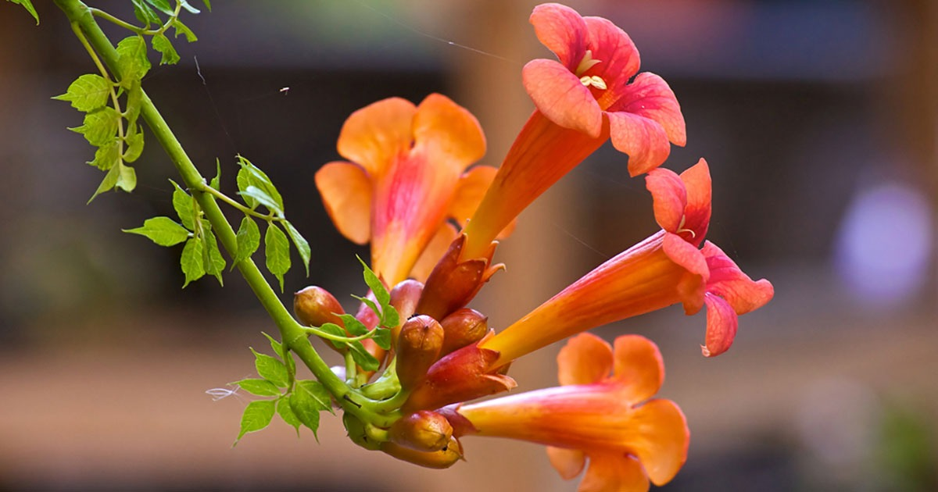
Structure-2: Sub + Auxi verb + the + superlative Form of Adj + Extension.
Ex,
1.Tamim is the most brilliant student in the class.
2. Hazrat Mohammad (S.M) is the wiset man.
3. Mango is the most delicious fruit in Bangladesh.

Slide 14
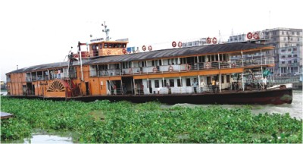
Individual Work
# Change the following sentences as direct.
No other city is as big as Dhaka.(Superlative)
Cricket is one of the popular games in the world.(Positive)
Corruption is the worst evil.(Comparative)
Very few inventions are as wonderful as mobile phone.(Superlative)
Book is better than any other friends in this world.(Positive)

Slide 15
HW
# Change the following sentences as direct.
Very few inventions are as wonderful as Television.(Superlative)
No other metal is as precious as gold.(Comparative)
Iron is harder than any other things.(Positive)
Honesty is the best virtue.(positive)
Corruption is worse than most other evils.(Superlative)

Slide 16
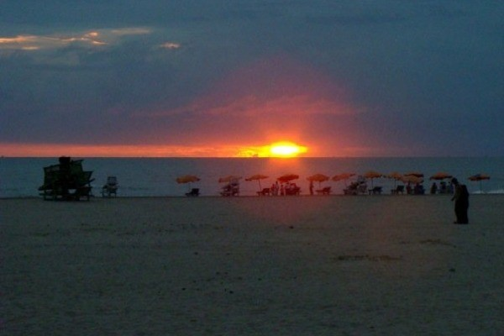
Goodbye Students

