Slide 1
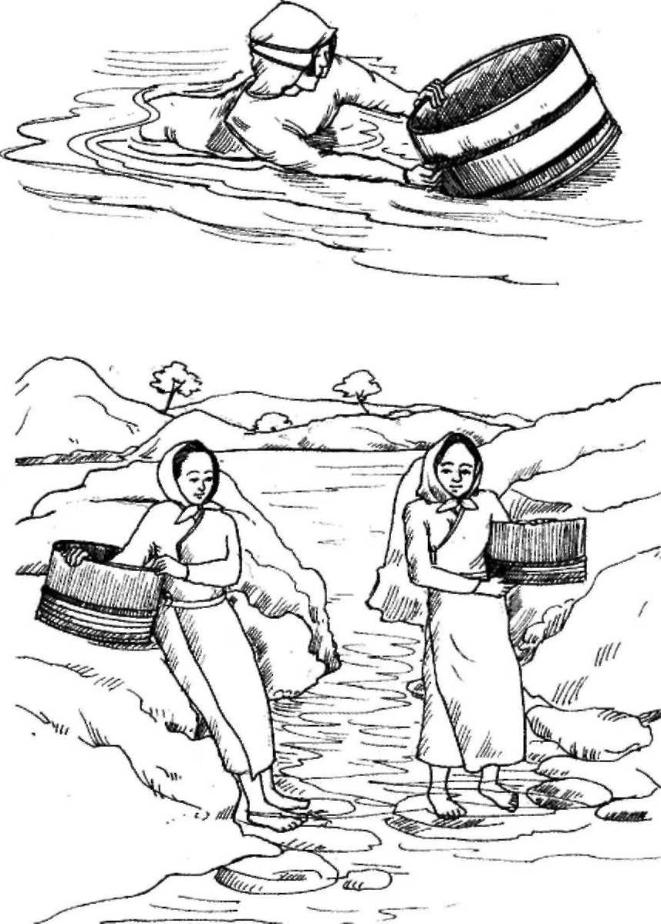
WELCOME TO MULTIMEDIA CLASS
Md.Alauddin,Assistant tescher,Pagla Govt.Model High School & College,Sunamganj.

Slide 2
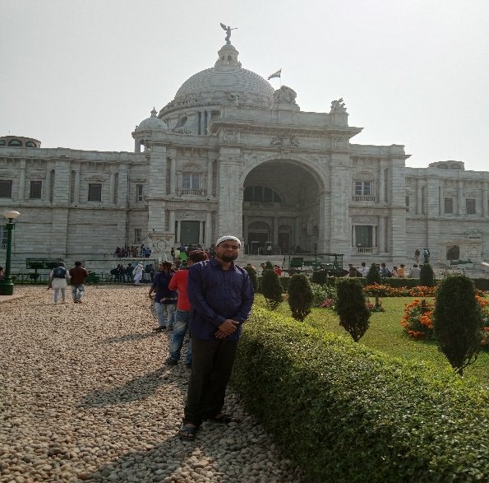
Introduction
Md Alauddin
Assistant teacher Pagla Govt. Model High School and college. SouthSunamgonj,Sunamgonj Mob.01765740395 | Class-8 English First Paper Unit-7,lesson-1 Topic-Pearls!Pearls!Pearls!
Md.Alauddin,Assistant tescher,Pagla Govt.Model High School & College,Sunamganj.

Slide 3
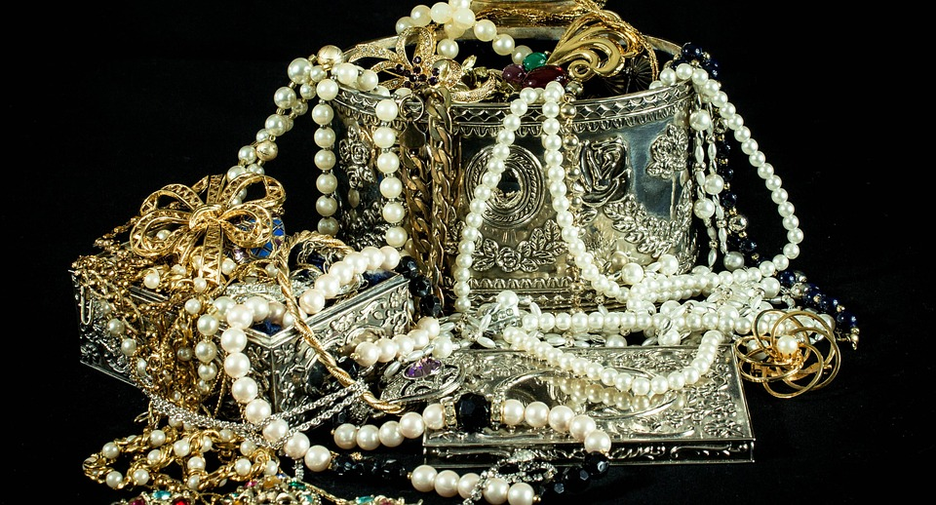
Can you guess what is the picture about?
Pearls
Md.Alauddin,Assistant tescher,Pagla Govt.Model High School & College,Sunamganj.

Slide 4
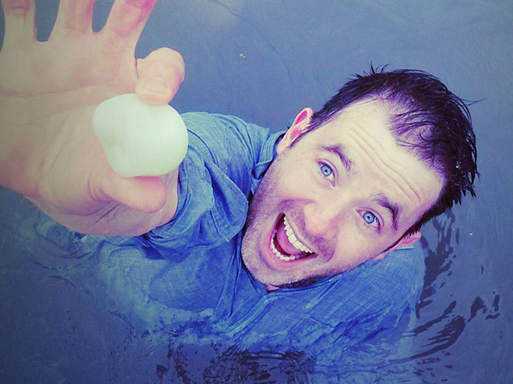
Our today’s topic is…..
Pearls! Pearls! Pearls!
Unit-7,Lesson-1
Md.Alauddin,Assistant tescher,Pagla Govt.Model High School & College,Sunamganj.

Slide 5
Learning outcomes…..
After we have studied this unit, we will be able to
Read and understand texts though silent reading.
Listen for information.
ask and answers to questions.
Write short paragraph.
Md.Alauddin,Assistant tescher,Pagla Govt.Model High School & College,Sunamganj.

Slide 6
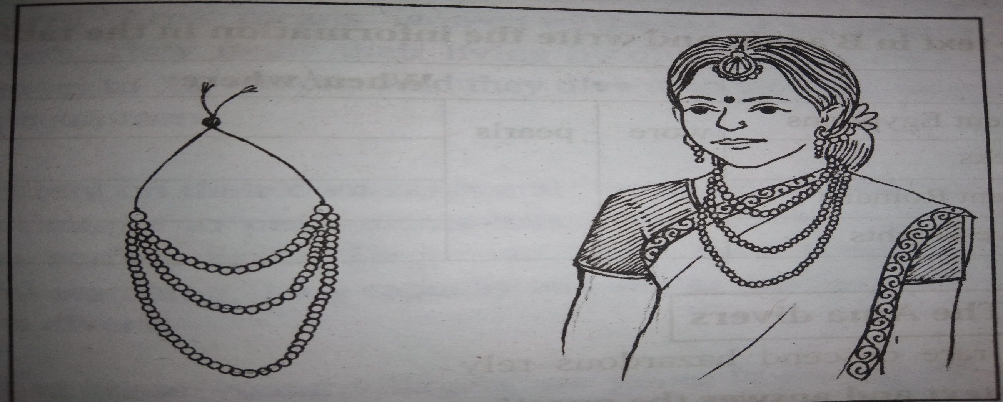
A. Look at the pictures and discuss in pairs.
Pair work
Md.Alauddin,Assistant tescher,Pagla Govt.Model High School & College,Sunamganj.

Slide 7
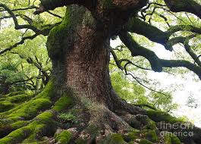
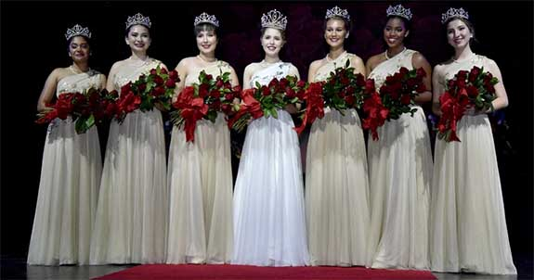
Key Words
Ancient
Very old
Rank
Status
Md.Alauddin,Assistant tescher,Pagla Govt.Model High School & College,Sunamganj.

Slide 8
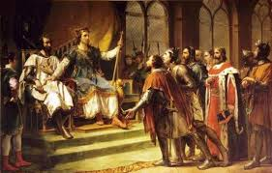
Key Words
Ancient story
Mythology
Absorb/fade
Dissolve
Md.Alauddin,Assistant tescher,Pagla Govt.Model High School & College,Sunamganj.

Slide 9
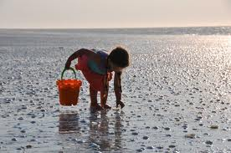
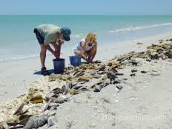
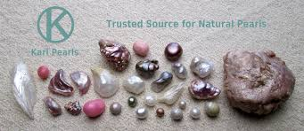
B.Read the text and answer the questions that follow
Thousands of years ago, the first pearl was probably discovered while human beings were searching for food at the sea shore.
Md.Alauddin,Assistant tescher,Pagla Govt.Model High School & College,Sunamganj.

Slide 10
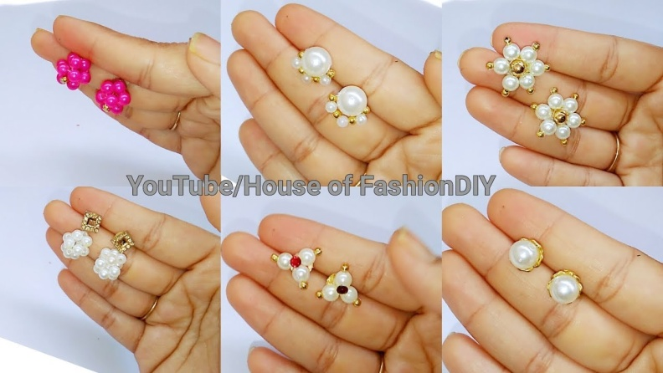
Throughout history the pearl with its shine has been one of the most highly valued gems
Md.Alauddin,Assistant tescher,Pagla Govt.Model High School & College,Sunamganj.

Slide 11
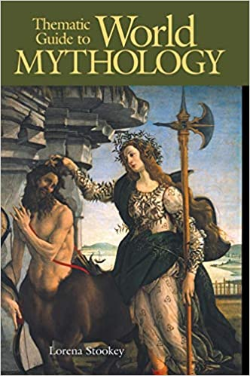
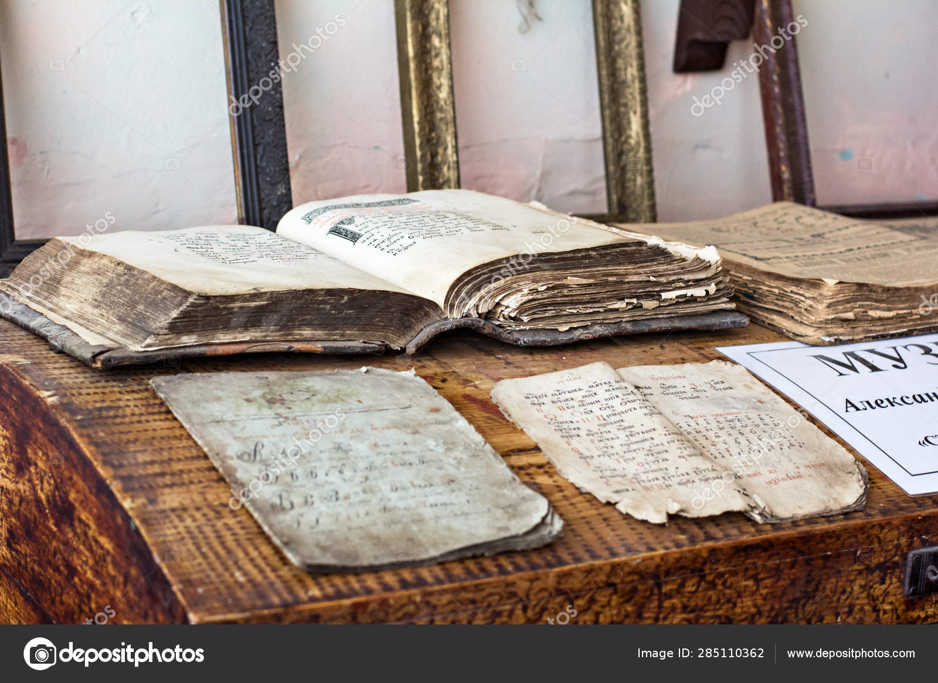
Pearls have been mentioned many times in religious texts and mythologies from the earliest times.
Md.Alauddin,Assistant tescher,Pagla Govt.Model High School & College,Sunamganj.

Slide 12
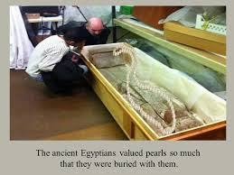
Md.Alauddin,Assistant tescher,Pagla Govt.Model High School & College,Sunamganj.

Slide 13
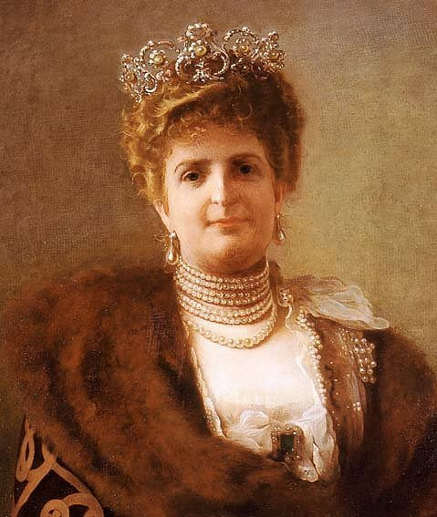
It is said that, the famous queen of Egypt Cleopatra would dissolve a pearl in a glass and drink it as a sign of love and respect for the entire nation.
Md.Alauddin,Assistant tescher,Pagla Govt.Model High School & College,Sunamganj.

Slide 14
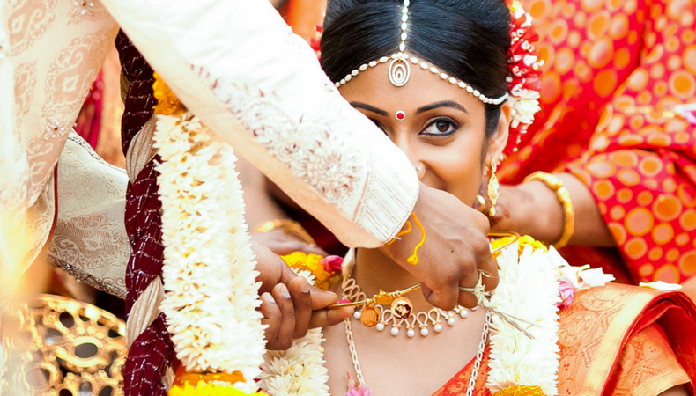
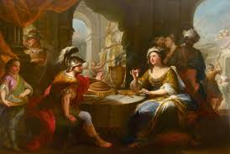
The Greeks thought of pearls as a sigh of wealth and social position.The beauty of pearls was aaccociated with love and marriage.
Md.Alauddin,Assistant tescher,Pagla Govt.Model High School & College,Sunamganj.

Slide 15
In ancient Rome, pearls were considered the greatest sign of wealth and social status.
Md.Alauddin,Assistant tescher,Pagla Govt.Model High School & College,Sunamganj.

Slide 16
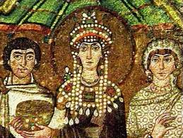
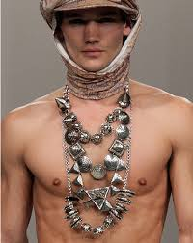
At that time the young women of noble families loved to were beautiful pearl and necklaces.
The brave knights used to wear them in the battle field for good luck.
Md.Alauddin,Assistant tescher,Pagla Govt.Model High School & College,Sunamganj.

Slide 17
Now answer the following questions.
What good luck the knights thought would pearls bring them ?
02. Do you think ‘pearls ‘ were discovered by accident ? Why ?
03. Do you think ‘pearls ‘ were valued so much in the past ?
Group work
Md.Alauddin,Assistant tescher,Pagla Govt.Model High School & College,Sunamganj.

Slide 18
C. Read the text B again and write the information in the table
Who |  |  | When/where
The ancient Egyptians |  |  | when they were buried .
The Greek | wore | pearls | at the time of love and marriage .
The ancient Romans |  |  | in noble families .
The brave knight |  |  | in the battles .
Md.Alauddin,Assistant tescher,Pagla Govt.Model High School & College,Sunamganj.

Slide 19
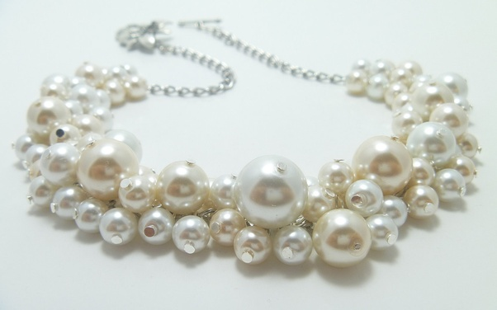
Evaluation
01.What is mythology ?
02. Do you think ‘pearls ‘ were discovered by accident ? Why ?
03. By whom were buried with valued pearls ?
Md.Alauddin,Assistant tescher,Pagla Govt.Model High School & College,Sunamganj.

Slide 20
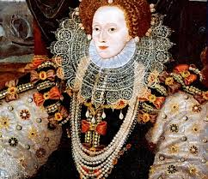
Home work
Write a paragraph on Pearls
Md.Alauddin,Assistant tescher,Pagla Govt.Model High School & College,Sunamganj.

Slide 21
Md.Alauddin,Assistant tescher,Pagla Govt.Model High School & College,Sunamganj.

