Slide 1
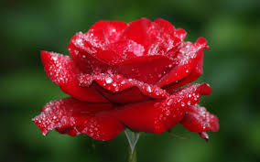
WEL COME

Slide 2
IDENTIFICATION
Md. Eunuse Ali
SENIOR TEACHER
Charan HIGH SCHOOL

Slide 3
Identification
of
degree

Slide 4
Positive degree
‡h mকল adjective `¦viv †Kv‡bv e¨w³ ev বস্তু ev cÖvbxi g‡a¨ †Kvb Zzjbv bv eywS‡q †Kej Zv‡`i ¸‡bi K_v ejv nq Zv‡K positive degree e‡j

Slide 5
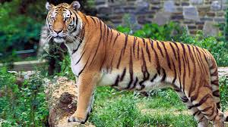
This is a very big tiger

Slide 6
STRUCTURE
OF
POSITIVE DEGREE

Slide 7
Positive degree
wZb fv‡e
MwVZ n‡Z cv‡i

Slide 8
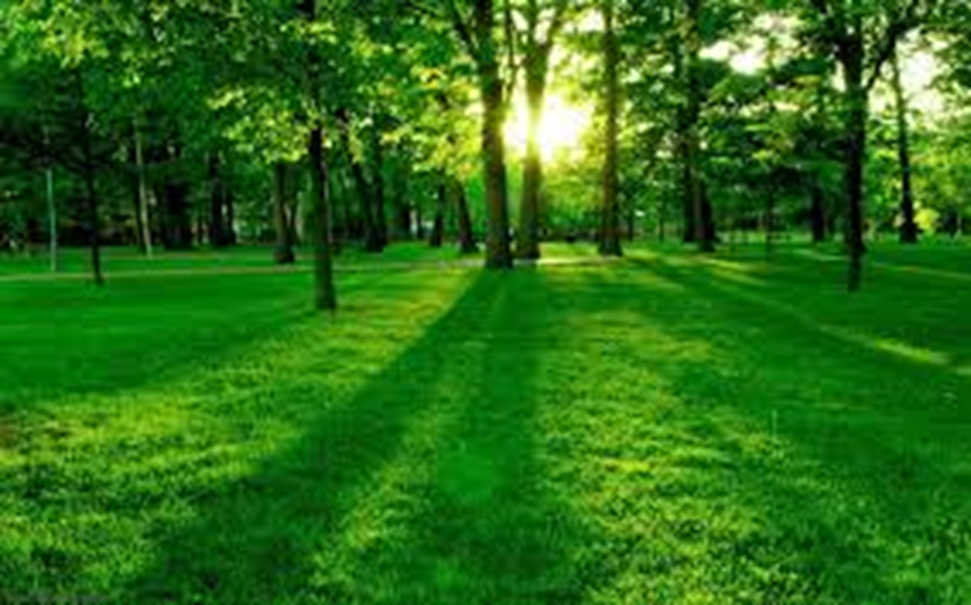
Subject + verb + positive form of adjective + object
It is a very nice scenery.

Slide 9
2. No other+ Ext.+ verb+ as/so+ Positive+ as+ NP.
Ex- No other man in the village is as good as Rahim.
3. Very few+ Ext. Plural Verb+as/so+positive+NP.
Ex- Very few poets are as famous as Kazi Nazrul.

Slide 10
COMPARATIVE DEGREE
‡h mgস্ত adjective Øviv `yB ev Z‡ZvwaK e¨ক্তি,e¯‘,ev cÖvYxi mv‡_ Zzjbv eySvq Zv‡K comparative degree e‡j|

Slide 11
STRUCTURE
OF
COMPERATIVE DEGREE
Comparative degree
পাঁচ ভাবে গঠিত হতে পারে। যেমন-
Sub+ Verb+ Comparative+ than any other+ Ext.
Ex- Rahim is better than any other boy in the class.

Slide 12
2. NP+Verb+Comparative+than all other+Ext.
Ex- Cricket is better than all other games in the world.
3. NP+Verb+Comparative+than most other+Ext.
Ex- Rani is taller than most other girls in the class
4. NP+Verb+Comparative+than few other+Ext.
Ex- She is more beautiful than few other women in the village.
5. NP+Verb+Comparative+than+NP
Ex- The fox is cleverer than the crow.

Slide 13
Superlative degree
দুইয়ের অধিক বা অনেকের মধ্যে Adjective এর তুলনাকে Superlative Degree বলে। Superlative degree দুইভাবে
গঠিত হয়। যেমন-

Slide 14
NP+Verb+the+Superlative+Ext.
Ex- Shachin was the best cricketer in India.
2. NP+Verb+one of the+Superlative+Ext.
Ex- He was one of the best cricketers in the world.

Slide 15
Superlative to Positive
1. Superlative degree এর পুর্বে the থাকলে Positive করার নিয়ম।
No other+Superlative এর পর থেকে শেষ পর্যন্ত বসে।
Verb+as/so বসে।
Superlative এর Positive form বসে।
as+ Subject বসে।
NB- Superlative এর পূর্বের the বাদ যাবে।
Sup- Tiger is the strongest animal in the forest.
Posi-No other animal in the forest is as strong as Tiger.

Slide 16
2. Superlative degree এর পূর্বে one of the থাকলে Positive করার নিয়ম।
Very few+Superlative এর পর থেকে শেষ পর্যন্ত বসে।
Verb এর Plural+as/so বসে।
Superlative এর Positive form বসে।
as+Subject বসে।
NB-Superlative এর পূর্বের one of the বাদ যাবে।
Sup-He was one of the best boys in the class.
Posi-Very few boys in the class were as good as He.
Sup- Gold is one of the most precious metals.
Posi- Very few metals are as precious as Gold.

Slide 17
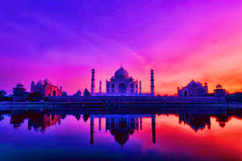
Exercise or practice
Jerry was the smallest boy in the orphanage.
Mongla is one of the most famous sea-ports in the world.
Shakespear was one of the greatest dramatists.
He is the happiest man in the village.
Tajmahal is the most beautiful place in the world.
Akbar was one of the mightiest kings of India.
Foyots was one of the costliest hotels in France.
January is one of the coldest months of the year.
Cricket is the most favourite games in the world.
Titanic was the largest ship in the world.

Slide 18
Superlative to Comparative
Superlative degree এর পূর্বে the থাকলে Comparative করার নিয়ম
Sub+Verb বসে।
Superlative এর Comparative form বসে।
than any other বসে।
Superlative এর পর থেকে শেষ পর্যন্ত বসে।
NB-Superlative এর পূর্বের the বাদ যাবে।
Sup- Kazi Nazrul Islam is the most famous poet in Bangladesh.
Com- Kazi Nazrul Islam is more famous than any other poet in Bangladesh.

Slide 19
Superlative degree এর পূর্বে one of the থাকলে Comparative করার নিয়মঃ
Sub+Verb বসে।
Superlative এর Comparative form বসে।
than most other বসে।
Superlative এর পর থেকে শেষ পর্যন্ত বসে।
NB- one of the বাদ যাবে।
Sup- Shakespear was one of the greatest dramatists in English literature.
Com-Shakespear was greater than most other dramatists in English literature.

Slide 20
Exercise
Jerry was the smallest boy in the orphanage.
Mongla is one of the most famous sea-ports in the world.
Shakespear was one of the greatest dramatists.
He is the happiest man in the village.
Tajmahal is the most beautiful place in the world.
Akbar was one of the mightiest kings of India.
Foyots was one of the costliest hotels in France.
January is one of the coldest months of the year.
Cricket is the most favourite games in the world.
Titanic was the largest ship in the world.

Slide 21
Comparative to Positive
Than any other / than all other যুক্ত Comparative কে Positive নিয়ম।
প্রথমে No other বসে।
other এর পর থেকে শেষ পর্যন্ত বসে।
verb+as/so বসে।
Comparative এর Positive form বসে
as+Sub বসে।
NB-than any other/ than all other বাদ যায়
Comp- Dhaka is larger than any other city in Bangladesh.
Posi- No other city in Bangladesh is as large as Dhaka.

Slide 22
Than most other / than few other যুক্ত Comparative কে Positive করার নিয়মঃ-
প্রথমে Very few বসে।
other এর পর থেকে শেষ পর্যন্ত বসে।
Verb এর Plural + as/so বসে।
Comparative এর Positive form বসে।
As+Sub বসে।
NB- than most other/than few other বাদ যায়।
Comp- Tiger is stronger than most other animals in the forest.
Posi- Very few animals in the forest are as strong as Tiger.

Slide 23
শুধুমাত্র than যুক্ত Comparative কে Positive করার নিয়ম।
শেষের NP+Verb+not so বসে।
Comparative এর Positive form বসে।
As+ প্রথম NP বসে।
NB- প্রদত্ত Sentence টি Negative হলে not so এর স্থলে as লিখতে হবে।
Comp-The lion is more ferocious than the Tiger.
Posi- The tiger is not so ferocious as the lion.
Comp- Rahim is not higher than Karim.
Posi- Karim is as high as Rahim.

Slide 24
Exercise
Fox is cleverer than all other animals in the forest.
Mobile is more wonderful than any other invention.
An aeroplane can run faster than a Bus.
She is not more beautiful than her mother.
Dhaka is larger than most other cities in Bangladesh.
Hilsha is more attractive than most other fishes.
Elephant is biggar than any other animal in the forest.
Rose is more beautiful than all other flowers.
Gold is more precious than most other metals.
Iron was more useful than any other metal.

Slide 25
Comparative to Superlative
1. than any other/ than all other যুক্ত Comparative কে Superlative করার নিয়ম।
NP+Verb+the বসে
Comparattive এর Superlative form বসে
other এর পর থেকে শেষ পর্যন্ত বসে।
NB- than any other/ than all other বাদ যাবে।
Comp- Dhaka is larger than any other city in Bangladesh.
Sup- Dhaka is the largest city in Bangladesh.
Comp-He was better than all other boys in the class.
Sup- He was the best boy in the class.

Slide 26
than most other/ than few other যুক্ত Comparative কে Superlaive করার নিয়ম।
NP+verb+one of the বসে
Comparative এর Superlative form বসে।
other এর পর থেকে শেষ পর্যন্ত বসে।
NB- than most other/than few other বাদ যাবে।
Comp-She was wiser than most other women .
Sup- She was one of the wisest women.
Comp- Fox is cleverer than few other animals in the forest.
Sup- Fox is one the cleverest animals in the forest.

Slide 27
More exercise for practice
Chittagong is biggar than any other sea-port in the world.
Hamlet is more popular than most other dramas.
Arabian Nights was better than most other stories.
Joya was worse than any other girl in the class.
Akbar was greater than all other kings of India.
Nazim is taller than few other students in the class
Dhaka is older than any other city in Bangladesh.
Iron is more useful than most other metals.
The Padma is larger than all other rivers.
Cricket is more enjoyable than any other game.

Slide 28
Positive to Comparative
No other যুক্ত Positive কে Comparative করার নিয়ম
Sub+Verb বসে।
Positive এর Comparative form বসে।
than any other বসে।
other এর পর থেকে Verb এর পূর্ব পর্যন্ত বসে।
NB- No other, as…as, so…as বাদ যায়।
Posi- No other river in Bangladesh is as mighty as the Padma.
Com- The Padma is mightier than any other river in Bangladesh.

Slide 29
Very few যুক্ত Positive কে Comparative করার নিয়ম
Sub+Verb এর Singular form বসে।
Positive এর Comparative form বসে।
than most other বসে।
few এর পর থেকে Verb এর পূর্ব পর্যন্ত বসে।
NB- very few, as…as, so…as বাদ যাবে।
Posi- Very few animals in the forest are as big as Elephant.
Com- Elephant is biggar than most other animals in the forest.

Slide 30
as…as যুক্ত Positive কে Comparative করার নিয়ম
শেষের NP+Verb+not বসে
Positive এর Comparative form বসে।
than+ প্রথম NP বসে
NB- as… as বাদ যাবে।
NB- প্রদত্ত Sentenceটি Negative হলে not বসবে না।
Posi- He was as clever as the fox.
Com- The fox was not cleverer than He.
Posi- Rani is not so beautiful as Rina.
Com- Rina is more beautiful than Rani.

Slide 31
Exercise For Practice
No other food on the menu was as cheap as vegetable fry.
Very few metals are so precious as Gold.
Cure is not so good as prevention.
He is as tall as his father.
Very few persons in the company was as mighty as Hiron.
No other ship in the world was so big as the Titanic.
No other flower is as beautiful as the rose.

Slide 32
Positive to Superlative
No other যুক্ত positive কে Superlative করার নিয়ম
Sub+Verb+ the বসে।
Positive এর Superlative form বসে।
other এর পর থেকে Verb এর পূর্ব পর্যন্ত বসে।
NB-other, as…as, so…as বাদ যাবে।
Pos-No other country in the world is as rich as France
Sup- France is the richest country in the world.

Slide 33
Very few যুক্ত Positive কে Superlative করার নিয়ম
Sub+Verb এর Singular+one of the বসে।
Positive এর Superlative form বসে।
Few এর পর থেকে Verb এর পূর্ব পর্যন্ত বসে।
NB- very few, as…as, so…as বাদ যাবে।
Pos-Very few boys in the town were as clever as Rahim.
Sup-Rahim was one of the cleverest boys in the town.
Pos-Very few poets are so great as Kazi Nazrul.
Sup-Kazi Nazrul is one of the greatest poets.

Slide 34
Exercise
No other food on the menu was as cheap as vegetable fry.
Very few metals are so precious as Gold.
Very few persons in the company was as mighty as Hiron.
No other ship in the world was so big as the Titanic.
No other flower is as beautiful as the rose.
Very few things are so useful as paper.
No other invention in the modern is as great as electricity.
Very few women are so clever as she.

