Slide 1
WELCOME

Slide 2
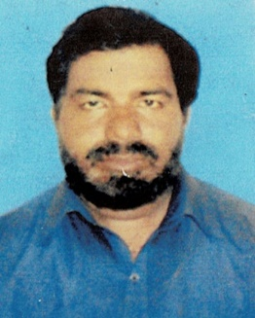
Identity
MD.BILLAL HOSSAIN. CLASS-SIX
KHOJEKHANI AYESHA SIDDIKA G.D. SUB-ENGLISH-2nd Paper
MADRASAH,SREEPUR,GAZIPUR GRAMMAR (Sentence)
E-MAIL-billalpatka71@gmail.com.

Slide 3
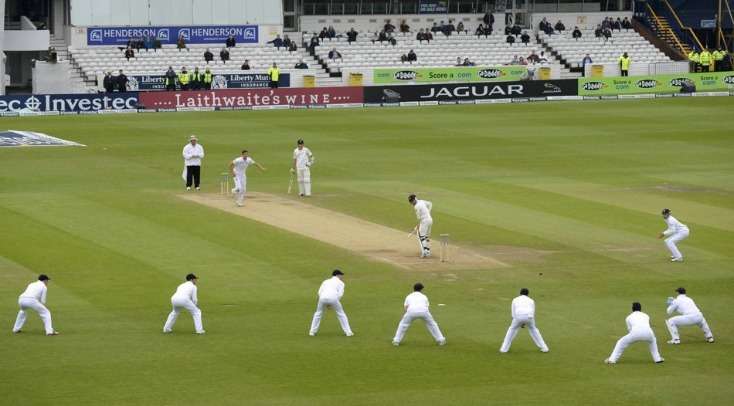
Every day we speak Diffrerent Kinds of Speeches.This speech which we speak every day is a Sentence.A group of words having a a full meaning is called a sentence.Dear students look at this Sentences and pictures given below:- 1.They are playing cricket.

Slide 4
2.What is this?

Slide 5
3.Don’t wet in the rain.

Slide 6
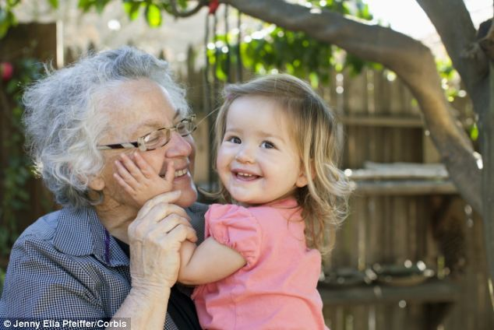
4.May Allah help you.

Slide 7
Hurrah! We have won the game.

Slide 8
Today’s lesson:-
Identity or character of a sentence
( Interrogative sentence)

Slide 9
Learning outcmes :-
By the end of this lesson the students will be able to:-
Identify Interrogative sentence.
They will be able to write Interrogative sentence.
They can explain interrogative sentence.
Can ask a question to know something.

Slide 10
Description :-
At the end of an interrogative sentence always carry a not interrogative signe. ( ? )
Interrogative sentence starts with –Wh
Example-What is your name?
How are you? etc.
Interrogative sentence starts with – Do/ Does, Don’t/Doesn’t
Example- Do you play football ?,Does he go to madrasah?
Don’t you eat rice ?
Interrogativ sentence stats with Auxiliary verb.(Am.is,are,have,has will,won’t,shall,etc.)
Am I a teacher?
Have you eaten rice ?

Slide 11
GROUP- WORK
Group-A
Group-B
Write 5 Interrogative sentence use of -Wh
Write 5 Interrogative sentence use
Of-Do/Does/Don’t/Doesn’t

Slide 12
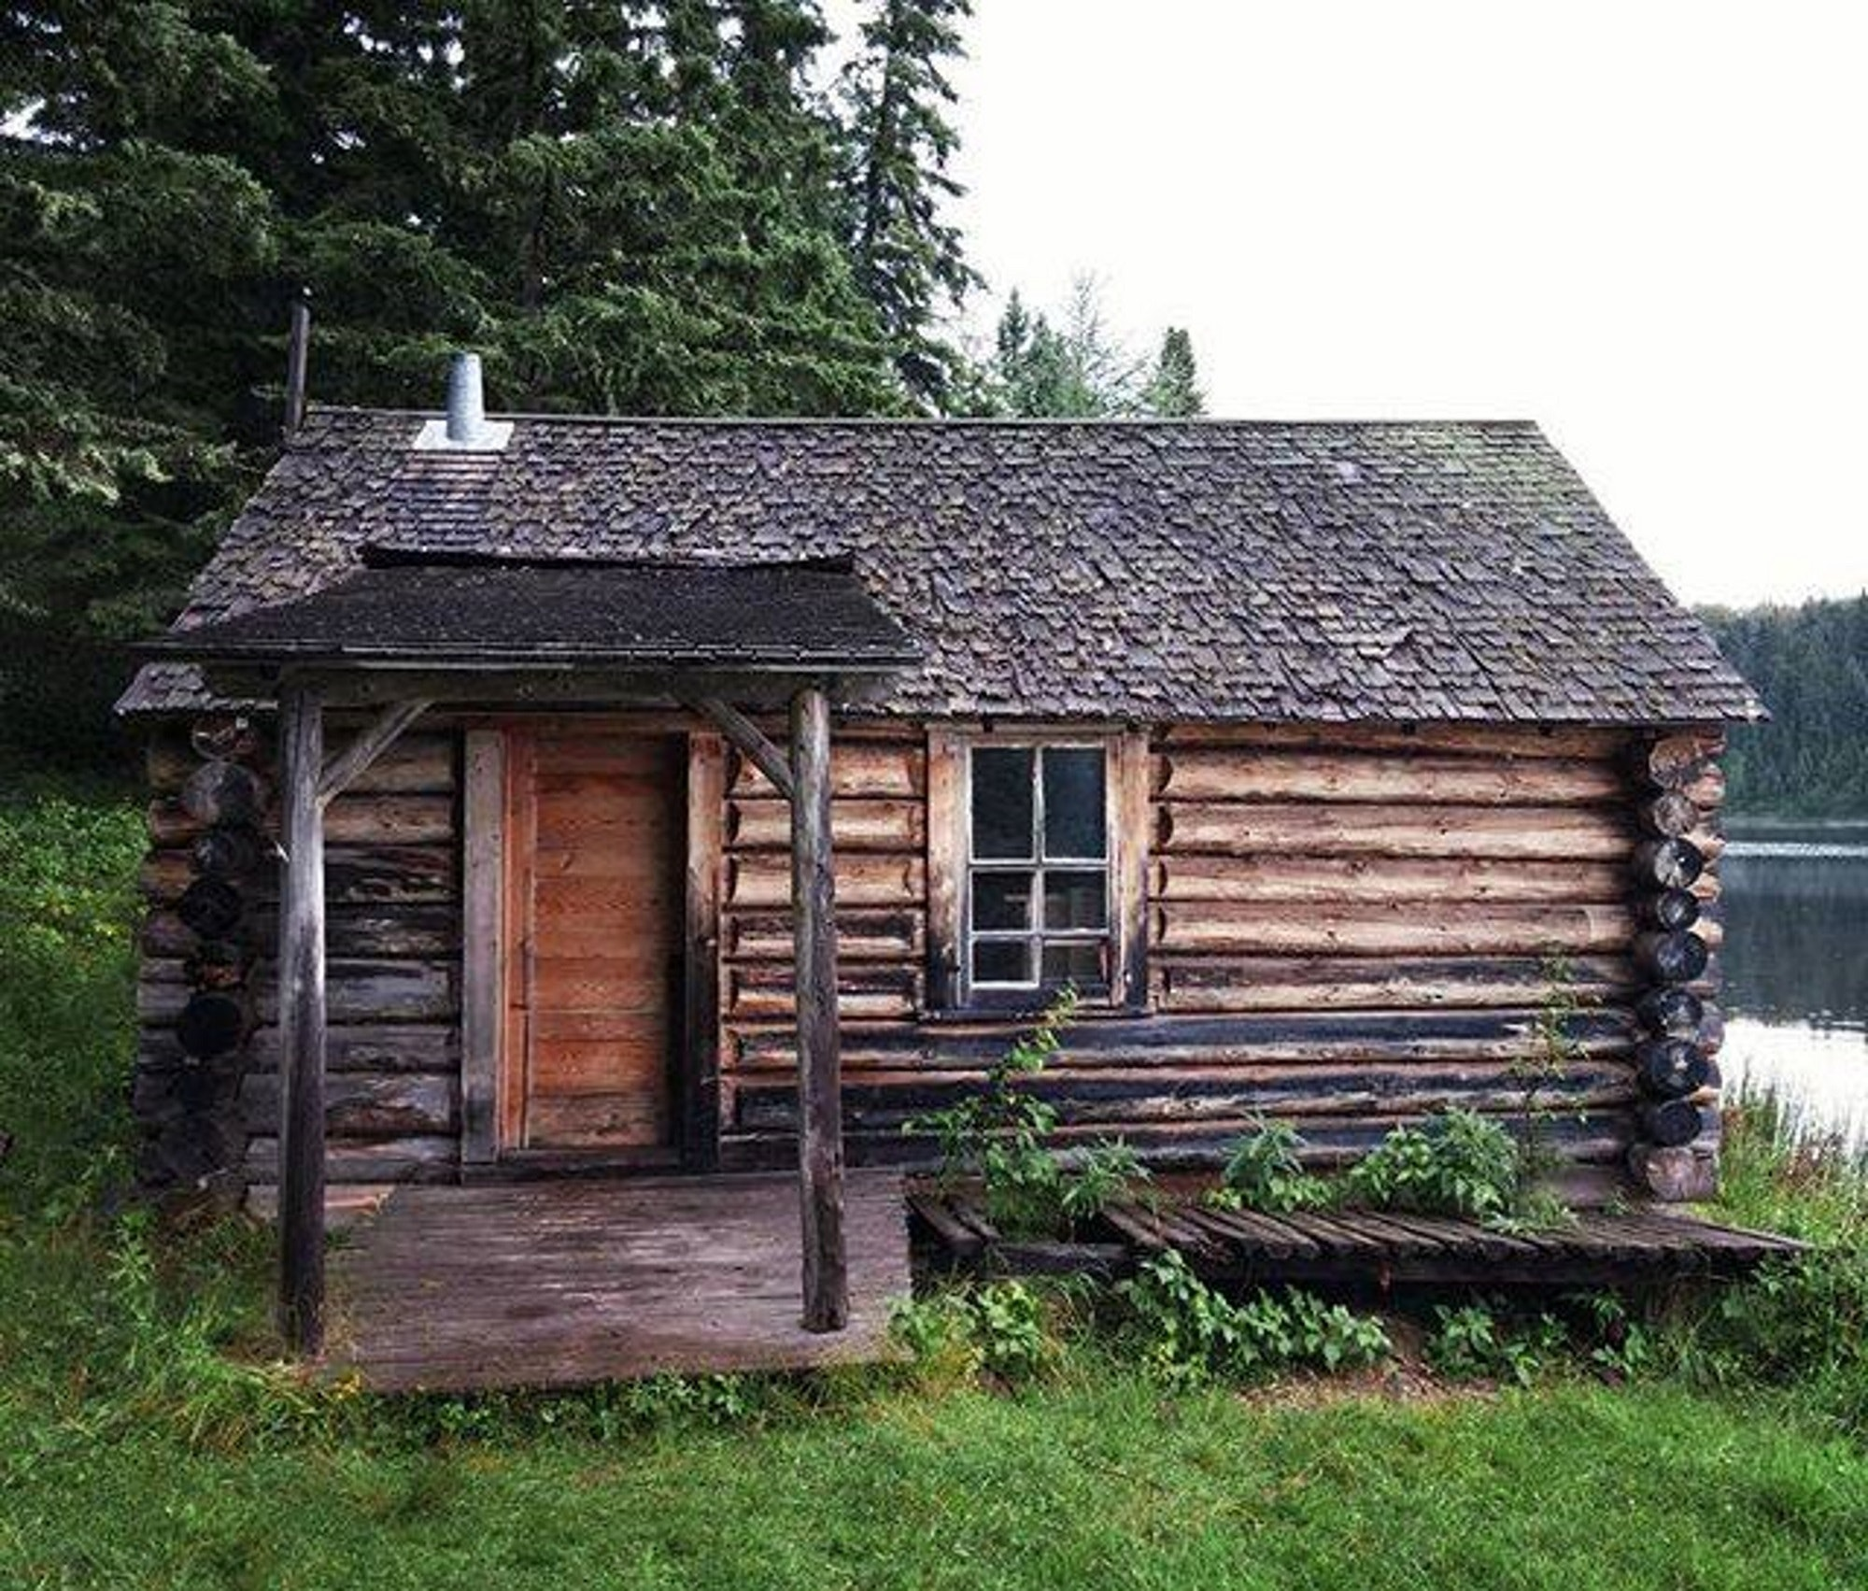
Home Work:
Make 15 Sentences use of Wh,Do,Does, Don’t,Doesn’t,Will, Shall,Have,has Had etc.

