Slide 1
Introduction to HTML
MD MAMUNUR RASID
mdmamun480@gmail.com

Slide 2
Definitions

Slide 3
Definitions

Slide 4
HTML Document Structure
<html>
<head>
<title> NACTAR </title>
</head>
<body>
This is what is displayed.
</body>
</html>
Notes:
09/22/97
3
University of Minnesota Extension Service
Master Internet Volunteer Program
Provide information in an organized way
Chat Groups
Specialized information areas
Internet access

Slide 5
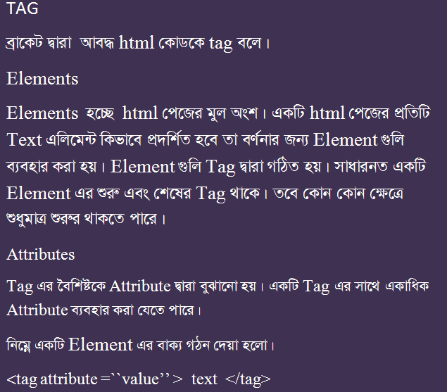
Tag, Element, Attribute

Slide 6
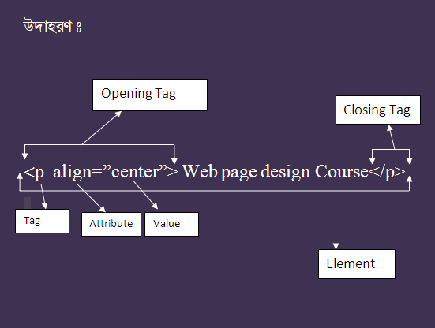
Tag, Element, Attribute

Slide 7
Creating Paragraph
Html Page
Output
<html>
<head>
<title> Text </title>
</head>
<body>
<p align =“center”> World wide web</P> <p> The world wide web is an Internet service, based on a common set of protocols.</P>
</body>
</html>
World wide web
The world wide web is an Internet service, based on a common set of protocols.
Notes:
09/22/97
3
University of Minnesota Extension Service
Master Internet Volunteer Program
Provide information in an organized way
Chat Groups
Specialized information areas
Internet access

Slide 8
Text Emphasis
<b> Text</b> : টেক্সট বোল্ড করার জন্য
<u> Text</u> : টেক্সট আন্ডারলাইন করার জন্য
<i> Text <i> : টেক্সট ইটালিক করার জন্য
<strong> Text </strong> : টেক্সট গাঢ় করার জন্য
<big> Text </b> : টেক্সট বড় করার জন্য
<small> small> : টেক্সট ছোট করার জন্য
Notes:
09/22/97
3
University of Minnesota Extension Service
Master Internet Volunteer Program
Provide information in an organized way
Chat Groups
Specialized information areas
Internet access

Slide 9
Text Emphasis
Html Page
Output
<html>
<head>
<title> Text </title>
</head>
<body>
<p align =“left”>Date : 25 June 2014</P> <p> The world wide web is an <b>Internet service</b>, based on a common <u>set of protocols.</u></P>
</body>
</html>
Date :25 June 2014
The world wide web is an Internet service, based on a common set of protocols.
Notes:
09/22/97
3
University of Minnesota Extension Service
Master Internet Volunteer Program
Provide information in an organized way
Chat Groups
Specialized information areas
Internet access

Slide 10
Additional Character Formatting Elements
<STRIKE> strike-through text</STRIKE>
DEL is used for STRIKE at the latest browsers
<BIG> places text in a big font</BIG>
<SMALL> places text in a small font</SMALL>
<SUB> places text in subscript position </SUB>
<SUP> places text in superscript style position </SUP>

Slide 11
Example
<P><STRIKE> strike-through text </STRIKE></BR>
<BIG>places text in a big font </BIG><BR>
<SMALL> places text in a small font</SMALL><BR>
<SUB> places text in subscript position </SUB>
Normal
<SUP> places text in superscript style position </SUP><BR> </P>

