Slide 1
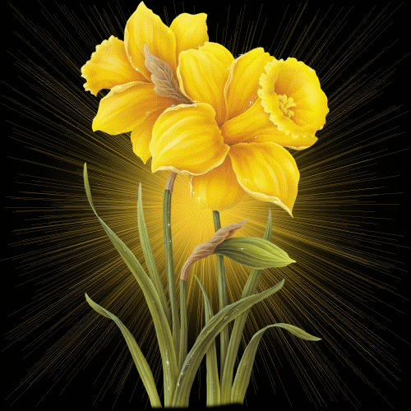
WELCOME TO MULTI MEDIA CLASS
Md. Saiful Islam, Assistant teacher (English) Bagbari Chowbaria High School, Sadar Tangail

Slide 2
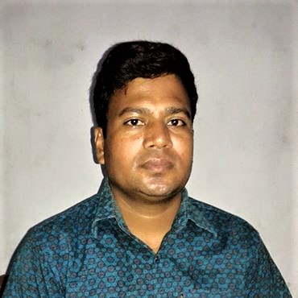
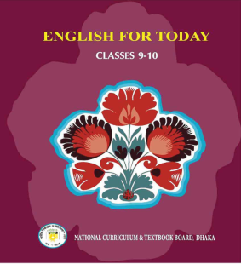
Introducing:
Md. Saiful Islam
Assistant Teacher (English)
Bagbari Chowbaria High School,
Tangail Sadar, Tangail
E-mail: hridoy9555@gmail.com
Class: Nine-Ten
Subject: English for today
Unit: 06
Lesson: 02
Time: 50 Minutes
Date: 01-11-2020

Slide 3
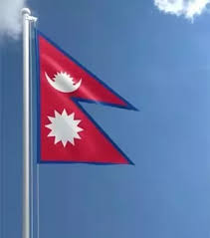
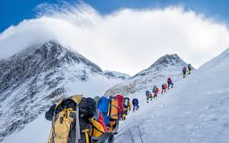
Look at the pictures
Md. Saiful Islam, Assistant teacher (English) Bagbari Chowbaria High School, Sadar Tangail

Slide 4
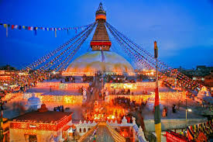
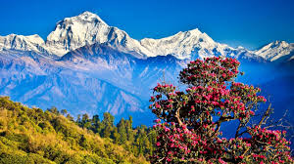
Look at the pictures
Md. Saiful Islam, Assistant teacher (English) Bagbari Chowbaria High School, Sadar Tangail

Slide 5
Let’s watch the video
Md. Saiful Islam, Assistant teacher (English) Bagbari Chowbaria High School, Sadar Tangail

Slide 6
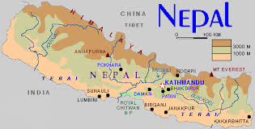
Lesson declaration
Nepal, the land of Everest
Md. Saiful Islam, Assistant teacher (English) Bagbari Chowbaria High School, Sadar Tangail

Slide 7
Learning outcomes:
After finishing the lesson, learners will be able to-
1. answer the questions.
2.choose the best answer from the alternative
3. say the meaning of the words
4. make a dialogue.
5. write a paragraph.
Md. Saiful Islam, Assistant teacher (English) Bagbari Chowbaria High School, Sadar Tangail

Slide 8
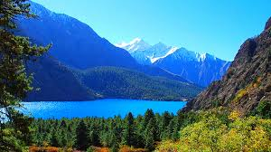
The Himalayas
Beauty of Nepal
The Himalayan Range
Known as the Land of Everest, Nepal is one of the most charming countries in Asia. The kingdom of Nepal is a small land of sublime beauty. It has some of the world’s best and very important temples. It is a country that is rich in scenic beauty and cultural heritage.
Md. Saiful Islam, Assistant teacher (English) Bagbari Chowbaria High School, Sadar Tangail

Slide 9
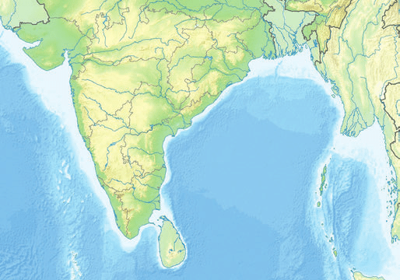
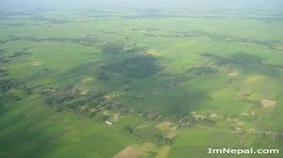
Indian part
Tibetan part of China
Tarai plain
Nepal lies between India and the Tibetan part of China. This small country as an area of 147,181square Kilometers. South Nepal is tropical low land known as the Terai Plains. This part of Nepal has hot summers and warm winters. Here the temperatures reach up 40C in April and May and monsoon rains drench this region from June to September.
Md. Saiful Islam, Assistant teacher (English) Bagbari Chowbaria High School, Sadar Tangail

Slide 10
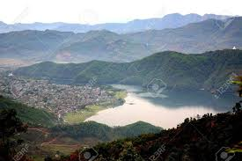
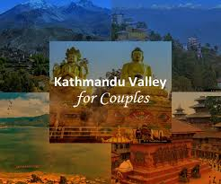
Pokhara Valley
Kathmandu Valley
The central hill-lands including the Kathmandu and Pokhara valleys have a temperate climate and are also influenced by the monsoon. North of that is the slope of the main section of the Himalayan range. This part of Nepal has some of the highest peaks of the world including Everest.
Md. Saiful Islam, Assistant teacher (English) Bagbari Chowbaria High School, Sadar Tangail

Slide 11
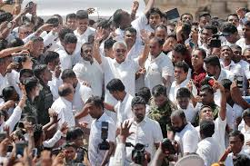
Capital of Nepal
The population of Nepal
Nepal is home to nearly 29,000,000 people. The population is primarily rural. Kathmandu, the capital city, has less than one million inhabitants. Nepal’s demographic features are complicated not only by dozens of ethnic groups, but by different castes.
Md. Saiful Islam, Assistant teacher (English) Bagbari Chowbaria High School, Sadar Tangail

Slide 12
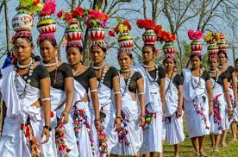
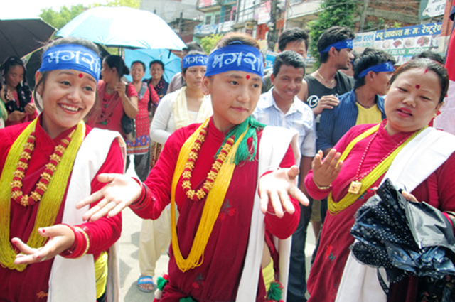
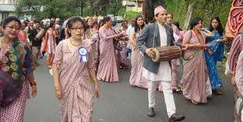
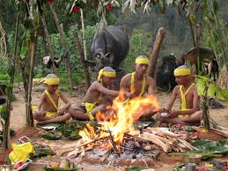
Tharu
Magar
Bahum
Chetri
In total, there are 103 castes and ethnic groups living in this small country. The two largest of such groups are known as Chetri and Bahun. Others include Magar, Tharu
Md. Saiful Islam, Assistant teacher (English) Bagbari Chowbaria High School, Sadar Tangail

Slide 13
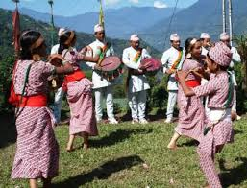
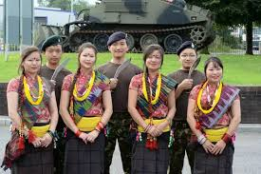
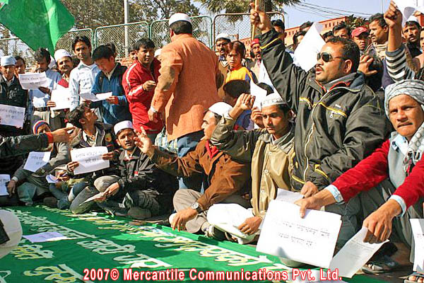
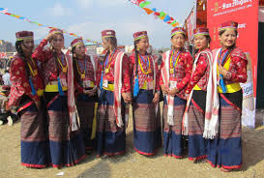
Damai
Gurung
Nepali Muslim
Tamang
and Tamang, Newar Muslim, Gurung and Damai. About 48 percent of the people speak Nepali. Among other languages spoken are Maithali, Bhojpuri, Tharu and Tamang..
Md. Saiful Islam, Assistant teacher (English) Bagbari Chowbaria High School, Sadar Tangail

Slide 14
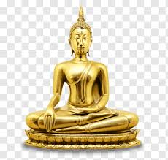
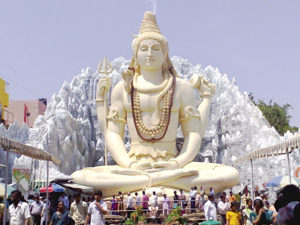
Gautam Buddha
Lora Pashupatinath
Nepal is the holy land of Lord Pashupatinath and Gautam Buddha where the Hindus and Buddhists have lived together in harmony for centuries. Temple of Pashupatinath is the most sacred Hindu shrine and one of the four most important sites in the world for Shiva worshippers.
Md. Saiful Islam, Assistant teacher (English) Bagbari Chowbaria High School, Sadar Tangail

Slide 15
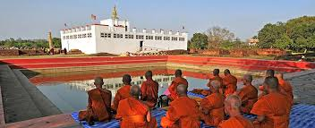
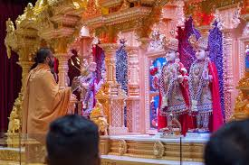
Temple of Buddha
Temple of Hindus
Lord Buddha, the light of Asia, was born in Lumbini in Nepal’s southern plains, which makes this sacred pilgrimage destination for the Buddhists as well. In fact, many Nepalese combine Hindu and Buddhists practices; many temples and shrines are shared between the two faiths, and some deities are worshipped by both Hindus and Buddhists.
Md. Saiful Islam, Assistant teacher (English) Bagbari Chowbaria High School, Sadar Tangail

Slide 16
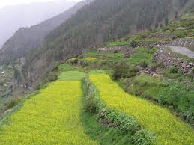
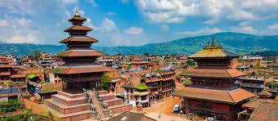
Kathmandu Valley
Patan Valley
BhaktapurValley
Kathmandu Valley is the richest cultural heritage centre of Nepal. The three ancient cities of the Valley- Patan, Kathmandu and Bhaktapur represent an epitome of harmony in urban design, elegant architecture and refined culture. These cities are famous for religious monuments unequalled in the world. The seven monuments zones situated within the Valley have been named as World Heritage Sites by UNESCO.
Md. Saiful Islam, Assistant teacher (English) Bagbari Chowbaria High School, Sadar Tangail

Slide 17
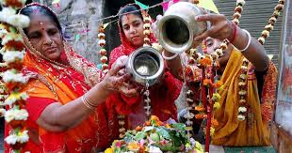
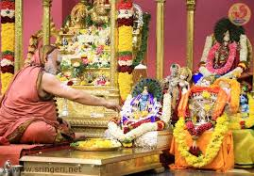
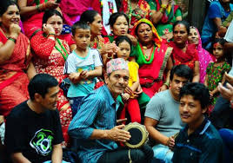
Maha Shivaratri
Krishna Jayanti
Caitra Dasain
Tihar is celebrated in November. Other festivals include the Holi and Chaitra Daisan. Some Hindu festivals are the Haribodhini Ekadashi. Maha Sivaratri and the Krishna Jayanti.
Md. Saiful Islam, Assistant teacher (English) Bagbari Chowbaria High School, Sadar Tangail

Slide 18
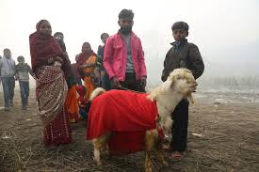
Chaitra Dasain
Animal sacrifice
Many festivals add dazzling colour to Nepal’s vibrant culture, which are celebrated throughout the year. Dasain or dusherra is celebrated nationwide in October. This is the most important of all Nepalese celebrations and includes the biggest animal sacrifice of the year.
Md. Saiful Islam, Assistant teacher (English) Bagbari Chowbaria High School, Sadar Tangail

Slide 19
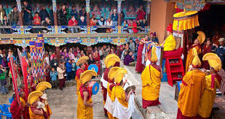
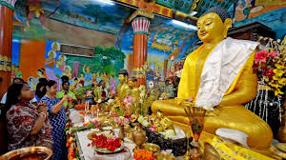
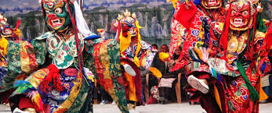
Mani Rimd
Buddha Jayanti
Losar
There are Buddhist celebrations too and those include Mani Rimd, Buddha Jayanti and Lasar, which marks the Tibetan New Year.
Md. Saiful Islam, Assistant teacher (English) Bagbari Chowbaria High School, Sadar Tangail

Slide 20
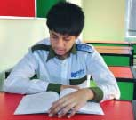
Individual work:
Answer the following questions:
1. What do you know about the weather of Nepal?
2. When do people celebrate ‘Tihar’?
3. Write about the temple of Pashupatinath of Nepal?
4. What is the area of Nepal?
5.How many ethnic groups are there in Nepal?
Answer
The weather of Nepal varies from place to place. Southern part has hot summers and warm winters and monsoon rains occur from June to September. Again, the central hill, lands have a temperate climate.
People celebrate ‘Tihar’ in November.
Nepal is called the holy land by the Hindus for the temple of Pashupatinath. It is the most sacred Hindu shrine in Nepal and one of the world’s most important cities for Shiva worshippers.
The area of Nepal is about 147181 square kilometers.
There are 103 ethnic groups are there in Nepal.
Md. Saiful Islam, Assistant teacher (English) Bagbari Chowbaria High School, Sadar Tangail

Slide 21
Pair work
Make a dialogue between you and your friend on your visiting to Nepal.
Md. Saiful Islam, Assistant teacher (English) Bagbari Chowbaria High School, Sadar Tangail

Slide 22
Group work
Write the meaning of the following words.
Sublime- উচ্চ- high
Luxury- বিলাসিতা- comfort
Heritage- ঐতিহ্য- tradition
Temperate- নাতিশীতোষ্ণ- moderate
Drench- প্রবল বৃষ্টি – heavy rain
Demographic- জন সংখ্যা বিষয়ক- related to population
Features- বৈশিষ্ট্য - characteristics
Important- গুরুত্বপূর্ণ - significant
Combine- একত্র করা- assemble
Deities- দেবী- goddess
Elegant-মার্জিত- accomplished
Vibrant-স্পন্দনশীল-plangent
Md. Saiful Islam, Assistant teacher (English) Bagbari Chowbaria High School, Sadar Tangail

Slide 23
Evaluation
Choose the best answer from the alternatives:
1. The land area of Nepal is------- square Kilometers.
(a) 147570 (b) 147181 (c) 144181 (d) 148181
2. Nepal lies between ----
(a) India and Bangladesh(b) India and Pakistan(c) India and Tibetan part of China (d) None
3. Which area has warm winters?
(a) Kathmandu (b) Lumbini (c) Terai Plains (d) Pokhara
4. Who is called the ‘ Light of Asia’?
(a) Mahatma Gandhi (b) Mother Teresa (c ) Dalai Lama (d) Lord Buddha
5. What is the closest meaning of ‘ Sublime’?
(a) usual (b) trivial (c) imposing (d) high
6. Everest is in the ----- of Nepal
(a) east (b) west (c) north (d) south
7. People of Nepal celebrate ‘Dasain or Dusherra in----
(a) September (b) October (c) November (d) December
Md. Saiful Islam, Assistant teacher (English) Bagbari Chowbaria High School, Sadar Tangail

Slide 24
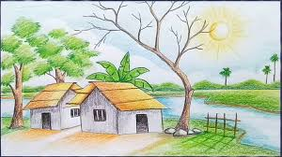
Home work
Write a paragraph about your ‘Neighbour’
Md. Saiful Islam, Assistant teacher (English) Bagbari Chowbaria High School, Sadar Tangail

Slide 25
Allah hafez
Md. Saiful Islam, Assistant teacher (English) Bagbari Chowbaria High School, Sadar Tangail

