Slide 2
Subject: English Second paper
Teacher’s Identity:
Khaleda Akter
Lecturer in English
Fajilpur Walia Fazil(Degree) Madrasa.
Class: Alim( Second Year)
Lesson: Completing Sentences

Slide 3
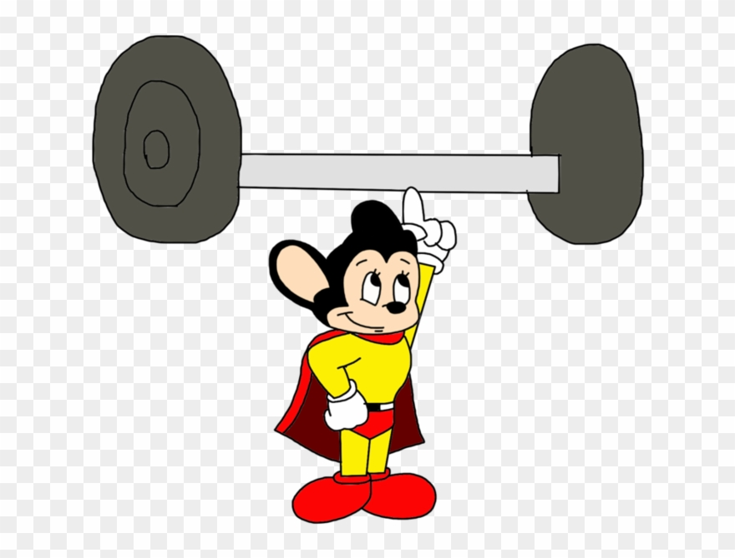
What about the picture?
The dumb-bell is too light to lift.

Slide 4
Rule-1: too-----to (এতই--- যে)
to buy clothes
1. He is too poor____________.
2. He is too good a man_________________.
3. I am too busy ________________.
4. I am too tired ________________.
5. The officer is too honest ______________.
6. The problem is too complex ____________.
to offend anyone
to talk to you
to climb the tree
to take a bribe
to be solved easily
Structure: to +verb+object

Slide 5
What about the picture?
The dumb-bell is so heavy that I can’t lift it.

Slide 6
Rule-2: so------that (এতই-----যে)
I cannot lift it.
The box is so heavy that ____________
My brother worked so hard that ___________
My grandfather is so weak that _____________
She is so short that _________________________
Water is so vital of all natural resources that _____________________
he could not fail the exam.
he cannot survive.
she cannot touch the ceiling.
we can’t live without water.
Structure: that+sub+can/could+not +verb+obj

Slide 7
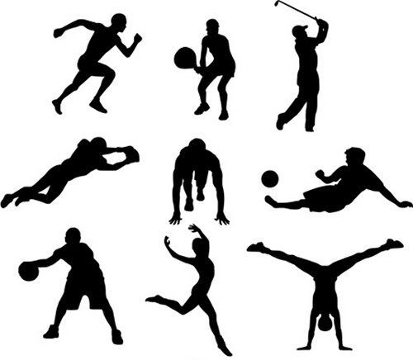
What about the picture?
They are doing exercise so that they can fit themselves.

Slide 8
Rule-3: so that (যাতে)
Ayesha is studying English so that _______________
I will go to France so that ______________________
Let’s go to the stadium early so that _________________.
I’m putting the dish in the oven now so that ____________________________
5.I opened the door so that ___________________
she can travel.
I can learn French.
we can get good seat
It can be ready by eight o’clock.
she could come in.
Structure: sub+can/could +verb+obj

Slide 9
What about the picture?
The man walks fast lest he should miss the train.

Slide 10
Rule-4: Lest (না হলে,যাতে না ঘটে)
you should catch the cold.
1.Put on your coat lest ______________________.
2.Speak quietly lest ______________
3.She turned her head away lest _________________
4.Take care lest ________________
5.She studied hard lest _________________________.
she should hear us.
he should see her tears.
you should fall asleep.
she should fail the exam.
Structure: sub+should/might +verb+obj

Slide 11
What about the picture?
Unless the third man runs fast, he will fail to win .

Slide 12
Rule-5: Unless(if……not) (যদি না)
Unless is like If in that we don’t use will/would after it. We only use the present simple tense.
Unless I hear from you, __________________.
Unless you study,________________________.
I’ll make dinner unless ____________________.
Unless you stop smoking, __________________.
I’ll see you at 5pm
you will fail/ you won’t pass
someone else wants to
you will feel bad

Slide 13
Unless-------
When unless comes before a main clause we use a comma:
Unless it rains, ______________________________.
Unless you use your time properly, _________________
Unless she works hard,__________________________.
When the main clause comes first, no comma is required:
They won’t come unless______________.
we’ll go for a picnic tomorrow.
you will not prosper in life.
she will not pass
you invite them.
Structure: sub+shall/will +verb+obj.

Slide 14
Exercise
Unless you read attentively----------------
Read diligently lest --------------------------
He works hard so that--------------------.
He worked hard so that -------------------.
The wind was so cold that-----------------.
Unless you work hard -----------------------.
The house is too costly for me-------------.
They walked fast lest--------------------------.

