Slide 2
Identity
Md. Afsar Ali
Senior Assistant Teacher
Majhira Model High School
Shajahanpur, Bogura
01719549949
afsar0903@gmail.com
English for today
Class-Eight

Slide 3
Look at the picture and guess what our today’s lesson
Honest
Brave
Kind-hearted
Responsible
Helpful
Courageous
Unselfish
Self-confident
Religious
Respectful
What kind of man is he who has the above quality?

Slide 4
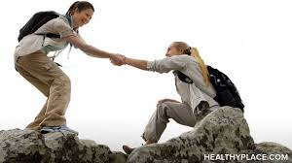
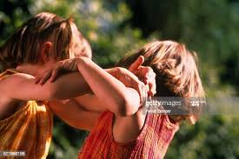
What do you see in the two pictures?
1
2
I can see two girls is quarrelling in the picture no-2
I can see a girl is helping to another girl in the picture no-1

Slide 5
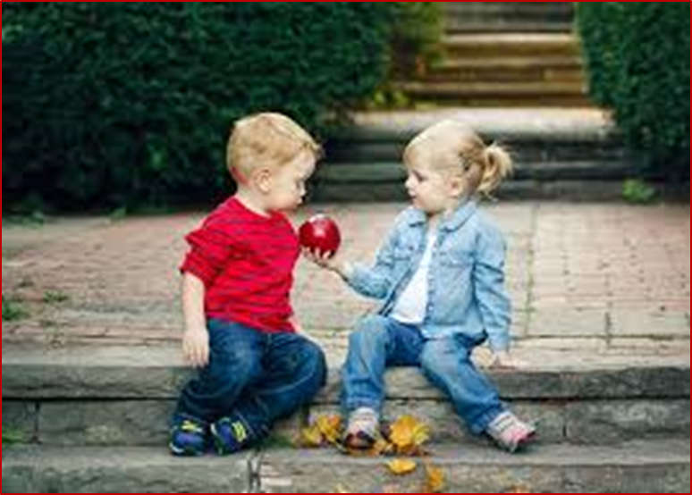
Yes, you are right. Today we will learn
Good Character
Good character
Unit-1 Lesson-3

Slide 6
Learning outcomes:
After we have studied this lesson, we will be able to-
narrate incident
participate in discussion
listen to and understand others
ask and answer questions,
Fill in the blanks.

Slide 7
A. Ask and answer the questions in pairs.
1.What do you understand by character?
Ans: By character, we understand how a person is.
Character refers to beliefs, activities and nature of a person
for which he or she is honoured or dishonoured by others.
2. What does a person with a good character usually do to others?
Ans: Well a person with a good character usually behaves well with others. He never tells a lie. He does not deceive others. He is a man of words. He is very sincere.

Slide 8
Listen to the Audio clips / Teacher and answer the following questions

Slide 9
1. Which is the correct statement according to the information in the listening /above text?
a. Good character does not mean special qualities.
b. Good citizens must have good character along with other qualities.
c. Character means a tool to curve wood.
d. Character traits are distinctive marks always seen on a person’s face.
2. The red crest of a rooster
a. is a symbol of power and strength.
b. enables it to crow in the morning.
c. makes the bird tall and beautiful.
d. shows how it is different from a hen.

Slide 10
3. The expression ‘distinctive qualities’ means those qualities of a person, which
a. are the same as others’.
b. emphasize honesty in him/her.
c. make him / her different from others.
d. he / she gets from their parents.
4. Character traits are
a. naturally gifted.
b. personally learned.
c. God given.
d. physically visible.

Slide 11
Fill in the blanks in the following passage with appropriate words from the box.
harmonious
allow
behaviour
respect
others
sense
qualities
believe
personally
family
class
doing
good
Citizens possessing good character live a life of virtue. They may belong to any social 1)--------------, upper or lower. Their thoughts and 2) --------------- show high moral values. That is, they have a strong
3) -------- of right and wrong. So what they do is 4)-------------- for themselves as well as for others in the 5)--------- and in the society. In fact, they cannot even think of 6)---------- any wrong to others. One of the most positive 7)----------- of these people is tolerance towards
8)-----------. Suppose a group of people in your community 9)---------- or practise something which you do not like 10)-----------. But as a good citizen you should 11)----------- them to perform their activities. Thus tolerance can generate 12)-------- for people of other cultures. Tolerance and respect together can make life 13)------------ and peaceful in society.

Slide 12
D. Read the completed passage and tick the best answer.
1. People with moral values
a. can do anything they like
b. belong to upper social class
c. do good only for themselves
d. cannot do anything wrong to others
2. ‘Tolerance’ means
a. allow others to say and do what they like
b. having a good character
c. having disagreements with others
d. a quality that every citizen has

Slide 13
D. Read the completed passage and tick the best answer.
3. What can make life harmonious in society
a. performing religious rites
b. encouraging cultural values
c. respecting others’ belief and opinions
d. fulfilling religious obligations

Slide 14
E. Find the opposites of these words. If you do not know any, look it up in your dictionary. Then make a meaningful sentence with each of these opposites:
tolerance, respect, allow, enjoyable
word | Opposite word | Sentence
Tolerance | intolerance | Intolerance hampers peace and harmony in the society.
Respect | Disrespect | We should not disrespect others’ thought.
Allow | Disallow | A good citizen never disallows others opinions.
enjoyable | unpleasant | It is an unpleasant situation

Slide 15
Home work
Write a paragraph about how tolerate or intolerant you are towards your classmates.

Slide 16
Good bye
See you again

