Slide 2
Welcome

Slide 3
Solayman
B.A. Hons, M.A. in English
Lecturer in English
Baghun M.U. Alim Madrasa
Kaligonj, Gazipur
Class: Nine
Subject: English 1st Paper
Unit: Five, Lesson: One
Duration: 45 Minutes
Date: 08.11.2020

Slide 4
Enjoy this video
River erosion in Bangladesh
What can you see in this video?

Slide 5
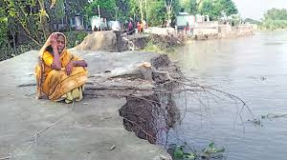
What can you see in the slide?
A woman lost every thing by river erosion

Slide 6
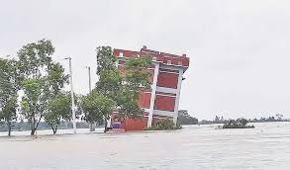
What can you see in the slide?
A building is going under water

Slide 7
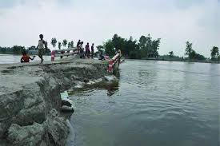
What can you see in the slide?
A bank of river has been broken by river erosion

Slide 8
Our today’s lesson is-
The greed of the roaring rivers

Slide 9
After we have studied this unit, we will be able to-
Learn new words.
comprehend and summarize texts.
ask and answer questions.

Slide 10
Read the passage silently.
Meherjan lives in a slum on the Sirajgonj Town Protection Embankment. Her polythene roofed shelter looks like a cage. She is nearly 45 but looks more than her age. In front of her shelter, she is trying to make a fire to cook the day’s only meal. Her weak hands tremble as she adds some fallen leaves and straw to the fire. The whispering wind from the river Jamuna makes the fire unsteady. The dancing of the flames reminds Meherjan of the turmoil in her life. Not long ago Meherjan had everything--- a family, cultivable land and cattle. The erosion of the Jamuna consumed gradually all her landed property. It finally claimed her last shelter during the last monsoon. It took the river only a day to demolish Meher’s house, trees, vegetable garden and the bamboo bush. She had a happy family once. Over the years, she lost her husband and her family to diseases that cruel hunger and poverty brought to the family. Now, she is the only one left to live on with the loss and the pain. The greedy Jamuna has shattered her dreams and happiness.
There are thousand others waiting to share the same fate with Meherjan. Bangladesh is a land of rivers that affect its people. Erosion is a harsh reality for the people living along the river banks. During each monsoon many more villages are threatened by the roaring of rivers like the Jamuna, the Padma and the Meghna. It is estimated that river erosion makes at least 100,000 people homeless every year in Bangladesh. In fact, river erosion is one of the main dangers caused by climate change. If we can’t take prompt actions to adapt to climate change, there will be thousands of more Meherjans in our towns and villages every year.

Slide 11
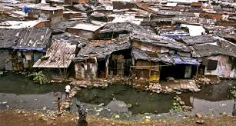
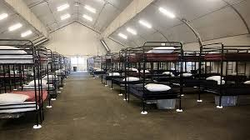
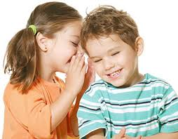
Vocabulary
slum
shelter
whispering
Inhabitant of the poor people
harbour
murmur

Slide 12
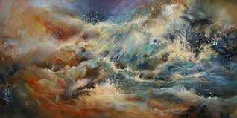
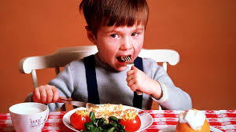
turmoil
Consumed
disorder
Eat/ drink

Slide 13
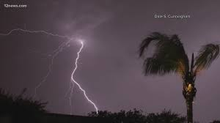
Unsteady
monsoon
unstable
a seasonal prevailing wind

Slide 14
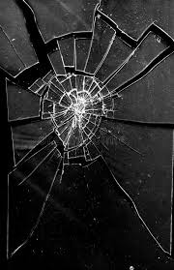
shattered
Harsh
exhausted
grating

Slide 15
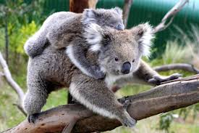
Threatened
estimated
pressurize
approximate

Slide 16
For each phrase below choose the meaning that is closest to the meaning used in the text above.
1. roaring rivers
a rivers that flow strongly making wild sounds
b rivers having many rowing boats in them
c rivers that make people cry out
d rivers that have noisy fishes
2. landed property
a a rented piece of land
b a piece of land on the bank of a river
c property in the form a source of income to its owner
d property used only as an agricultural farm

Slide 17
3. whispering wind
a wind that blows from across the river
b wind that blows with a hissing sound
c wind that helps someone make a fire
d wind that blows in summer
4. dancing of the flame
a a traditional form of folk dance
b a flame that makes people dance around it
c a flame that is made unstable by the blast of air
d a flame made by people to remember their pasts

Slide 18
Group Work
a What does Meherjan use to make fire for cooking her meals?
b What property did Meherjan lose due to river erosion?
c What do you know about Meherjan’s family?
d In which season does river erosion most likely occur?

Slide 19
Evaluation
Meherjan is a typical (1) ………………… woman who lives in a slum. She lost her shelter and properties (2) ………………… the erosion of river Jamuna. She also lost her family. Her husband had died of diseases caused by poverty and (3) …………………. Now, she is only a (4) ………………… . Like Meherjan there are many people who have become the (5) ………………… of river erosion. River erosion is still posing (6) ………………… to the lives and properties of thousands of people. People living (7) ………………… the rivers are the most likely victims of river erosion. Each year about (8) ………………… people become homeless due to river erosion in Bangladesh. Meherjan’s life is just one (9) ………………… of how climate change (10) ………………… the lives of thousands of people

Slide 20
Home Work
Write a paragraph on “The Slum People”.

