Slide 2
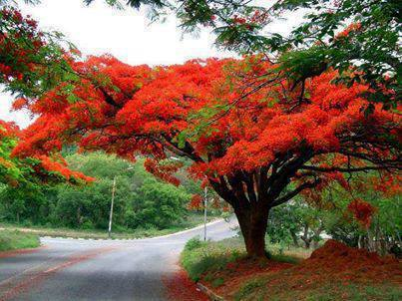
Welcome
to
all
in
my
Class.

Slide 3
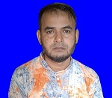
i
Teacher Introducing
Md Shamsunnoor
Head Teacher
Murergaon Govt. Primary school
Companiganj, Sylhet
Mobile : 01712-307039
Email : shadmanheya@gmail.com

Slide 4
Lessom Identity
Class : Five
Subject : English
Time : 40 minute

Slide 5
Learning outcomes
At the end of the lesson students will be able to-
1.3.1 recognize which words in a sentence are stressed.
1.1.1 say words, phrases and sentences with proper sound and stress.
1.5.1 read words, phrases and sentences in the text with proper
pronunciation, stress and intonation.
1.7.1 read paragraphs, dialogues stories, letters and other texts.

Slide 6
Let’s we sing a song.

Slide 7
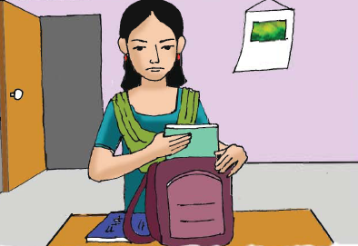
What do you see in this picture ?
Who is she?
What is the girl doing in the picture ?
She is Maria.
She puts her books in her bag.

Slide 8
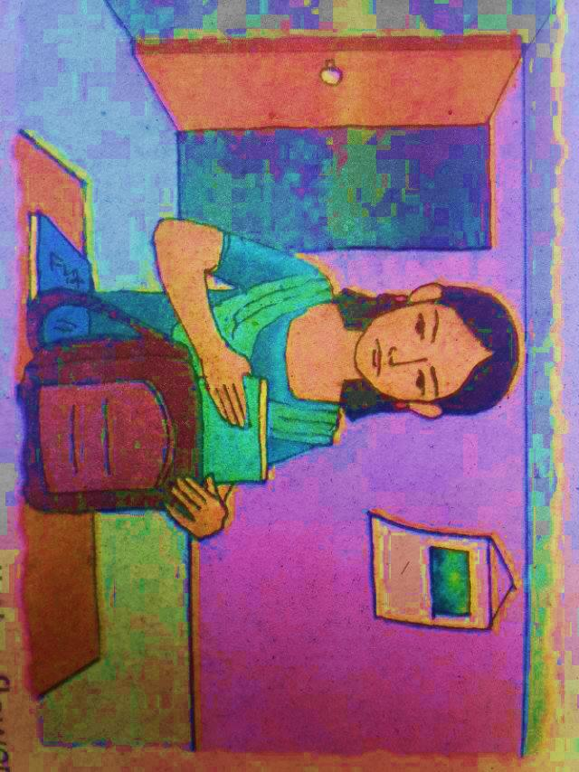
Today’s lesson
Life is Beautiful!
Lessons : 1-2
It’s a …….ready for school.
Unit : 20
Page : 78

Slide 9
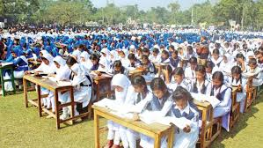
Loud reading

Slide 10
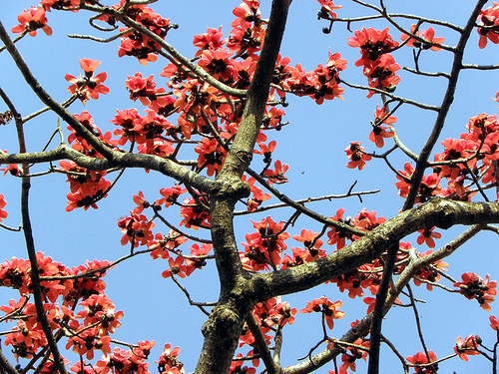
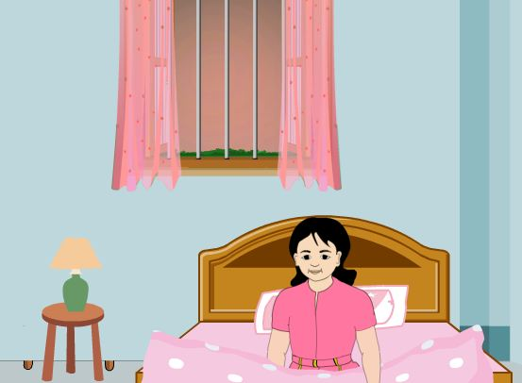
Listen and read-
It’s a beautiful spring day.
Maria gets up early.
She
She feels happy.

Slide 11
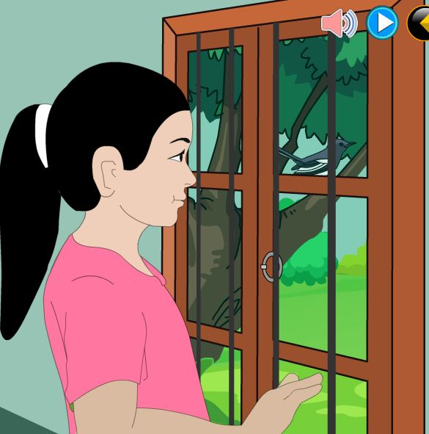
Listen and read-
She knows that it’s a nice
day because she puts her
hand on the glass of the
window.
It’s very warm.

Slide 12
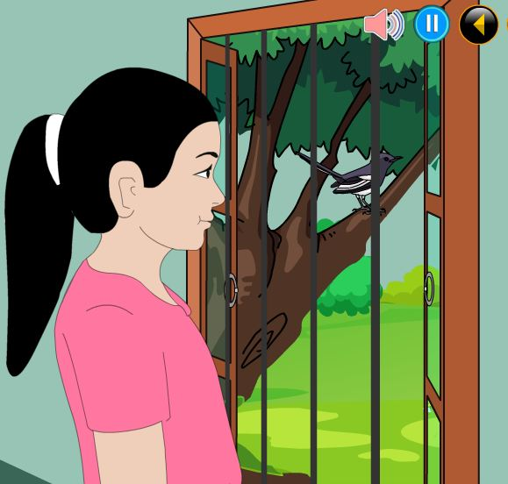
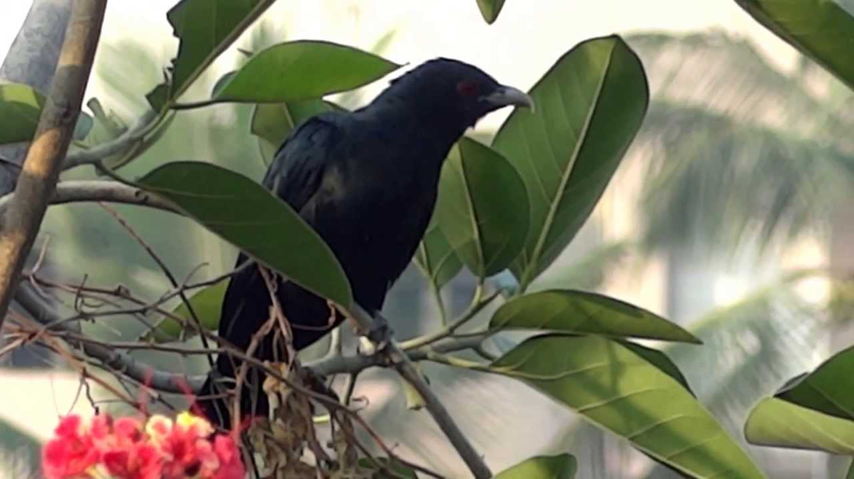
Listen and read-
She opens the window and
the singing of the birds fills
the room.

Slide 13
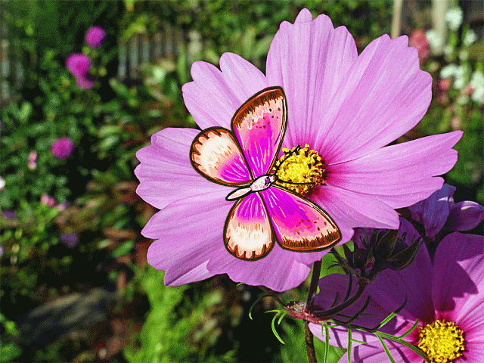
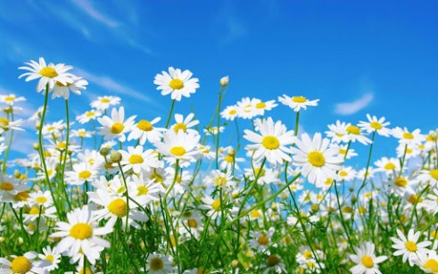
Listen and read-
She can smell the flowers
outside her home.
They
smell sweet and fresh.

Slide 14
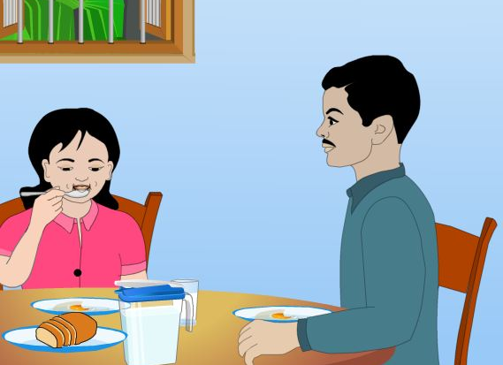
Listen and read-
After Maria gets dressed
and has her breakfast,
she
puts her books In her bag.
She is ready for school.

Slide 15
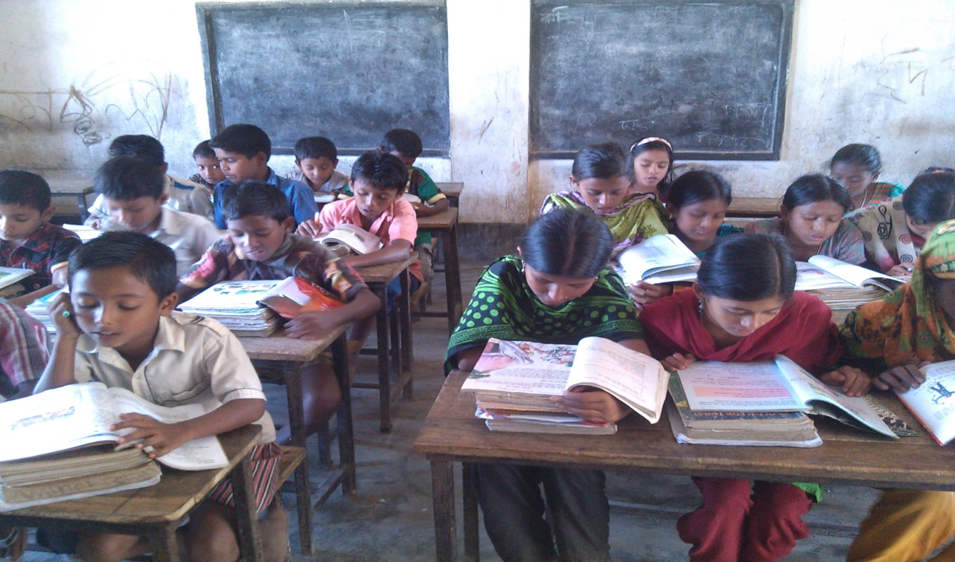
Silent reading

Slide 16
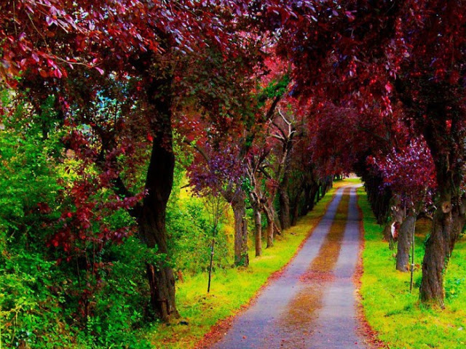
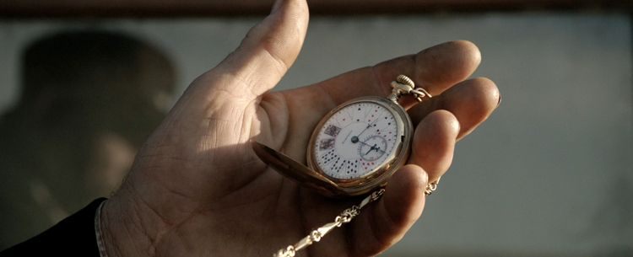
New Words
Meaning in English
very attractive.
Beautiful
the season between
winter and summer.
spring
early
before the usual time.

Slide 17
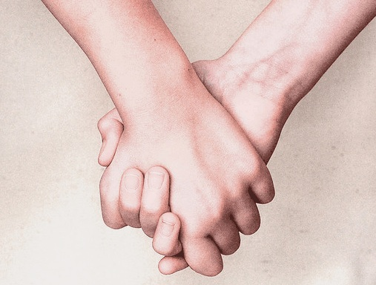
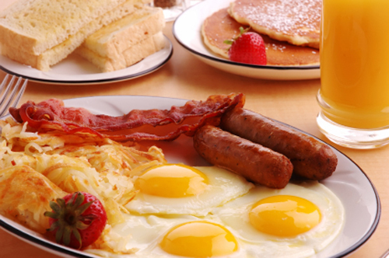
New Words
Meaning in English
to experience something
physically or emotionally.
Feel
a meal eaten in
the morning.
breakfast

Slide 18
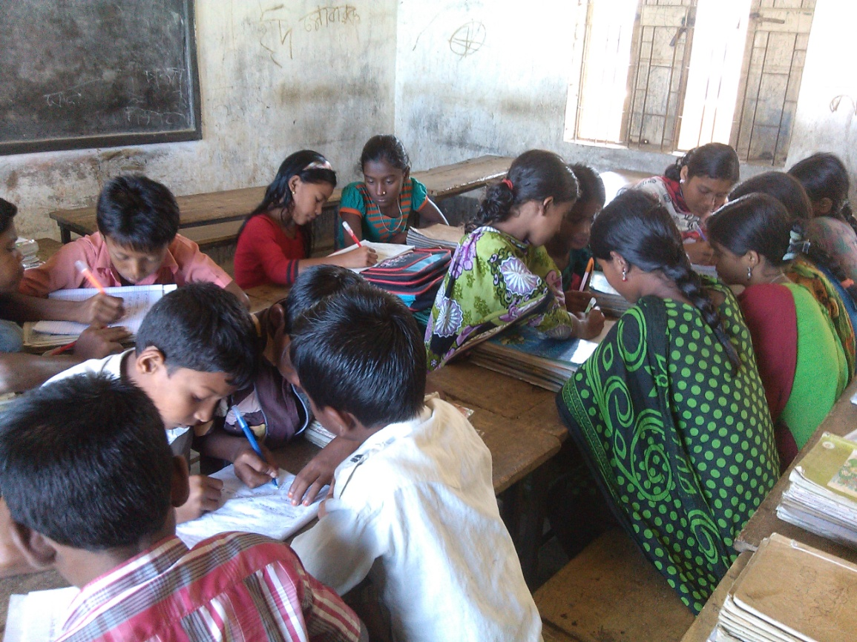
Group work
Write “T” for true or “F” for False.
It’s a beautiful spring day.
2. She feels worried.
3. Maria gets-up early ?
4. Resma is ready for school ?
T
F
T
F

Slide 19
Evalution
Matching
having or producing a
comfortably high temperature.
early
happy
the external side of surface of something.
outside
before the usual time.
warm
Feeling or showing pleasure.

Slide 20
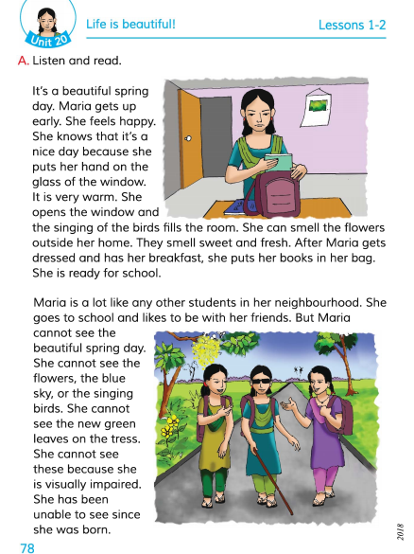
Connection with EFT Book.

Slide 21
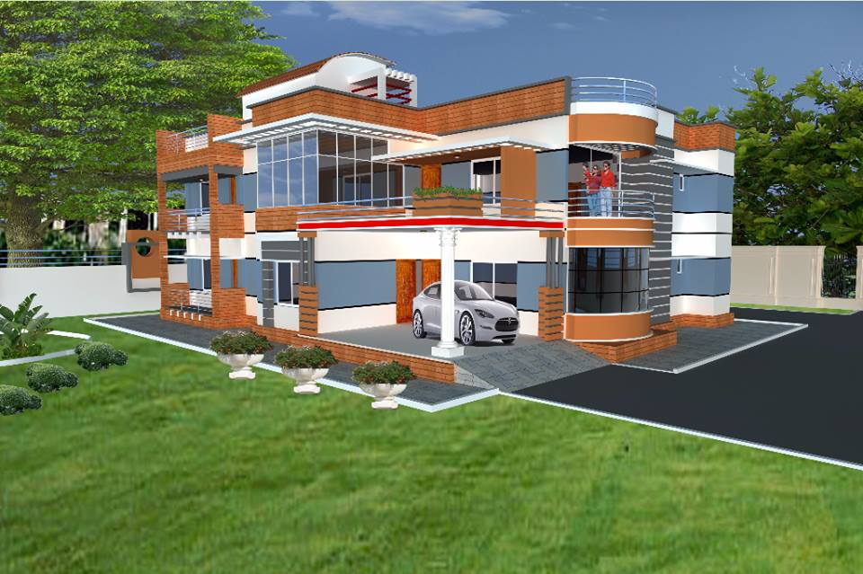
Home work
Write five sentences
about Maria.

Slide 22
Thanks everybody.
See you again.
Bye Bye

Slide 23
END
OF
THE
LESSON

